Slide 1
Topic 9 – Development Geography
A – Regions and Development
B – Transportation and Development
C – The Rise of the Global South
D – Resources, Environment and Development
E – Landscapes of Development

Slide 2
Conditions of Usage
For personal and classroom use only
  Excludes any other forms of communication such as conference presentations, published reports and papers.
No modification and redistribution permitted
  Cannot be published, in whole or in part, in any form (printed or electronic) and on any media without consent.
Citation
  Neumann, Roderick P. and Price, Patricia L. (2019) Contemporary Human Geography: Culture, Globalization, Landscape, Second Edition.
  Dr. Jean-Paul Rodrigue, Dept. of Global Studies & Geography, Hofstra University.

Slide 3
A – Regions and Development
The history of thinking about development, the diverse ways to measure it, and how development has shaped, and reshaped, regions.

Slide 4
Development: A brief history
The prosperity paradigm
  The idea of development has a remarkably influential but relatively short history.
  Try to explain why some regions of the world enjoy relative prosperity, while others do not.
The term development
  Emerged in the post–World War II era.
  When scholars as well as government and policy officials became concerned that the standard of living in many regions of the world was quite low.
  In general, a low standard of living was most prevalent in countries whose economies were based primarily on subsistence agriculture.
  It was believed that introducing new technologies and skills would enable these countries to develop more productive forms of agriculture.
  Industrialization would follow, which would then lead to a higher standard of living.

Slide 5
Stages of Economic Growth
The development process
  Rostow posited that economic development was a process that all regions of the world would go through and experience in similar ways.
  Assumed that regions would progress in a linear fashion through defined stages of economic growth.
What is development and how the “great divergence” took place?

Slide 6
Types of Economic Activity by Sector
Primary sector
  The set of economic activities that involves extracting natural resources from the Earth.
  Usually associated with low levels of development.
Secondary sector
  Economic activities that involves processing the raw materials extracted by primary sector activities into usable goods.
  Commonly referred to as manufacturing and linked with intermediate development levels.
Tertiary sector
  The different types of work necessary to move goods and resources around and deliver them to people; in other words, service activities.
Quaternary sector
  Intellectual and informational economic activities.
  Associated with high levels of development.

Slide 7
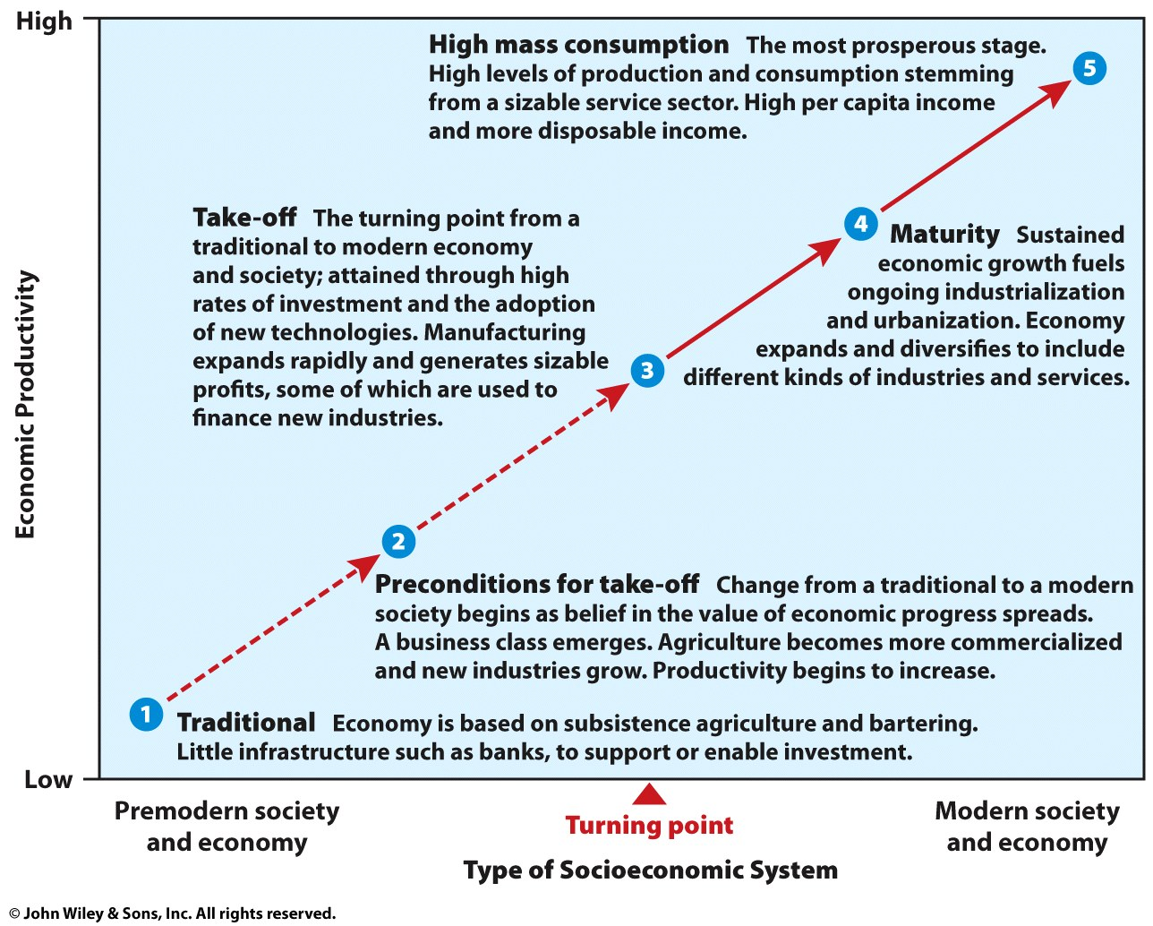
Rostow's Stages of Development
Stages of growth model of development
  Derived from observations made in the 1950s and1960s.
  Mostly reflective of western economies and the industrial revolution.
Five basic stages
  Traditional society.
  Preconditions for take-off.
  Take-off.
  Drive to maturity.
  Age of High mass consumption.

Slide 8
The Great Divergence: World GDP, 1CE - 2015
Notes:
Note: In 1990 Dollars, purchasing power parity.
Source: Data compiled by A. Maddison, University of Groningen. Updated with World Bank GDP figures for 2010.

Slide 9
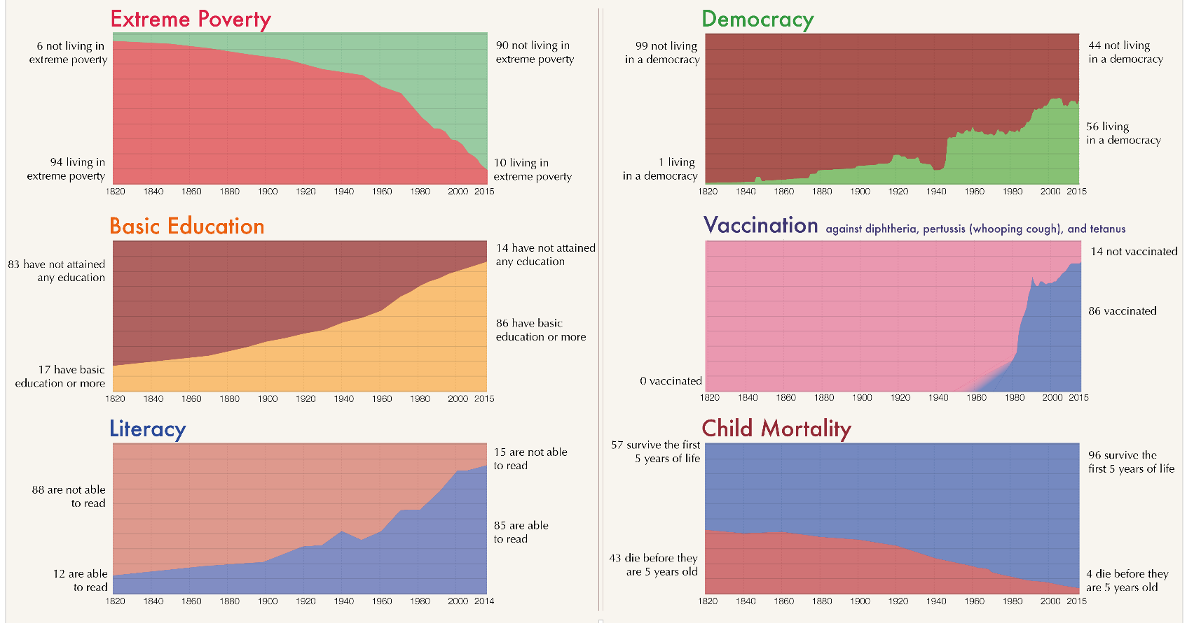
The World as 100 People since the early 19th Century
Notes:
Source: Max Roser at Our World In Data - From the Our World in Data's publication A history of global living conditions in 5 charts, https://en.wikipedia.org/wiki/Our_World_In_Data#/media/File:The_World_as_100_People.png

Slide 10
World Systems Theory
World systems
  Categorizes world history as moving through a series of socioeconomic systems.
  Culminating in the modern world system; interdependent, capitalist world economy rooted in nation-state economies.
Core
  World regions have the most advanced industrial and military technologies, complex manufacturing systems, and external political power.
  Highest levels of wealth and mass consumption.
  The first core region emerged in England and northern Europe with the Industrial Revolution.
  Through the nineteenth century, other areas became core regions, notably the European settler colonies in Australia and North America.
  Japan, whose government oversaw a massive industrialization and modernization effort in the 1900s, also became a core region.

Slide 11
World Systems Theory
Periphery
  Places that exhibit characteristics opposite those of the core.
  Relatively little industrial development, simple production systems focused mostly on agriculture and raw materials, and low levels of consumption.
Semi-periphery
  Mix of characteristics.
  Mediating politically and economically between the core and periphery.
  May or may not be in a transitional stage toward either the core or the periphery.
  Examples include Mexico, Brazil, and South Korea.
Core / Periphery model
  A spatial model of the interrelations between core regions where economic, political, and cultural powers are centered.
  Peripheral regions that are dependent upon and serve the needs of the core.

Slide 12
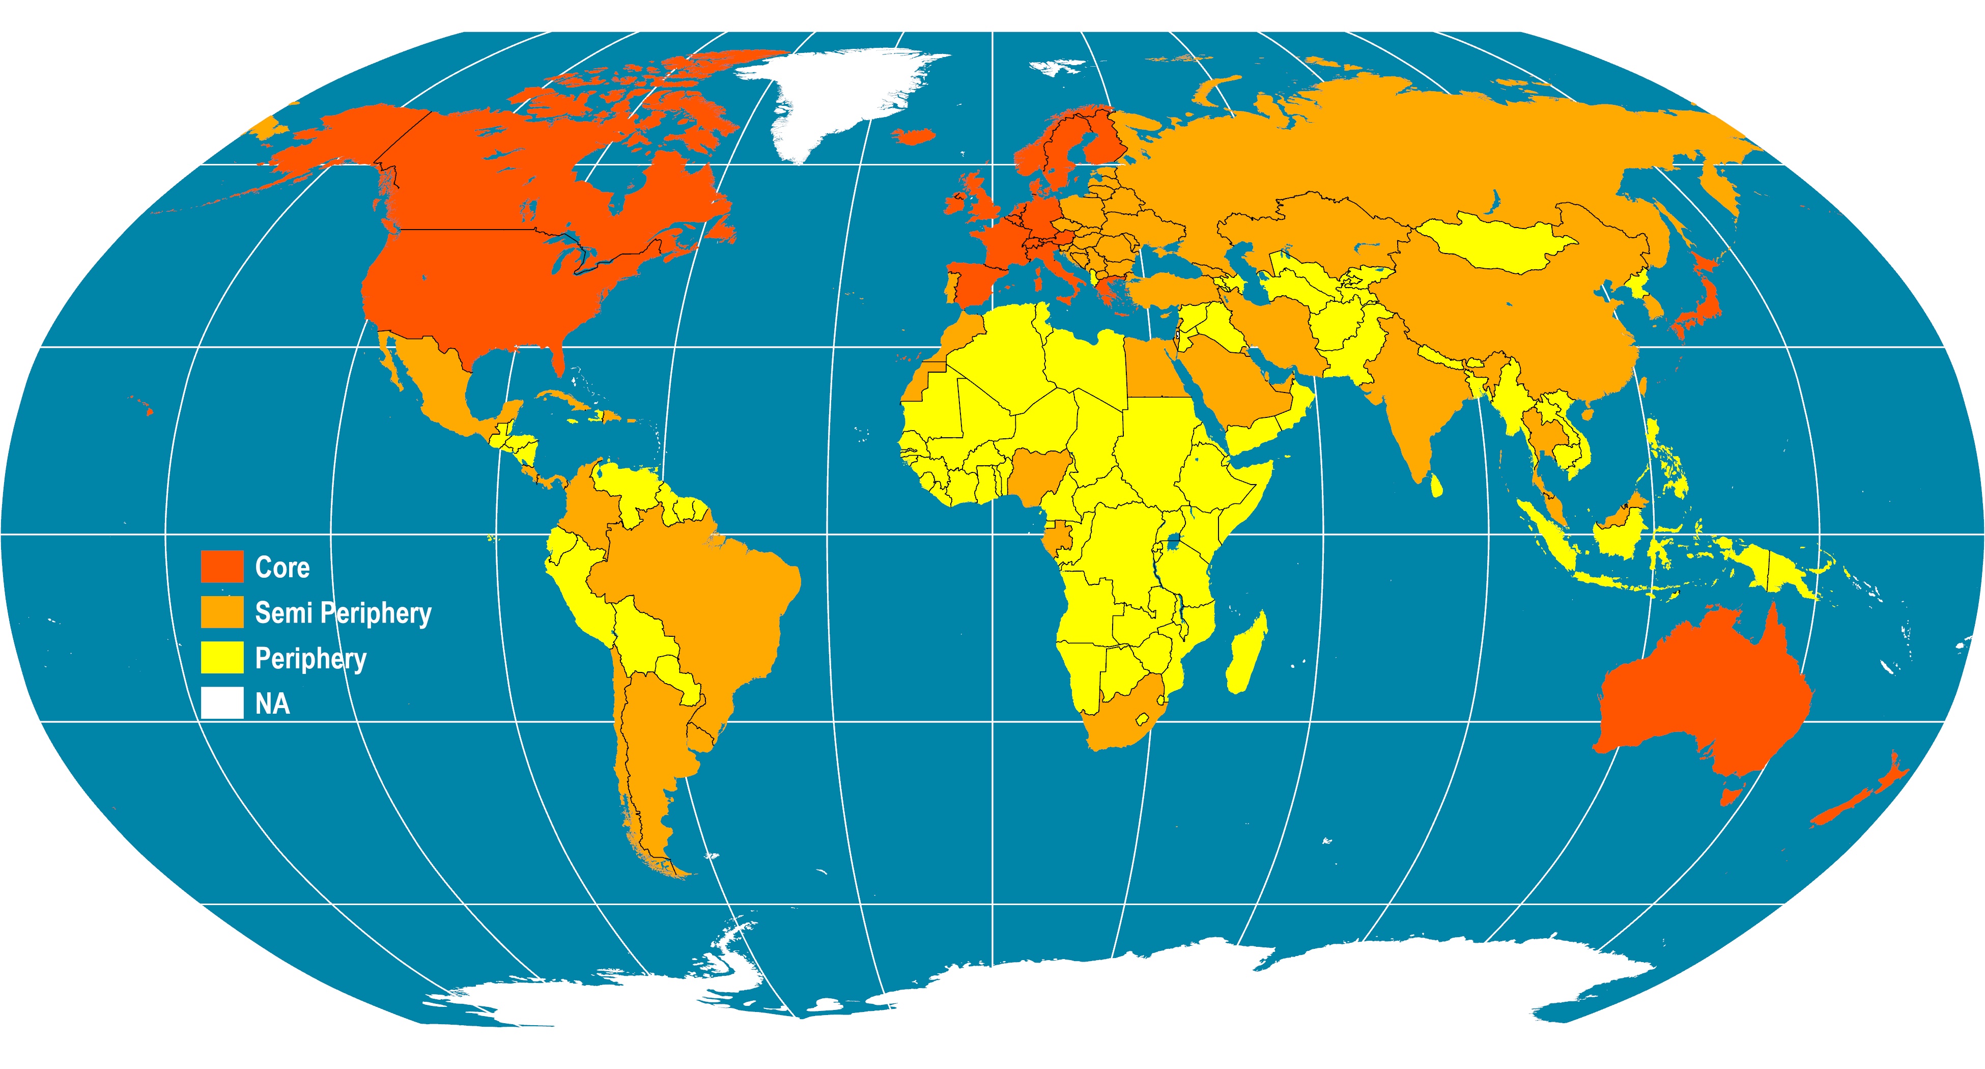
Core / Periphery Division of the World
Notes:
Map location: global_socioeconomic

Slide 13
“Many Worlds” Approach
During the Cold War, the world was seen as being divided into First, Second, and Third World.
First World
  Represented the world’s wealthy, democratic, capitalist countries.
Second World
  Countries that were ruled by communist or socialist governments and had central or command economies, rather than capitalist ones.
Third World
  Made up of low-income countries.
  During the cold war period, the two superpowers (US and USSR) vied for influence in Third World countries, and many proxy wars were fought between them.
What are the main differences between the world systems and the “many worlds” approaches?

Slide 14
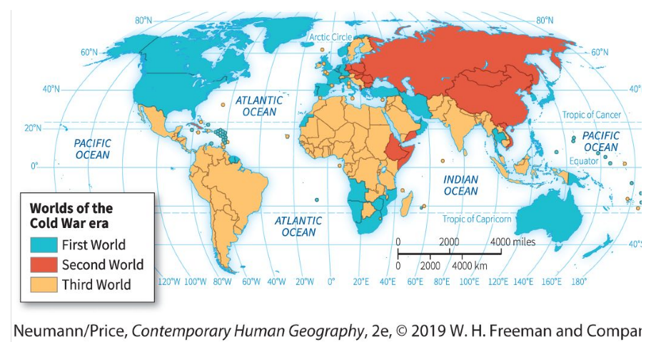
The three worlds of the Cold War era
The three worlds of the Cold War era. During the middle decades of the twentieth century, when the world order was shaped by the geopolitical tensions among the liberal democracies and communist nations, the world
was divided into those nations aligned with these two positions and those non-aligned nations known as the third world. As the Cold War progressed, the terms First and Third World became synonymous with wealthy and poor nations, respectively.

Slide 15
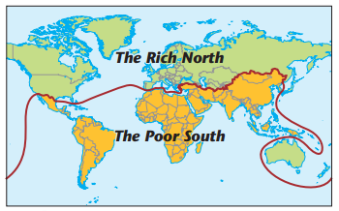
The Brandt line
Brandt line
  In the 1970s, West German Chancellor Willy Brandt proposed what came to be known as the Brandt Line as a way of understanding the world.
  It divided the world into two regions: wealthy and poor.
  Corresponded to the northern and southern hemispheres.
The Brandt Line. This line divides the wealthy nations of the Global North from the poor nations of the Global South. It provided another way of conceptualizing world regions from a development
perspective.

Slide 16
A Contemporary Approach to Development
Developing versus developed
  Refers to different regions of the world.
  Does not assume a linear progression in development.
Developing
  Regions whose economies include not only a good deal of subsistence activities but also some manufacturing and service activities.
  People are often unable to accumulate wealth, since they produce just enough, or at times not enough, food and other resources for their own immediate needs.
  These places therefore are considered relatively poor.
Developed
  Regions whose economies are based more on manufacturing, services, and information.
  Considered wealthier because people living there are better able to accumulate resources.

Slide 17
Measuring development
The key terms relating to development geography have traditionally been economically based.
Gross Domestic Product (GDP)
  The value of goods and services produced in a country in a year,
  GDP per capita (i.e. the average per person).
  GDP PPP:
    Adjusted for purchasing power parities.
    How much you can buy for your money in that particular country.
    A more realistic impression of the economic status of a country.
    In low-income countries GDP will be a higher number when adjusted for PPP.
Not much can be inferred from GDP numbers except that some countries have economies that are far larger than the economies of other countries.

Slide 18
Measuring development
Not included in the GDP
  Value of goods and services produced in the informal sector of the economy (i.e. “off the books”; the goods and services that are not taxed).
  The distribution of wealth between people or groups of people in a country.
  Having the economic means to provide them is no guarantee that basic needs will be met for all members of society.
  Gender differences in earnings
  Measurements of the actual wellbeing of the population.
  Anything that contribute to purchases will count positively (military expenses)

Slide 19
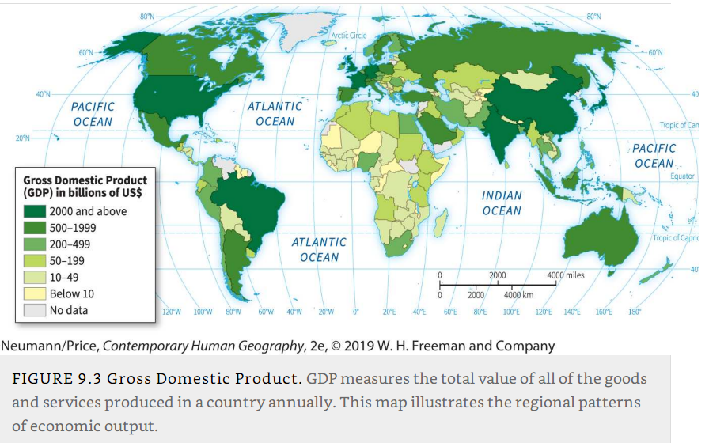
Gross Domestic Product

Slide 20
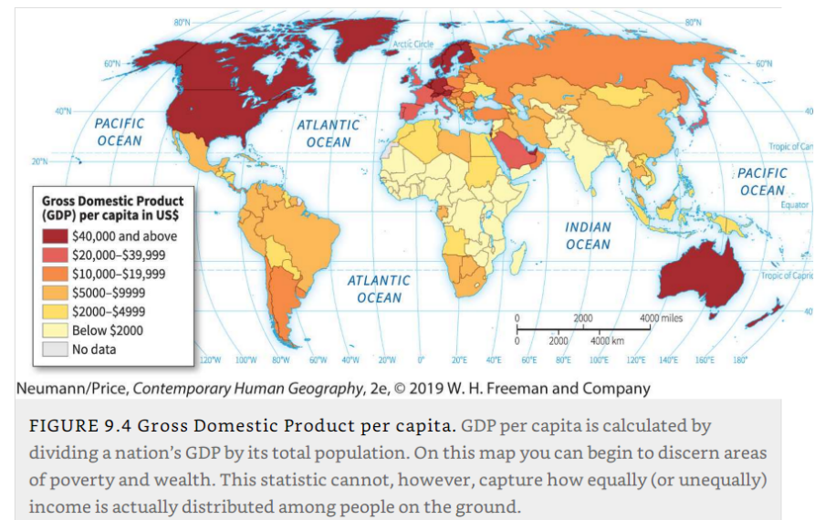
Gross Domestic Product per capita

Slide 21
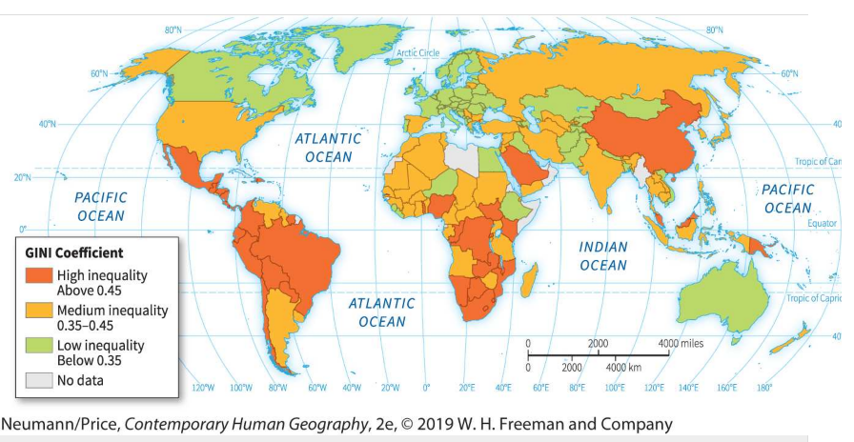
Income inequality: The Gini coefficient

Slide 22
Development as quality of life
Human Development Index
  Development is about enhancing individual and societal quality of life.
  In 1990 the United Nations Development Program (UNDP) developed a new type of measurement: the HDI.
  HDI measures how well people’s basic needs are being met:
  “HDI is a composite index measuring average achievement in three basic dimensions of human development—a long and healthy life, knowledge and a decent standard of living.”
  HDI combines:
    Life expectancy at birth.
    Expected years of schooling.
    Mean years of schooling.
    Gross national income (GNI) per capita.
Provide some examples of how development can be measured.

Slide 23
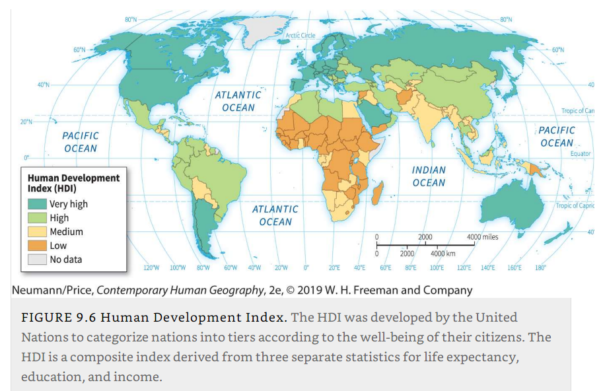
Human Development Index

Slide 24
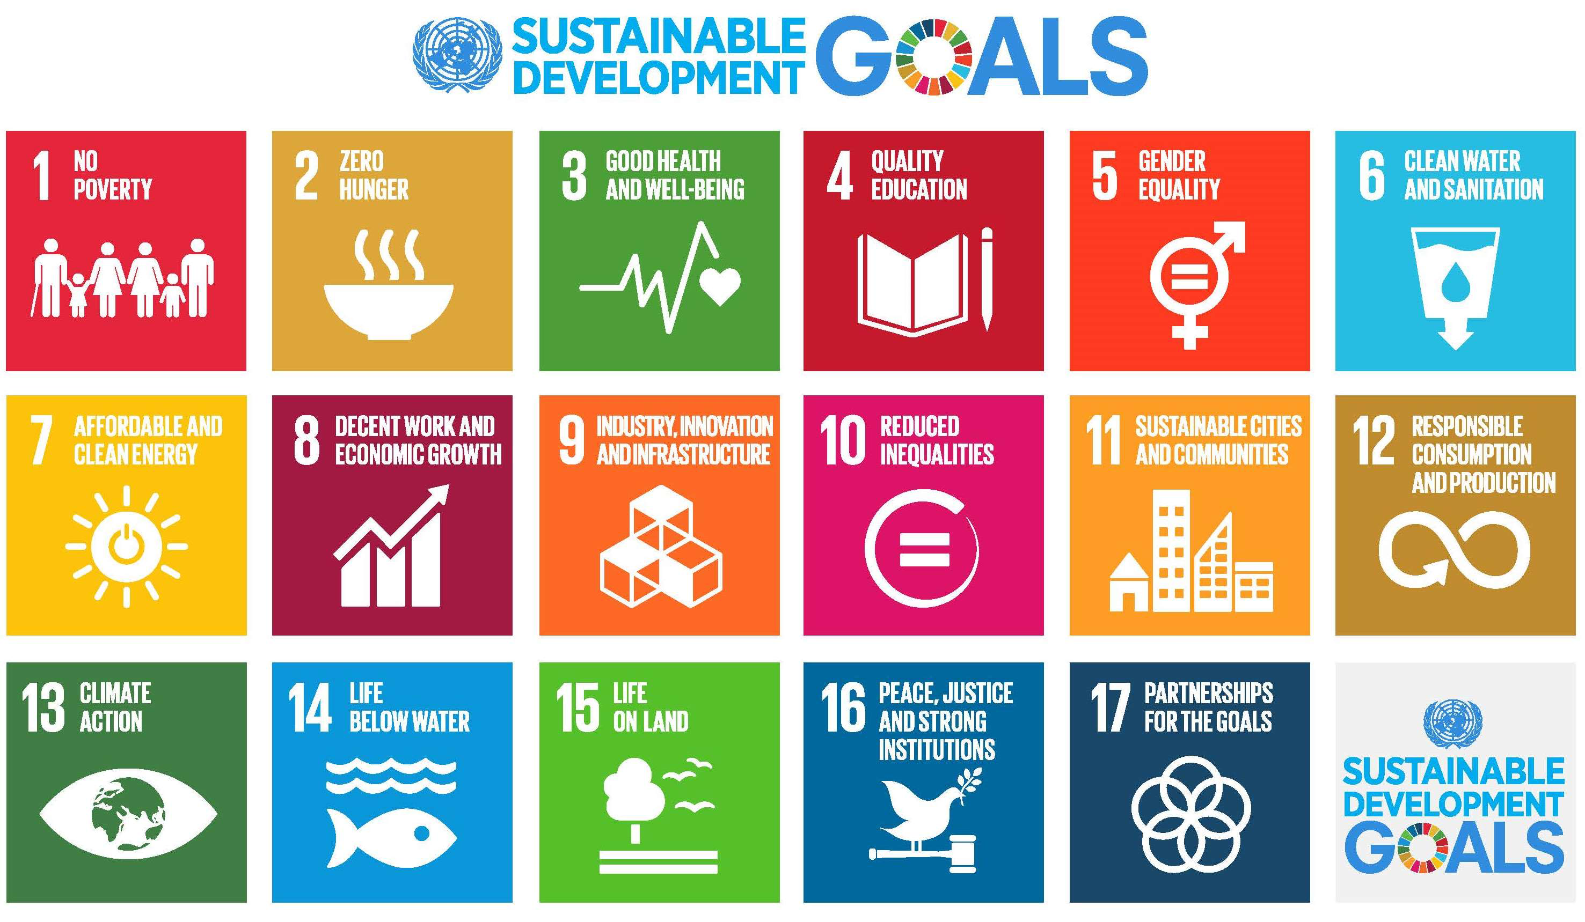
“The Global Goals”: end poverty, protect the planet and ensure that all people enjoy peace and prosperity. (2030 Agenda, UNDP)

Slide 25
Development actors
Traditionally, there have been several major actors in the field of development
  International organizations (e.g., the World Bank, the IMF, the UN Development Programme, World Health Organization, Oxfam).
  Churches and religiously affiliated NGOs; secular NGOs.
  National governments (both individually and working together).
  Corporations (and individuals associated with corporations).
  Development actors and activities not sanctioned or recognized (e.g., Mexico’s drug lords).

Slide 26
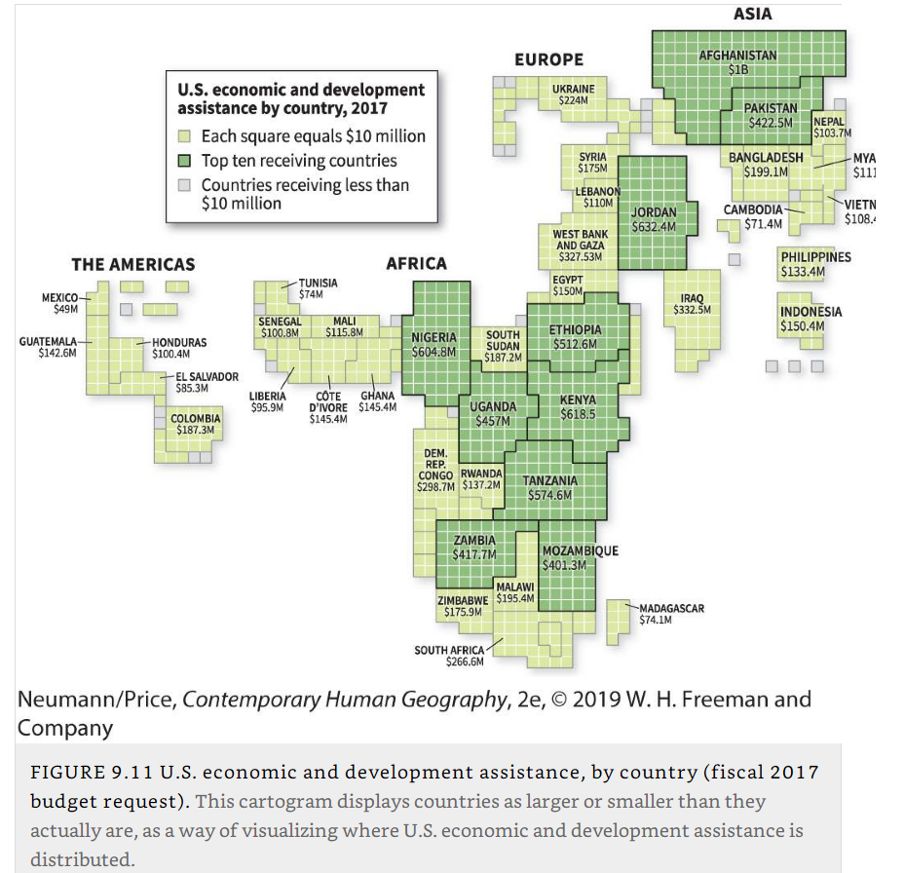
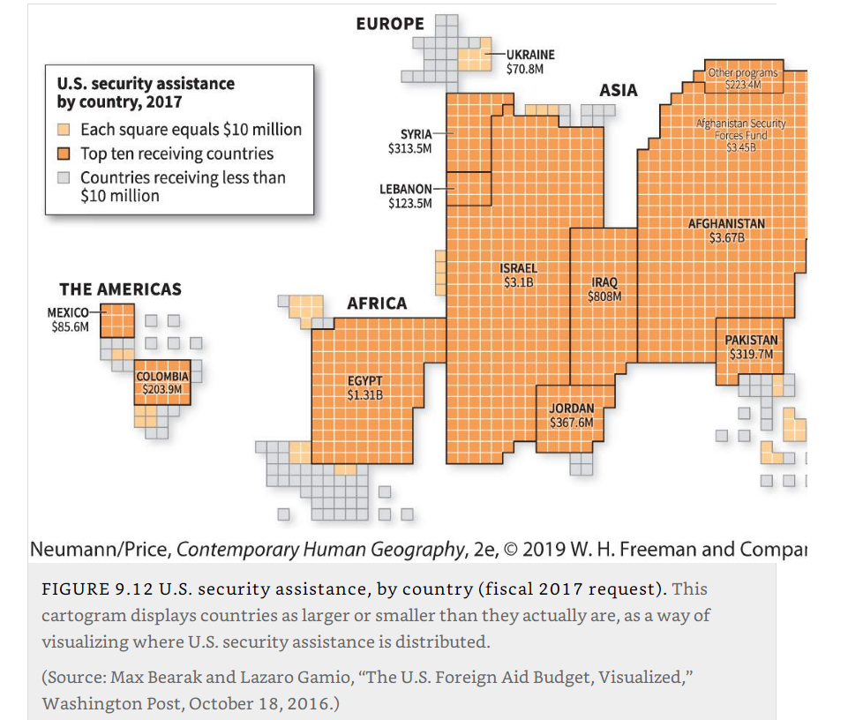
U.S. economic, development and security assistance by country

Slide 27
B – Transportation and Development
The relationships between transportation and development.

Slide 28
Transportation and development
Transportation
  The movement of goods, people, and information from one place to another.
  The most important element linking development, industrialization, and urbanization.
Industrial Revolution
  Beginning in England in the mid-1700s.
  Saw the rapid transformation of the economy through the introduction of machines, new power sources, and novel chemical processes.
  Encouraged and was furthered by the development of new forms of transportation (steam ships and railroads).
  Move raw materials and finished products from one place to another cheaply and quickly.
  The main stimulus that led to transportation breakthroughs.
  Gave industrializing countries an enormous advantage; strengthening of the British Empire.

Slide 29
Transportation and the colonial legacy
Physical transportation of raw materials
  From the site of their extraction, to places where they were processed into manufactured goods, was essential to industrialization.
  Set specific networks and relations, even in advanced economies such as Canada, Australia and Russia.
Nationalization
  Independence were often waged on and around the means of transportation (port and rail links).
  Government takeover of the transportation infrastructure and fuel sources from private foreign ownership.
  Former colonies have inherited the transportation infrastructure that was built during the colonial era.
  Oriented toward coasts and port cities, and do not necessarily move people and goods efficiently within countries.

Slide 30
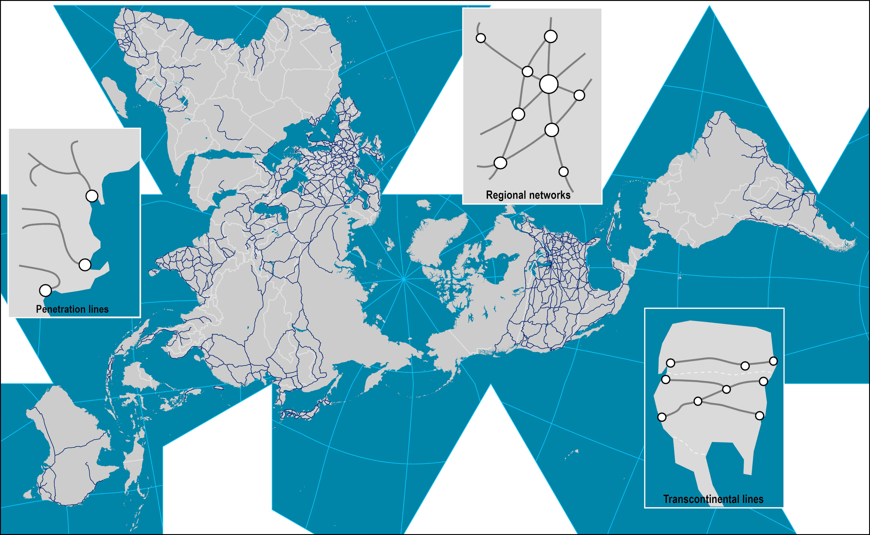
World Rail Network and Rail Systems
Notes:
Map location: Land Network

Slide 31
Precolonial, colonial, and postcolonial differences in transportation networks
Precolonial transportation routes
  Focused inward, on moving people and goods across interiors and connecting places to each other.
Colonial-era infrastructure
  Concerned with getting people and goods to sea and river ports as expediently as possible.
Regional differences
  Major regional differences exist in the relative importance of the various modes of transport.
  Highways in the United States.
  Railroads in Russia and Ukraine.
  Balance of transport in Western Europe.

Slide 32
Transportation haves and have-nots
Modernizing transportation infrastructure
  A costly and difficult undertaking.
  Having a modern transportation infrastructure is vital to development.
  Much of Africa, Latin America, and former communist countries in Europe are facing a predicament.
  Too expensive to demolish existing facilities and build new ones.
  In advanced economies such as the United States:
    An unwillingness to modernize the transportation infrastructure.
    High sunk costs of prior highway investments.
  Formerly underdeveloped areas:
    Emphasized the modernization and expansion of their transportation infrastructure.
    Some have become global hubs of economic mobility (e.g., Singapore).

Slide 33
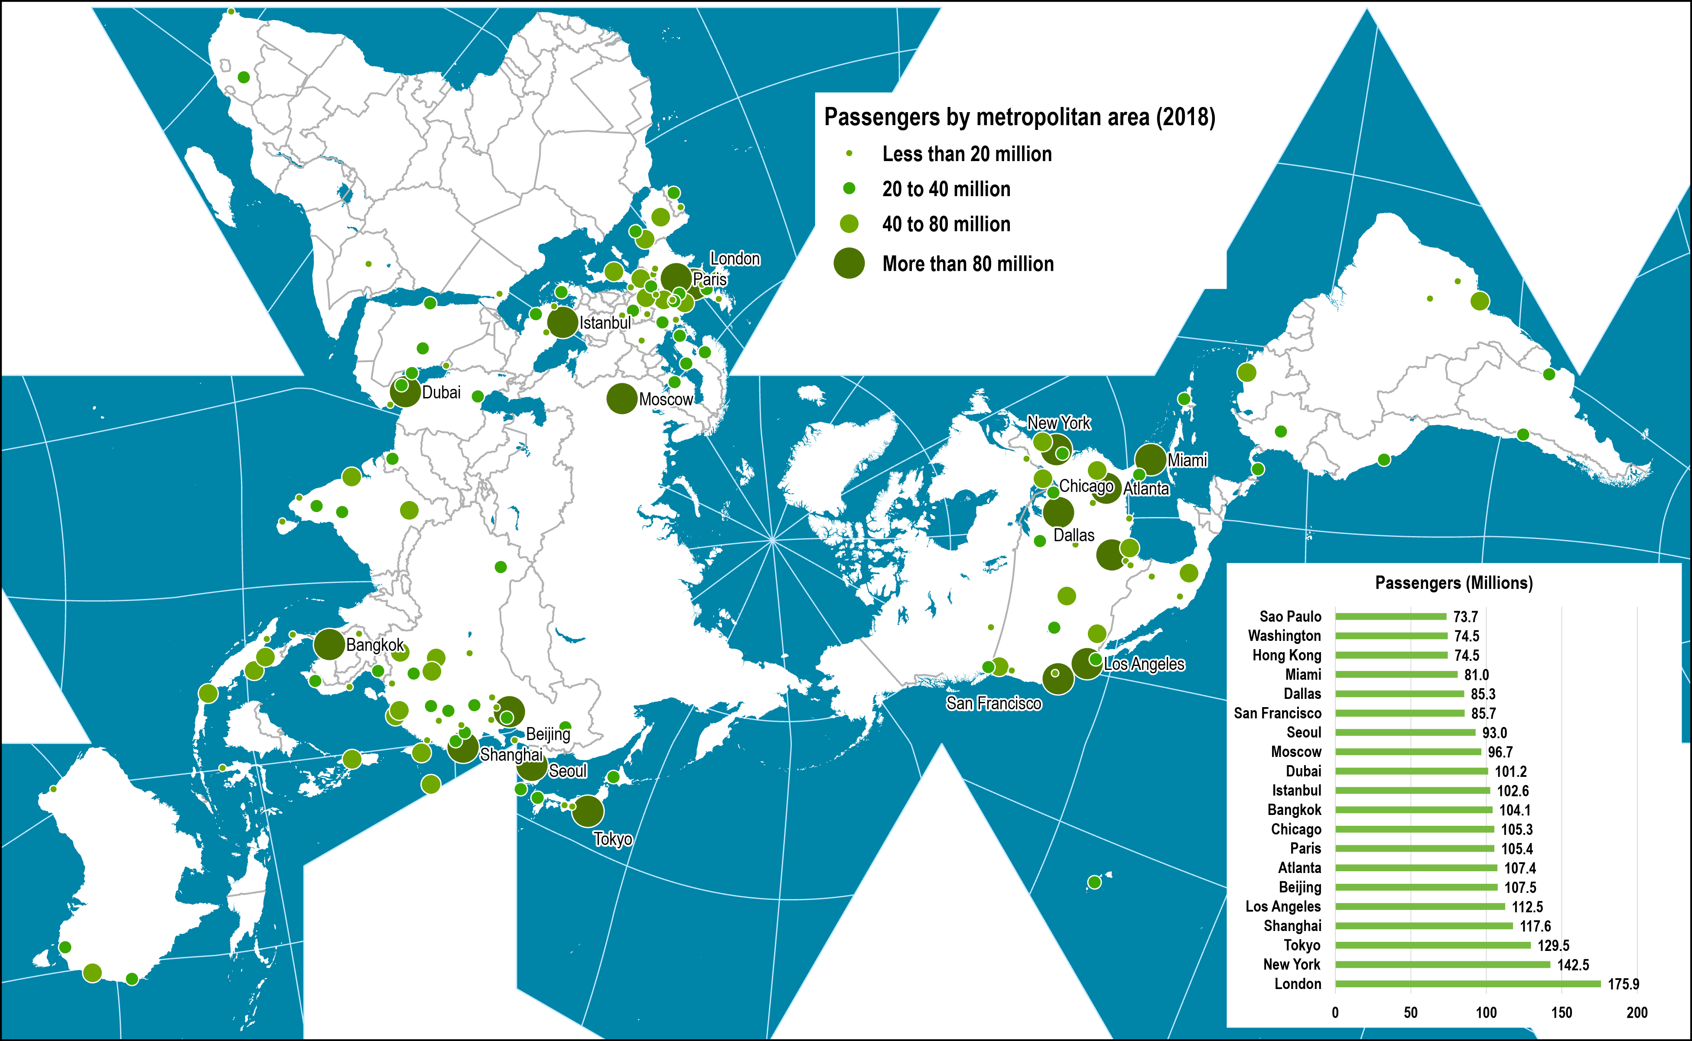
Airport Passenger Traffic by Metropolitan Area, 2018
Notes:
Source: Airports Council International, http://www.airports.org
Note: Includes airports with an annual cargo volume above 25,000 metric tons
Map location: airport_terminals

Slide 34
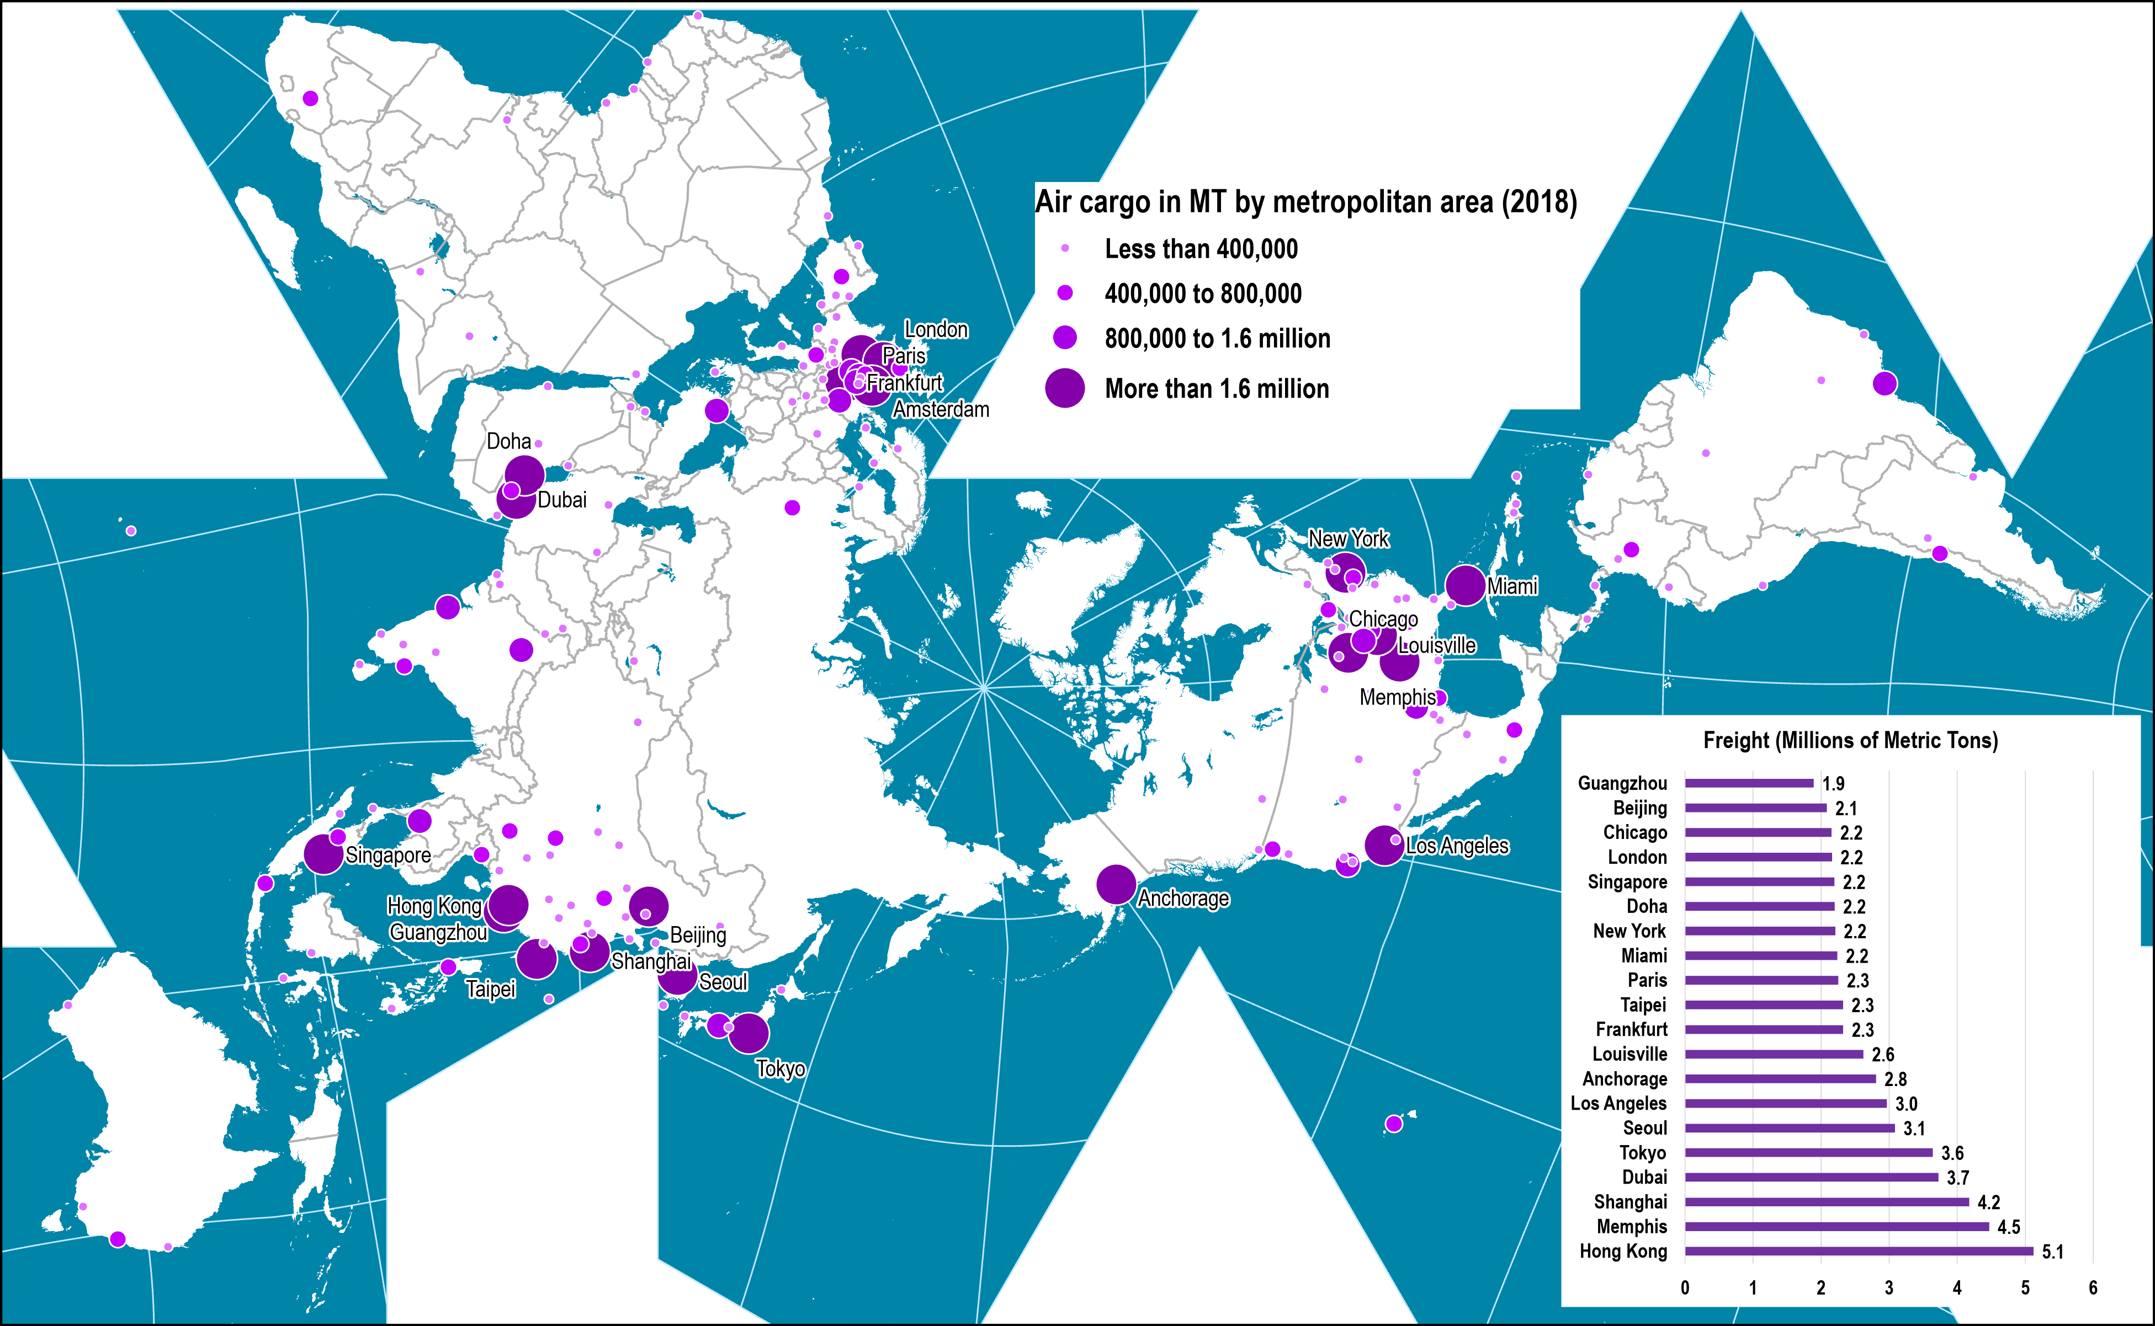
Air Cargo Traffic by Metropolitan Area, 2018
Notes:
Source: Airports Council International, http://www.airports.org
Note: Includes airports with an annual cargo volume above 25,000 metric tons
Map location: airport_terminals

Slide 35
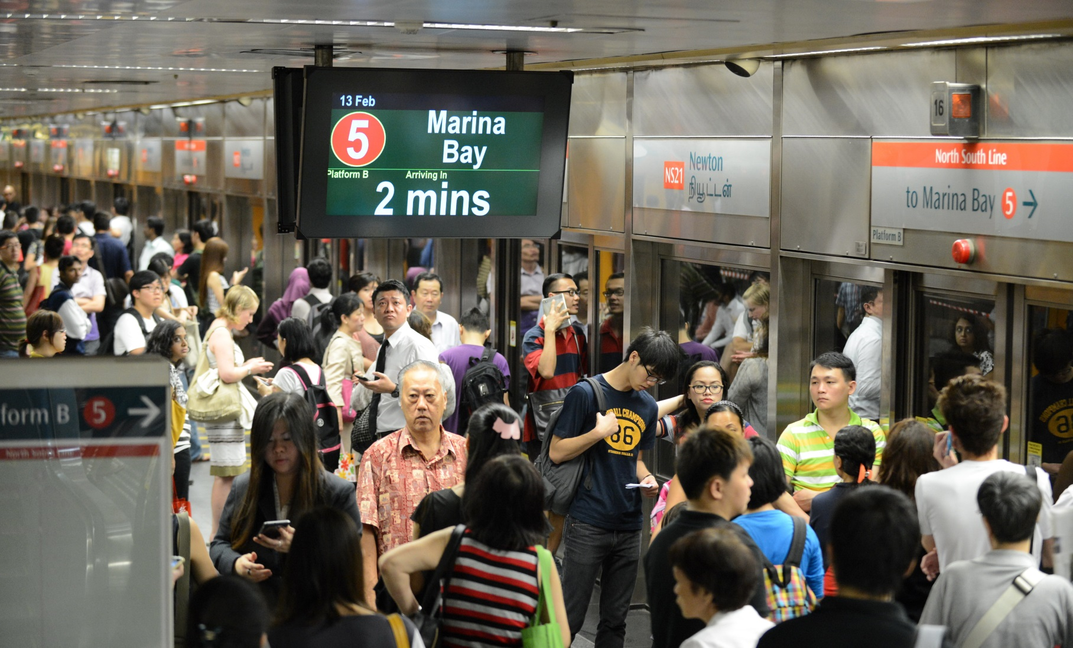
Figure 9.17 Singapore’s subway station. Singapore’s MRT system efficiently moves more than half the population of the city-state about on a daily basis. (ROSLAN RAHMAN/AFP/Getty Images.)
Notes:
Neumann and Price. 2019. Contemporary Human Geography.

Slide 36
The U.S.: The challenges of aging transport infrastructure
Aging transport infrastructure
  The United States is an example of a wealthy country whose aging transportation infrastructure is becoming a detriment to economic well-being.
  Growing number of infrastructure incidents such as bridge collapses.
  The transportation infrastructure is generally old, outdated, and not adequately maintained (deferred maintenance).
  Most railways, airports, seaports, bridges, and roadways were built decades, if not centuries, ago.
  Traffic congestion, delays, and fatalities are significantly higher when compared to western Europe.
Explain how transportation infrastructure is associated with development.

Slide 37
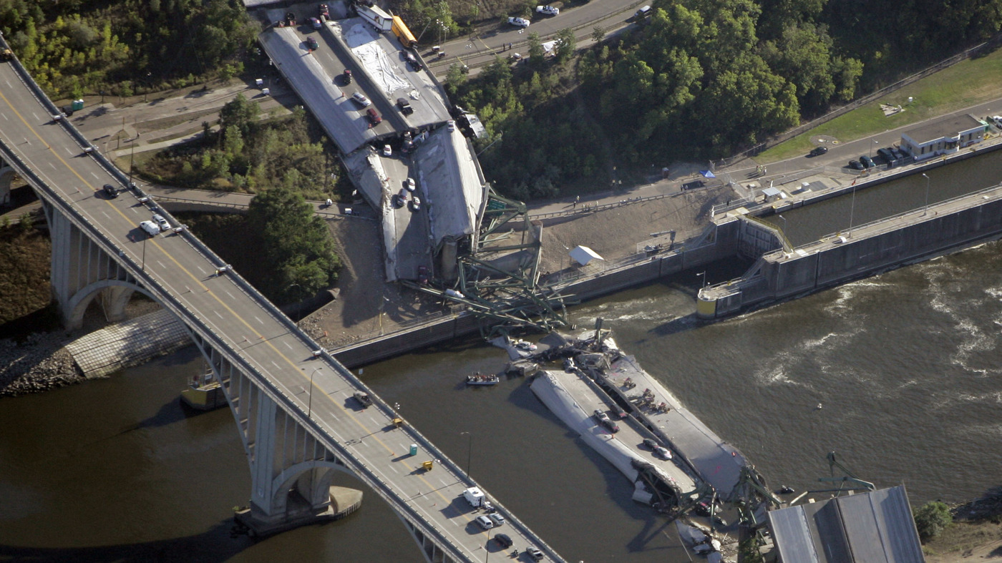
2007 I35 Bridge collapse, Minneapolis

Slide 38
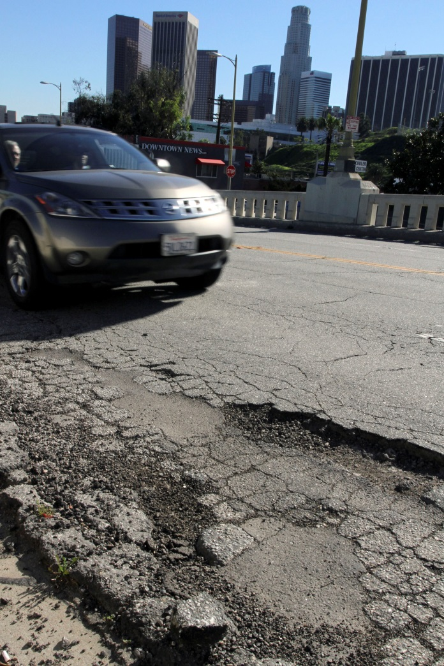
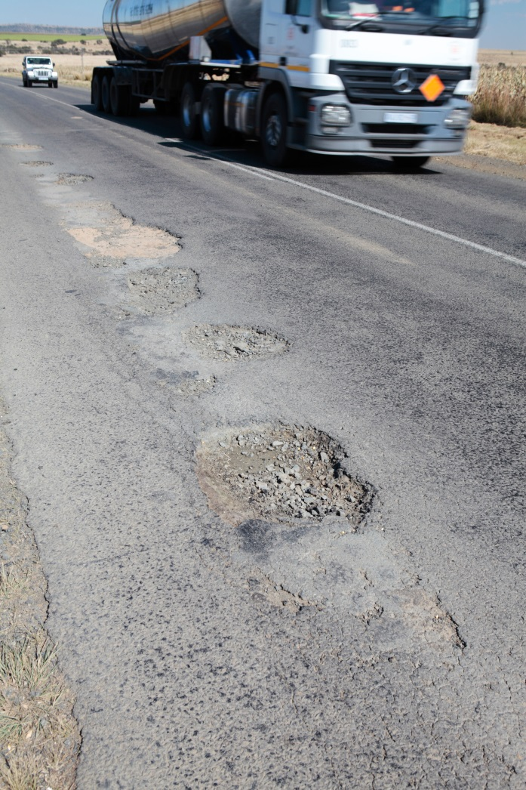
Figure 9.20 Deteriorated roadways. The image on the left is from Los Angeles, California, and the one on the right was taken in South Africa. The similarity in road conditions underscores that differences between so-called developed and underdeveloped/developing places aren’t always hard and fast, especially with respect to the quality of infrastructure. (Jonathan Alcorn/Bloomberg via Getty Images; EggImages/Alamy.)

Slide 39
The U.S.: The challenges of aging transport infrastructure
Factors
  The United States spends far less as a percentage of GDP than other nations on infrastructure.
  Americans insist on low automobile and fuel taxes that are a principal source of funding for building and maintaining roadways.
  Poor regional planning and political squabbling; reluctance to fund construction and repairs.
  Budget crises mean less public investment in transportation infrastructure.
  Solutions that would privatize costs (e.g., tolls, taxes, and fees) are unpopular.

Slide 40
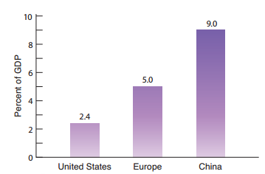
Figure 9.21 Spending on transportation infrastructure. This graph depicts wide variations in the proportion of GDP that is devoted to building and repairing
transportation infrastructure, such as bridges, roads, waterways, airports, and railroad facilities.

Slide 41
C – The rise of the global south
How formerly poor places are today significant agents of development.

Slide 42
Post-development and the Rise of the Global South
Cyclical shift in development prospects
  Many civilizations now considered “underdeveloped” formerly were hubs of economic activity, technological innovation, cultural diversity, and political dominance.
  In reality, very few of the world’s places are impoverished, isolated, and predominantly agricultural anymore.
  Even within countries that may still be less developed as a whole, there are pockets of accelerated urbanization, innovation, and connection to global networks.
  By the same token, many developed countries and regions have slipped.
  Detroit:
    Once a world leader in the auto industry and the United States’ fourth largest city.
    In 2013 Detroit declared bankruptcy, the largest U.S. city ever to do so.
    It lost over half of its population since its heyday in 1950.

Slide 43
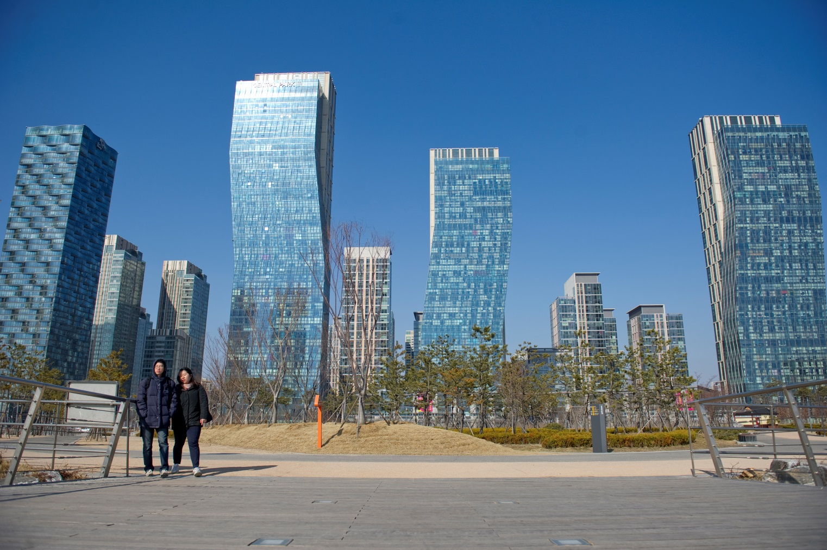
Figure 9.22 Songdo International Business City. This new development is located on reclaimed land along South Korea’s Incheon Waterway, near the capital city of Seoul. It includes ultra-modern residential, commercial, education, leisure, and healthcare facilities. Forty percent of the area is devoted to green spaces such as the park you see here. Songdo is a “smart city” representing the cutting edge of urban design: sustainable, green, and wired. (Ann Hermes/The Christian Science Monitor via Getty Images.)

Slide 44
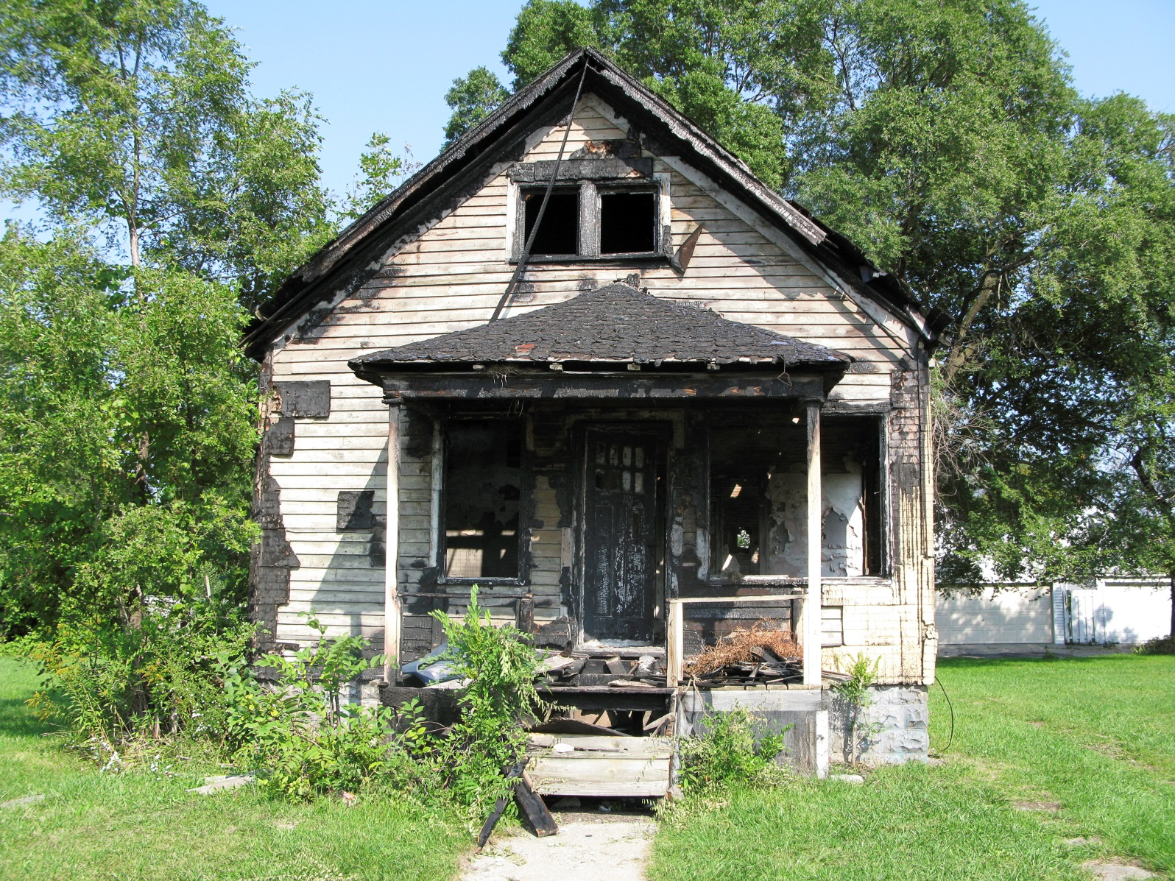
Detroit’s deteriorated cityscape. This abandoned house is one of many in Detroit. The city estimates that one-fifth of its housing stock is abandoned and blighted. (Getty Images/WIN-Initiative RM.)

Slide 45
Post-development and the Rise of the Global South
Post-development
  An approach that is critical of standard development practices.
  Monetary aid, investments, expertise, and projects— were seldom successful.
  State or agency supported development efforts do not work because they are ultimately about controlling.
  Perception that development initiatives constituted a modern form of imperialism.

Slide 46
The rise of the global south
Global South
  A term that has largely replaced “Third World” when referring to regions of Latin America, Africa, and most of Asia.
  Recognition that much of the world’s dynamism, growth, and power resides in these places.
South–South cooperation
  Major dimension of the dynamism occurring within the Global South.
  Refers to trade, technological innovation, and other forms of exchange and assistance that occurs between the larger and wealthier countries of the Global South and poorer countries.
  Example: China.

Slide 47
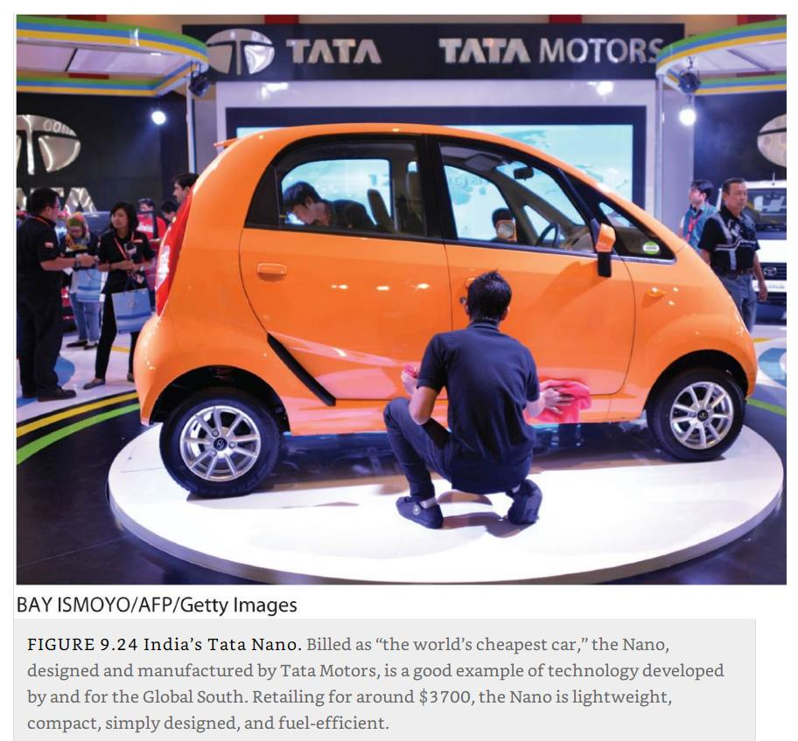
Car manufacturing in India: The Tata Nano

Slide 48
The rise of the global south
Technology and the global south
  Revolutions in transportation and communications technologies continue to play a huge role in economic development.
  Small- to medium-sized enterprises in countries of the Global South are the catalysts for providing low-cost solutions to common problems there.
  Mobile phones:
    Provide a field of South–South technological innovation and exchange.
    Usage in the Global South has surpassed that in wealthy Northern countries.
  The break of the “digital divide”:
    The rift between those who benefit from easy access to the Internet and, more importantly, the vast storehouse of knowledge available online, and those who do not have easy access.
    More the half the world’s population have access to the Internet.
How the rise of the “global south” is taking form?

Slide 49
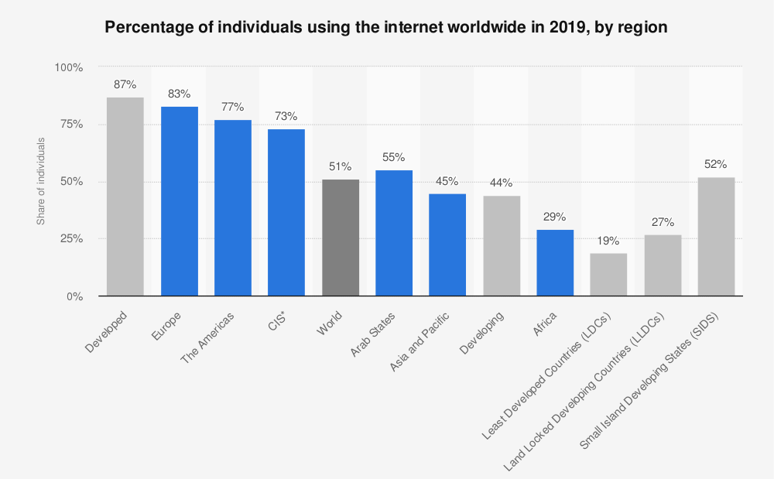

Slide 50
Celebrities and development
Conventional role
  In the past many celebrities voiced their opinion for or against an issue (mostly political).
  Charlie Chaplin: “The Great Dictator”.
  Jane Fonda: Anti-war activism in the 1960s.
  Many acted as patron for charities.
Ethiopian famine of 1984
  Heralded the advent of contemporary high-profile celebrity-led development efforts televised worldwide.
  The 1985 Live Aid charity concert.
  1.4 billion of the world’s then 5 billion inhabitants watched.
  At one point 95 percent of the world’s television sets were tuned in to the concert.
  More than $200 million was raised.

Slide 51

Charlie Chaplin, The Great Dictator, 1941

Slide 52
Celebrities and development
Communities of concern
  Celebrity figures from the world of music, film, and sports are the faces of “communities of concern” for underdeveloped regions.
  Wealth, mobility, and cultural visibility of celebrities can go a long way toward bringing worldwide attention to events that might otherwise remain under the radar.
Widespread criticism of celebrity development efforts
  Most media celebrities are not trained economists, climate change scientists, medical doctors, educators, or social workers.
  Performative activism and narcissism.
  Celebrity development efforts tend to portray the Global South as passive victims of calamity who are waiting for wealthy Westerners to rescue them.
  “The White Savior complex”.

Slide 53

Celebrity and international development. Actress Angelina Jolie and development economist Jeffrey Sachs joined forces to film a video diary of their travels to various African development projects addressing the U.N. Millennium Goals. (Andrew Kent/Getty Images.)

Slide 54
D – Resources, Environment and Development
The role that nature has played over time as concepts and practices of development have changed.

Slide 55
Renewable resource crises
Long history of resource depletion
  Deforestation has been a problem since the beginning of human civilization.
  Greeks, Romans, and Chinese faced problems with the silting of their harbors as the lands cleared for domestic crop cultivation eroded.
  Shipbuilding led to deforestation in Europe and North America.
Finite and renewable resources
  Appears that only finite resources are affected by industrialization.
  Renewable resources such as forests and fisheries are challenged.
Renewable resources
  Those primary sector products that can be replenished naturally at a rate sufficient to balance their depletion by human use.
  Deforestation at a rate faster than they can be replaced.
  Overfishing has brought a crisis to many ocean fisheries.

Slide 56
Global climate change
Global climate change
  Alterations in climate caused by human activity.
  Particularly by the greatly increased amount of carbon dioxide (CO2) produced by burning fossil fuels.
  Released by burning down and cutting down forests, and methane gas (CH4) emitted from livestock.
Greenhouse effect
  Effect of increased atmospheric CO2, CH4 and other heat-absorbing gases.
  Permits solar shortwave heat radiation to reach the Earth’s surface.
  Block or trap long-wave outgoing radiation, causing a thermal imbalance and global warming.

Slide 57
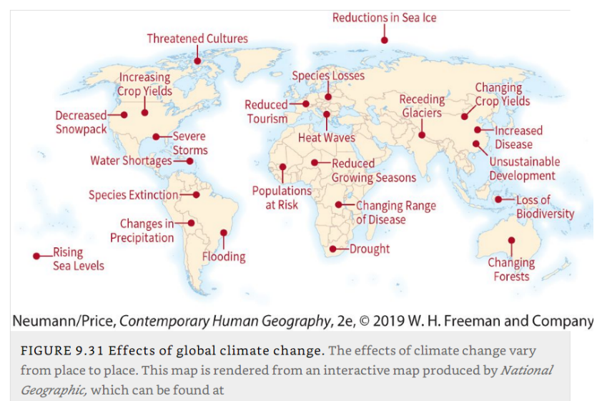
Expected effects of global climate change

Slide 58
The environmental consequences of powering industrialization
The resource demands of development
  Extraction of natural resources, and their transformation into the consumer goods.
  Depends on the provision of energy to run factories and transport finished products.
  Consumers demand heated and cooled dwellings, artificial lighting, and running water, among other amenities.
  Conventional agriculture requires larges amounts of energy.
Give some examples of issues related to development and the use of resources.

Slide 59
Alternative energy sources
Alternative energy
  Alternatives to traditional fossil fuels, including hydroelectric, solar, wind, geothermal, biofuel.
  The expense involved in building, running, and maintaining sites for harnessing and distributing these power sources have deterred their widespread adoption.
  The world still relies heavily on fossil fuels to power economic activities.
  Very rapid transition is currently taking place as the cost of alternative energy is declining rapidly.

Slide 60
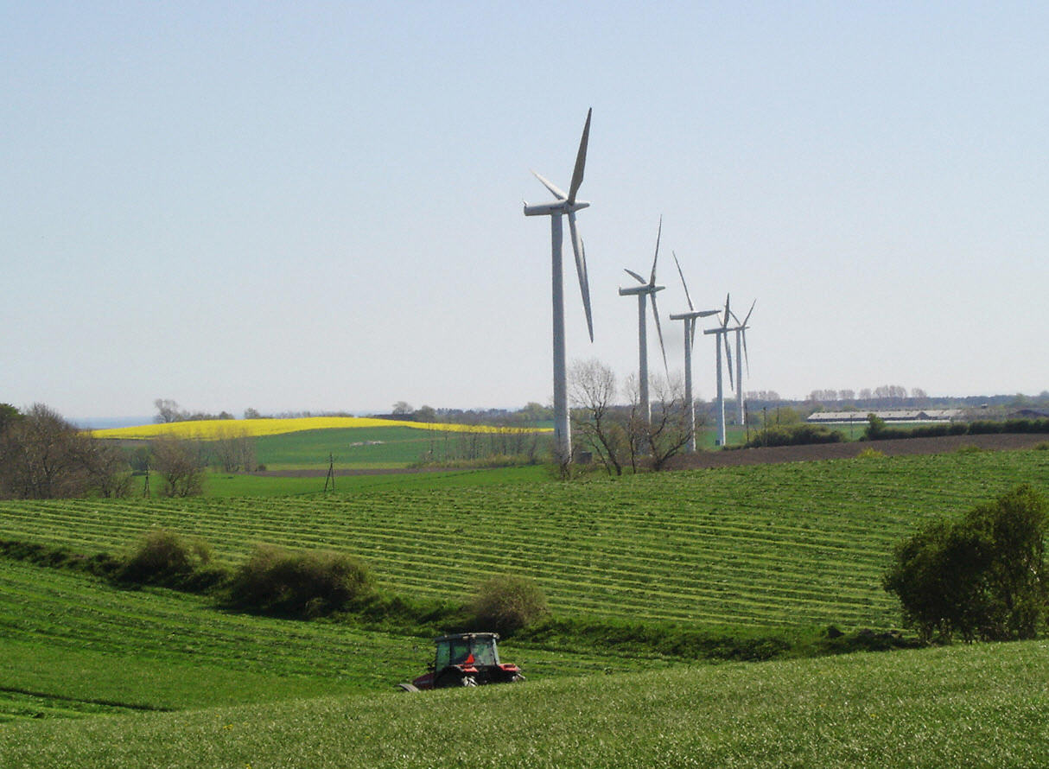
Europe’s renewable energy island. Samsø, located off the coast of Denmark, is a model of alternative energy in Europe. This photo depicts some of the island’s wind-powered turbines, which supply 100 percent of the 4,200 residents’ electrical needs. Solar power and wood chips are used to provide heating. In all, Samsø removes more carbon dioxide from the atmosphere than it contributes. (Slim ALLAGUI/AFP/Getty Images.)

Slide 61
China’s harmful air quality
Rapid development and industrialization
  China follow the same course, energy-wise, as the wealthy nations of the North did to fuel industrial development.
  Enduring 10% annual economic growth since the 1980s.
  China is now the world’s biggest emitter of pollution, including CO2 emission.
  2017 revealed that the sources of pollution in the country had increased by more than 50 percent since the first census, conducted in 2010.
  Human health is severely affected and visibility is reduced.
  Since 2013, China has undertaken a “war against pollution”, particularly for domestic coal-powered heaters.

Slide 62
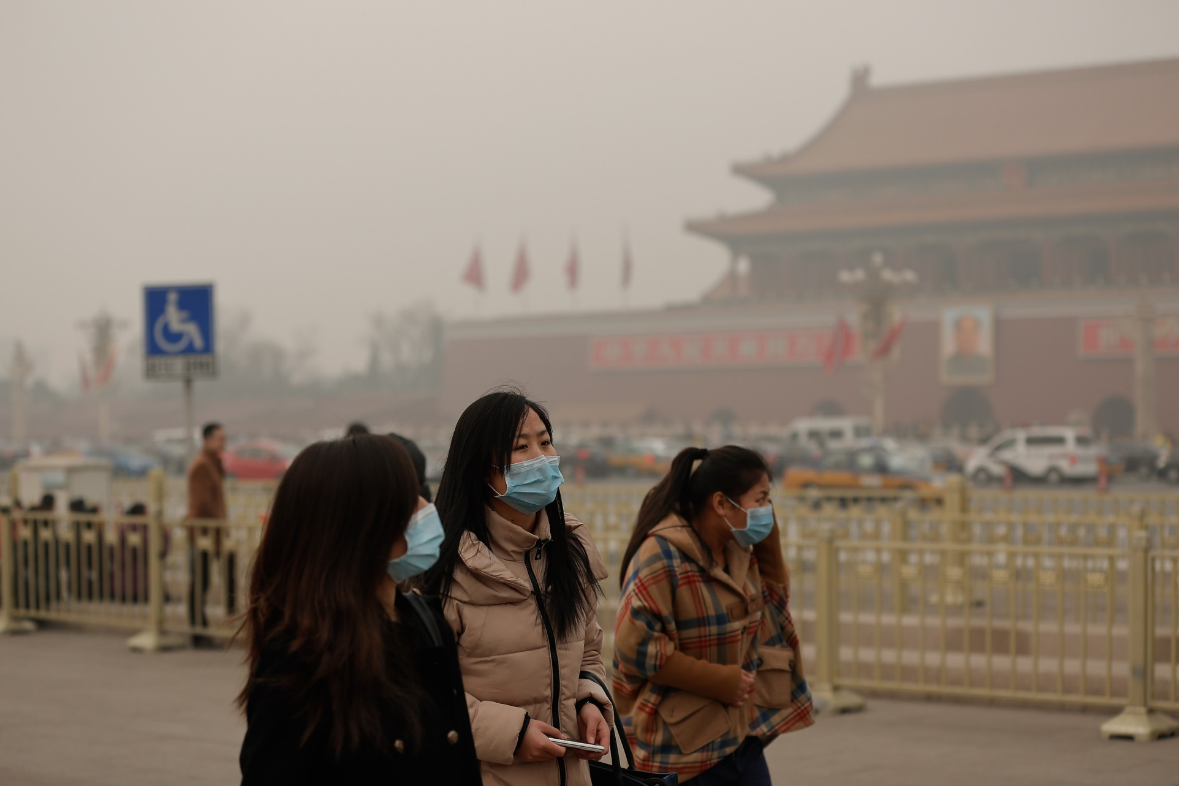
China’s deteriorated air quality. This photo was taken at Beijing’s Tiananmen Square during the winter, when air contamination from burning coal is at its worst. (Lintao Zhang/Getty Images.)

Slide 63
E – Landscapes of Development
How development has shaped landscapes.

Slide 64
Development on the landscape
Anthropocene
  No place on Earth that has not been touched in some way by human activity.
Primary industries
  Produce perhaps drastic impacts (e.g., mines, deforestation, etc.).
Secondary sector
  Among the most obvious features of the landscapes of secondary sector activities (manufacturing) are factory buildings.
Service industries
  Produce a cultural landscape as well.
  High-rise office buildings, fast-food restaurants, gasoline stations, strip malls, and concrete and steel webs of highways and railroads).
Provide some examples about how development has an imprint of the landscape.

Slide 65
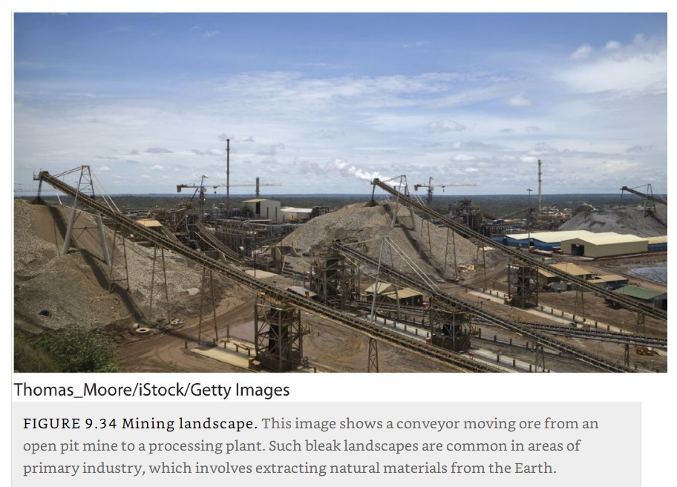
Mining landscape

Slide 66
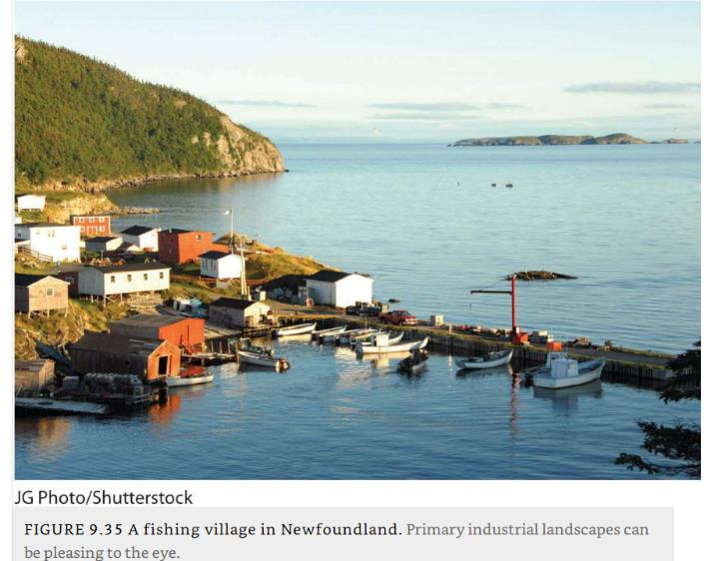
Fishing village, Newfoundland

Slide 67
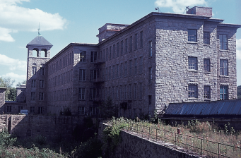
Early industrial landscape, Massachusetts
Mill buildings in central Massachusetts. Most textile mills in New England were abandoned by the mid-twentieth century, as textile production moved to southern states and then to countries outside the United States. (Courtesy of Mona Domosh.)

Slide 68
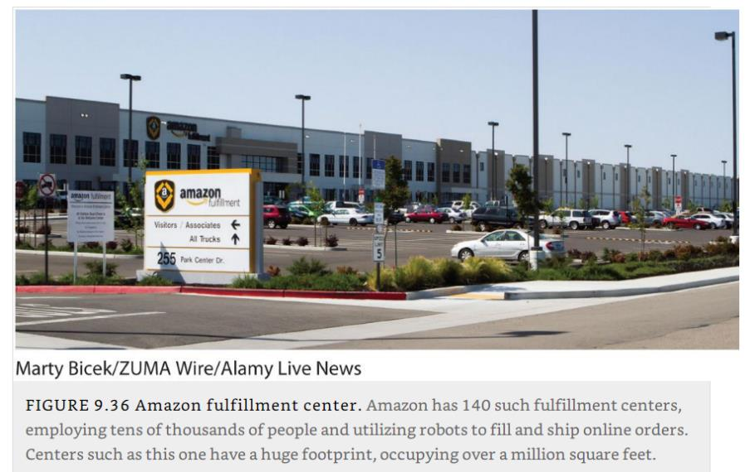
The landscape of distribution, Amazon fulfillment center

