Slide 1
Topic 8 – Agriculture and Food
A – Agricultural Practices and Regions
B – Mobility and Domestication
C – Globalization and Agriculture
D – Agriculture and the Environment
E – Field Patterns

Slide 2
Conditions of Usage
For personal and classroom use only
  Excludes any other forms of communication such as conference presentations, published reports and papers.
No modification and redistribution permitted
  Cannot be published, in whole or in part, in any form (printed or electronic) and on any media without consent.
Citation
  Neumann, Roderick P. and Price, Patricia L. (2019) Contemporary Human Geography: Culture, Globalization, Landscape, Second Edition.
  Dr. Jean-Paul Rodrigue, Dept. of Global Studies & Geography, Hofstra University.

Slide 3
A – Agricultural Practices and Regions
The major agricultural production types, their regions, and the social and environmental factors shaping them.

Slide 4
The importance of agriculture
Agriculture
  The cultivation of domesticated crops and the raising of domesticated animals.
  All humans depend, directly or indirectly, on agriculture for their survival.
  Agriculture remains the most important economic activity in the world.
  Using more land than any other activity.
  Employing between 2% and 40% of the working population (declining fast).
  Climate is one of the main variables determining what kind of agriculture is possible.
  Regional agricultural patterns tend to reflect regional climate patterns.

Slide 5
Classifying Agricultural Practices
Farming systems
  Farms that share a similar resource base.
  Distinctive mix of three fundamental variables: land, labor, and capital.
  Climate, water availability, slope, topography, and soil quality.
  Similar set of practices including crop and livestock types.
  Property ownership, farm size, temporal and spatial patterns of cultivation and animal rearing, and the use of machinery or irrigation.
Peasant
  Small-scale farmers who own their fields.
  Rely on family labor and produce both for their own subsistence and for sale in the market.
  Often represent a distinctive folk culture and socioeconomic class strongly rooted in the land.

Slide 6
Classifying Agricultural Practices
Extensive agriculture
  Farming and livestock raising using low levels of labor and capital relative to the areal extent of land under production.
  Relying on natural soil fertility and prevailing climate.
Intensive agriculture
  Farming and livestock raising using high levels of labor and capital relative to the size of the landholding.
  Overcoming environmental constraints through irrigation, land reclamation, synthetic fertilizers, chemical pesticides and herbicides, and genetic engineering.

Slide 7
Classifying Agricultural Practices
Subsistence agriculture
  Food production mainly for consumption by the farming family and local community, rather than for sale in the market.
Commercial agriculture
  Oriented toward the production of agricultural commodities for sale in the market.
Plant crop systems
  Agricultural systems oriented to grow crops for human consumption.
Livestock systems
  Agricultural systems oriented to raise animals for human use and consumption.
  Can involve growing crops to feed animals.
What are farming systems and how they are linked with geography?

Slide 8
Crop-Based Systems
Slash-and-Burn agriculture
  Land-rotation farming system, mostly for subsistence.
  Cutting small plots in forests or woodlands, burning the cuttings to clear the ground and release nutrients, and planting in the ash of the cleared plot.
  Intercropping:
    Allows taller, stronger crops to shelter lower, more fragile ones.
    Reduces the chance of total crop losses from disease or pests.
    Provides the farmer with a varied diet.
  Relatively little tending of the plants is necessary until harvest time.
  No fertilizer is applied to the fields because the ashes from the fire are a sufficient source of nutrients.
  Lasts 3 to 5 years until soil fertility declines.
  The abandoned cropland lies fallow for 10 to 20 years before farmers return to clear it and start the cycle again.

Slide 9
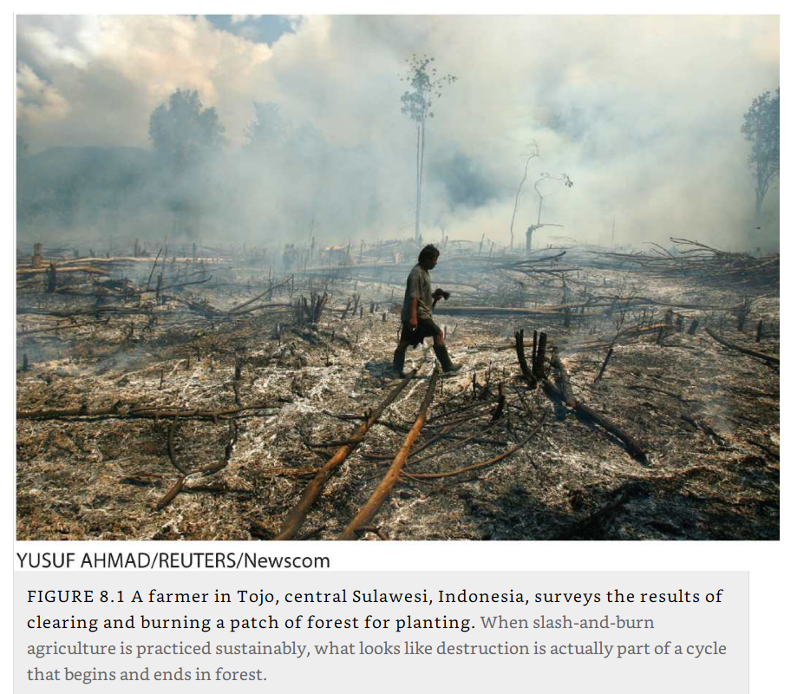
Slash and Burn Agriculture, Sulawesi, Indonesia

Slide 10
Paddy rice farming
Paddy rice farming
  The cultivation of rice on a paddy, or small flooded field enclosed by mud dikes.
  Practiced in the humid areas of Asia (particularly monsoon areas).
  A paddy rice farm of 3 acres is usually adequate to support a family.
  Most paddy fields are for subsistence farming.
  Irrigation system that can deliver water when and where it is needed is key to success.
  Large amounts of fertilizer must be applied.
  Paddy farmers often plant and harvest the same parcel of land twice per year – double-cropping (and some places triple-cropping).

Slide 11
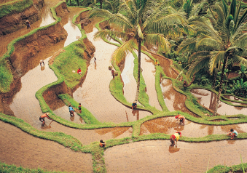
Rice cultivation, Bali, Indonesia
Cultivation of rice on the island of Bali, Indonesia. Paddy rice farming traditionally entails enormous amounts of human labor and yields very high productivity per unit of land. (Denis Waugh/Stone/Getty Images.)

Slide 12
Cereal – Root Crop Mixed Farming
Cereal – Root Crop Mixed Farming
  Peasant agriculture.
  Colder, drier farming regions that are climatically unsuited to wet rice and other crops.
  River valleys of the Middle East, parts of Europe, much of central and southern Africa, and the mountain highlands of Latin America and New Guinea.
  Dominant grain crops in these regions are wheat, barley, sorghum, millet, oats, and maize.
  Common cash crops include cotton, flax, hemp, coffee, and tobacco.
  Also raise herds of cattle, pigs, sheep, llamas and alpacas (South America).

Slide 13
Plantation agriculture
Plantation agriculture
  A system of monoculture for producing export crops.
  Requiring relatively large amounts of land and capital.
Plantation
  A large landholding devoted to specialized production of a tropical cash crop.
  Plantations maximize the production of crops such as sugarcane, bananas, coffee, coconuts, spices, tea, cacao, pineapples, rubber, and tobacco.
Origins
  Originated in the 1400s on Portuguese-owned sugarcane-producing islands off the coast of tropical West Africa.
  The greatest concentrations now exist in the American tropics, Southeast Asia, and tropical South Asia.
  Close to the seacoast for exports.
Notes:
Domosh et al.; https://blackpast.org/gah/sao-tome-island

Slide 14
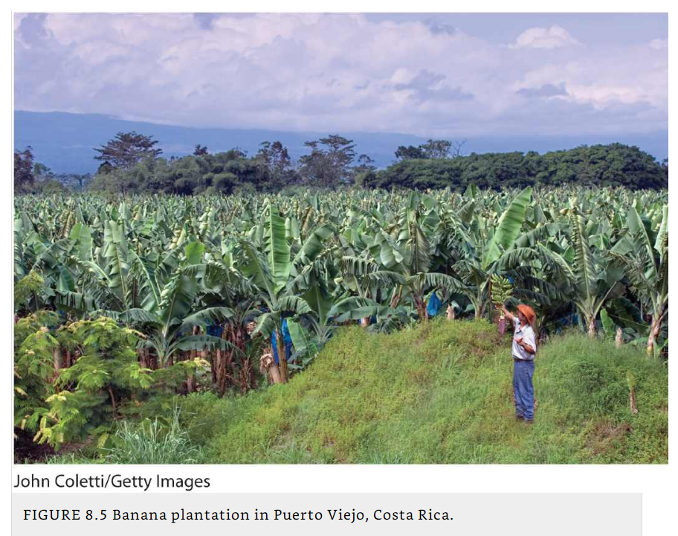
Banana Plantation, Costa Rica

Slide 15
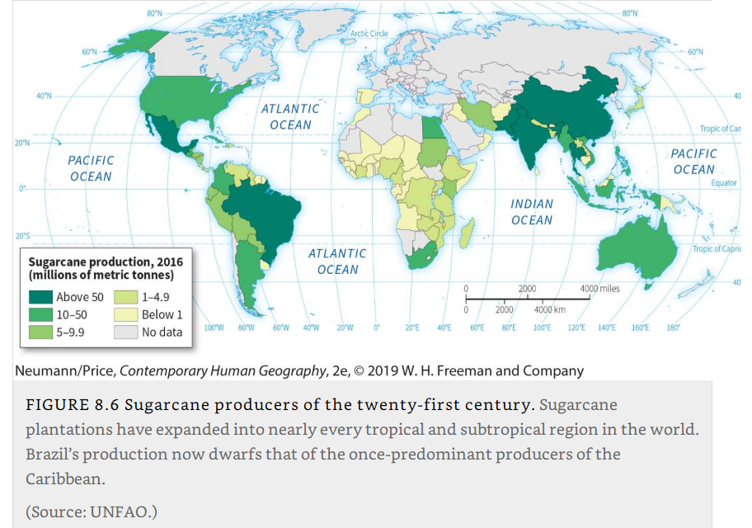
Sugarcane production

Slide 16
Market gardening and truck farming
Market gardening
  The growth of urban markets gave rise to other commercial forms of agriculture.
  A small-scale farming system of one to a few acres, usually farmer-owned and managed.
  Produces a mixture of vegetables and fruits, mostly for local and regional markets.
Truck farming
  A term often used synonymously with market gardening.
  Scaled-up version of market gardening.
  Larger acreages, less crop diversity, and more distant markets.
  Truck does not refer to a vehicle, but rather is derived from a French word for “barter” or “exchange.”
  Both systems are classified as intensive agriculture, but neither system is involved in livestock rearing.

Slide 17
Grain farming
Grain farming
  A specialized type of agriculture in which farmers grow primarily wheat, rice, or corn for commercial markets.
  Wheat belts stretch through Australia, the Great Plains of North America, the steppes of Russia and Ukraine, and the pampas of Argentina.
  Farms are generally very large, and widespread use of machinery, synthetic fertilizers, pesticides, and genetically engineered seed varieties enables grain farmers to operate on this scale.
  In North America, irrigation is increasingly based on “fossil water” that has been stored over the millennia in natural underground reservoirs called aquifers.
Notes:
Aquifers: (see Pulsipher’s WRG)

Slide 18
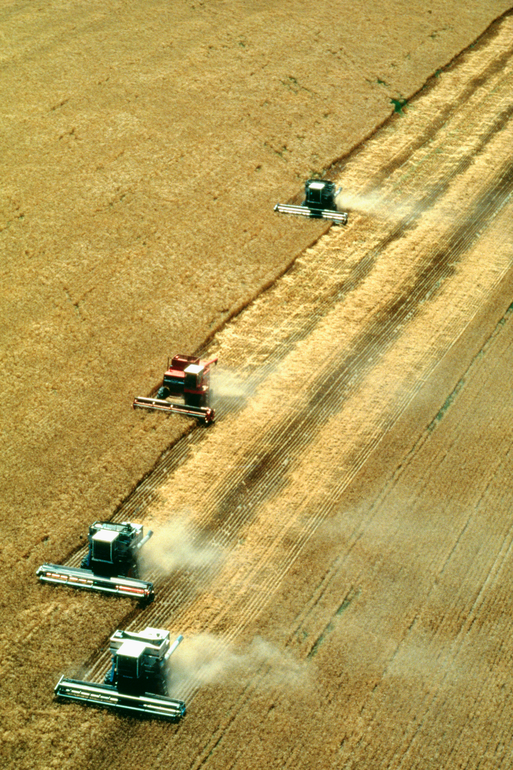
Mechanized wheat harvest on the Great Plains of the United States. An aerial view of combines harvesting wheat near Colorado. North American grain farmers operate in a capital-intensive manner, investing in machines, chemical fertilizers, and pesticides. What long-term problems might such methods cause? What benefits are realized in such a system? (Glowimages/Getty Images.)
Explain the characteristics of two crop-based agricultural systems.

Slide 19
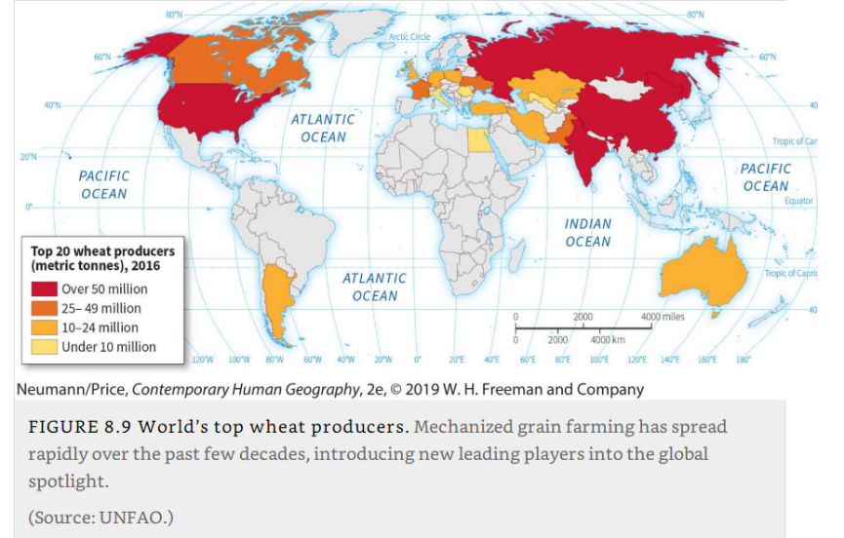
Larges Wheat Producers in the World

Slide 20
Animal-Rearing Systems: Pastoralism
Pastoralism
  Sometimes called pastoral nomadism or nomadic herding.
  A system of breeding and rearing domesticated herd animals by moving them over expansive areas of open pasturelands.
  Occurs in areas that are climatically unsuited to crop cultivation.
  Associated with ethnic and indigenous tribal culture groups.
Transhumance
  Herders move with their livestock in search of the best forage for the animals as seasons and pasture conditions change.
  Vertical pattern from lowlands in winter to mountain highlands in summer.
  Horizontally pattern, following the seasonal movement of rainfall in order to herd animals to the areas with the most plentiful pastures.

Slide 21
Animal-Rearing Systems: Pastoralism
Nomadic livestock herder
  A member of a group that continually moves with its livestock in search of forage for its animals.
  Material possessions must be portable, including tents used for housing.
  Typically, in nomadic cultures, wealth is based on the size of livestock holdings rather than on accumulation of property and personal possessions.
  Some national governments established policies encouraging nomads to practice sedentary cultivation of the land – easier control by central governments.

Slide 22
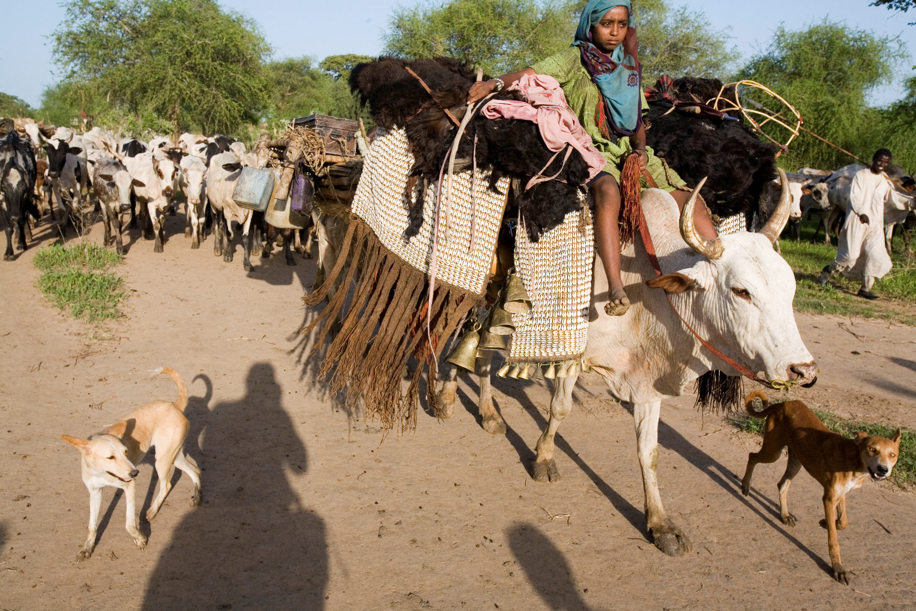
Nomadic pastoralists in West Africa. This household in Chad is moving their livestock to new pastures. Mobility is key to their successful use of the variable and unpredictable environment of this region of Africa. They are taking with them all of their possessions, including their shelter—a hut, which they have packed on top of their cows. (Michael Nichols/National Geographic/Getty Images.)

Slide 23
Animal-Rearing Systems: Livestock ranching
Ranching
  The commercial raising of herd livestock on a large landholding.
  Emerged commercially during colonial times in the Americas.
Livestock ranchers
  Have fixed places of residence and operate as individuals.
  Raise livestock on a large scale for market.
  Are found in areas with environmental conditions too harsh for crop production.
  Raise two kinds of animals in large numbers: cattle and sheep.
  Sheep ranching is geographically concentrated to such a degree that only four countries— Australia, China, New Zealand, and the United Kingdom— account for 62%.
  Cowboys in North America, gauchos in South America, and vaqueros in Mexico.

Slide 24
Animal-Rearing Systems: Livestock ranching
Livestock fattening
  A commercial type of agriculture that produces fattened cattle and hogs for meat.
  Invented in the United States in the late nineteenth century.
  Became prevalent in the 1960s.
  Farmers breed many of the animals they fatten, especially hogs – feedlot system.
  Feedlots purchase grain from farmers in the region, although in the case of hogs many farmers feed animals with the corn cultivated on their own farms.
  Corn Belt of the U.S. Midwest: farmers raise corn and soybeans to feed cattle and hogs.
  Typically, slaughterhouses are located close to feedlots, creating a new meat-producing region, which is often dependent on mobile populations of immigrant labor.

Slide 25
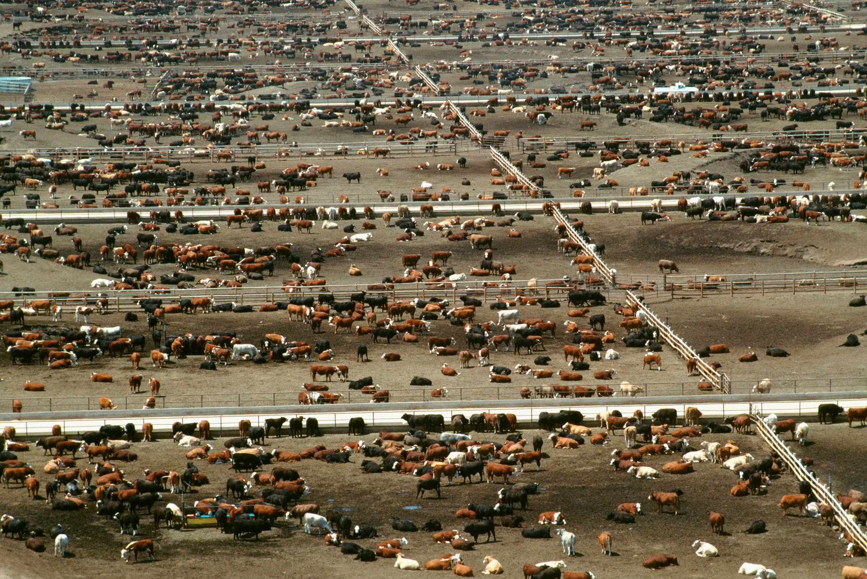
Cattle feedlot for beef production. This feedlot, in Colorado, is reputedly the world’s largest. What ecological problems and health risks do such an enterprise cause? (Glowimages/Getty Images.)

Slide 26
Animal-Rearing Systems: Dairying
Dairying
  The specialized production of dairy goods resembles livestock fattening.
  Produce milk and its various by-products, such as yogurt, butter, and cheese.
  Depends on the large-scale use of pastures.
  Dairy products vary from region to region, depending, in part, on how close the farmers are to their markets.
  Dairy belts near large urban centers usually produce milk, which is more perishable, while those farther away specialize in butter, cheese, or processed milk.
  Dairy farmers have adopted the feedlot system and now raise their cattle on feed purchased from other sources – rely on hired labor to maintain herds.
Explain the characteristics of two liverstock-based agricultural systems.

Slide 27
Urban agriculture
Urban agriculture
  The raising of food, including fruit, vegetables, meat, and milk, inside cities.
  Especially common in developing countries.
  Can provide subsistence and commercial surplus.
  In China, urban agriculture provides 90% or more of all the vegetables consumed in the cities.
  Urban agriculture is increasingly important to family income and food security in West Africa.
  Can improve food security.

Slide 28
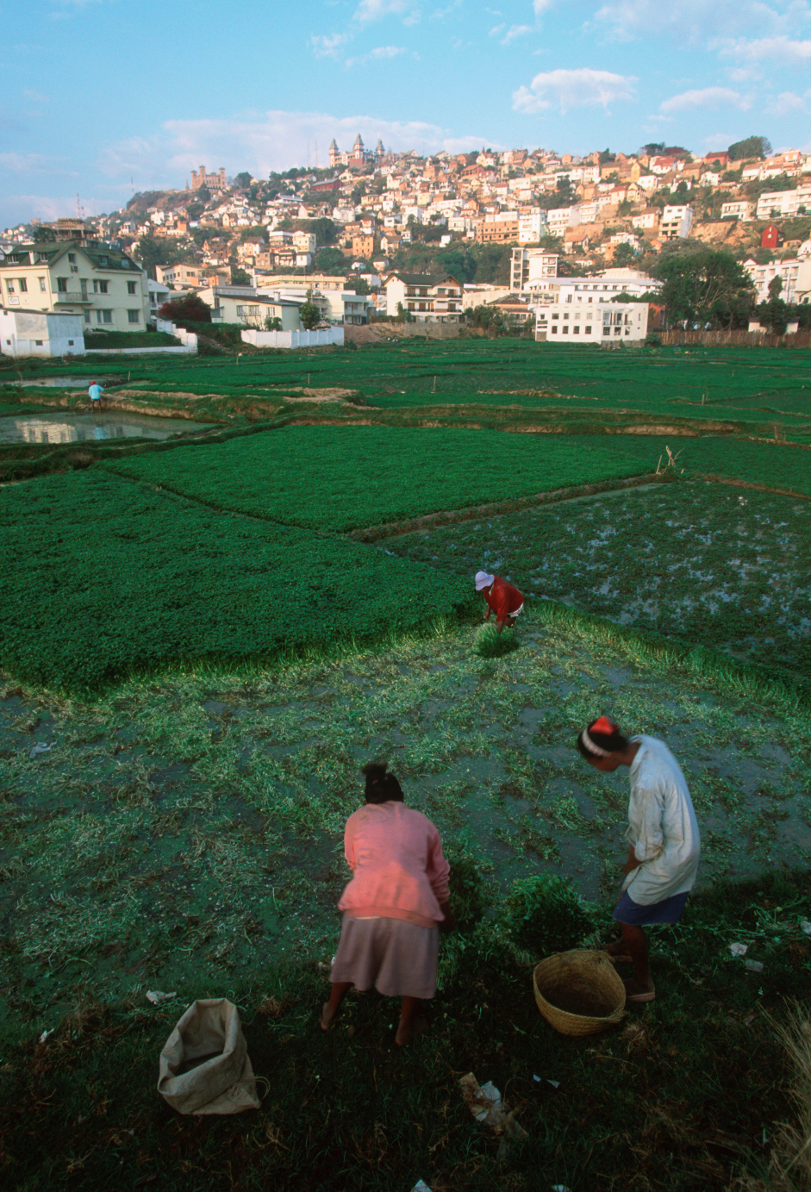
Urban agriculture in NYC:
https://www1.nyc.gov/site/agriculture/index.page
Urban agriculture. Farmers work a rice field near Antananarivo, Madagascar. Urban agriculture is a critical food source for many African city dwellers. (Martin Harvey/Gallo Images/Getty Images.)

Slide 29
Aquaculture
Aquaculture
  The cultivation, under controlled conditions, of aquatic organisms.
  A very old practice.
  Primarily for food but also for scientific and aquarium uses.
  As the populations of wild species decline and the price of captured fish increases, farmed seafood increase.
  At the turn of the 21st century, aquaculture was growing nearly 4x faster than all terrestrial animal food-producing sectors combined.
Mariculture
  A branch of aquaculture that refers to the farming of saltwater species such as shrimp, oysters, and marine fish.
  It often involves the transformation of coastal environments and the production of distinctive new landscapes.
  Ponds, rafts, nets, tanks, and buoys.

Slide 30
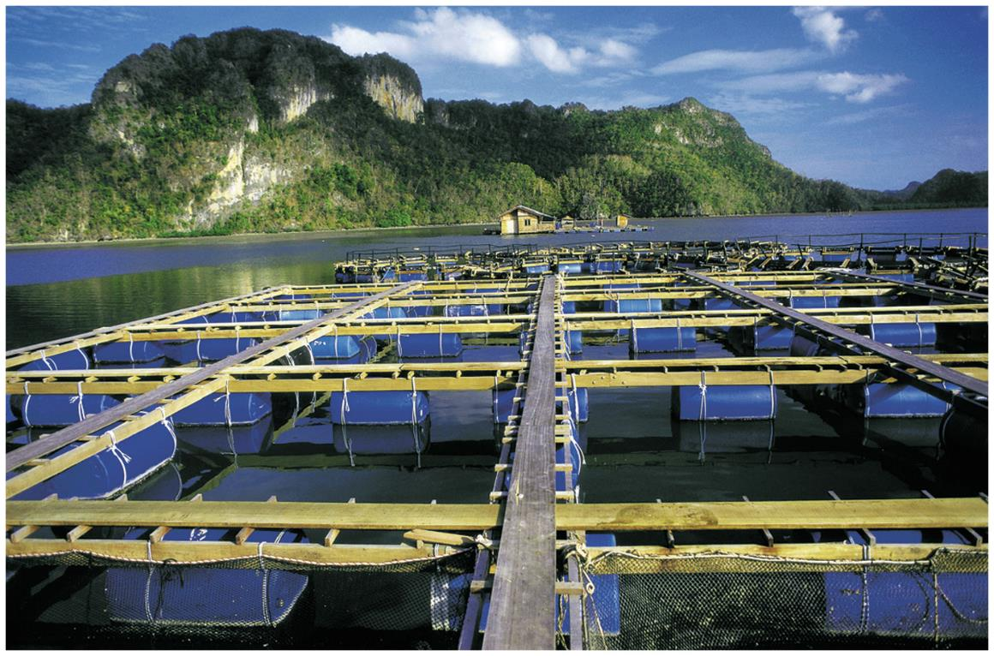
Mariculture, Malaysia
Marine fish farming off Langkawi Island, Malaysia. Mariculture is expanding rapidly around the globe, led by China, the world’s top producer. Virtually all mariculture takes place within countries’ 200-mile coastal territory known as the EEZ (exclusive economic zone). The EEZ is also the site of most commercial fishing, which has greatly depleted wild fish stocks and raised the need for increased mariculture production. (Source: Global Education Project, Fishing and Aquaculture.)

Slide 31
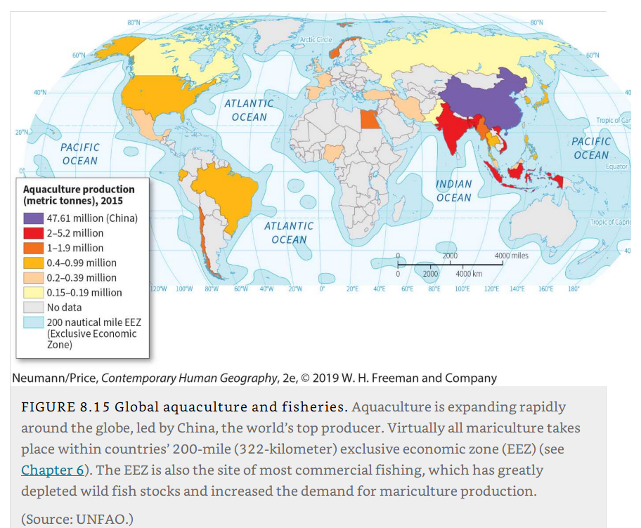
Global aquaculture and fisheries

Slide 32
Aquaculture
Impacts
  Most commercial aquaculture relies on large energy and chemical inputs:
    Antibiotics and artificial feeds made from wastes of poultry and hog processing.
  Tends to concentrate toxins in farmed fish, creating a potential health threat to consumers.
  Discharge from fish farms can pollute nearby natural aquatic ecosystems.
  Around the tropics, especially tropical Asia, the expansion of commercial shrimp farms is contributing to the loss of highly biodiverse coastal mangrove forests.

Slide 33
The Von Thunen Model
Model
  Understand the distribution and intensity of agriculture in relation to transportation costs to market.
  “Isolated state”:
    No trade connections with the outside world.
    Only one, centrally located market.
    Uniform soil and climate.
    Level terrain throughout.
  Series of concentric zones:
    Each occupied by a different type of agriculture.
    Located at progressively greater distances from the central market.

Slide 34
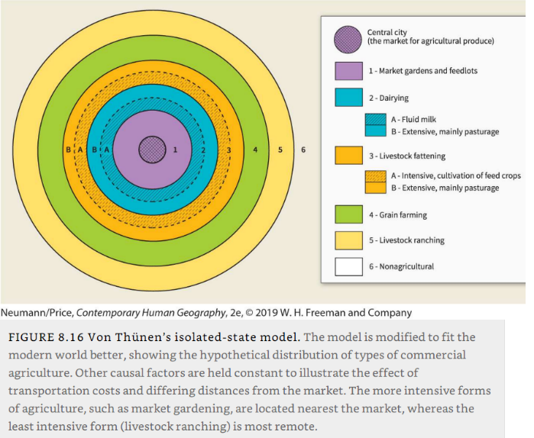
Von Thünen’s isolated-state model

Slide 35
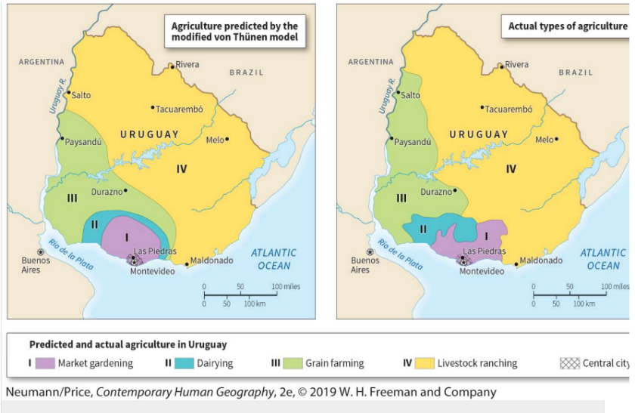
Ideal and actual distribution of types of agriculture in Uruguay

Slide 36
B – Mobility and domestication
Ancient and modern patterns of domesticated plant and animal diffusion and the importance of labor mobility to industrialized agriculture.

Slide 37
Ancient Origins and Diffusion of Domestication
Domestication
  Multigenerational process through which humans selectively breed, protect, and care for individuals taken from populations of wild plant and animal species.
  Create genetically distinct species, known as domesticates.
  Ongoing process of trial and error, not a singular event such as a discovery.
  Began as the gradual culmination of thousands of years of close association between hunter-gatherers and the natural environment.

Slide 38
Ancient Origins and Diffusion of Domestication
Plant domestication
  First step was perceiving that a certain plant was useful.
  Led initially to its protection and to seed selection and deliberate planting.
  Domesticated plants are genetically distinct from their wild ancestors.
  Result from selective breeding by agriculturists.
  Tend to be bigger than wild species, bearing larger and more abundant fruit or grain.
  The original maize grew on a cob only one-tenth the size of the cobs of domesticated maize.
  Domestication was accomplished by peoples who had enough food to remain settled in one place and devote considerable time to plant care.
  Regions of great biodiversity providing abundant vegetative raw material for experimentation and crossbreeding.

Slide 39
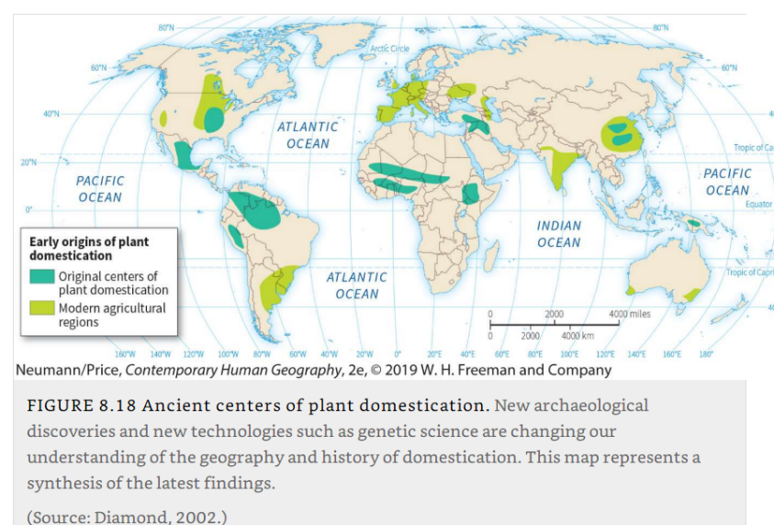
Ancient centers of plant domestication
Fertile Crescent in the Middle East: origin of the cereal grains of wheat, barley, rye, and oats. Grapes, apples and olives.
China and New Guinea: Rice, bananas, and sugarcane.
Africa: Peanuts, yams, and coffee.
Mesoamerica: Maize, tomatoes and beans.
Andes: Potato.

Slide 40
Ancient Origins and Diffusion of Domestication
Animal domestication
  Occurred later in prehistory than did the first planting of crops.
  Exception of the dog:
    Companionship with humans appears to be much more ancient and related to hunting rather than agriculture.
  The wild ancestors of major herd animals— such as cattle, pigs, horses, sheep, and goats— lived primarily in a belt running from Syria and southeastern Turkey.
  5000 years ago, people of the Indus Valley civilization began using oxen to pull the plow.

Slide 41
Modern diffusions
Impact of colonialism
  “Colombian exchange”.
  Redistributing a wide variety of crops on a global scale.
  Maize and potatoes from North America went to Eurasia and Africa.
  Wheat and grapes from the Fertile Crescent went to the Americas.
  West African rice went to the United States and Brazil.
  Introduction of the olive, grape, and date palm by Spanish missionaries in 18th century California, where no cultivation previously existed.
  Chili peppers and maize (Mexico), carried by the Portuguese to their colonies in South Asia, became staples of diets across that region.

Slide 42
Modern diffusions
Green revolution
  Introduction of high-yield hybrid crops and chemical fertilizers and pesticides into traditional Asian agricultural systems.
  Resistance to insects and diseases.
  Began with wheat in the United States and expanded to rice.
  Paddy rice farming, with attendant increases in production and ecological damage.
  In some countries (e.g., India), the green revolution diffused rapidly in the 1960s; doubled output between 1950 and 1970.
  Loss of plant diversity and genetic variety.

Slide 43
Modern diffusions
Labor mobility
  Agriculture is constrained by the rhythms of nature.
  Biological cycles associated with planting and harvesting are reflected in cycles of labor demand.
  Farmers need to mobilize a large labor force for harvesting crops.
  Keeping a year-round work force raises farm production costs.
The use of migrant workers
  Been central to the growth and profitability of farming.
  Bracero Program (US); contract workers were brought from Mexico to California during periods of peak labor demand.
  Migrant farmworkers remain ubiquitous such as the European Union.
  Agricultural boom in Spain and Italy relies heavily on North African migrant workers.
Provide some examples of the modern diffusion associated with food and agricultural practices.

Slide 44
C – Globalization and Agriculture
How the processes of globalization have restructured the geography of agricultural production and food consumption and the sorts of problems that have arisen from that restructuring.

Slide 45
The global food system
The global food system
  Agro-industrial complex, organized at the global scale.
  Encompasses all elements of growing, harvesting, processing, transporting, marketing, consuming, and disposing of food for people.
  A very small number of multinational corporations now dominate this system.
Exploration, colonization, and globalization
  Created new regional cuisines (mix of ingredients).
  Simplified the global diet to a disproportionate reliance on only three grains: wheat, rice, and maize.

Slide 46
The global food system
Expansion of plantation system
  Warm climates produced what were then luxury foods for markets in the Global North.
  Such as sugar, tea, coffee, bananas, and other tropical crops.
  A global food system now exists that has freed consumers in affluent regions from the constraints of local ecologies.
  Emphasis on a relatively small number of staple crops.
  Abandonment of local crop varieties and a decline in associated biological diversity.

Slide 47
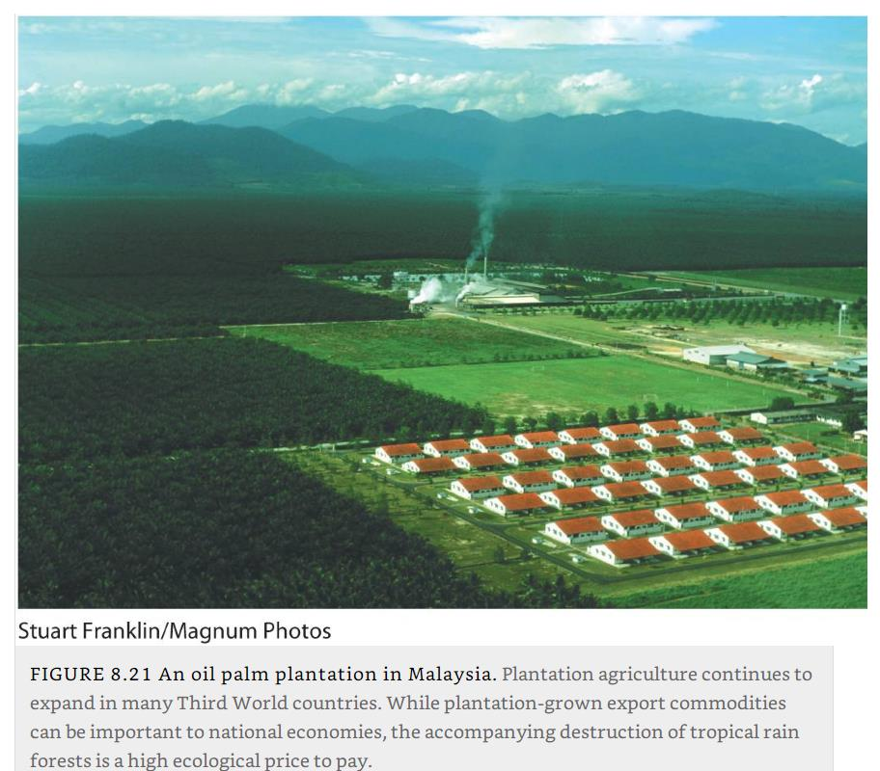
Palm oil plantation in Malaysia

Slide 48
Agricultural industrialization and technological change
Reliance on the use of synthetic fertilizers, pesticides, and herbicides
  Synthetic fertilizer:
    Nutrient needed for plant growth, most commonly nitrogen, phosphorus, and potassium.
  Pesticides:
    Industrial chemicals that kill or repel animals, insects, or plants that can damage, destroy, or inhibit the growth of crops.
  Herbicides:
    Common type of pesticide designed to kill or inhibit the growth of unwanted plants (weeds) that compete with crop plants.
  These chemicals are produced within the petrochemical industry.
  Petrochemical use has become common in conventional agriculture.
  Artificial fertilizer application stimulates crop growth and pesticides reduce crop losses.
  Application has been responsible for major increases in yields per acre of many crops.

Slide 49
Agricultural industrialization and technological change
Livestock sector
  Seen a similar rise in the use of industrial inputs.
  Productivity increases from shortening the time from birth to slaughter.
  Advances in animal nutrition and growth led to the introduction of concentrated feeds and synthesized vitamins and hormones.
  Reduced the need for extensive pasture areas and allowed farmers to move livestock production into confinement facilities.
  Concentrated animal feeding operation (CAFO), confines livestock, including cattle, sheep, turkeys, chickens, and hogs, at high densities in cages.
  Required additional inputs of vaccines and antibiotics in order to combat the spread of diseases that reduce productivity.

Slide 50
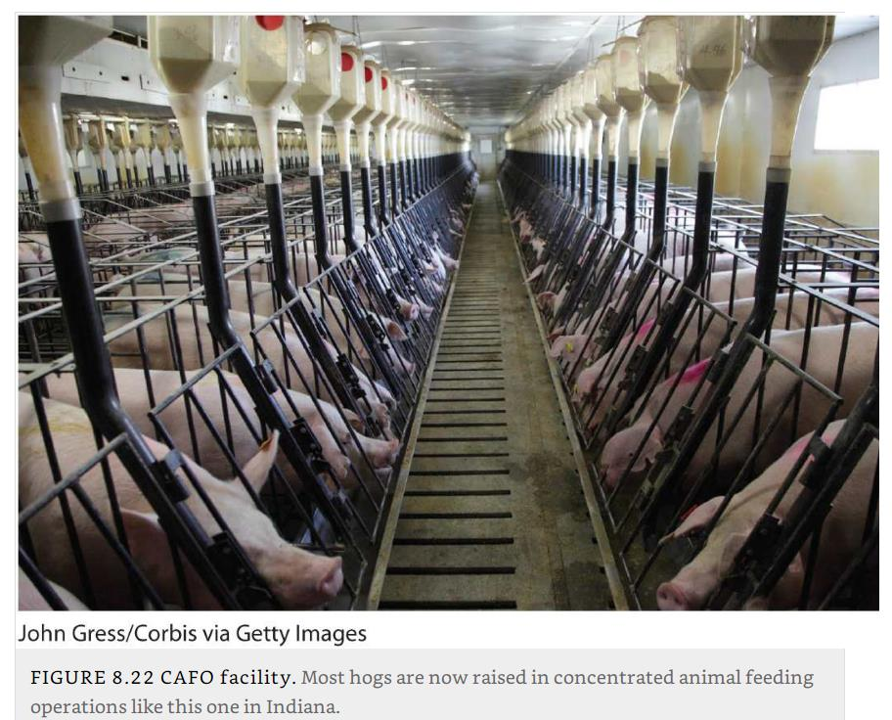
CAFO facility, Indiana

Slide 51
Agricultural industrialization and technological change
Increasing mechanization
  Industrialized farms are dependent on fossil fuels.
  Propel the cultivators and harvesters, pump the irrigation water, heat buildings.
  Machinery is growing ever more sophisticated (and expensive).
  Greatly increased both labor productivity and, indirectly, the size of farms.
  Fewer workers are needed, and vast portions of rural areas around the world are experiencing depopulation even as they become more productive.
  Development of cold chains.
  New refrigeration and food-freezing technologies to keep farm produce fresh in climate-controlled environments.

Slide 52
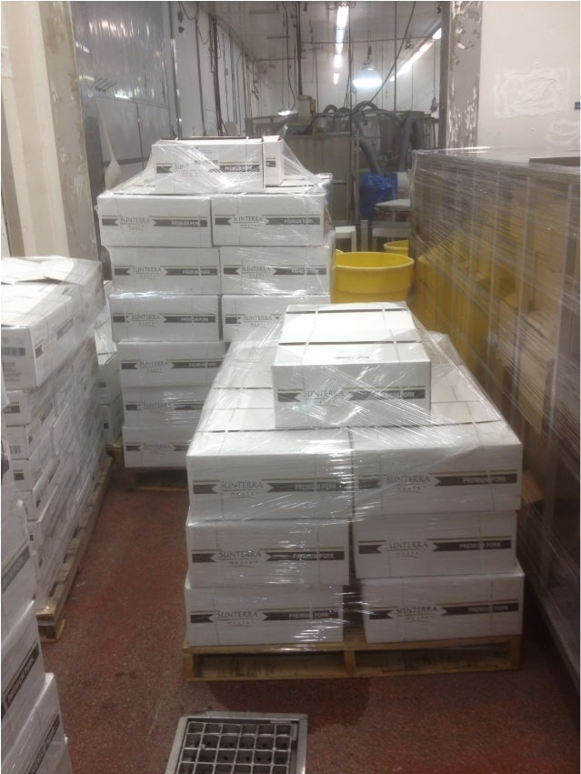
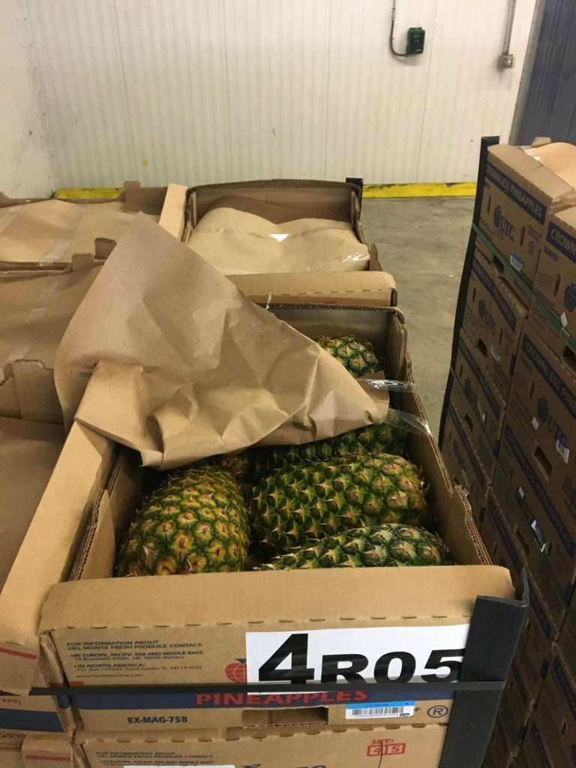
Cold Chain Technology and Processes
Source Loading of Chilled Meat in a Reefer
Crownless Pineapples in Cold Chain Inspection Room

Slide 53
Agricultural industrialization and technological change
Emergence of biotechnology and genetic engineering
  Pieces of DNA can be recombined with the DNA of other organisms to produce new properties, such as pesticide tolerance or disease resistance.
  Transferred not only between plant species but also between plant and animal species.
  Genetically modified organisms (GMO).
  Commercial production of GMO foods began first in the United States only in 1996.
  90% of all soybeans, corn, sugar beets, and canola produced in the United States are genetically modified varieties.
Explain some challenges to the global food system, such as the impact of technology and corporate interests.

Slide 54
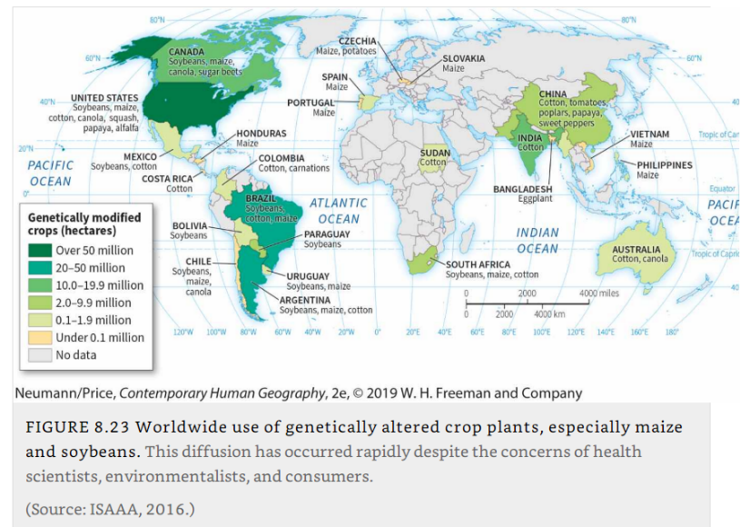
Worldwide use of genetically altered crop plants

Slide 55
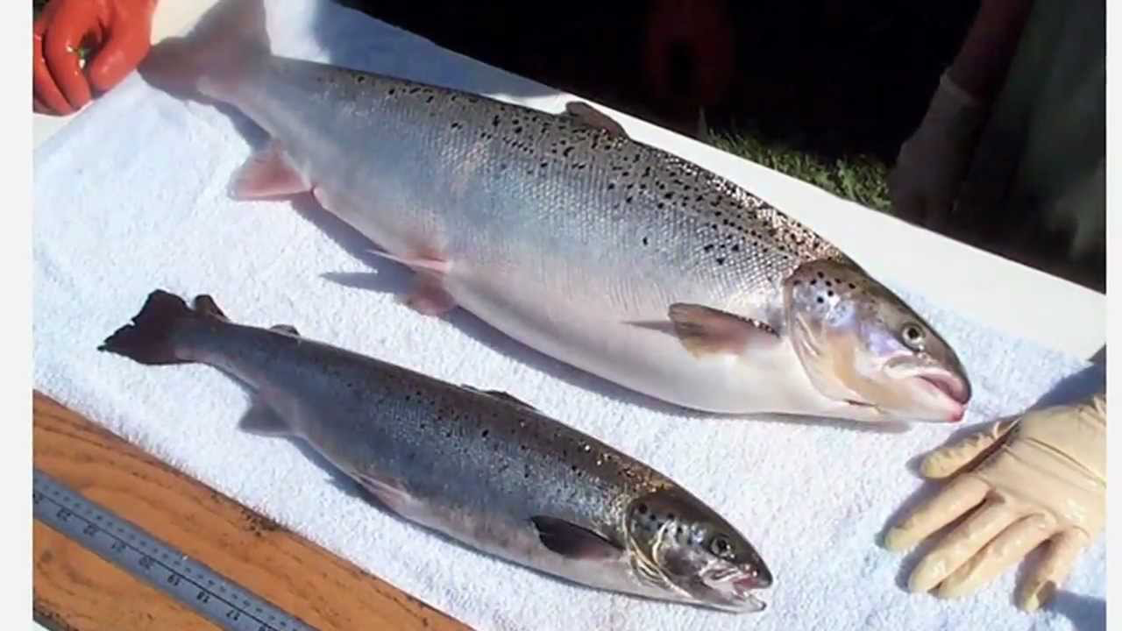
GMO Salmon: AquaAdvantage
http://www.nytimes.com/2015/11/20/business/genetically-engineered-salmon-approved-for-consumption.html
Notes:
Photo source: http://www.march-against-monsanto.com/wp-content/uploads/2015/10/salmonnn.jpg

Slide 56
Multinational Corporations in Agriculture
Agribusiness
  Highly mechanized, large-scale farming, usually under corporate ownership.
Monoculture
  The raising of only one crop on a huge tract of land in agribusiness.
  Vertical integration; firm involved in several stages of the process.
Chicken agribusiness
  Since the 1990s, per-capita consumption of chicken has continued to grow as that of beef continues to decline.
  (1) Mills that convert raw materials to poultry feed.
  (2) Hatcheries where eggs are incubated.
  (3) Slaughtering plants where the birds are butchered.
  (4) Secondary processing facilities where mean turned into products.
  (5) The product brands.

Slide 57
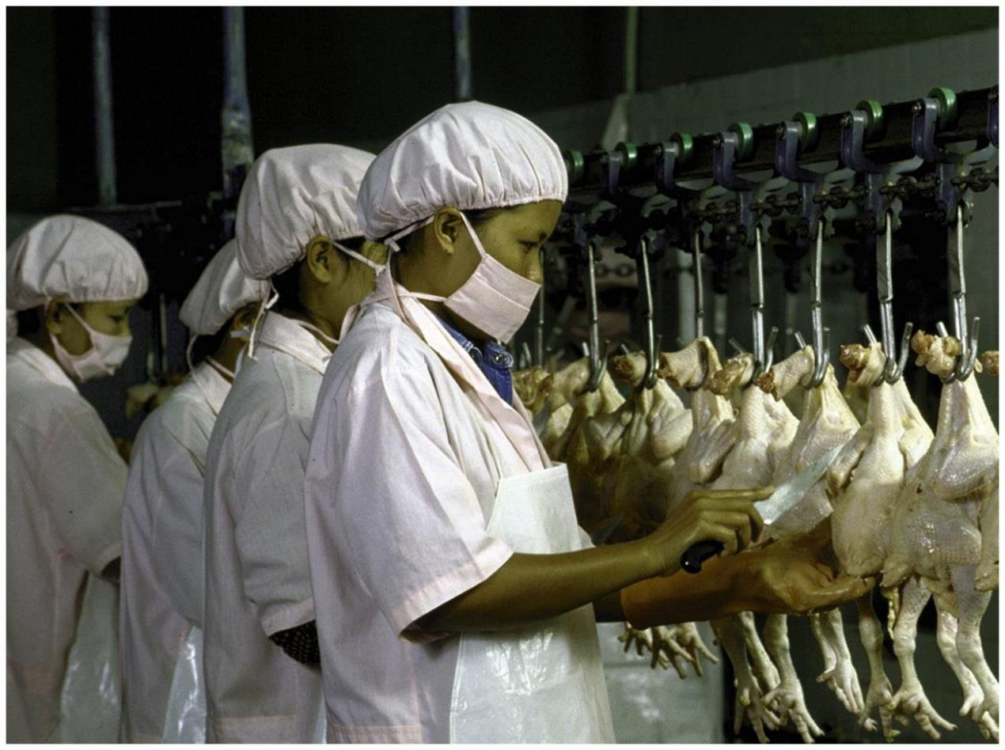
Industrialized poultry, Bangkok, Thailand
Notes:
Photo Credit: Robert Nickelsburg/Time Life Pictures/Getty Images

Slide 58
Multinational Corporations in Agriculture
Contract farming
  Arrangement between an independent farmer and an agribusiness company.
  Farmer receives all the inputs from the company needed to produce a crop.
  Conditions specified by the company.
  Guaranteed buyer and price for the crop.
  Widespread practice in the production of many different crops worldwide.
Chicken contract farming
  Corporation provides all the hatchlings, feed, drugs, technical advice, and transport.
  Promises to buy the finished chickens based on weight gained.
  A stable and predictable income without bearing the cost of inputs.
  Farmer bears all the risks in the event of crop failure and all the costs of farm maintenance.
  90% of all U.S. chickens are grown under contract.

Slide 59
Persistence of Food Deprivation
Paradoxes
  Overconsumption resulting in conditions such as hearth diseases, obesity and diabetes.
  Chronic malnutrition in several parts of the world.
  Disappearance of famines.
  Food production has grown more rapidly than the world population over the past 50 or 60 years.
  Per capita, more food is available today than in 1950, when fewer than half as many people lived on Earth.

Slide 60
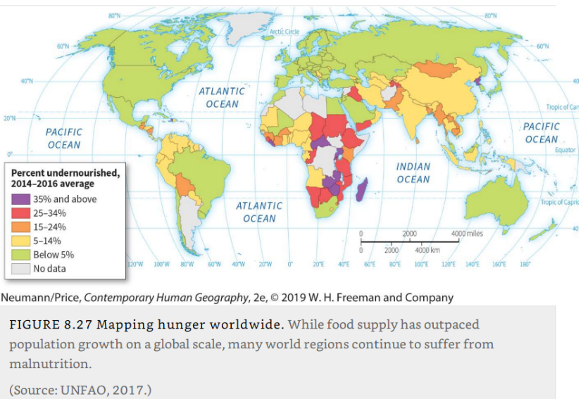
Share of the population undernourished

Slide 61
Persistence of Food Deprivation
Factors for food deprivation
  International political economics as a factor.
  Government subsidies support many farmers in advanced economies.
  Many developing countries do not grow enough food to feed their populations.
  Cannot afford to purchase enough imported food to make up the difference.
  Poor transportation infrastructure often prevents effective distribution.
  Political instability can disrupt food shipments, and donated food often falls into the hands of corrupt local officials.
  War:
    Hunger used as a weapon.
    Acts of siege warfare: seizing or destroying livestock etc.
    Crops and soil destroyed.
    Infrastructure is destroyed; local economies and human resources are devastated.
Notes:
War and hunger: worldhunger.org

Slide 62
Persistence of Food Deprivation
Food fears
  Globalized food system is particularly to food contaminations that can cause illness and even death.
  Food poisoning a significant factor for illness.
Foodborne outbreaks
  When two or more people acquire the same illness from the same contaminated food or drink.
  The centralization and globalization of food production systems have made foodborne outbreaks both more common and difficult to control.
  Frequent contaminants are various genetic strains and species of common viruses and bacteria.
  Salmonella. Hepatitis A. Norovirus.
  Particularly concerning fresh food.

Slide 63
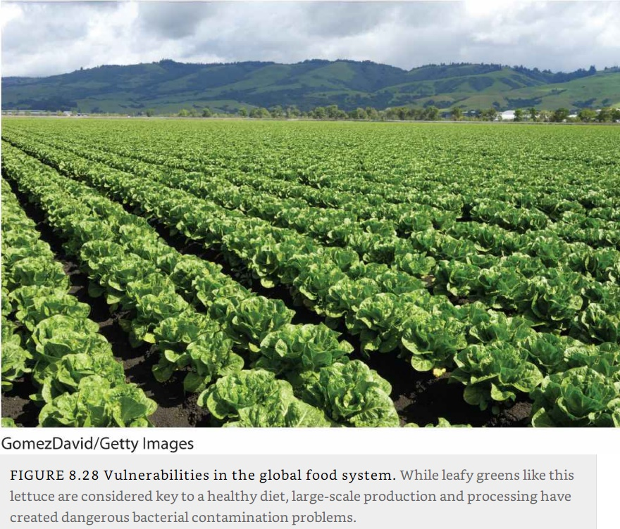
Vulnerabilities in the global food system: Large scale salad farming

Slide 64
D – Agriculture and the Environment
The complex interactions between industrial agriculture and the environment, especially with regard to issues of agrichemical use and climate change.

Slide 65
Environmental Costs of Industrial Agriculture
Water control
  Land reclamation impacts (Netherlands).
  Drainage of freshwater wetlands (half of original wetlands lost in the US; 90% for California).
  Irrigated agricultures relies on surface impoundments with dams and ground water extraction.
  Recent irrigation efforts have allowed “deserts to bloom” and greatly increased the amount of land under cultivation.
  The risk of salinization (accumulation of salt on the soil top layer).

Slide 66
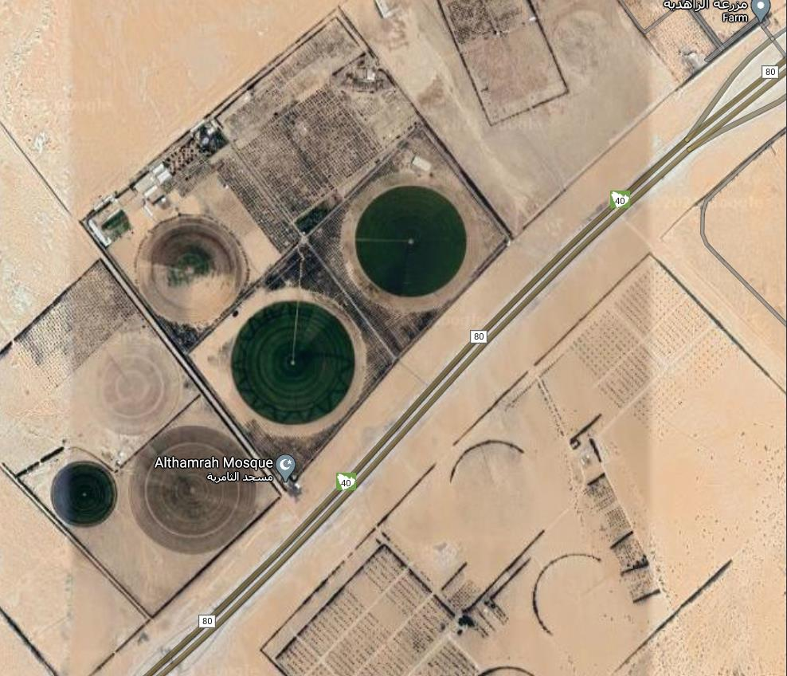
Groundwater irrigated agriculture, Saudi Arabia

Slide 67
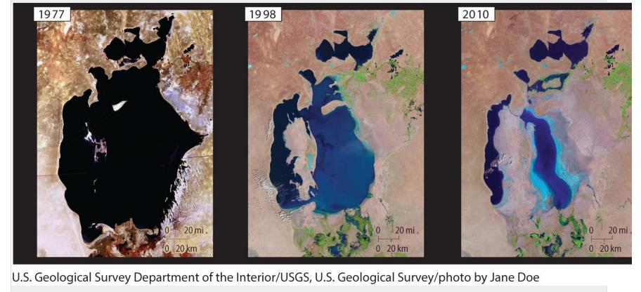
Aral Sea, Central Asia (Kazakhstan and Uzbekistan)

Slide 68
Agrichemicals
Complex cost-benefit
  Fertilizers, pesticides and herbicides.
  Increased the productivity of farms in recent decades.
Pesticides
  95% of the pesticide spray may not reach its pest target.
  Pesticides kill insects indiscriminately.
  Insect-feeding wildlife, especially birds, will decline.
  Some pesticides also kill bees, which are necessary for the pollination of many agricultural crops.
  Pesticides can enter the bodies of living animals and inhibit reproduction.
  Pesticides are known to have adverse health effects on humans, including hormone disorders, skin and neurological diseases, and cancers.
  Risks of runoffs from farm areas.

Slide 69
Agrichemicals
Fertilizers
  Synthetic fertilizers are manufactured forms of naturally occurring plant nutrients.
  Different environmental effects.
  When excess synthetic fertilizer or animal wastes enter aquatic systems they produce a sudden flush of nutrients.
  Can trigger rapid plant growth, most notably algae.
  Nutrients in runoff result in “algae blooms,” sudden spurts of algae growth that turn bodies of water green.
  Growth is so rapid and extensive that it consumes most of the dissolved oxygen in the water.
  “Dead zones”.

Slide 70
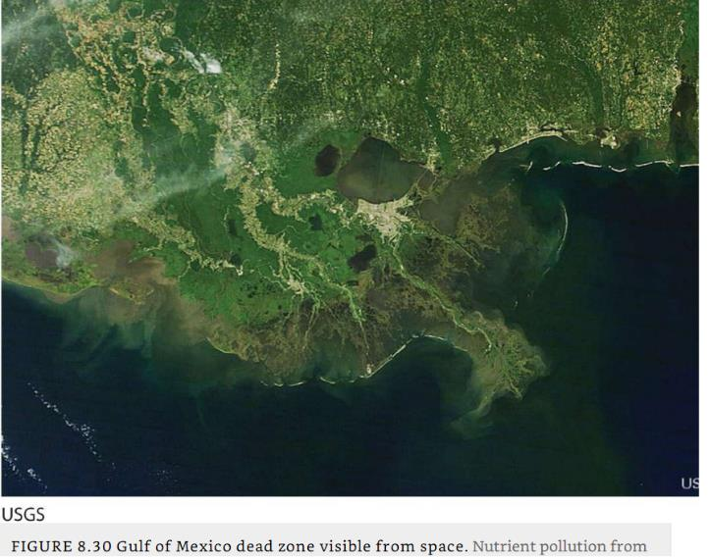
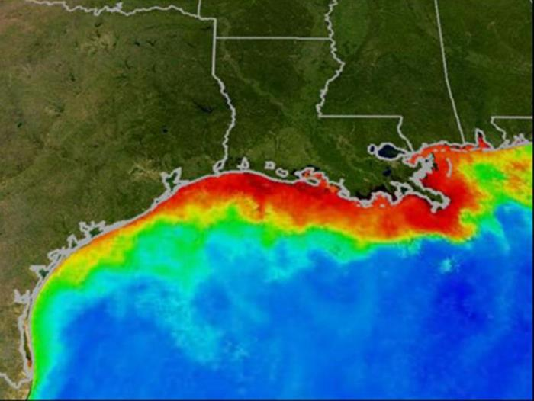
Dead Zone at the mouth of the Mississippi River delta

Slide 71
Agriculture and Climate Change
Expectations
  Increase in extreme weather, such as droughts and floods, that can reduce crop yields.
  Regional climates are expected to shift geographically.
  Some areas can be less suitable for agriculture, while others (north) could be more.
  Sub-Saharan Africa particularly vulnerable:
    Fast demographic growth.
    Lower levels of economic development.
  Impacts on irrigation.

Slide 72
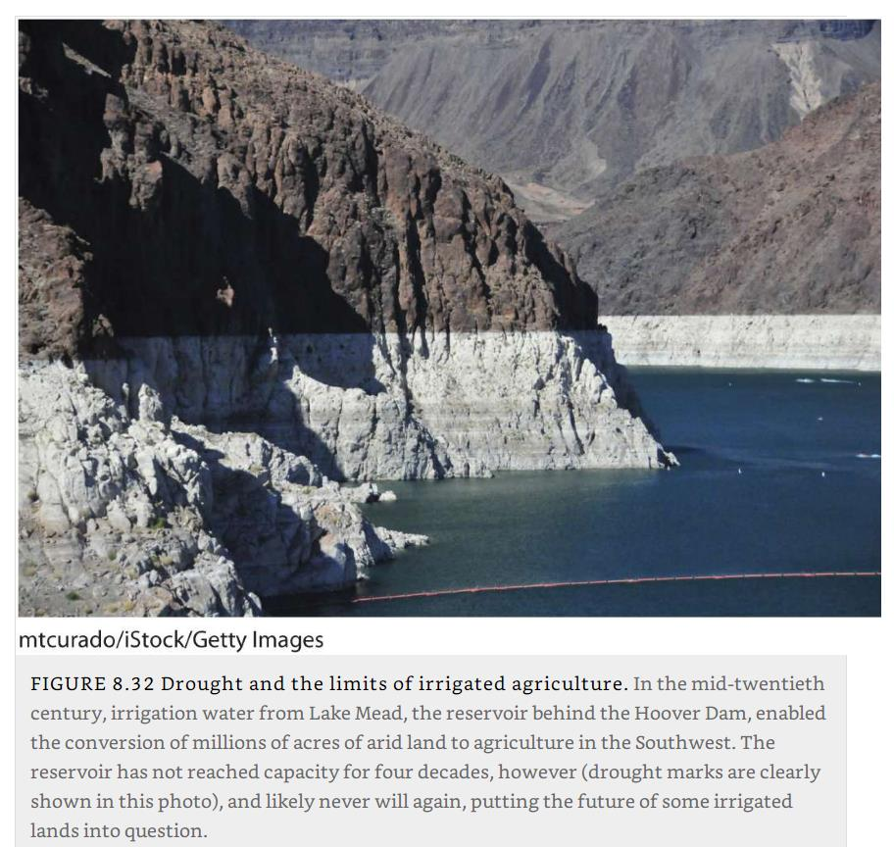
Lake Mead, Arizona and Nevada

Slide 73
Agriculture and Climate Change
Effects of agriculture on climate
  Agriculture contributes:
    14% of the world’s total of anthropogenic CO2.
    42% of methane.
    Largest source of another GHG, nitrous oxide, accounting for 75 percent of the world’s emissions.
  Clearing and burning of forests for cultivation both increases atmospheric CO2 (from forest combustion).
  Reduces the amount of CO2 removed from the atmosphere.
  Forests are considered carbon sinks because in growing they take up atmospheric CO2 and store it for decades in living biomass.
  For centuries, increased food production has been achieved by converting forests to pastures and plowed fields.
What are the main impacts of agricultural systems on the environment?

Slide 74
E – Field Patterns
The influence of agriculture in shaping the cultural landscape and how that influence varies geographically.

Slide 75
Cadastral Surveys and Field Patterns
Fragmented farms
  Major regional contrasts exist in property lines and field patterns.
  Unit-block versus fragmented landholdings.
  Geometric government survey lines versus irregular customary property boundaries.
  Fragmented farms are found throughout Eurasia and Africa and in many indigenous cultural regions.
  Farmers live in nucleated settlements of small towns and villages.
  Landholdings are fragmented into many separate fields situated at varying distances and in various directions from the settlement.
  Boundaries were established by customary use rather than formal surveys.
  Each farm household in the community had access to land of varying soil composition and terrain.

Slide 76
Cadastral Surveys and Field Patterns
Unit-block farms
  Property is contained in a single, contiguous piece of land.
  Found mainly in the European settler colonies of the Americas, Australia, New Zealand, and South Africa.
  Much of the land was surveyed prior to and in preparation for settlement.
  United States:
    Early settlement was surveyed in a metes and bounds system.
    Used natural features such as trees, boulders, and streams.
    Textual description of the field and its boundaries.
    Produced irregularly shaped property boundaries.
    Later, a rectangular pattern was imposed (township).

Slide 77
Cadastral Surveys and Field Patterns
Long-lot farms
  Consists of a long, narrow unit block stretching back from a road, river, or canal.
  Organize farmers’ dwellings in a linear settlement pattern.
  Occur widely in the hills and marshes of central and western Europe, in parts of Brazil and Argentina, along the rivers of French-settled Québec.
  Elongated because such a layout provides each farmer with fertile valley land, water, access to transportation facilities, or some combination.
  Allows for the greatest number of farmers.
  Divides access to a scarce resource equally rather than concentrating it in the hands of a few.

Slide 78
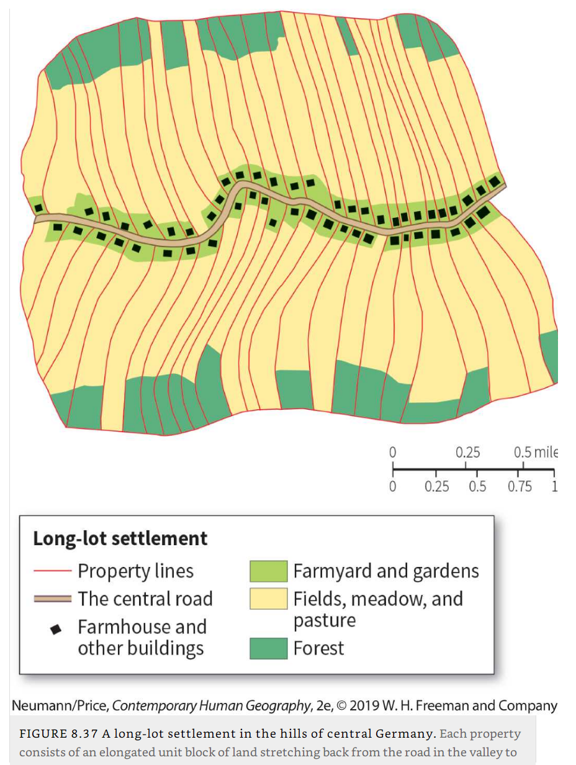
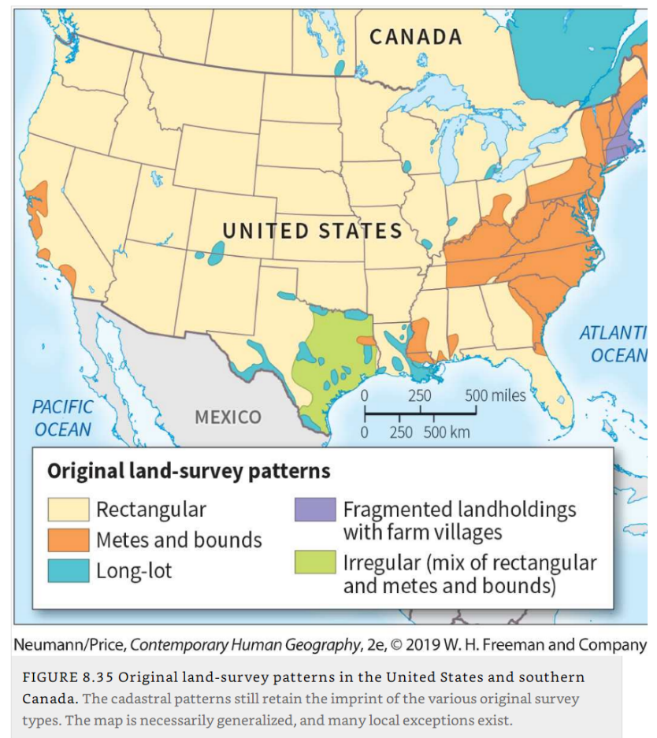
Land survey patterns

Slide 79
Fencing and hedging
Property and field borders
  Marked by fences or hedges, heightening the visibility of these lines in the agricultural landscape.
  Add a distinctive touch to the cultural landscape.
  Different cultures have their own methods and ways of enclosing land, types of fences and hedges.
  In New England, western Ireland, or the Yucatán Peninsula; stone fencing.
  Barbed-wire fences across the American countryside.
Hedge
  A living fence.
  Brittany and Normandy in France and in large areas of the United Kingdom, hedgerows are a major aspect of the rural landscape.

Slide 80
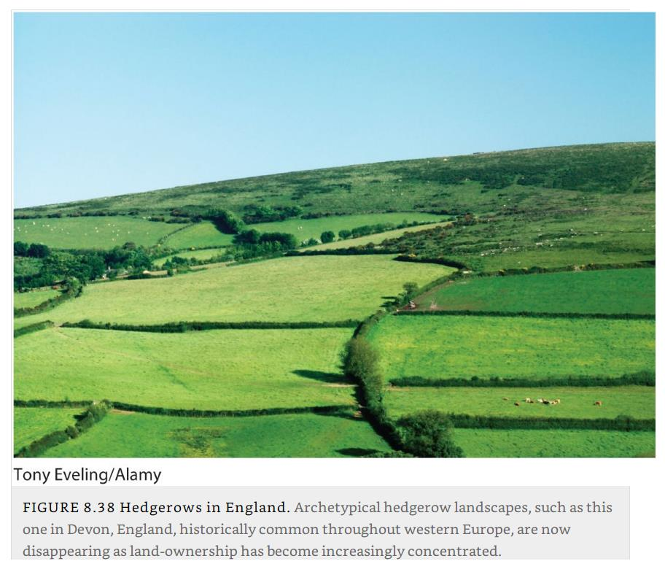
Hedgerows in England

Slide 81
Fencing and hedging
Windbreaks
  Row of trees or shrubs planted on the edges of cultivated fields to slow the wind and reduce soil erosion.
  Particularly found in the US West in arid and semi-arid regions.
  Strong, persistent winds and long dry seasons when exposed soils can dry out and become susceptible to erosion.
  Became common practice after the Dust Bowl crisis.
  Technique applied across the world to stop desertification.
Explain the main types of fields patterns and boundaries used in agriculture.

Slide 82
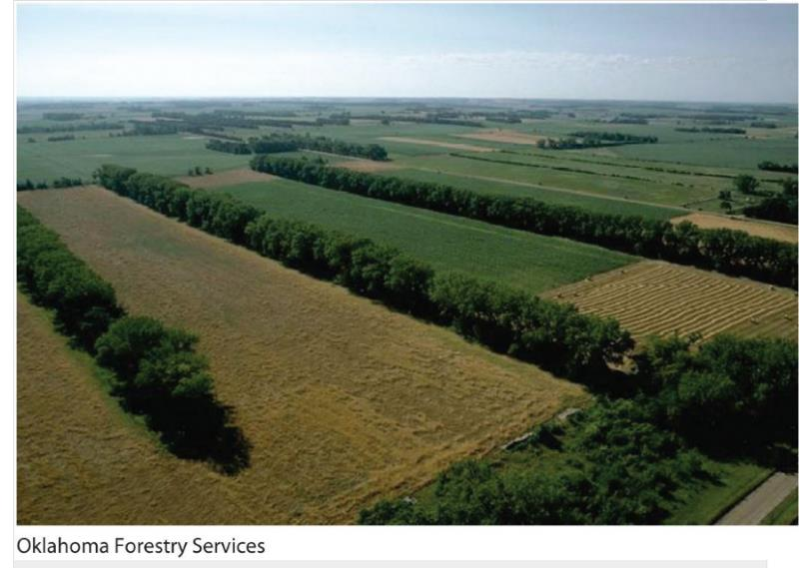
Windbreak on the Great Plains, Oklahoma

