Slide 1
Topic 7 – Geography of Religion
A – Religions of the World
B – Religions and Mobility
C – Globalization and Religion
D – Religions and the Natural Order
E – Religious cultural landscape

Slide 2
Conditions of Usage
For personal and classroom use only
  Excludes any other forms of communication such as conference presentations, published reports and papers.
No modification and redistribution permitted
  Cannot be published, in whole or in part, in any form (printed or electronic) and on any media without consent.
Citation
  Neumann, Roderick P. and Price, Patricia L. (2019) Contemporary Human Geography: Culture, Globalization, Landscape, Second Edition.
  Dr. Jean-Paul Rodrigue, Dept. of Global Studies & Geography, Hofstra University.

Slide 3
Religion
Unified system of beliefs and practices
  Join all those who adhere to them in a single moral community.
  Usually involves systems of formal or informal worship and faith in the sacred and divine.
  Formalized views about the relation of the individual to this world and to the hereafter.
  Religious beliefs are interwoven with the traditions of local cultures.
Providing meaning
  Explanation of natural phenomenon.
  Ethical and behavioral rules.
  Social roles (hierarchy) and order.
  Concept of an afterlife.
Notes:
Getis, Getis, and Fellmann

Slide 4
A – Religions of the World
The differences among religions as well as the basic tenets of the world’s principal religions, and locate their primary regional expressions on a world map.

Slide 5
Proselytic and ethnic religions
Proselytic religion
  Actively seek new members and aim to convert all humankind (Christianity and Islam).
  Sometimes also referred to as universalizing religions.
  Instruct faithful to spread the Word using persuasion and sometimes violence to convert nonbelievers.
  Colonization sometimes a result of the desire to conversion to the conqueror’s religion.
Ethnic religion
  Also called folk religion.
  Strong territorial and cultural group identification (Judaism, Hinduism, Shintoism).
  Becomes a member by birth or by adoption of a complex lifestyle and cultural identity.
  No proselytizing.
  Particular ethnic group, region, or political unit.
Notes:
Getis, Getis, and Fellmann

Slide 6
Indigenous religions
Special forms of ethnic religions
  Small size.
  Identity with localized culture groups not yet fully absorbed into modern society.
  Close ties to nature.
  Animism:
    Life exists in all objects, and/or such objects are the abode of the dead, of spirits, and of gods.
  Some traditional religions are Shamanistic:
    The Shaman has special powers and can intercede with and interpret the spirit world.
Notes:
Getis, Getis, and Fellmann

Slide 7
Monotheistic and polytheistic religions
Monotheistic religions
  Islam and Christianity.
  Believe in only one God.
  May expressly forbid the worship of other gods or spirits.
Polytheistic religions
  Believe there are many gods.
  Each god part of a hierarchy and serving a specific purpose.
  Example, Vodun (Voudou in Haiti or Voodoo in the southern United States):
    West African religious tradition with adaptations in the Americas.
    As with most major religions, there is one supreme God.
    Hundreds of spirits, or iwa, that Vodun adherents turn to in times of need.

Slide 8
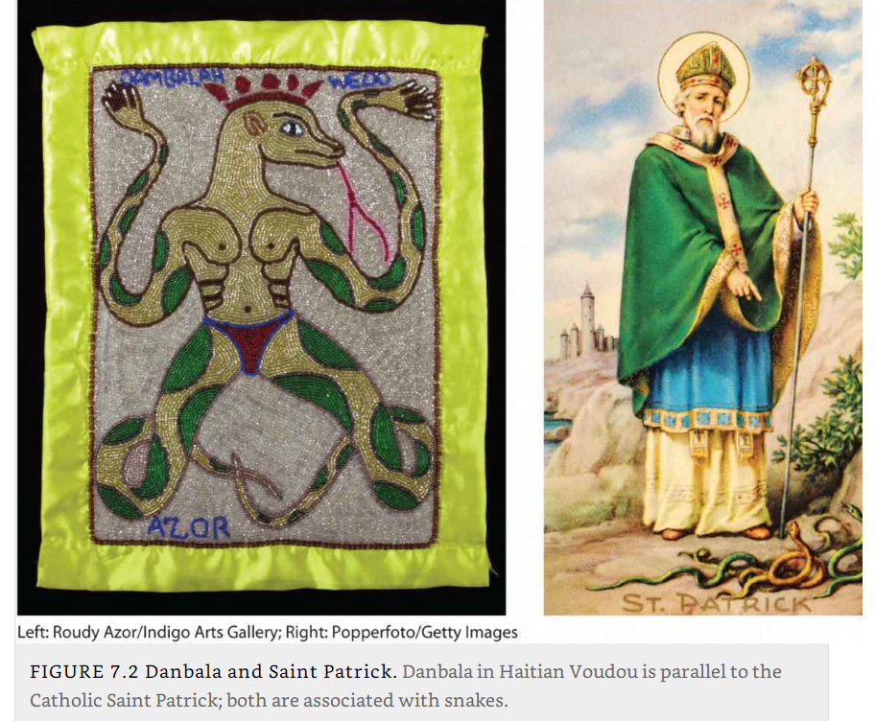
Religious Parallels
Notes:
Danbala Wedo, the peaceful snake-god who brings rain and fertility;.

Slide 9
Syncretic and Orthodox religions
Syncretic religion
  Mixing, blending of traditions and beliefs from different religions.
  Caribbean and Latin American religious practices often combine elements of European, African, and indigenous American religions.
  Some Asian religions, such as Shintoism, are syncretic.
Orthodox religion
  Emphasize purity of faith and are generally not open to blending with elements of other belief systems.
  Orthodoxy comes from Greek and literally means “right” (ortho) “teaching” (doxy).
  Many religions, including Christianity, Judaism, Hinduism, and Islam, have orthodox strains.
Provide an overview of the main types of religions and their differences.

Slide 10
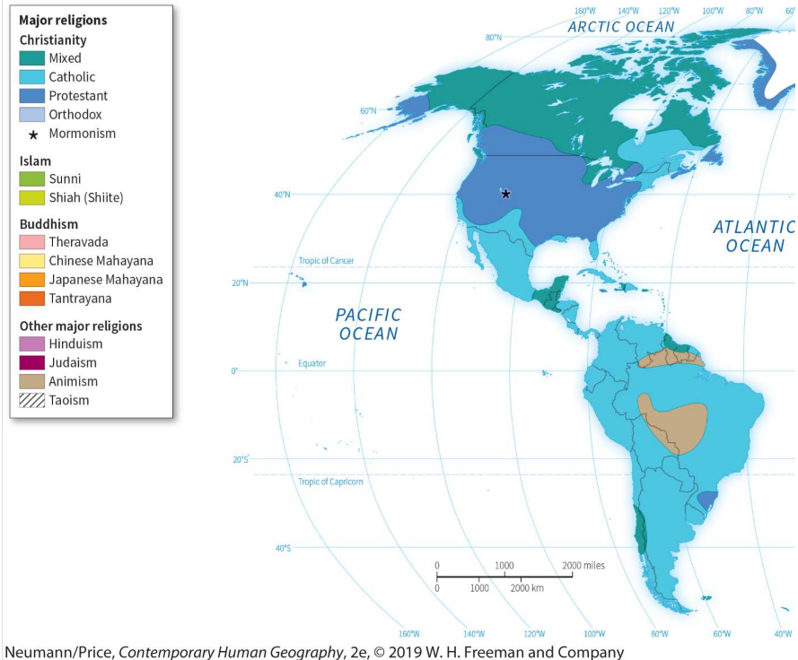
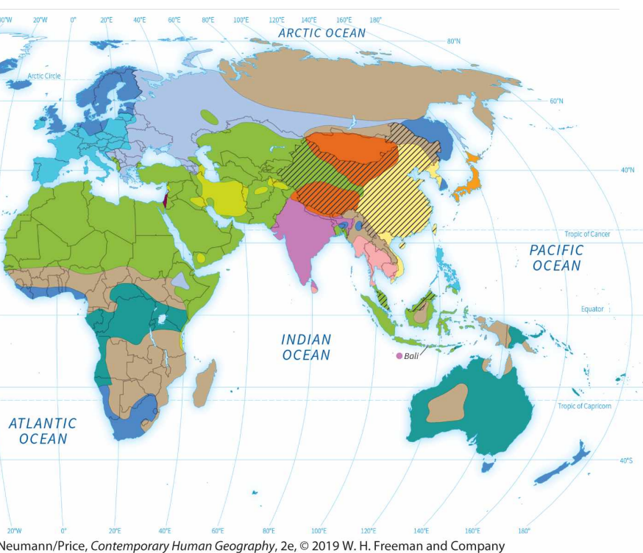
Religious Culture Regions

Slide 11
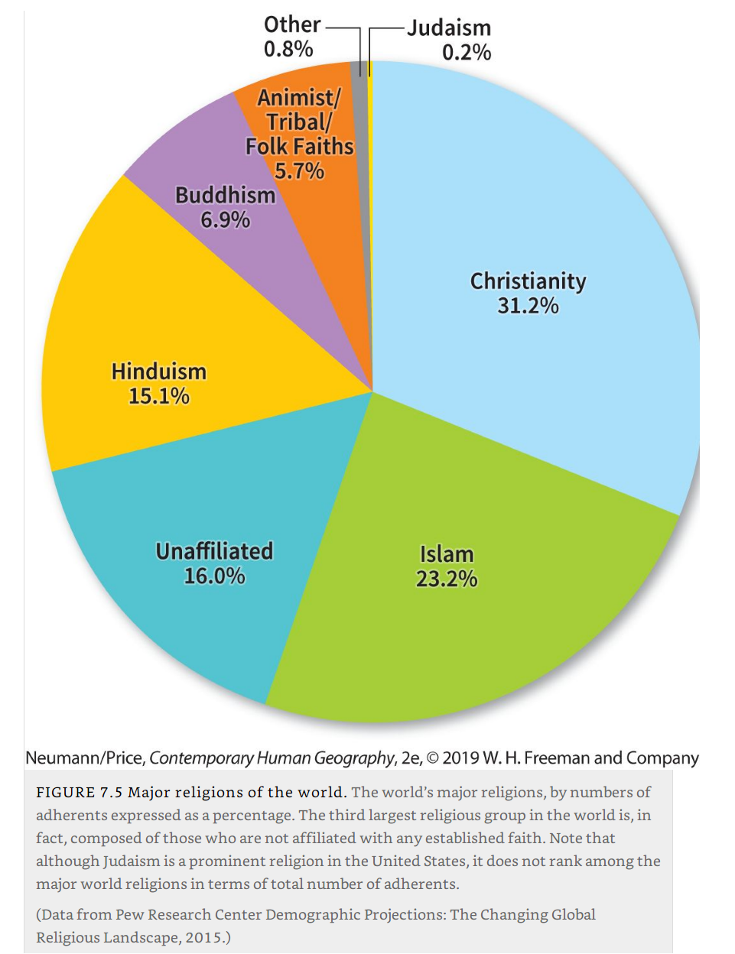
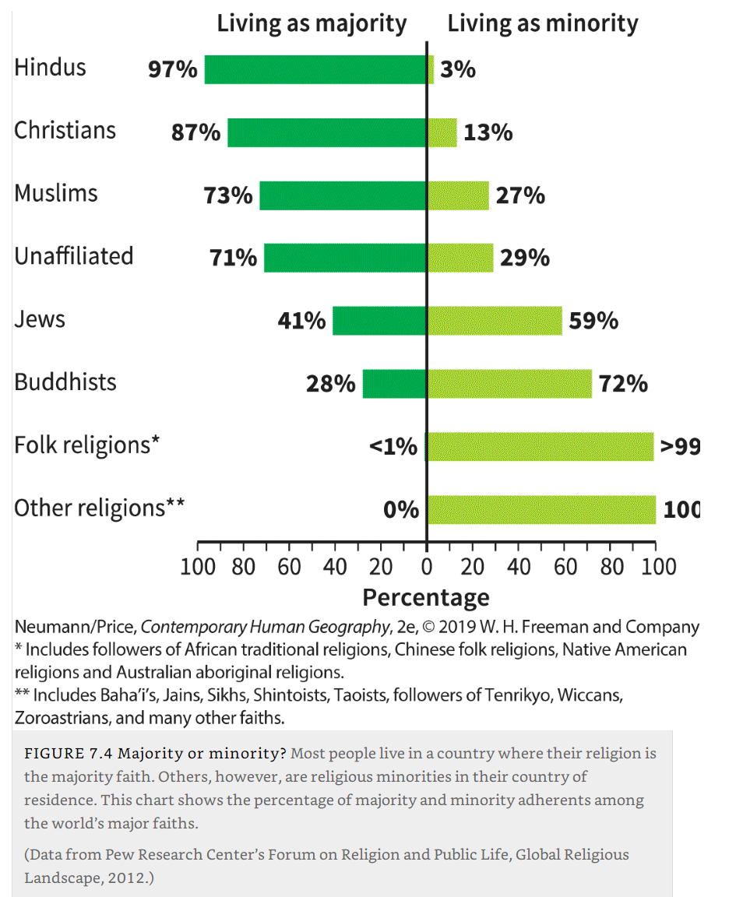
Major religions and majority status

Slide 12
World Religions: Judaism
Judaism
  Founded around 4,000 years ago, by the patriarch Abraham who led his followers from Mesopotamia to the shores of eastern Mediterranean.
  Parent religion of Christianity and is also closely related to Islam.
  One God who created humankind for the purpose of bestowing kindness on us.
  People are rewarded for their faith, punished for violating God’s commandments, and can atone for their sins.
  The Torah:
    Law and scripture.
    God’s divine teachings revealed to the Jews.
Notes:
Getis, Getis, and Fellmann, Pulsipher and Pulsipher.

Slide 13
World Religions: Judaism
Diaspora
  Dispersion of an originally homogeneous population.
  After rebellion against the Roman Empire in A.D. 73, expelled from the eastern Mediterranean and migrated to North Africa, Europe, Asia, and later also to the Americas.
  Became minority groups where they went.
  Many Jews experienced persistent discrimination and even pogroms (episodes of ethnic cleansing).
  Many sought refuge in Poland and Russia in 13th and 14th centuries.
  19th and 20th centuries: Jews a significant part of the European immigration wave to the Western hemisphere.
  Discrimination culminated under the Nazi era: Six million Jews were killed.
  Europe ceased to be the main homeland of Judaism.
Notes:
~.22% = ~ 14 mill.

Slide 14
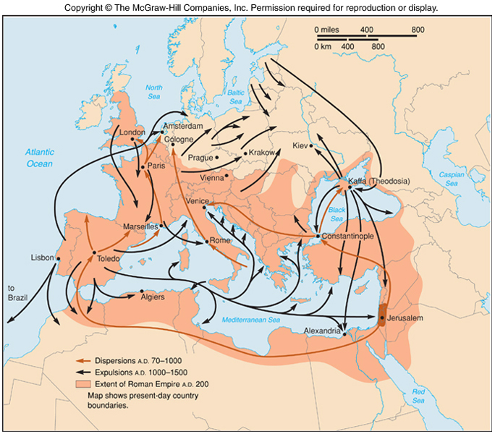

Slide 15
World Religions: Christianity
Christianity
  Proselytic faith.
  The world’s largest religion, both in area covered and in number of adherents.
  Claiming 2.3 billion people, or about a third of the global population.
  Jesus of Nazareth (believed to be the incarnate son of God), gathered followers in Palestine.
  After his execution and resurrection his teachings spread and became known as Christianity.
  Judeo-Christian:
    Judaism is the parent religion of Christianity.
    Torah, the first five books of what Christians call the Old Testament (which forms part of the Christian Bible or holy book).
    The practice of prayer and a clergy.
Notes:
Getis, Getis, and Fellmann

Slide 16
World Religions: Christianity
Fragmentation of Christianity
  By year 400 Christianity was the official religion of the Roman Empire.
  1054: split into Western tradition (Rome) and Eastern/Orthodox tradition (Constantinople).
  After the spread of Islam only remnants of Christianity remained in the eastern Mediterranean and North Africa.
  Later centuries: missionaries converted kings and/or tribal leaders.
  Christianity spread first to Europe and Russia.
  Later to the Americas and parts of Asia and Africa by colonization and missionary activities.
  Militaristic expansion: re-conquest of Iberia; invasion of Latin America, Sub-Saharan Africa.
  Thereafter, the religion spread contagiously (=“contact conversion”).
Notes:
~31.2% = ~2.3bill. (pewforum.org)

Slide 17
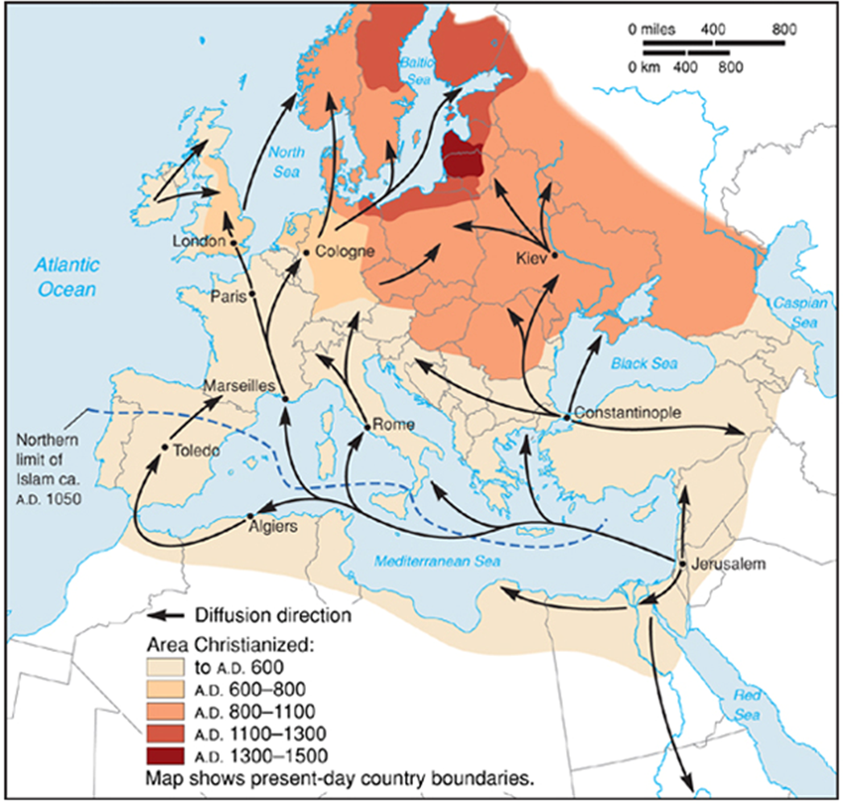

Slide 18
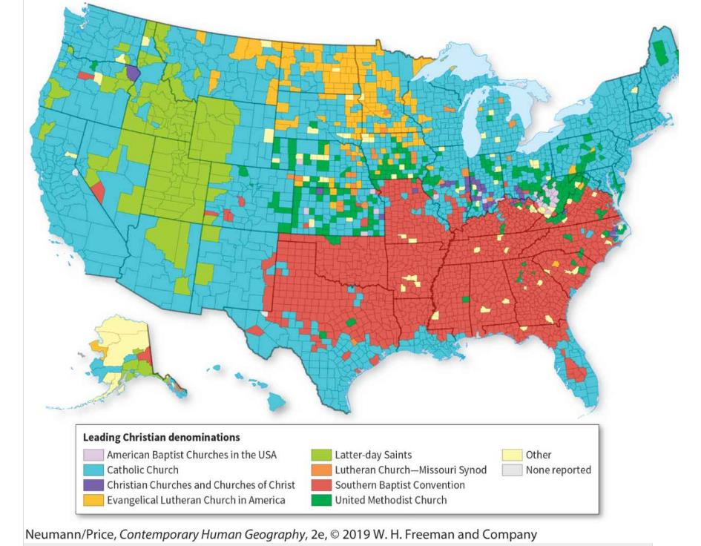
Leading Christian denomination in the United States

Slide 19
World Religions: Islam
Islam
  Dominant religion in Middle East and North Africa.
  1.8 billion Muslims (“those who submit to the will of God”).
  The word of Allah believed to have been revealed to Muhammad by angel Gabriel (Jibrail).
  The Qur’an:
    Islam’s holy book, is the text of these revelations.
    Also serves as the basis of Islamic law, or Sharia.
  Started on the Arabian Peninsula, spread throughout Middle East and North Africa, and parts of South Europe, Central Asia and South Asia.
  Holy cities: Makkah, Medina, and Jerusalem.
Notes:
Sources: Getis, Getis, and Fellmann 2008, Pulsipher and Pulsipher 2008, Norton 2008

Slide 20
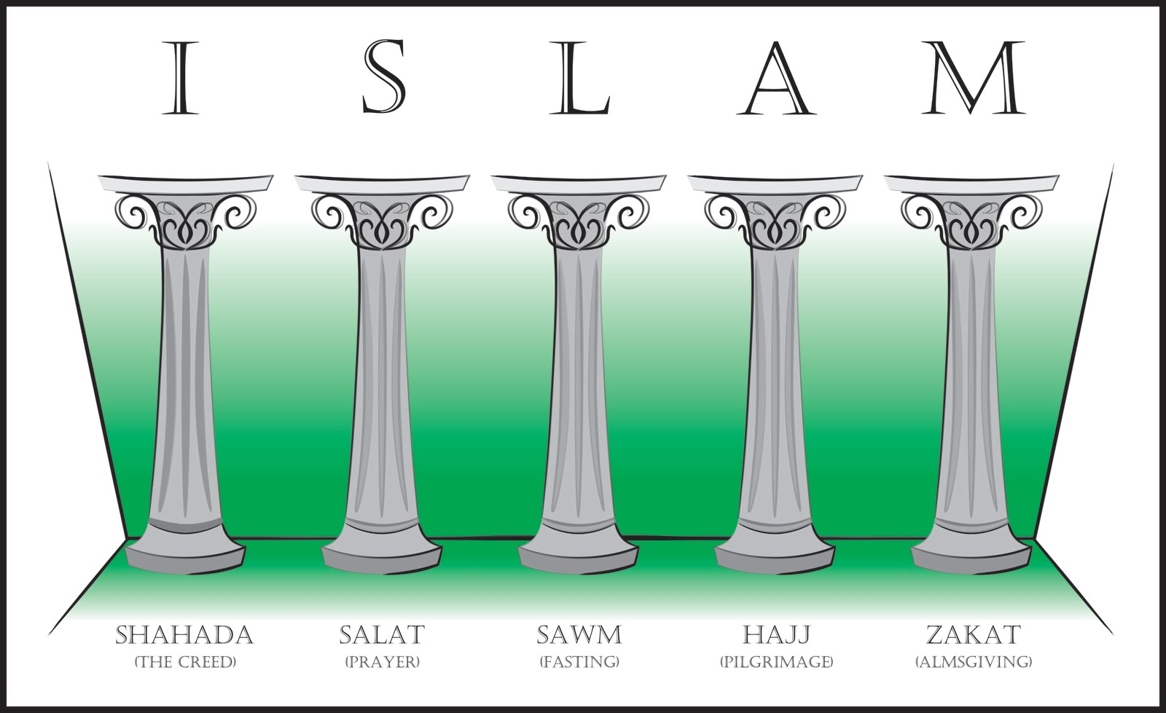
The Five Pillars of Islam
Declaration of faith
  “There is only one God (‘Allah’ = ‘God’ in Arabic) and Muhammad was his Messenger”
Daily prayer
Fasting dawn to dusk in the month of Ramadan
Almsgiving
  Give money/food to the poor
Pilgrimage to holy sites
Notes:
~24.1% = ~1.8bill. (pewforum.org)

Slide 21
World Religions: Islam
Spread and division of Islam
  Following the death of Prophet Muhammad in 632 Islam spread primarily by conquest.
  Later by both missionaries and traders, mystics (Sufis), and armies.
  Split between Sunnis and Shi’as occurred after Muhammad’s death over who should be his successor (known as a “Caliph”).
  Sunni Muslims believed Muhammad did not formally appoint a successor; elected Muhammad’s father-in-law (Abu Bakr) as Caliph. The most numerous branch of Islam.
  Shi‘ites Muslims believed that Muhammad appointed his son-in-law Ali ibn Abi Talib as successor.

Slide 22
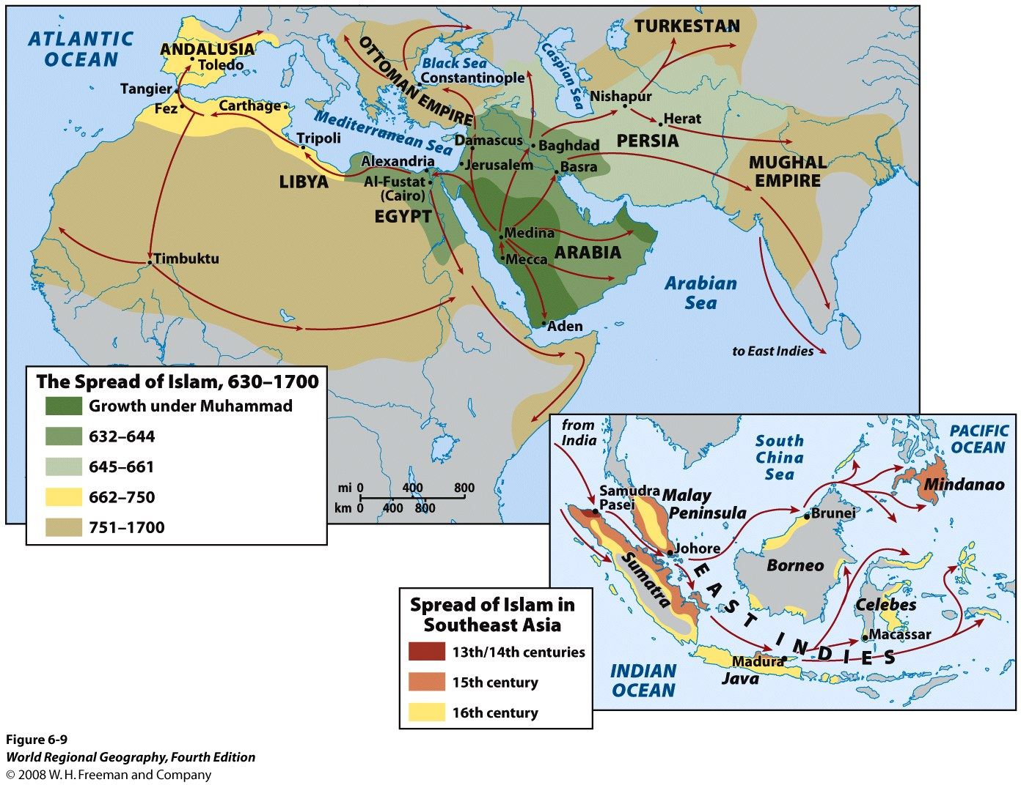

Slide 23
World Religions: Hinduism
Hinduism
  Polytheistic (and ethnic) religion with 1.1 billion adherents.
  Around 4,000 years old.
  Blending of ritual concepts and practices from many communities.
  Native Indus Valley customs merged with Aryan invaders’ beliefs and practices.
  Recognize one supreme god, Brahman, it is his many manifestations that are worshipped directly.
  Religious, philosophical, social, economic, and artistic elements that constitutes Indian civilization.
  India: 80% of the population are Hindus.
  Nepal and Mauritius and Hindu majority countries.

Slide 24
World Religions: Hinduism
No common creed, single doctrine, or central ecclesiastical organization
  Caste system: hereditary hierarchical categories.
  Karma: what an individual experiences in this life is a direct result of that individual’s thoughts and deeds in a past life.
  Reincarnation: eternal transmigration of souls.
  Dharma: law and duties prescribed to each individual.
  Most sacred river: Ganga (Ganges).
  Most sacred city: Varanasi, in Uttar Pradesh.
Notes:
Text source: Norton, J.H.K. (2008) “India and South Asia”. Eight edition
Image source: http://www.sanatansociety.com/indian_art_galleries/pieter_weltevrede/pw_ga_brahma01_painting.htm
Answer: ~15.1% = ~1.1bill. (pewforum.org)

Slide 25
The Caste System
A hierarchical system of strict, hereditary, social stratification based upon ancestry and occupation
  Historically prevalent in India and Nepal.
  Brahmins: priests, teachers.
  Kshatriyas: rulers, warriors.
  Vaishyas: landowning farmers, merchants.
  Shudras: laborers, artisans.
  Dalits/Harijans: “Untouchables”: at the very bottom of the social hierarchy.
Removal of the caste system
  In the 1950s Gandhi began the official effort to eliminate untouchability.
  India’s constitution bans caste discrimination, yet still common, especially in rural areas.
  Affirmative action: government jobs, higher education, parliamentary seats for Dalits, and Adivasis (indigenous people).

Slide 26
World Religions: Buddhism
Buddhism
  Founded 2,500 years ago by Siddhartha Gautama, the Buddha (“the enlightened one”).
  Reform and reinterpretation of Hinduism (both are dharmic religions).
  Explanations of evil and human suffering.
  Everybody can attain the ultimate enlightenment.
  State religion in India from the 3rd century BC.
  Spread to Southeast Asia and East Asia by missionaries, monks, and merchants.
  Fused with native ethnic religions (Confucianism, Taoism, Shintoism).
  Almost disappeared from the Indian subcontinent by the 1400s.
  Karma: Good and evil deeds result in appropriate reward or punishment in this life or in a succession of rebirths.
Notes:
~6.9% = ~ 0.5bill. (pewforum.org)

Slide 27
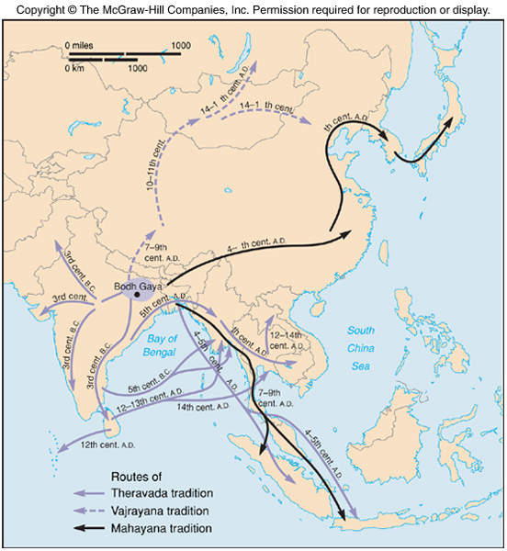

Slide 28
World Religions: Taoic religions
Taoic religions
  Tao, the force that balances and orders the universe.
  Confucianism:
    Official state philosophy.
    Bureaucratic, ethical, and hierarchical.
    Is more a way of life than a religion in the proper sense.
  Taoism:
    Both an established religion and a philosophy.
    Emphasizes the dynamic balance depicted by the Chinese yin-yang symbol (dualism, complementarity).
    Centered on the “three jewels of Tao”— humility, compassion, and moderation.
  Shintoism:
    Traditional religion of Japan.
    Worship nature and ancestors.
    Complex set of deities (kami); deified emperors, family spirits, and divinities residing in the sun and the moon, rivers, trees, certain animals and mountains.
    Gods are believed to reside in shrines.

Slide 29
B – Religions and Mobility
How and why the world’s religions became distributed as they are today.

Slide 30
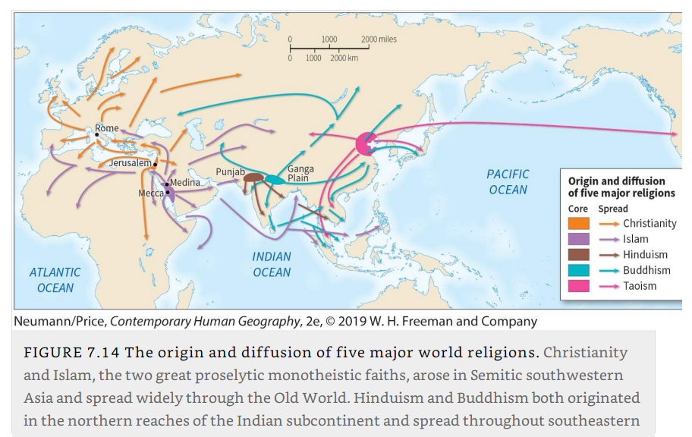
Diffusion Pattern of the World’s Major Religions

Slide 31
The Semitic Religious Hearth (Judaism, Christianity, and Islam)
Common hearth
  Middle East.
  Relocation and expansion diffusion.
Christianity
  Benefited from the road system of the Roman Empire, resulting in a hierarchical diffusion.
  Early congregations were established in cities and towns, temporarily producing a pattern of Christianized urban centers and pagan rural areas.
  The Latin word pagus, “countryside,” is the root of both pagan and peasant.
  Ancient connection between non-Christians and the countryside.
  Conversion of kings and tribal leaders.
  Some expansion militaristic (reconquest of Iberia and invasion of Latin America).

Slide 32
The Semitic Religious Hearth
Islam
  Predominantly militaristic expansion.
  Following the command of the Qur’an.
  “do battle against them until there be no more seduction from the truth and the only worship be that of Allah”
  Turks converted and carried out Islamic conquests (e.g. Eastern Europe).
  Implant Islam hierarchically in the Philippines, Indonesia, and the interior of China.
  Sub-Saharan Africa is the current major region of Islamic expansion.

Slide 33
The Indus-Ganges Religious Hearth
Northern edge of the Indian subcontinent
Hinduism
  Initial expansion in other areas, but expansion outside India eventually lost to other religions.
Buddhism
  China (100 B.C.E. to 200 C.E.), Korea and Japan (300 to 500 C.E.), Southeast Asia (400 to 600 C.E.), Tibet (700 C.E.), and Mongolia (1500 C.E.).
  Mostly relocation diffusion in the contemporary setting.

Slide 34
The East Asian Religious Hearth
Confucianism and Taoism
  Attempt at contagious diffusion failed.
  Became successful once elites decided adoption.
  Taoism and Confucianism have spread with the Chinese people through trade and military conquest.
  After 1949, the Chinese government officially repressed organized religion.
  Would not only halt the spread of religion, but would erase it from Chinese public and private life.
Describe how and why the world’s religions became distributed as they are today.

Slide 35
Religious Pilgrimage
Journeys to sacred places
  Typical of both ethnic and proselytic religions.
  Particularly significant for followers of Islam, Hinduism, Shintoism, and Roman Catholicism.
  Religious pilgrimage is an important driver of tourism.
  Some religions mandate pilgrimage, such as Islam, where pilgrimage to Mecca is one of the Five Pillars of the faith.
Locations
  Some have been the setting for miracles.
  Regions where religions originated or areas where the founders of the faith lived.
  Sacred physical features, such as rivers, caves, springs, and mountain peaks.
  Believed to house gods.
  Religious administrative centers where leaders of the religion reside (e.g. Rome).

Slide 36
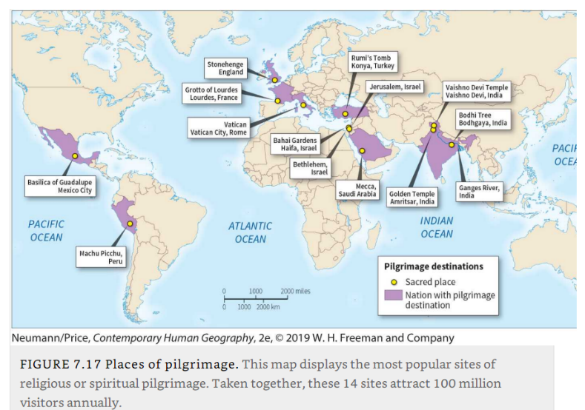
Major Places of Pilgrimage
Notes:
Rumi’s Tomb: A Sufi scholar.
Golden Temple: Core site for Sikhism.

Slide 37
Religious Pilgrimage
Discuss pilgrimages as a form of global mobility.
Travel
  Religion provides the stimulus for pilgrimage.
  Offering those who participate in the purification of their souls or the attainment of some desired objective in their lives.
  Pilgrims often journey great distances to visit major shrines.
  Large economic impacts (Lourdes gets 4 to 5 million pilgrims per year).
  Impact on the development of transportation routes and carriers.
  Provisions such as inns, food, water, and sanitation facilities.
The Hajj
  One of the world’s largest pilgrimage (2.5 million attendance in 2019).
  Impacts air traffic:
    Normally, traffic is north-south predominant, with Europe-Africa flights being the main flow.
    When Hajj begins, a good amount of traffic starts operating east-west (ie. Africa-Saudi Arabia and vice versa).

Slide 38
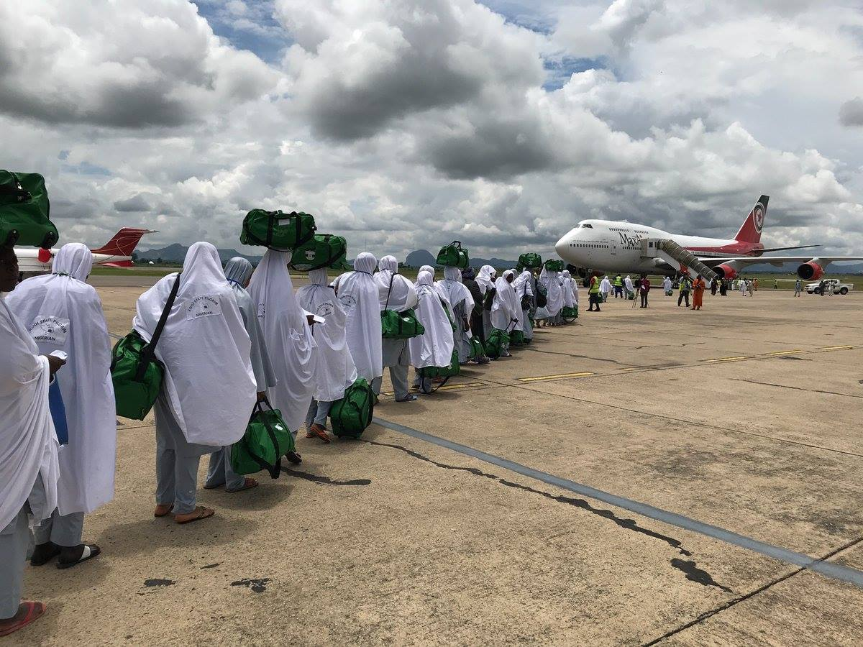
Pilgrims boarding a flight to Saudi Arabia

Slide 39
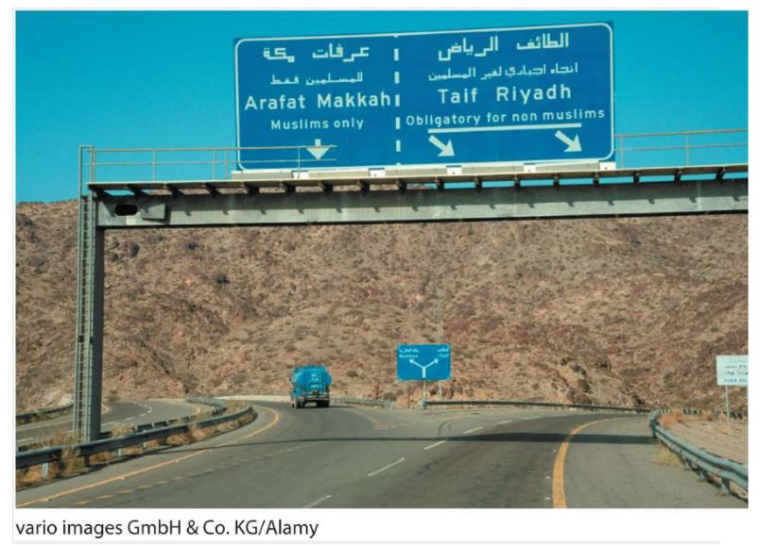
Access Restriction to Mecca

Slide 40
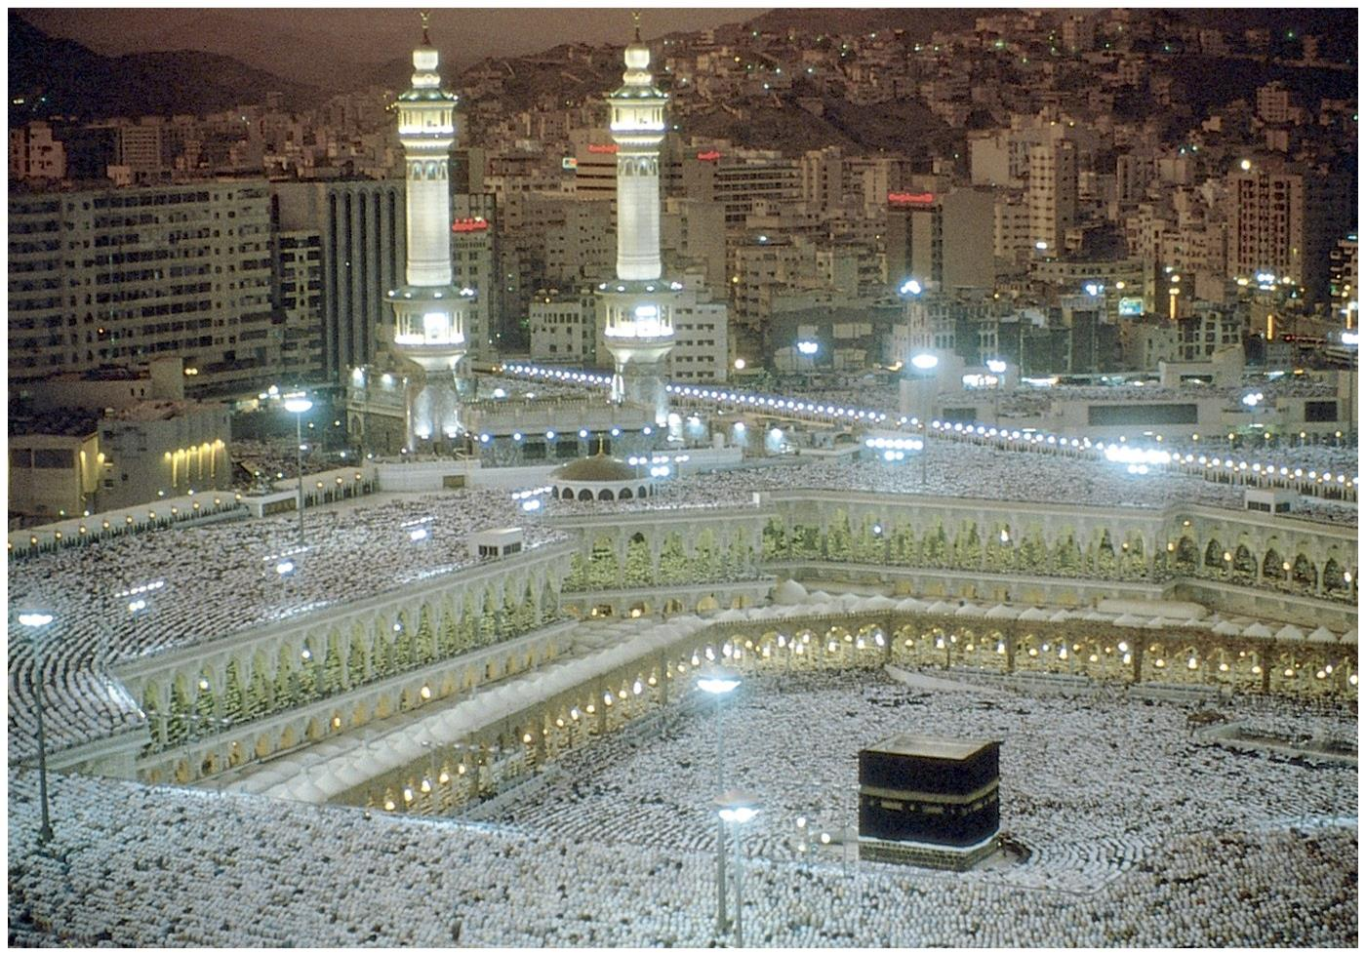
The Great Mosque of Mecca with the Kaaba at the center
The Kaaba (the Cube; House of God) is considered to be the most sacred site in Islam.

Slide 41
C – Globalization and religion
How globalization has affected the practice of religion.

Slide 42
Evangelical Protestantism in Latin America
Dominance of Roman Catholicism eroded
  Since the late 1400s.
  Three out of five Catholics are in Latin America.
  120 million adherents in Brazil alone.
  65% of Brazilians are Catholics today; 50 years ago, that figure was more than 95%.
  By 2020 Brazil’s Protestants outnumbered Catholics.
  Latin Americans: the Catholic Church has failed to keep in touch with contemporary urban societies.
  Birth control, divorce, and persistent poverty are issues that simply have not been addressed by Roman Catholicism to the satisfaction of many Latin Americans.
  Turning to evangelical Protestant faiths; Seventh-Day Adventist and Pentecostal churches.
  Focus on thrift, sobriety, and resolving problems directly rather than through the mediation of priests.

Slide 43
Religion on the internet
The printing press allowed the massive diffusion of the Bible
Potential impacts of the internet
  Traditionally, people have come together to receive sacraments, sing, pray, and celebrate major life events in houses of worship.
  Less necessary to be physically present.
  Read religious literature.
  Submit and read prayers.
  Engage in theological debate.
  Watch broadcasts of religious services.
  May erode placed-based religious communities.
  The COVID-19 pandemic provided substantial momentum.

Slide 44
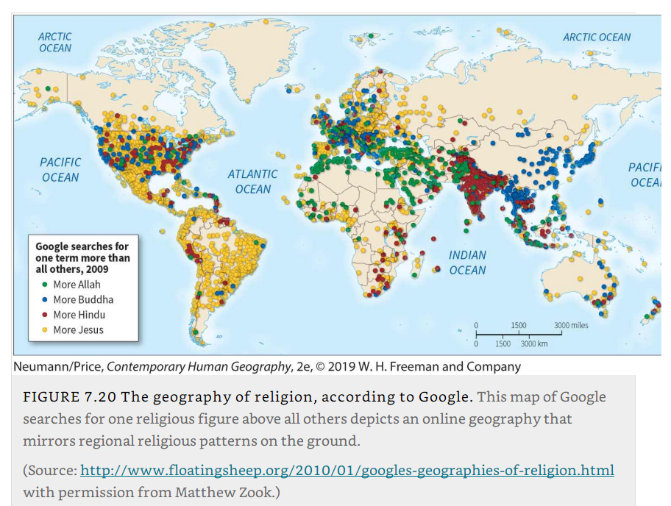
The geography of religion, according to Google

Slide 45
The relevance of religion in a global world
Variation in importance
  53% of Americans considered religion to be very important in daily lives (2016).
  Low importance in Europe.
  Average importance in Latin America.
  Growing share of “nones” (25% in the US and 1.2 billion worldwide).
  Rising numbers of individuals becoming affiliated with Christianity and Islam in sub-Saharan Africa.
  Retreat from organized religion.
  Can result from a government’s active hostility toward religion in general:
    French government has long discouraged public displays of religious faith.
    Chinese government made the practice of religion illegal after 1949.
    Soviet Union repressed religious groups and practices.
What could be the reasons why there are geographical variations in the relevance of religion?

Slide 46
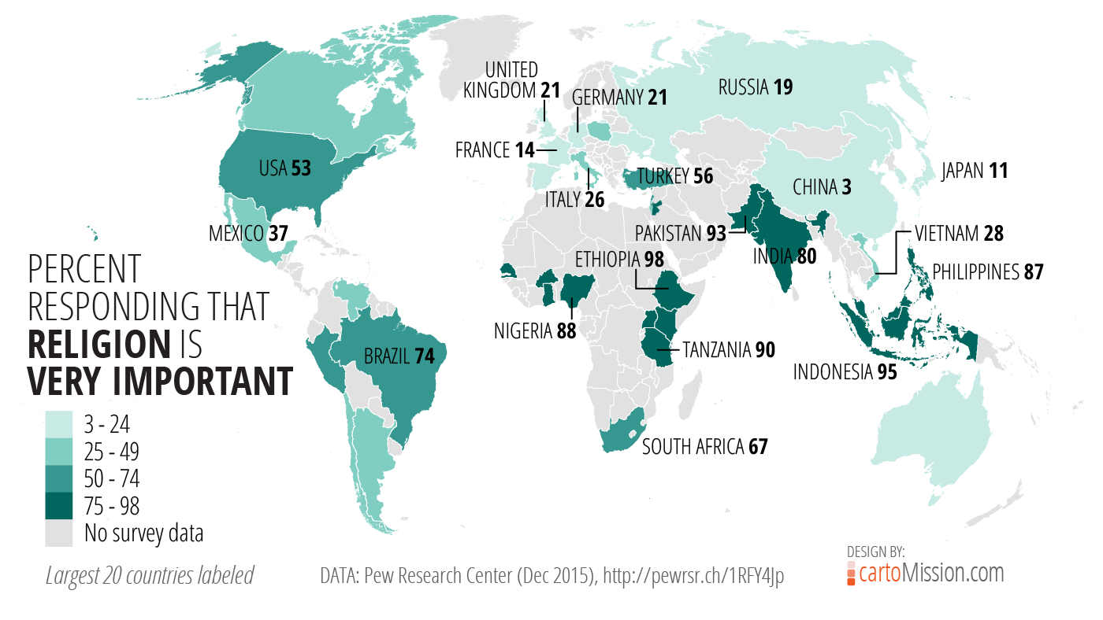

Slide 47
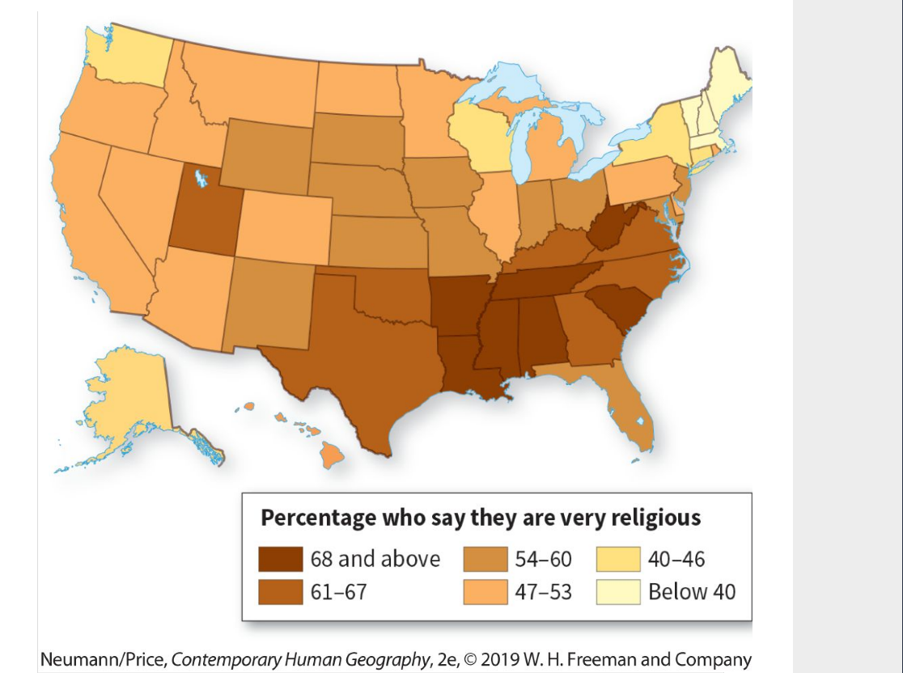
Importance of religion in the United States

Slide 48
D – Religions and the natural order
Specific ways in which the natural environment shapes, and is shaped by, religious beliefs and practices.

Slide 49
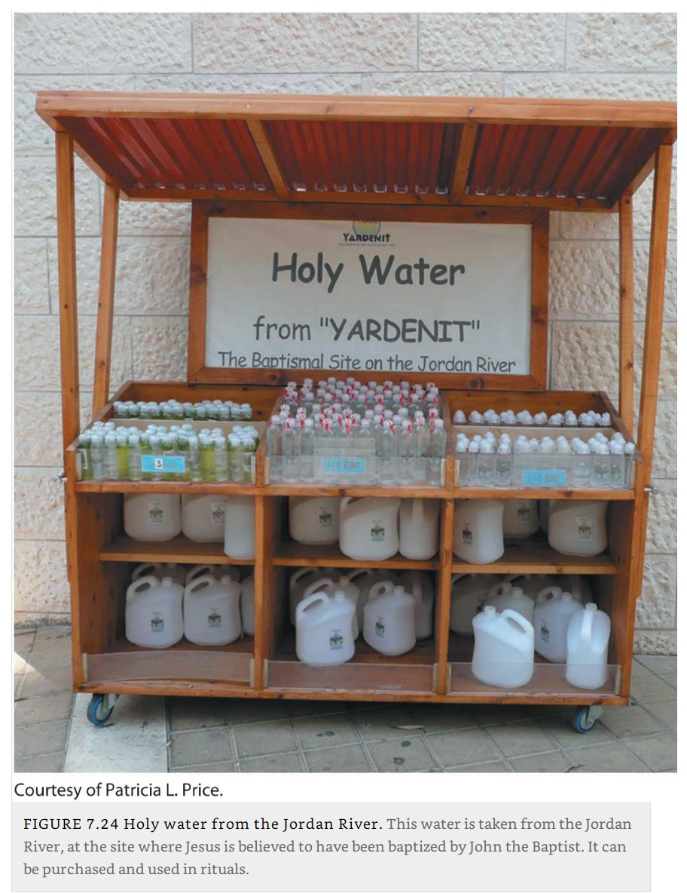
Appeasing the forces of nature
Harmony between people and the physical environment
  Physical environmental factors, particularly natural hazards and disasters, exert a powerful influence on the development of religions.
  Particularly in animistic faiths:
    Intended to bring rain, quiet earthquakes, end plagues, or manipulate environmental forces by placating the spirits believed responsible for these events.
  Rivers, mountains, trees, forests, and rocks often achieve the status of sacred space, even in the great religions:
    Ganges for Hindus.
    Jordan River for Christians.

Slide 50
Appeasing the forces of nature
Mountains and high places
  Mount Fuji is sacred in Japanese Shintoism.
  Many high places are revered in Christianity, including Mount Sinai.
  The great pre-Columbian temple pyramid at Cholula, near Puebla in central Mexico, mimics the shape of the nearby active volcano Popocatépetl.
Nature-spirits
  Feng shui, which literally means “wind and water”.
  Practice of harmoniously balancing the opposing forces of nature in the built environment.
  Emphasizes Tao, the dynamic balance found in nature.
  Choosing auspicious sites for locating houses, villages, temples, and graves.
  The homes of the living and the resting places of the dead must be aligned with the cosmic forces of the world in order to ensure good luck, health, prosperity.
  In Judeo-Christian tradition, disasters such as plagues to punish sinners.

Slide 51
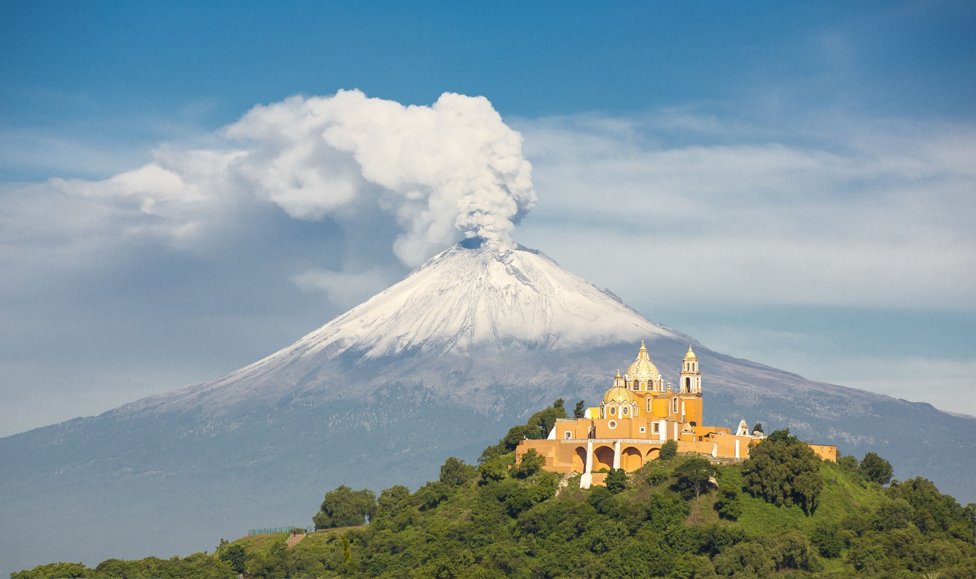
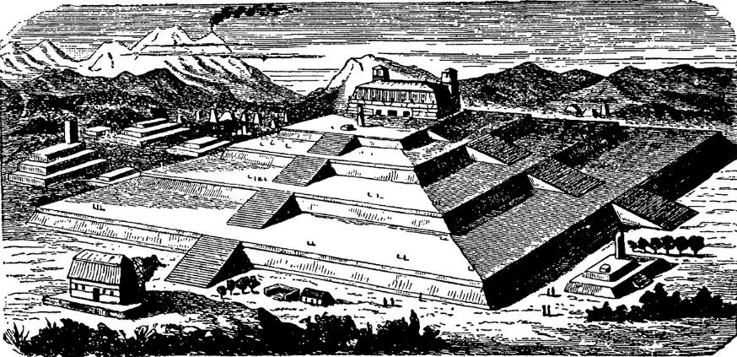
Great Pyramid of Cholula, Mexico

Slide 52

Apartment Complex in Hong Kong

Slide 53
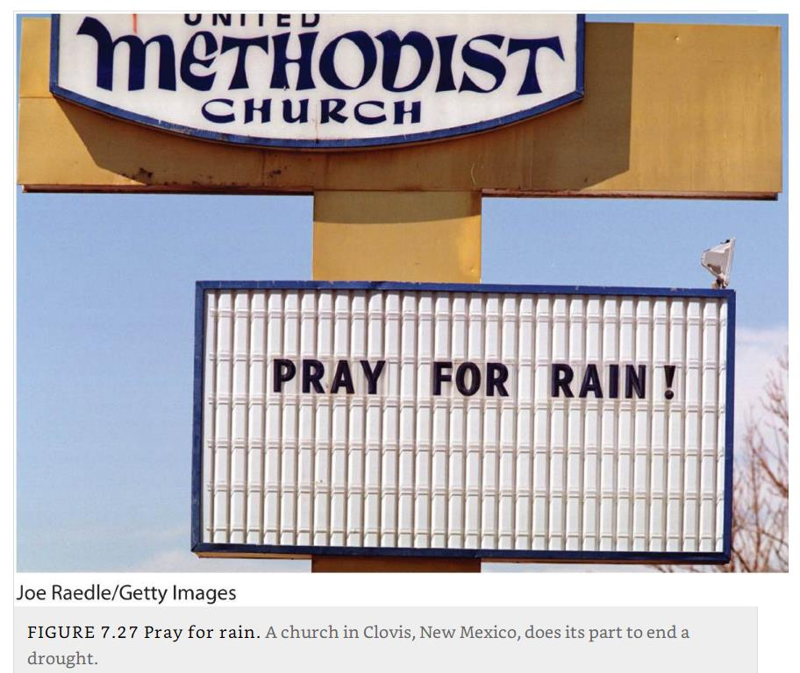
Environmental stress can involve religious response
Provide some examples about how the natural environment shapes religions

Slide 54
Impacts of Belief Systems on Plants, Animals, and Food
Food choices
  In some faiths, certain plants and livestock, as well as the products derived from them, are in great demand because of their roles in religious ceremonies and traditions.
  Plants or animals tend to spread or relocate with the faith.
  Wine as a symbol of communion favored the diffusion of vineyards in Europe.
Religious taboos
  Barriers preventing diffusion of foods, drinks, and practices that violate the taboo.
  Very specific guidelines for food preparation and consumption.
Judaism
  Some animals deemed “unclean,” including shellfish, pork, and insects.
  Meat and milk must not be stored, prepared, or consumed together.
  Kosher food fit for consumption by observant Jews.
  Only meat slaughtered by a trained individual using a sharp knife, drained of blood, and deemed disease-free.

Slide 55
Impacts of Belief Systems on Plants, Animals, and Food
Islam
  Muslims are commanded to consume only halal, or permissible, foods.
  Pork and alcohol are prohibited.
  Halal livestock should be fed with “clean” food that is free of animal by-products.
Hinduism
  Religious beliefs shape the role of animals in society.
  Avoiding the use of cows as food while emphasizing the animal’s sacred as well as practical functions.
  Dairy products provided, such as yogurt and ghee (clarified butter).
  Provide valuable agricultural labor in tilling fields.
  Provide free fertilizer in the form of dung.

Slide 56
Ecotheology
Judaism, Christianity, and Nature
  Judeo-Christian tradition teaches that humans have dominion over nature.
  Promoting the view that the Earth was created especially for human beings, who are separate from and superior to the natural world.
  Humans were God’s helpers in finishing the task of creation.
  Scientific advances permitted the Judeo-Christian West to modify the environment at an unprecedented rate.

Slide 57
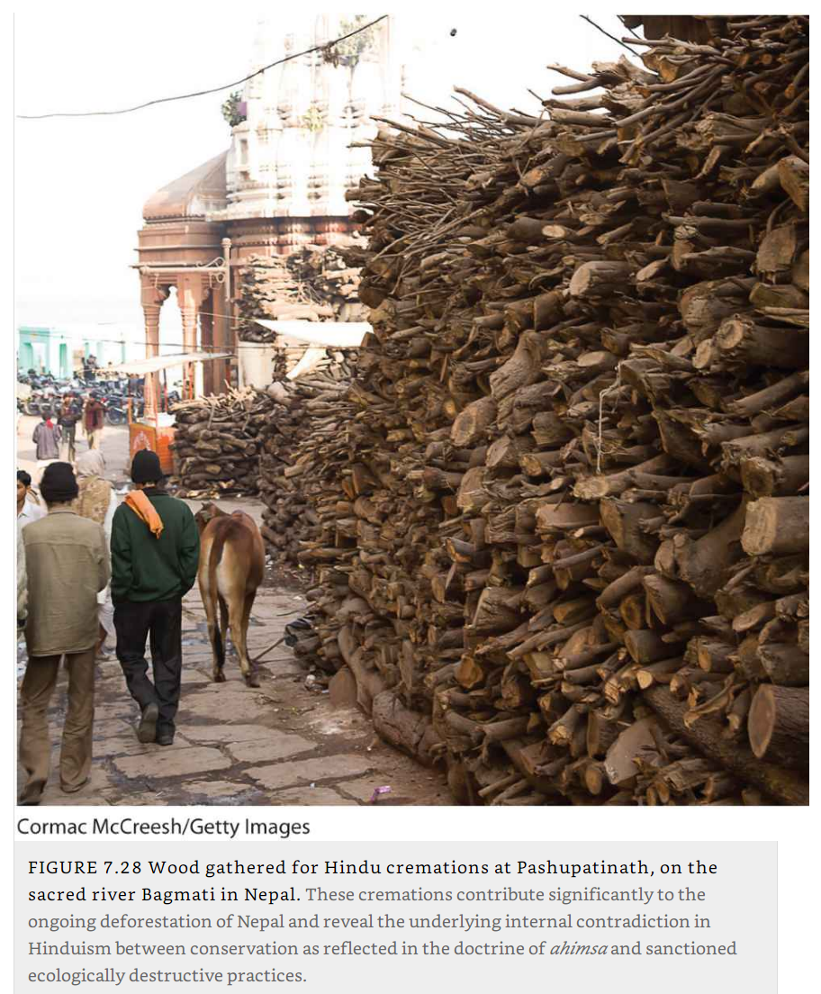
Ecotheology
Buddhism and Hinduism and Cremation
  Demand large quantities of wood for cremation (880 pounds of wood for one cremation).
  Funeral pyres are estimated to strip some 50 million trees from India’s countryside annually.
  Ashes are later swept into rivers.
  Burning itself releases carbon dioxide into the atmosphere.

Slide 58
E – Religious cultural landscape
How religions have left their particular mark on the cultural landscape.

Slide 59
Religious Structures
Prominence
  Buildings erected to house divinities or to shelter worshippers.
  Across the world, religious buildings are among the most salient architectural expression.
  Roman Catholic church building:
    Literally the house of God, and the altar is the focus of key rituals.
    Catholic churches are typically large, elaborately decorated, and visually imposing.
    In many towns and villages, the Catholic house of worship is the focal point of the settlement, exceeding all other structures in size and grandeur.
    In medieval European towns, Christian cathedrals were the tallest buildings, representing the supremacy of religion over all other aspects of life.
  Islamic mosques are usually the most imposing structures in the landscape:
    Oriented towards Mecca.
  Hinduism has produced large numbers of visually striking temples.

Slide 60
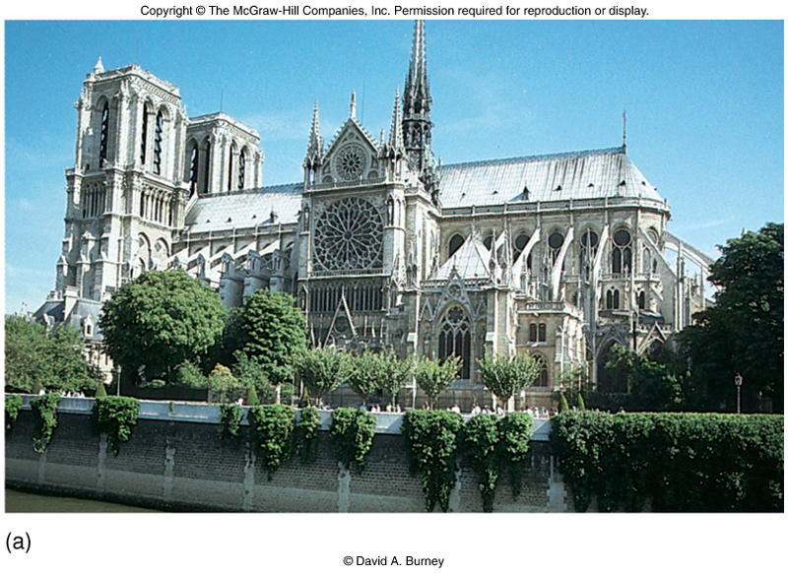

Slide 61
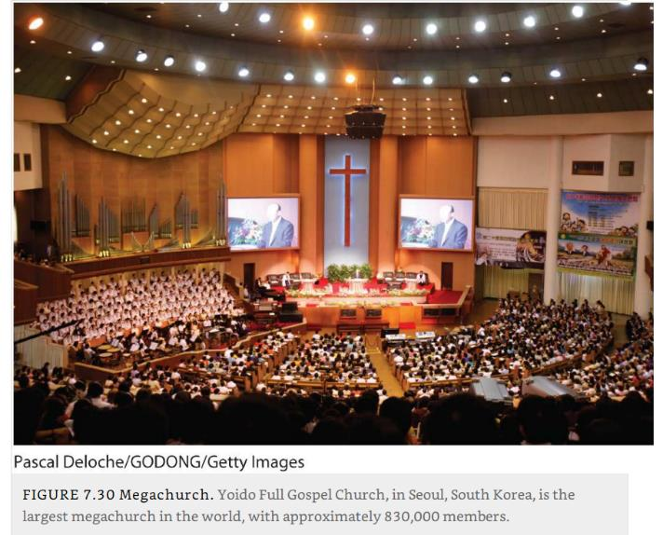
Megachurch: Yoido Full Gospel Church, Seoul, South Korea

Slide 62
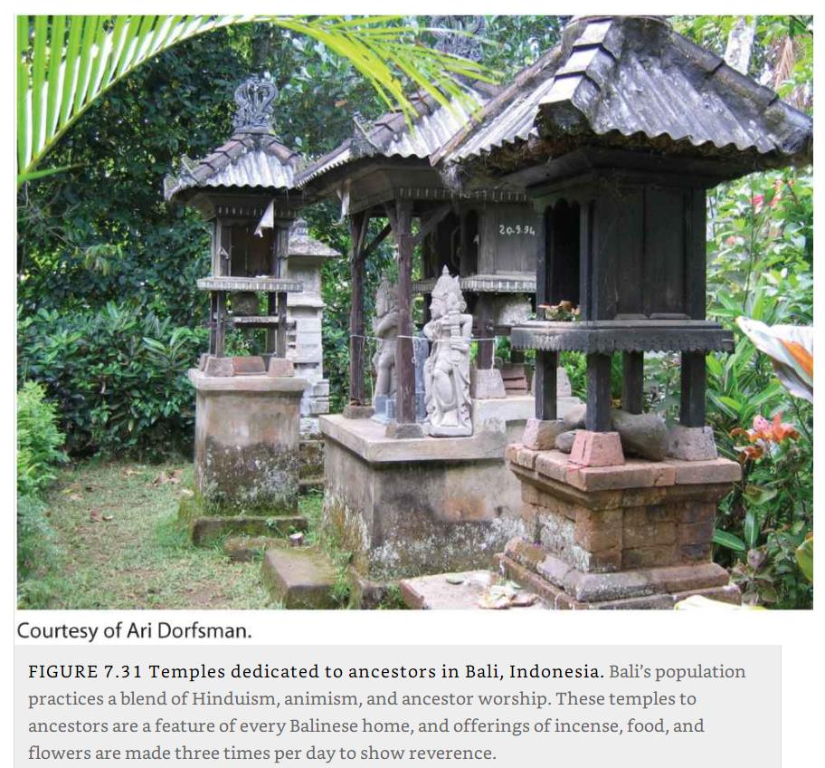
Temples dedicated to ancestors, Bali, Indonesia

Slide 63
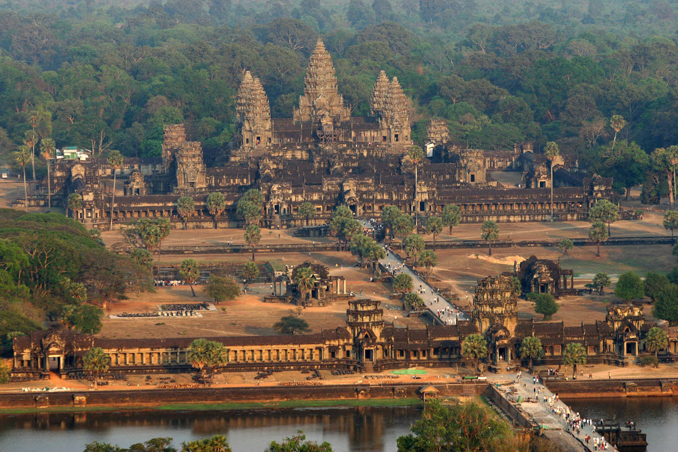
Angkor Wat, Cambodia

Slide 64
Landscapes of the dead
Provide some examples about how the deceased leave a mark on the landscape.
Leaving a mark in the landscape
  Religions differ greatly in the type of tribute to its dead.
  Variations appear in the cultural landscape.
  Hindus cremate their dead, leaving no obvious mark on the land.
  In Egypt, spectacular pyramids and other tombs were built to house dead leaders.
  Lie on desert land not suitable for farming.
  Muslim cemeteries are usually modest in appearance.
  Spectacular tombs are sometimes erected for aristocratic persons:
    Taj Mahal in India, one of the architectural wonders of the world.
  Taoic Chinese typically bury their dead, setting aside land for that purpose and erecting monuments to their deceased kin.
  Christians typically bury their dead in sacred places set aside for that purpose.

Slide 65
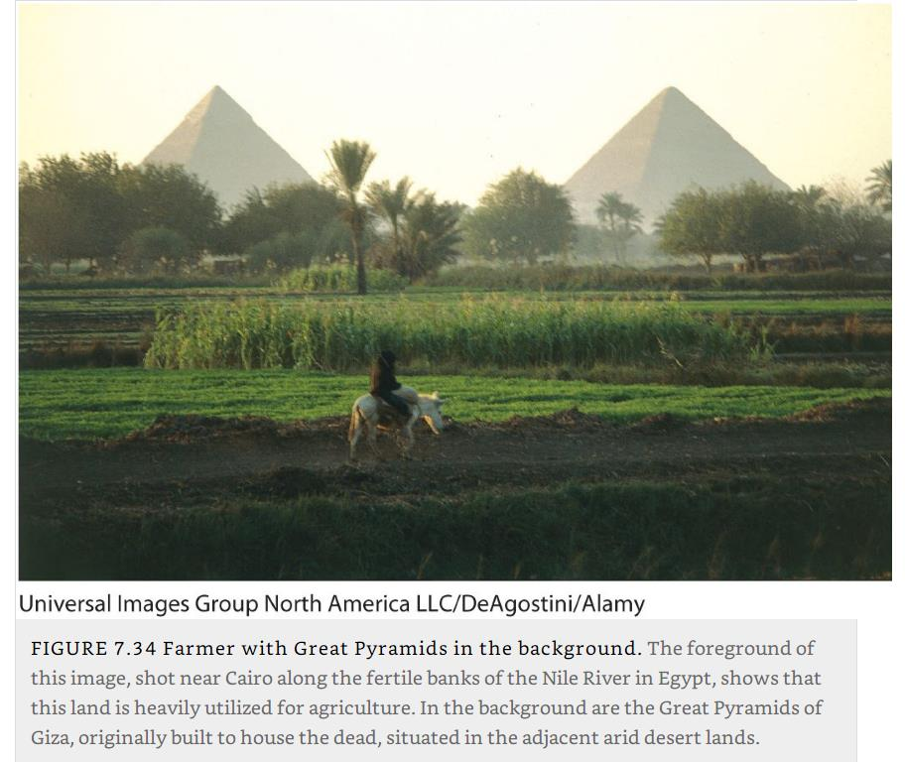
Great Pyramids of Giza, Egypt

Slide 66
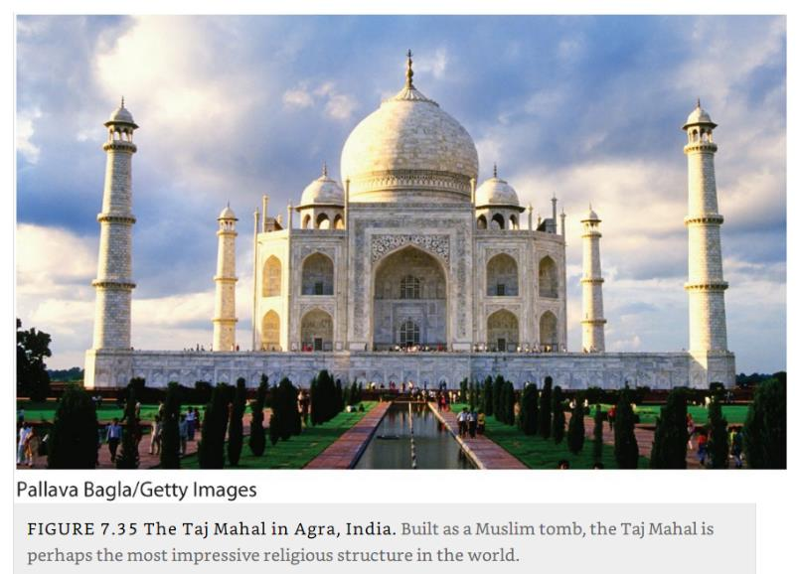
Taj Mahal, Agra, India

Slide 67
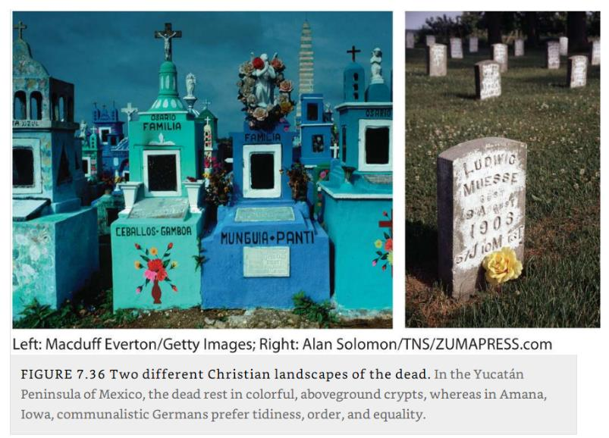

Christian landscapes of the Dead, Yucatan versus Iowa + Roadside memorial (I75, Michigan)

Slide 68
Sacred Spaces
Sacred spaces
  Natural or human-made sites that possess special religious meaning.
  Recognized as worthy of devotion, loyalty, fear, or esteem.
  Could be avoided by the faithful, sought out by pilgrims, or barred to members of other religions.
  Often includes the site of supposed supernatural events or viewed as the abode of gods.
Conflicts
  Muslim Dome of the Rock where Muhammad is believed to have ascended to heaven.
  Stands above the Western Wall, the remnant of the ancient Jewish temple.
  These two religions literally claim the same space as their holy site, which has led to conflict.

Slide 69
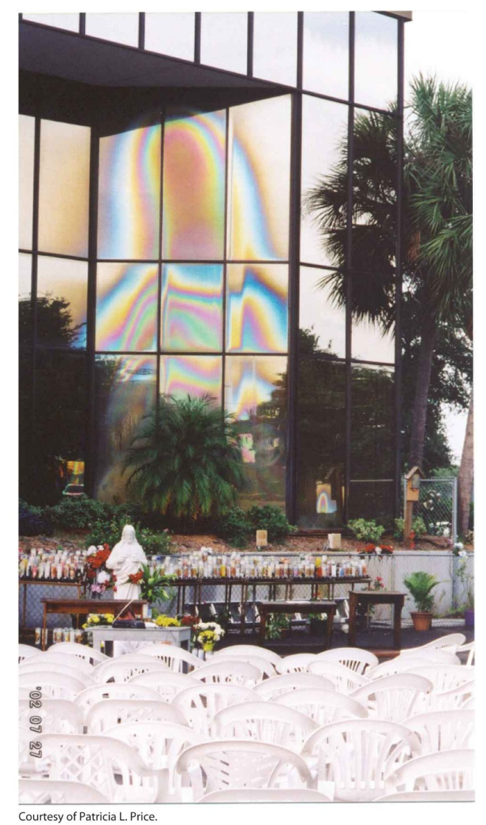
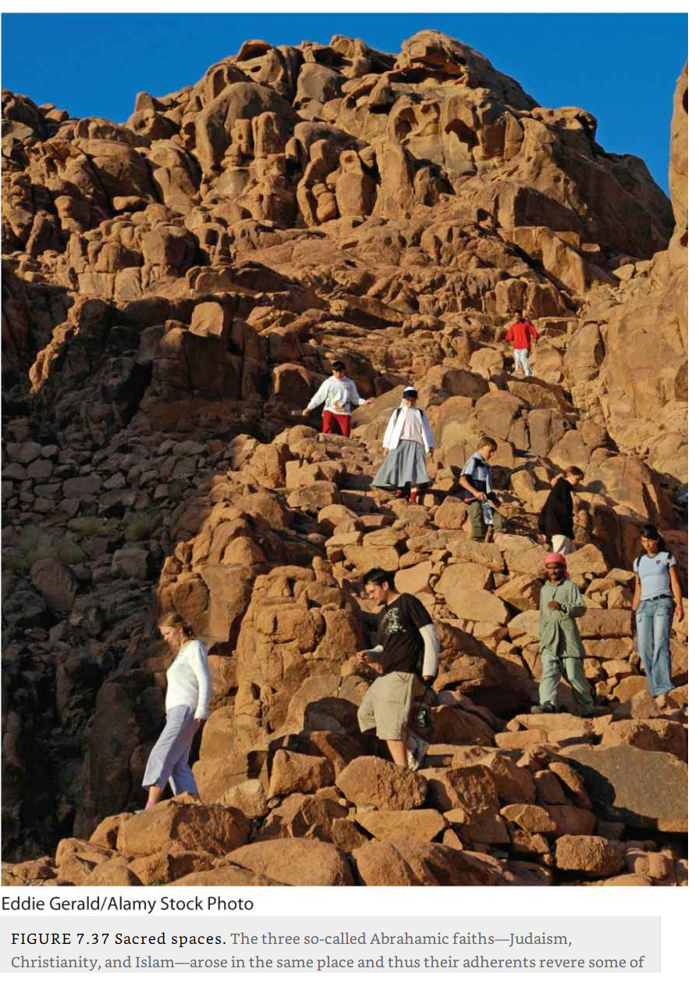
Mount Sinai, Egypt & Our Lady of Clearwater, Florida
Appeared shortly before Christmas 1996 and drew hundreds of thousands of pilgrims to an office building off U.S. 19. Glass shattered in 2004.

