Slide 1
Topic 5 – Geographies of Race and Ethnicity
A – Race and Ethnicity
B – Urban Ethnic Regions
C – Migration and Refugees
D – Genocides
E – Cultural Adaptation
F – Cultural Landscape

Slide 2
Conditions of Usage
For personal and classroom use only
  Excludes any other forms of communication such as conference presentations, published reports and papers.
No modification and redistribution permitted
  Cannot be published, in whole or in part, in any form (printed or electronic) and on any media without consent.
Citation
  Dr. Jean-Paul Rodrigue, Dept. of Global Studies & Geography, Hofstra University.

Slide 3
A – Race and Ethnicity
Differentiate between race and ethnicity and describe how ethnic groups are distributed geographically.

Slide 4
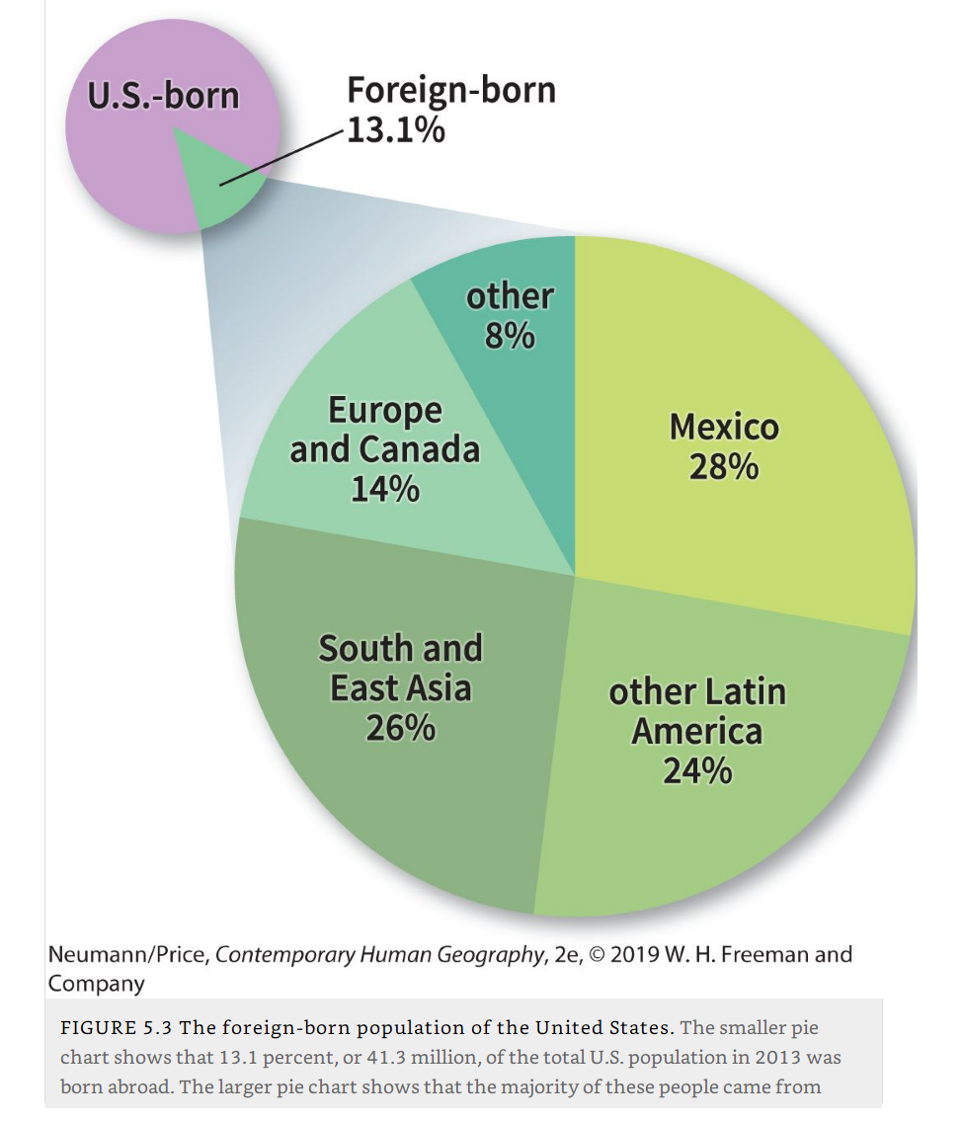
American? USian?
American
  Anybody from the Americas.
  South America, Caribbean, Central America, Canada, United States.
United States
  Mosaic, tapestry, salad bowl, melting pot, or something else?
  What percentage of people in the US are foreign-born?

Slide 5
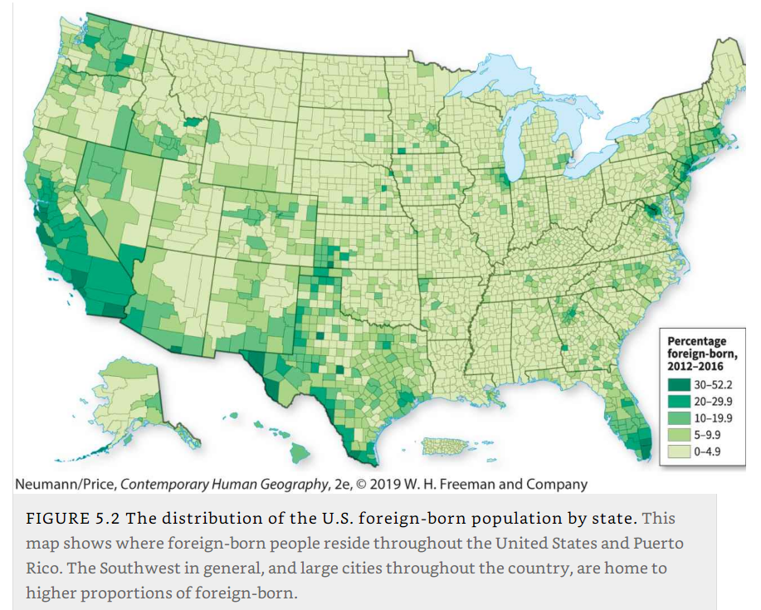
US-born vs. Foreign-born

Slide 6
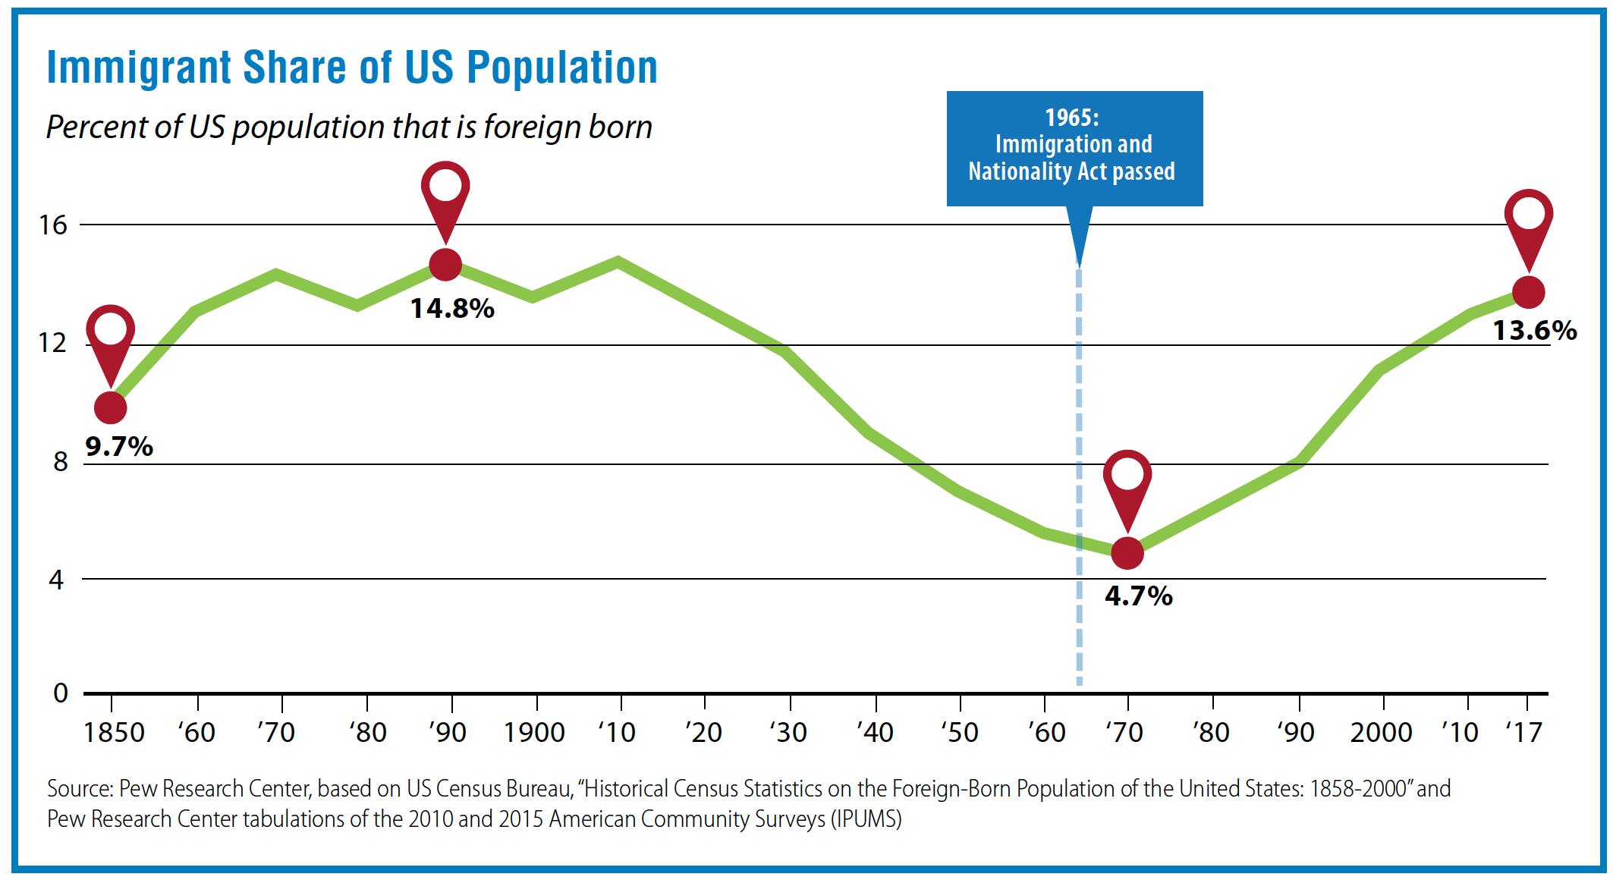
Updated figure: 13.6% foreign-born
National Issues Forums Institute. 2020. “Immigration: Who should we welcome? What should we do?”

Slide 7
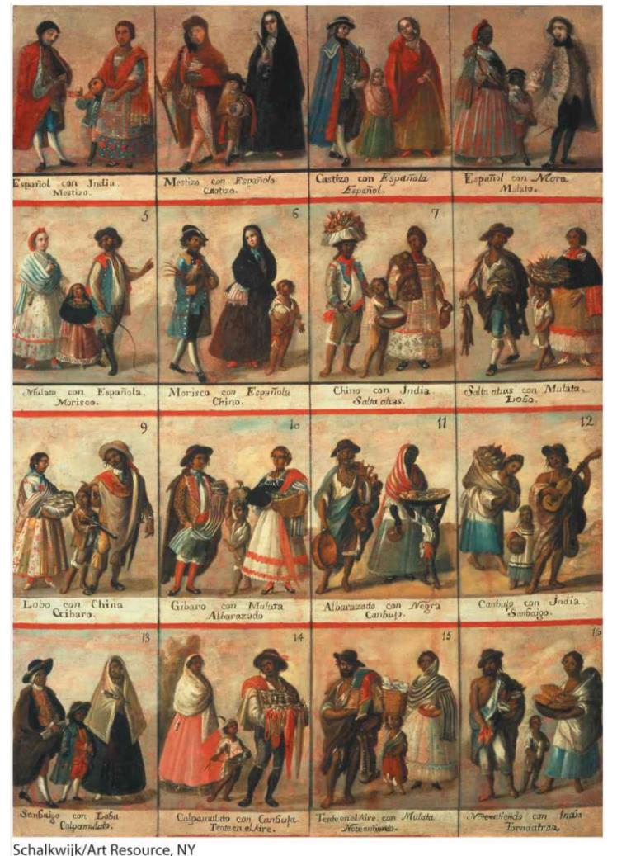
Race? Ethnicity?
Race
  A classification system that is sometimes understood as arising from genetic differences among human populations, or phenotypes (visual differences).
  Current view in natural and social sciences is to look at race as a social construct:
    Depends on people’s perceptions and discourses.
    Varies across time and space.
  Greater DNA differences have been found between people belonging to the same “race” than between people across “races”.

Slide 8
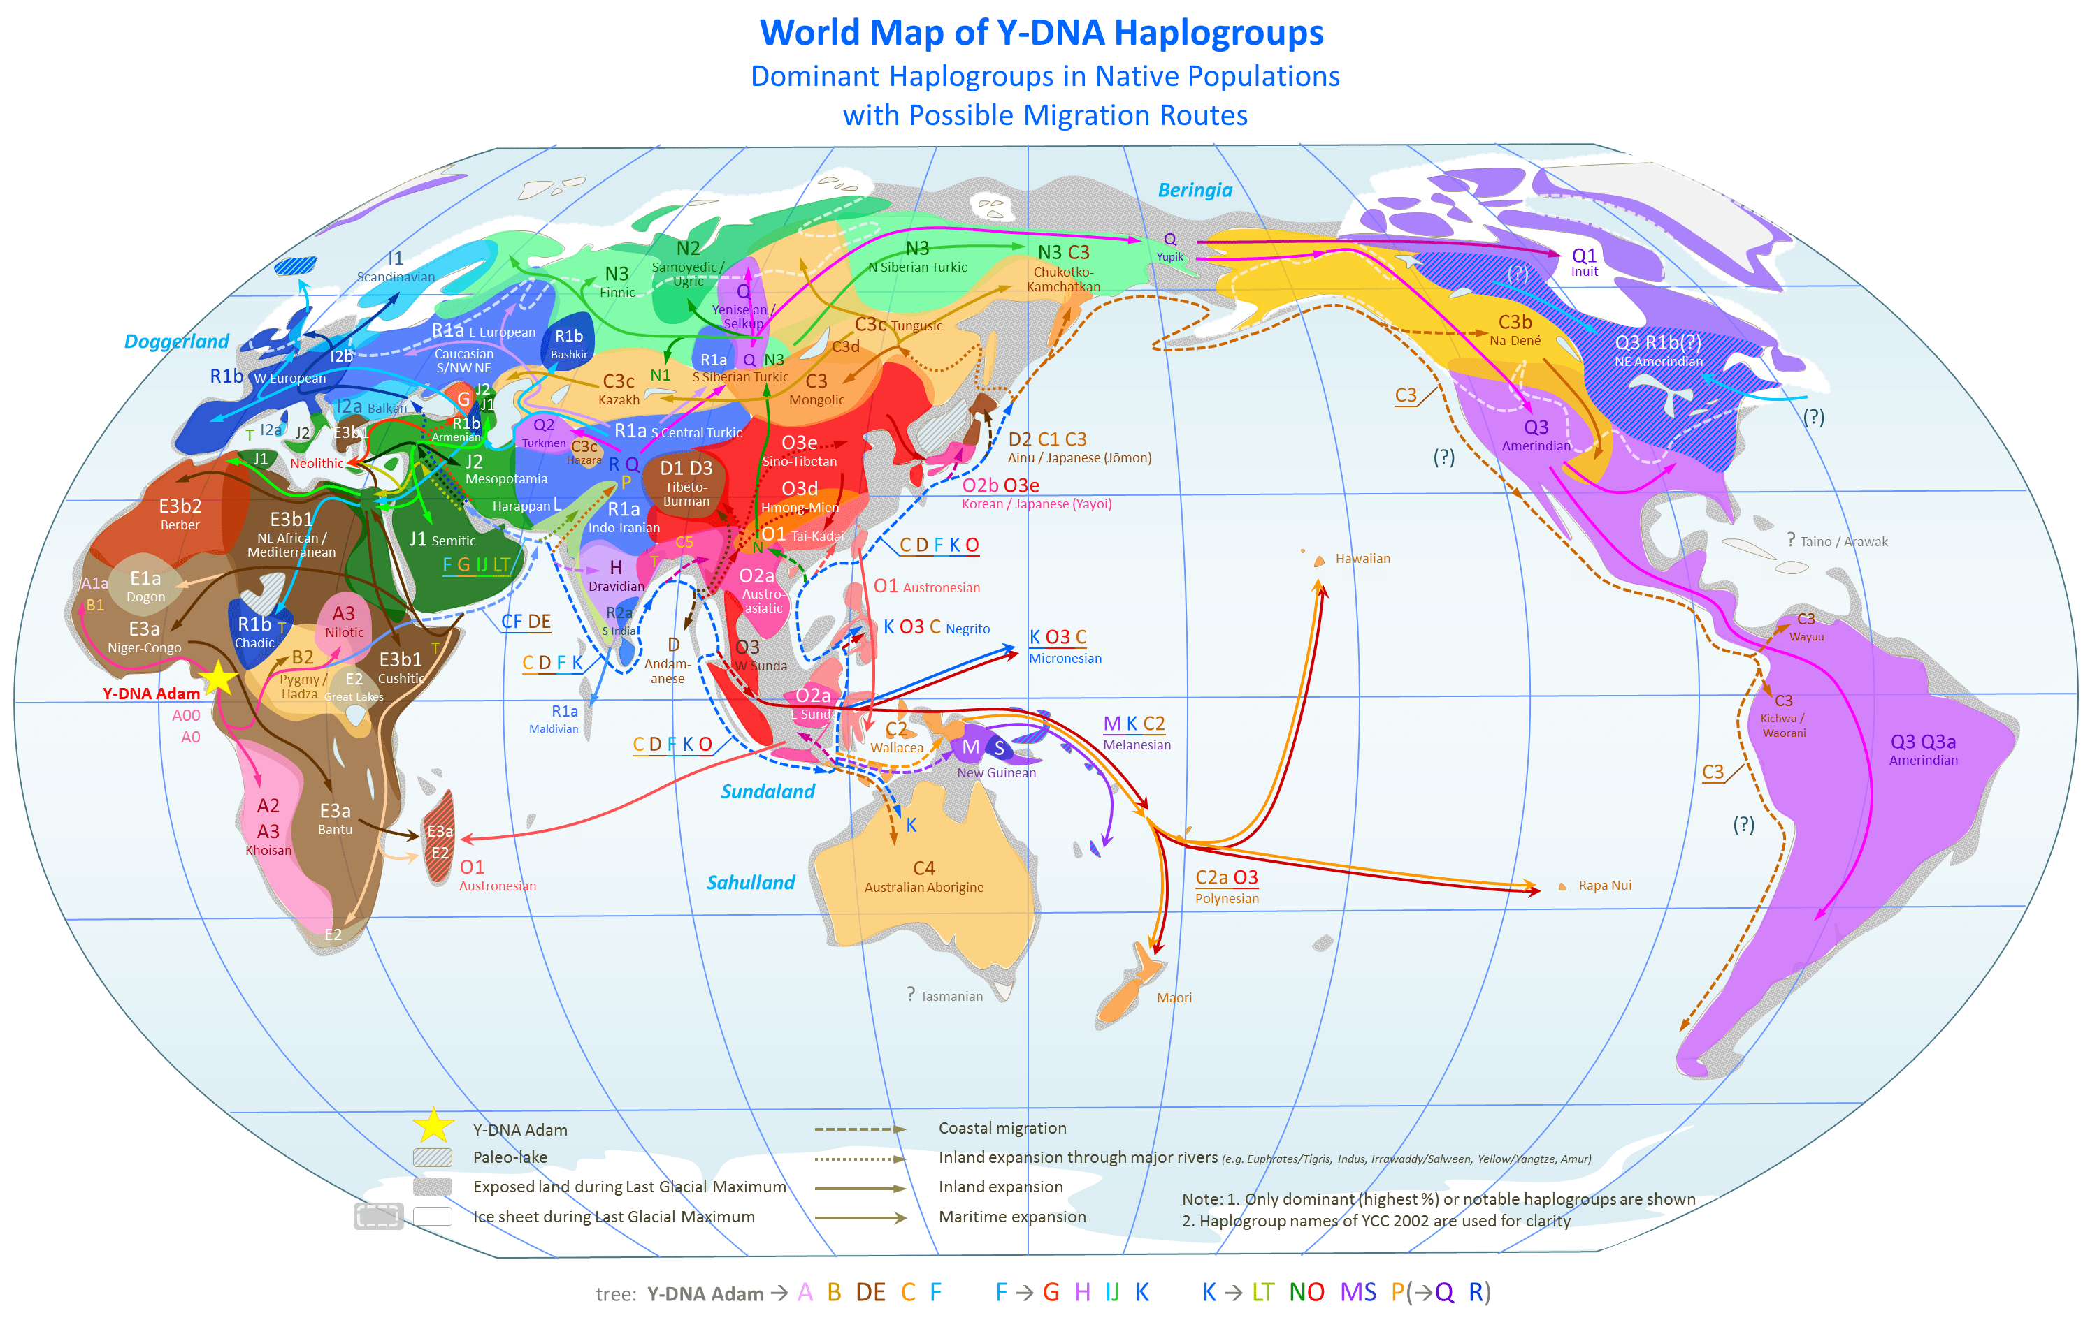
National Geographic’s DNA project
Notes:
A haplotype is a group of alleles in an organism that are inherited together from a single parent, and a haplogroup is a group of similar haplotypes that share a common ancestor with a single-nucleotide polymorphism mutation.

Slide 9
US Census Bureau’s definitions and findings
Racial categories
  Included in the census questionnaire.
  Generally, reflect a social definition of race recognized and not an attempt to define race biologically, anthropologically, or genetically.
Multiple races
  In 2000 for the first time, one could declare multiple races.
  2010: 97% of the population reported only one race.
  A growing number of people who do not identify with any of the official race categories.
  Increasing number of respondents have been racially classified as “Some Other Race.”
  An increasing number of people label themselves “racially mixed”, “biracial”, “multiracial” etc.

Slide 10
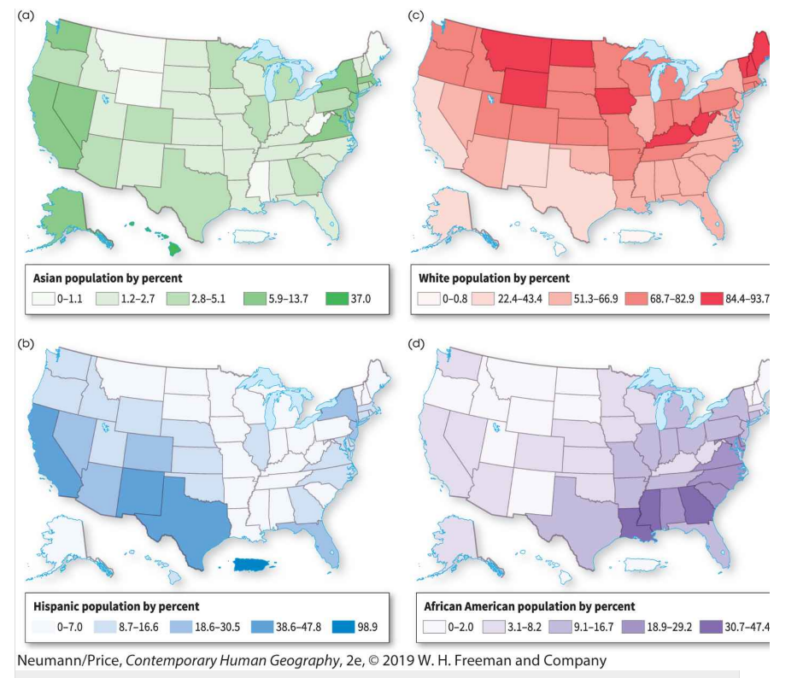
US Census Results 2017

Slide 11
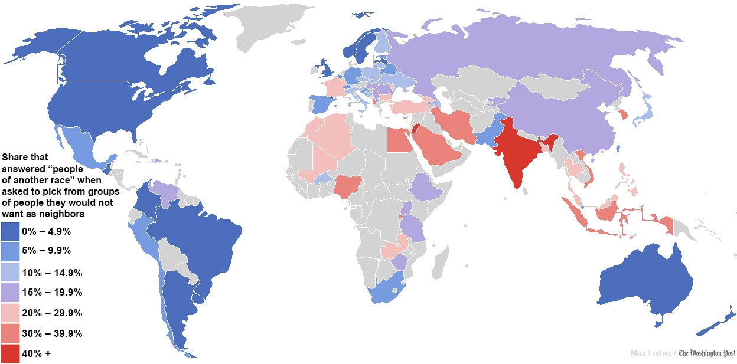
Level of Racial Tolerance
Anglo-Saxon and Latin countries the most tolerant
Notes:
Source: World Values Survey. https://www.washingtonpost.com/news/worldviews/wp/2013/05/15/a-fascinating-map-of-the-worlds-most-and-least-racially-tolerant-countries/

Slide 12
Race? Ethnicity?
Ethnicity
  A group of people who share a common ancestry and cultural tradition.
  Can be based on different traits (religion, language, history, place of origin).
  Strong feeling of group identity.
  Involuntary membership (at birth).
  Outsiders usually can join by marriage or adoption.
  Often living as a minority group in a larger society (the majority / minority paradox).
  Han Chinese in China versus abroad.
  Mexicans in Mexico versus the United States.
What are the fundamental differences between race and ethnicity?

Slide 13
Ethnic Minorities and the Host Culture
Acculturation
  The group adopts the ways of the host society.
Assimilation
  Blinding-in with the host culture with the potential of the loss of many distinctive ethnic traits.
Cultural simplification
  Immigrant ethnic groups lose certain aspects of their traditional culture in the process of settling overseas, creating a new culture that is less complex than the old.
  Also called culture shedding.

Slide 14
Ethnic Minorities and the Host Culture
Melting pot
  Perspective that all ethnic groups will eventually be assimilated into the American culture.
Transculturation
  People adopt elements of other cultures as well as contributing elements of their own culture, thereby transforming both cultures.
Salad bowl
  Racial and ethnic differences mix but never entirely dissolve.
Discuss the main forms of adaptation of ethnic minorities to host cultures.

Slide 15
B – Urban Ethnic Regions
Ethnicity and race shape the settlement patterns of rural homelands and islands, as well as urban ethnic neighborhoods, ghettos, and ethnoburbs.

Slide 16
Ethnic Homelands and Islands
Ethnic homelands
  Sizable populations
  Cover large areas.
  Overlapping borders.
  Because of their size, the age of their inhabitants, and their geographical segregation, they tend to reinforce ethnic identities.
  Residents typically seek or enjoy some measure of political autonomy or self-rule.
  Homeland populations usually exhibit a strong sense of attachment to the region.
  Most homelands belong to indigenous ethnic groups and include special, venerated places that serve to symbolize and celebrate the ethnic character or heritage of the region.
  The homeland represents that most powerful of geographical entities, one combining both formal and functional culture regions.

Slide 17
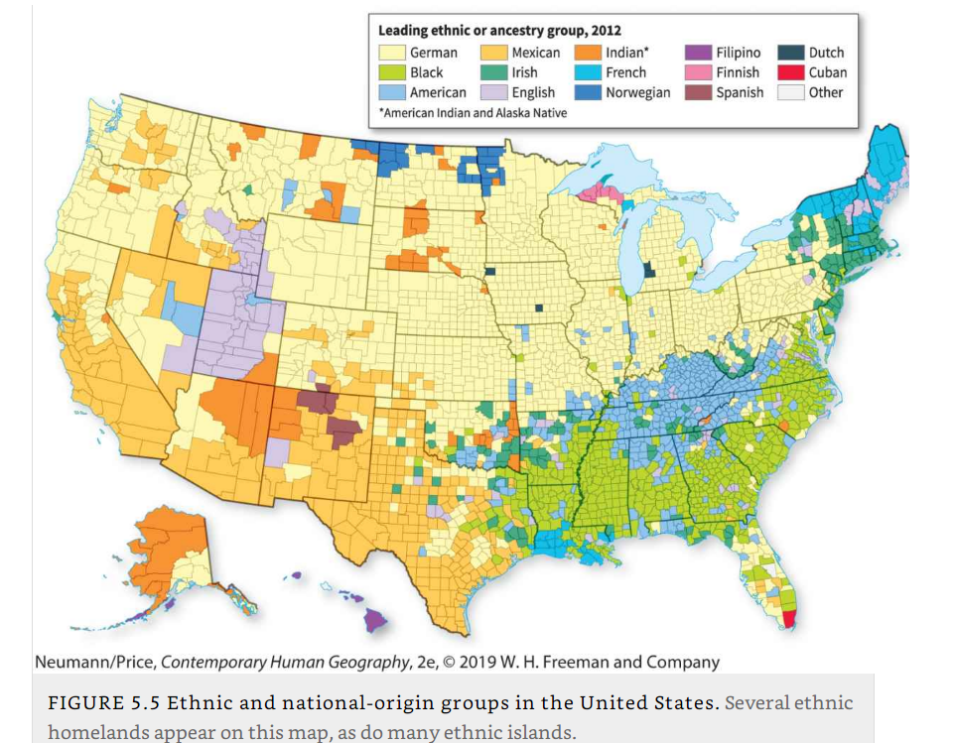
Ethnic Homelands and Islands

Slide 18
Ethnic Homelands and Islands
Ethnic islands
  Small areas in the countryside or an urban area.
  Usually occupying an area smaller than a county and serving as home to several hundred to several thousand people of the same ethnic group (at most).
  Do exert a significant influence.

Slide 19
Ethnic Neighborhoods
What are ethnic neighborhoods and which forms they can take?
Ethnic neighborhood
  A voluntary community where people of similar origin reside by choice.
  (Example: “Little Bangladesh” in Jackson Heights, Queens, NY).
  Common language. Specialized products and services. Important institutions (churches).
Ghetto
  Traditionally, an ethnic neighborhood within a city, where an ethnic group lives, either by choice or by force.
  Emerged as a term in the 13th century medieval Europe (Jews living in segregated communities).
Ethnoburb
  A suburban ethnic neighborhood, sometimes home to relatively affluent immigration populations.
  (Example: Iranians/Persians in Great Neck, Nassau county, NY).

Slide 20
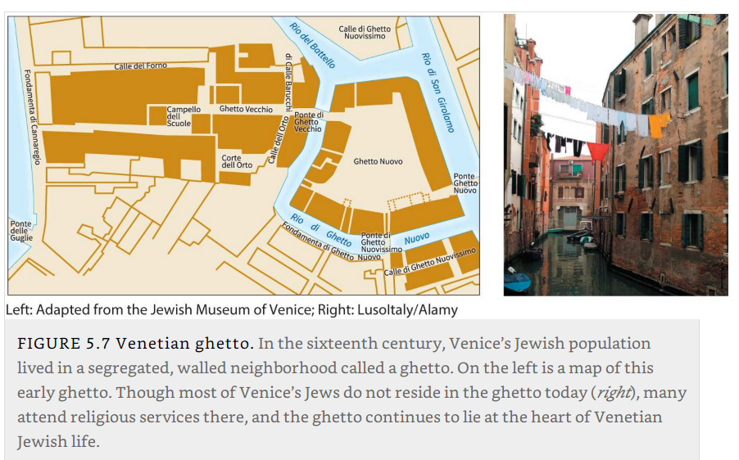
Venetian Ghetto 16th Century

Slide 21
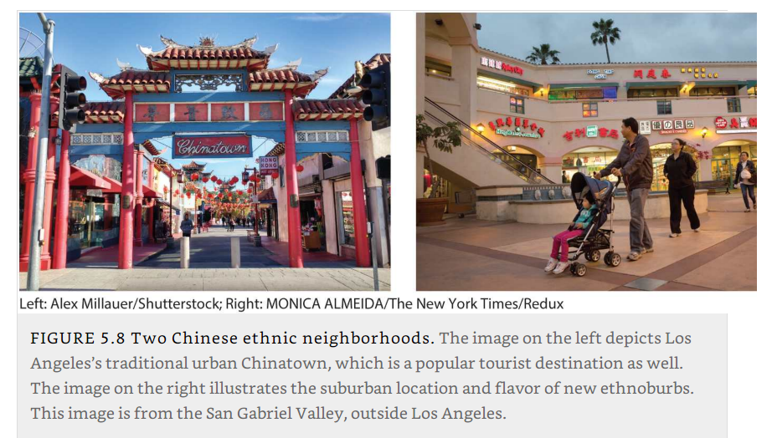
Los Angeles: Chinatown and San Gabriel Valley Ethnoburb

Slide 22
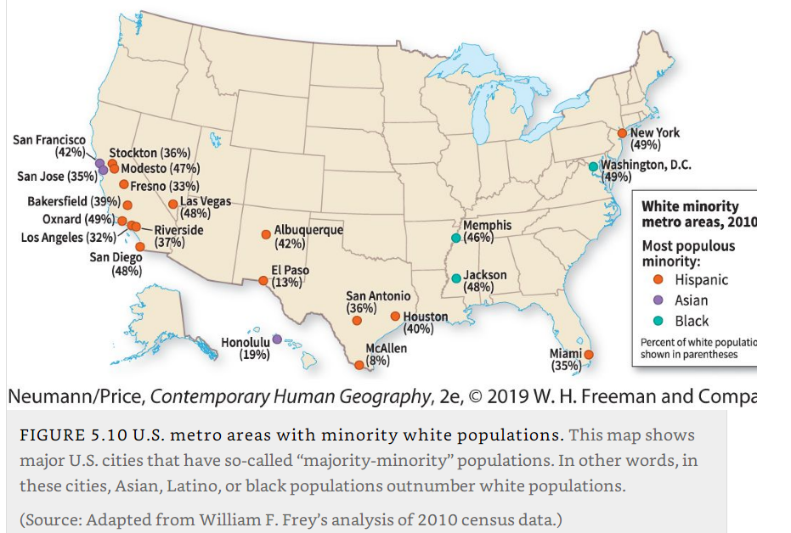
Metropolitan Areas with Minority White Populations, 2010

Slide 23
Cities with the Largest Share of Foreign-Born Population
Notes:
https://en.wikipedia.org/wiki/Foreign_born

Slide 24
C – Migration and refugees
The ways that migration and mobility shape, and are shaped by, race and ethnicity.

Slide 25
Migration
Chain migration
  The tendency of people to migrate along channels, over a period of time, from specific source areas to specific destinations.
  (Example: Dominicans in Inwood section of Manhattan.)
Involuntary migration
  The forced displacement of a population, whether by government policy, warfare, or other violence, ethnic cleansing, disease, natural disaster, or enslavement.
  Also called forced migration.
  (Darfur; Afghanistan; Iraq; Syria; Rohingya in Burma fleeing to Bangladesh).

Slide 26
Migration
Return Migration
  A type of ethnic diffusion that involves the voluntary movement of a group of migrants back to its ancestral or native country or homeland.
  (African-American return to the “Black Belt” in the US; People from Ghana and Ethiopia returning from Western countries to their home countries due to new job opportunities and economic growth).
Ethnic cleansing
  The removal of unwanted minority populations from a nation-state through mass killing, deportation, and/or imprisonment.
  (Jews in Nazi Germany; Tutsis in Rwanda; Bosnian war and the Srebrenica genocide of Bosniaks (Bosnian Muslims); Darfur; Rohingya).

Slide 27
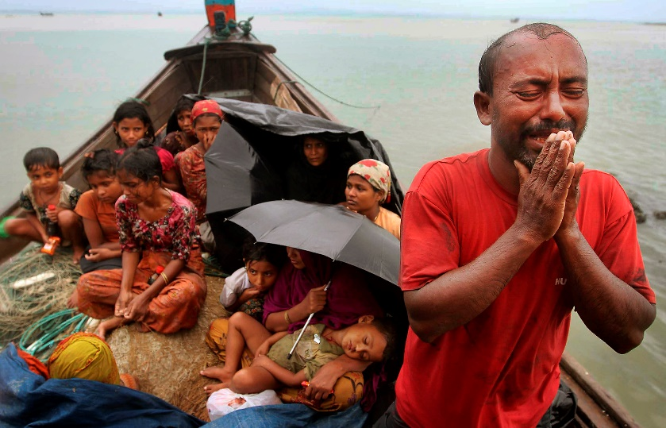
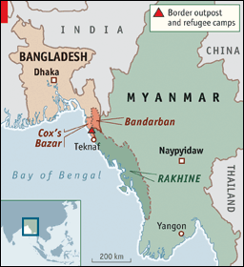
Rohingya refugees fleeing Myanmar/Burma
Context
  Settled in Myanmar >200 years, in Rakhine state.
  Denied citizenship, education, religious freedom. (Rohingya are Muslims, most of the other Burmese people are Buddhists.)
  ~300,000 in refugee camps in Bangladesh last three decades
  Ongoing “ethnic cleansing”: killings, rapes, villages burned down
  ~700,000 has fled into Bangladesh last 2 years
  Bangladesh overpopulated; has started removing them to a remote island which is vulnerable to cyclones
  Bangladesh says it cannot take more refugees
Notes:
Photo source: Daily NHT (Google images).
Articles: https://www.theguardian.com/world/rohingya
https://www.theguardian.com/world/2019/mar/01/rohingya-crisis-bangladesh-says-it-will-not-accept-any-more-myanmar-refugees

Slide 28
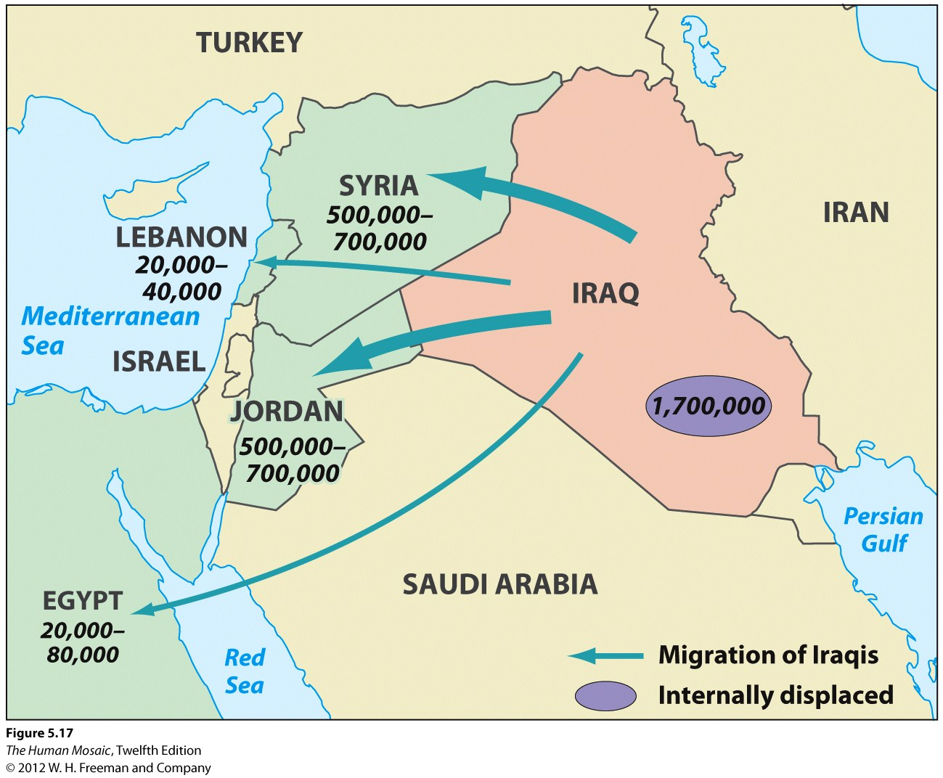
Iraqis Displaced by Conflict 2003-2007
The map shows numbers of Iraqi refugees 2003-2007.
Total number of Iraqis who fled to Syria during the US-led war: ~1 mill.

Slide 29
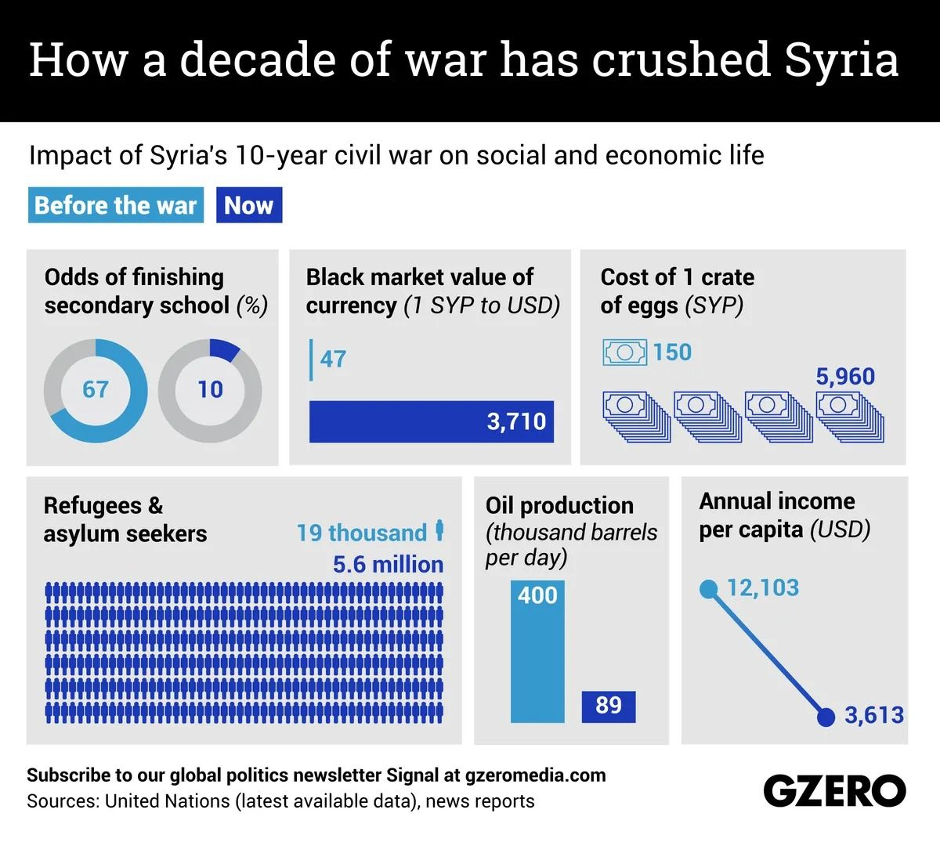
The Syrian refugee crisis
Syria
  Population was 22 million in 2011.
  17 million in 2019.
  6 million people have fled to Turkey, Iraq, Lebanon, Jordan, and Europe since then
  8 million are internally displaced (IDP), often multiple times.
  1 million have sought asylum in Europe.
Second-largest humanitarian crisis worldwide
In which ways migration can be shaped by race or ethnicity?
Notes:
http://www.theguardian.com/world/2015/sep/04/syrian-refugee-crisis-why-has-it-become-so-bad
http://www.internal-displacement.org/middle-east-and-north-africa/syria/
http://www.telegraph.co.uk/news/worldnews/europe/11841346/Refugee-crisis-How-many-Syrians-have-applied-for-asylum-in-Europe-and-how-many-has-Britain-helped.html
http://www.theguardian.com/world/ng-interactive/2015/sep/18/latest-developments-in-europes-refugee-crisis-a-visual-guide
https://www.cia.gov/library/publications/the-world-factbook/geos/sy.html

Slide 30
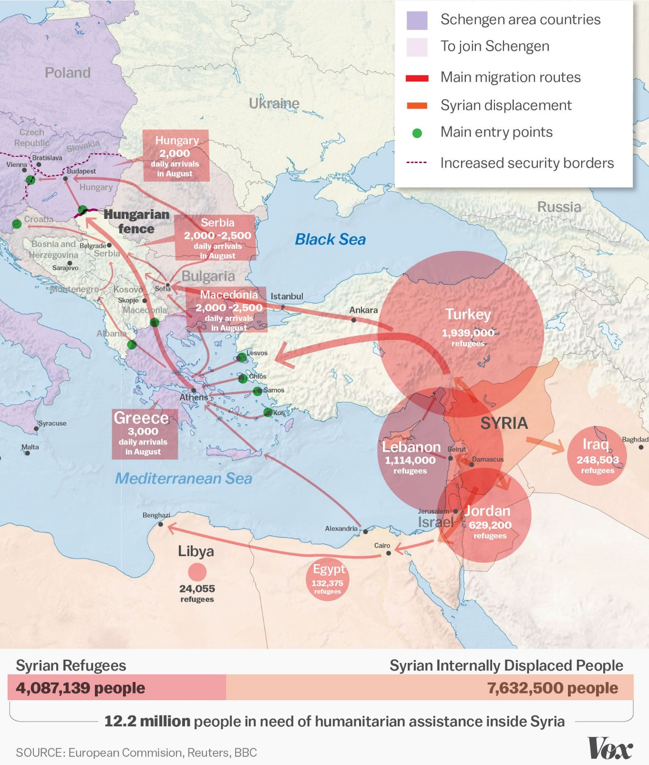
Syrian refugee numbers, 2015

Slide 31
D – Genocides
How globalization has deepened, transformed, or erased ethnicity, race, and racism.

Slide 32
Twentieth Century Genocides
Name | Place | Dates | Estimated Deaths | % Population killed | Rationale
Holocaust | Nazi-controlled Europe | 1939-1945 | 4.2 to 11 million | 78% of Jews in Nazi-controlled Europe | National Socialism
Holodomor | Ukraine and Soviet republics | 1932-1933 | 1.8 to 7.5 million | 10% of Ukraine’s population | Communism
Cambodian Genocide | Democratic Kampuchea | 1975-1979 | 1.7 to 3 million | 21-33% of Cambodia’s population | Communism
Belarusian Genocide | Soviet Belarus | 1941-1944 | 1.3 to 2 million | 25% of Belarusian population | Communism
Soviet Ethnic Cleansings | Soviet Union | 1920-1951 | 1 to 1.5 million | 25-50% of Chechen population, 30% of Tatar population | Communism
Armenian Genocide | Ottoman Empire | 1915-1922 | 0.8 to 1.5 million | 75% of Armenians in Turkey | Ethno-Nationalism
Rwandan Genocide | Rwanda | 1994 | 0.8 to 1 million | 70% of Tutsis in Rwanda | Ethno-Nationalism

Slide 33
Twentieth Century Genocides
Rwandan Genocide 1959-1962
  When Belgium took the territory in 1918, the distinction between Hutus and Tutsis became racialized.
  Preferential treatment of Tutsis (government, education, business) to ensure that the locals would not unite against the colonizers.
  The local perception: Hutus and Tutsis are social, not racial categories:
    A Hutu could become Tutsi by accruing more wealth and become herder instead of farmer.
  1959-62: The Hutu majority rebelled -> 20,000 Tutsis were killed. Many more displaced, many to Uganda
Rwanda independence of 1962
  Hutus came to power.
  Tutsis were disenfranchised (lost citizenship).

Slide 34
Twentieth Century Genocides
Return of refugees (1990)
  Tutsi refugees in Uganda invaded Rwanda.
  Demanding an end to racial discrimination and reinstatement of citizenship.
Genocide (1994)
  Between 800,000 and one million Tutsis and Hutu sympathizers were killed in a few months.
  (70% of Tutsis; 20% of the population).
  Culmination of longstanding ethnic competition and tension.
  Today there is still tension under the surface, although the government has encouraged “Rwandan” identity instead of Hutu/Tutsi.

Slide 35
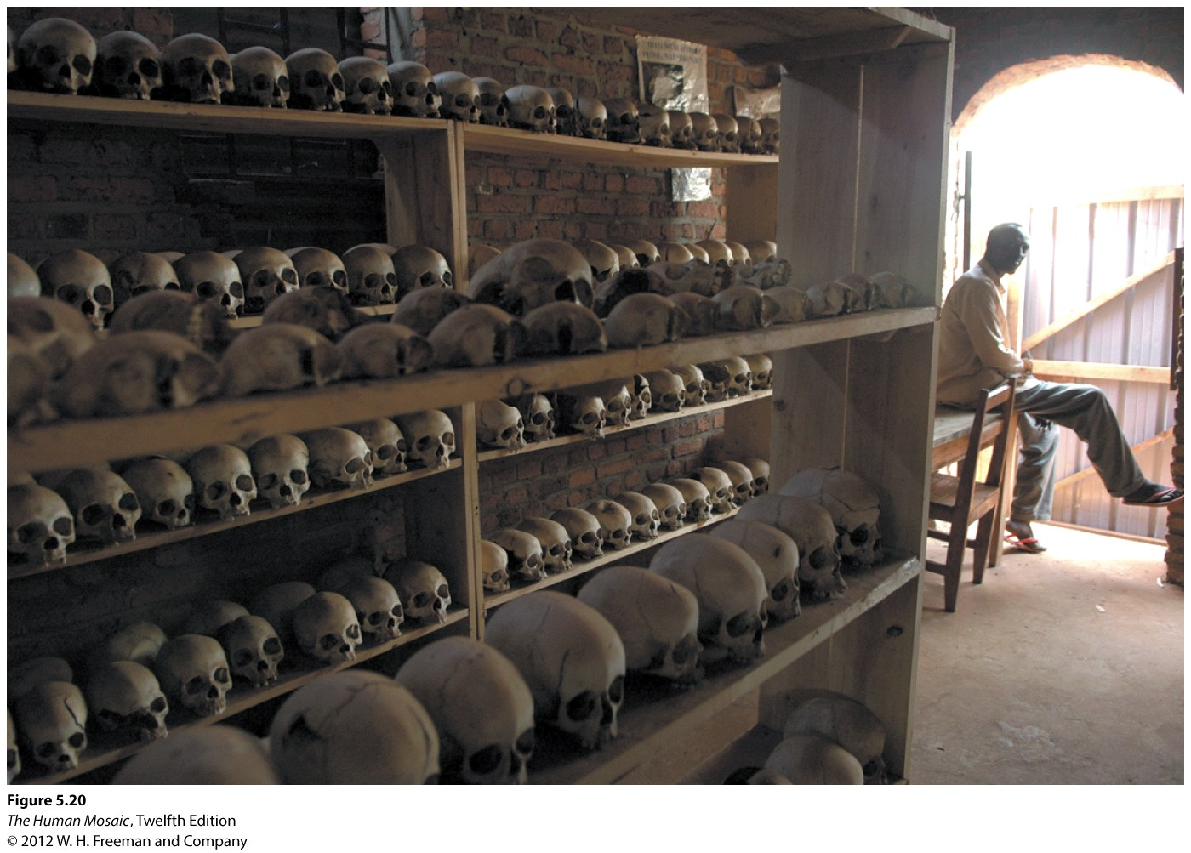
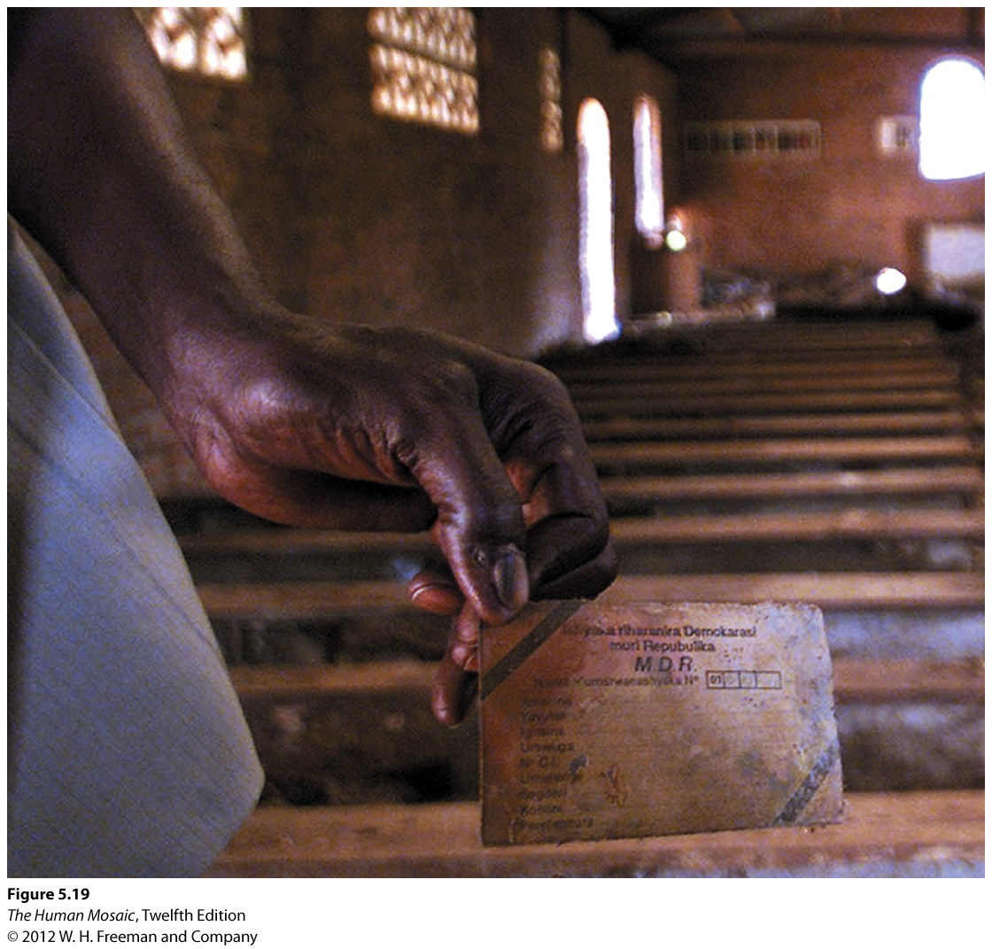
The Rwandan Genocide

Slide 36
E – Cultural Adaptation
The diverse ways in which ethnic and racial groups interact with the natural environment.

Slide 37
Cultural Preadaptation
Cultural preadaptation
  A set of adaptive traits possessed by a group in advance of migration.
  Gives the ability to survive and a competitive advantage in colonizing the new environment.
  Often occurs in groups migrating to a place that is environmentally similar to the one they left behind.
  The adaptive strategy they had pursued before migration works reasonably well in the new home.
  Cubans in Florida.
  Vietnamese on the Gulf of Mexico.

Slide 38
Cultural Simplification
Cultural migration
  When groups migrate and become ethnic in a new land.
  Potential to introduce the totality of their culture by relocation diffusion.
  Every facet of their traditional way of life could be reestablished.
  Ethnic immigrants never successfully introduce the totality of their culture.
  Profound cultural simplification occurs.
  Only localized fragments of a national culture diffuse overseas.
  Groups from particular places migrating in particular eras.
  Selection of traits that are effective in the new environment.
  Borrow traits from cultures at the new location.

Slide 39
F – Cultural Landscape
The ways that ethnicity and race leave imprints on the cultural landscape.

Slide 40
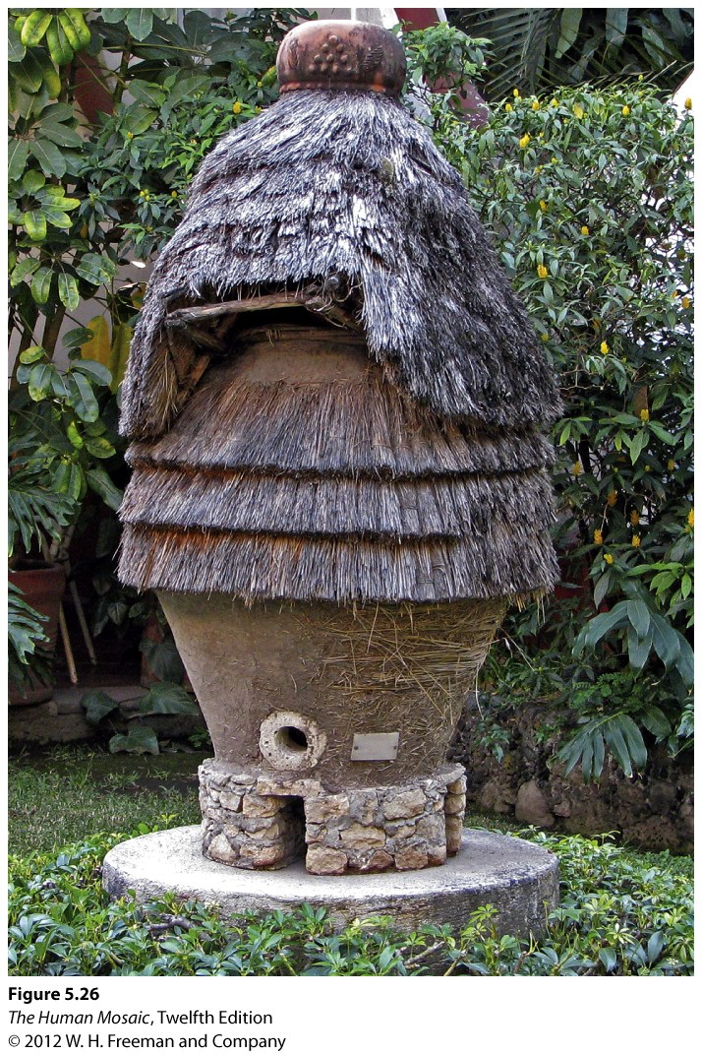
Ethnic flag
  A readily visible marker of ethnicity on the landscape.
  Monuments and statues.
Maize granary, unique to the indigenous population in Tlaxala state, Mexico.

Slide 41
Urban Ethnic Landscapes
Coloring murals
  A wide variety of wall surfaces, from apartment house and store exteriors to bridge abutments.
  Wide ranging subjects, from religious motifs to political ideology, from statements about historical wrongs to those about urban zoning disputes.
Color can connote and reveal ethnicity
  Red: a venerated and auspicious color to the Chinese.
  Light blue is a Greek ethnic color, derived from the flag of their ancestral country.
  Greeks also avoid red, which is perceived as the color of their ancient enemy, the Turks.
  Green, an Irish Catholic color, also finds favor in Muslim ethnic neighborhoods.

Slide 42
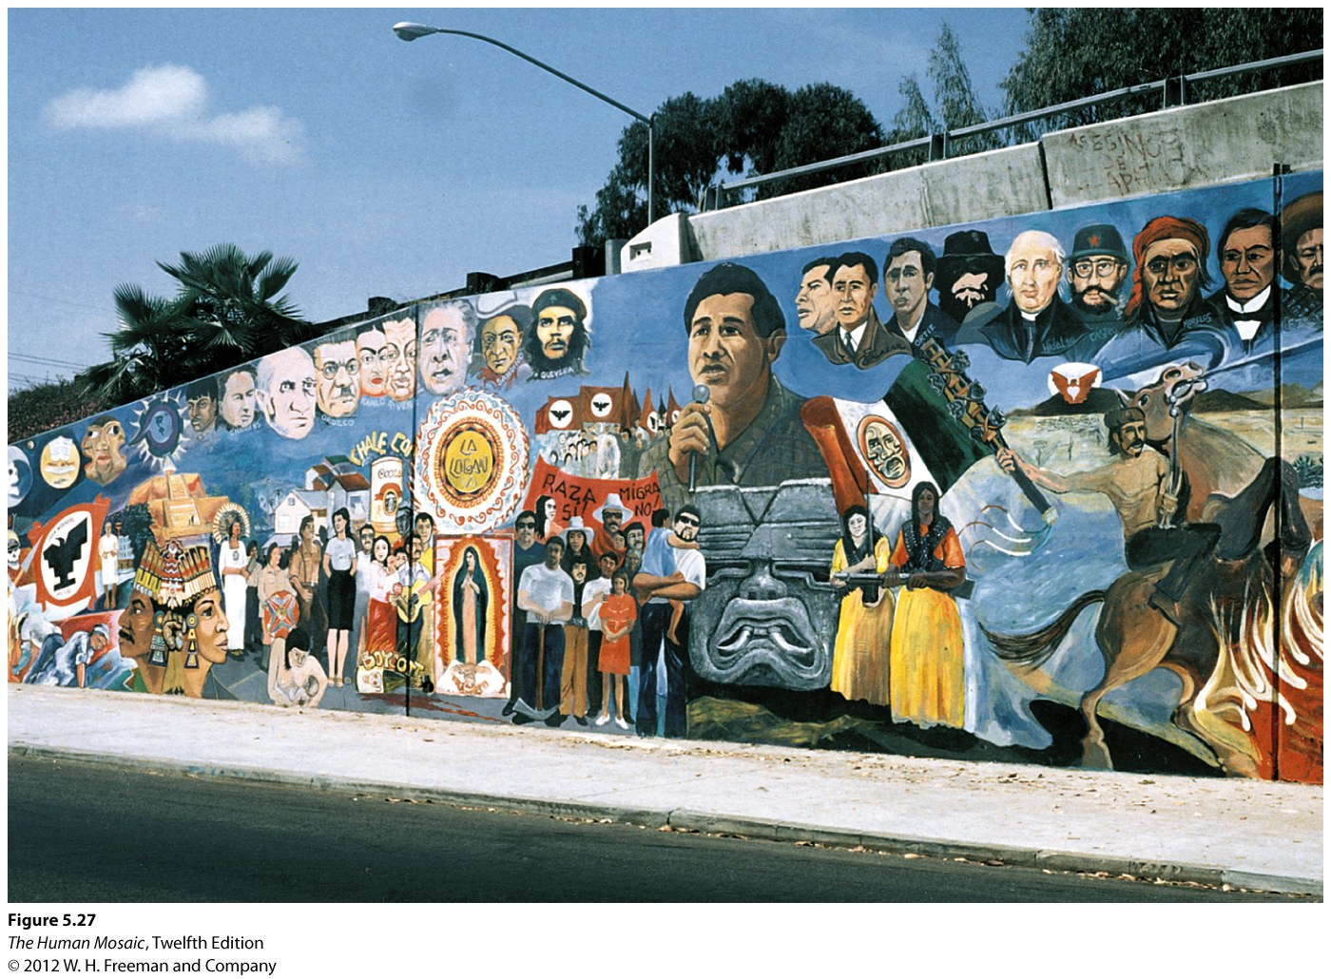
Urban Ethnic Landscapes: San Diego

Slide 43
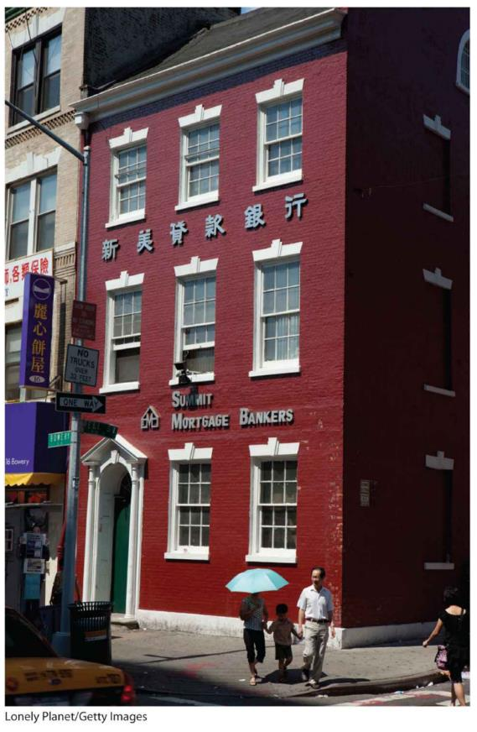
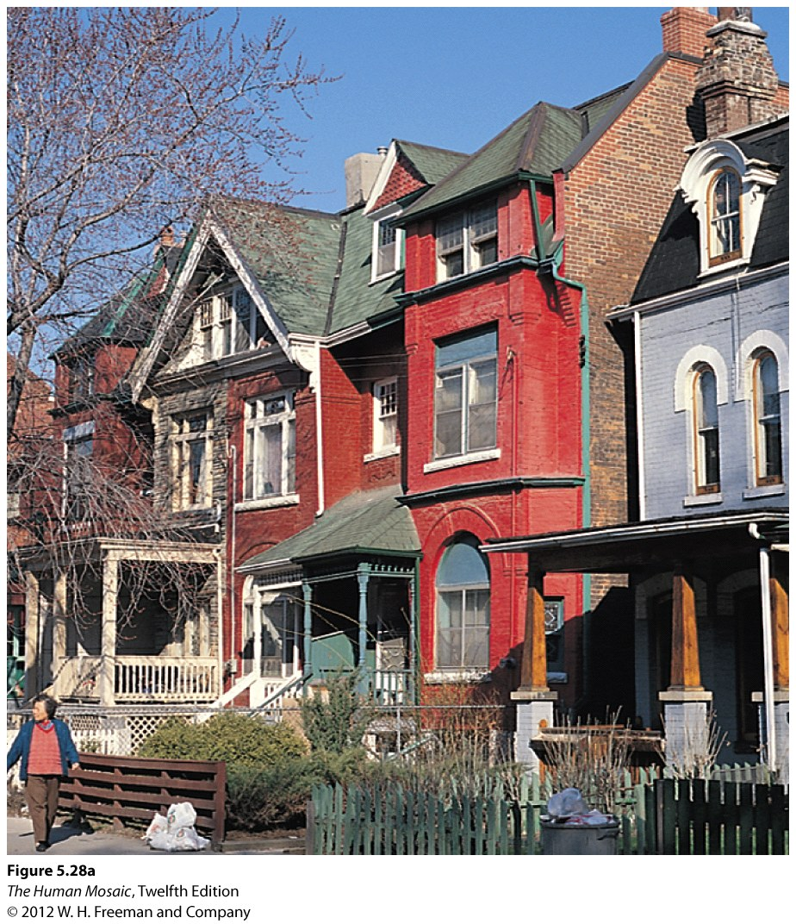
Urban Ethnic Landscapes: Chinatown, Toronto

Slide 44
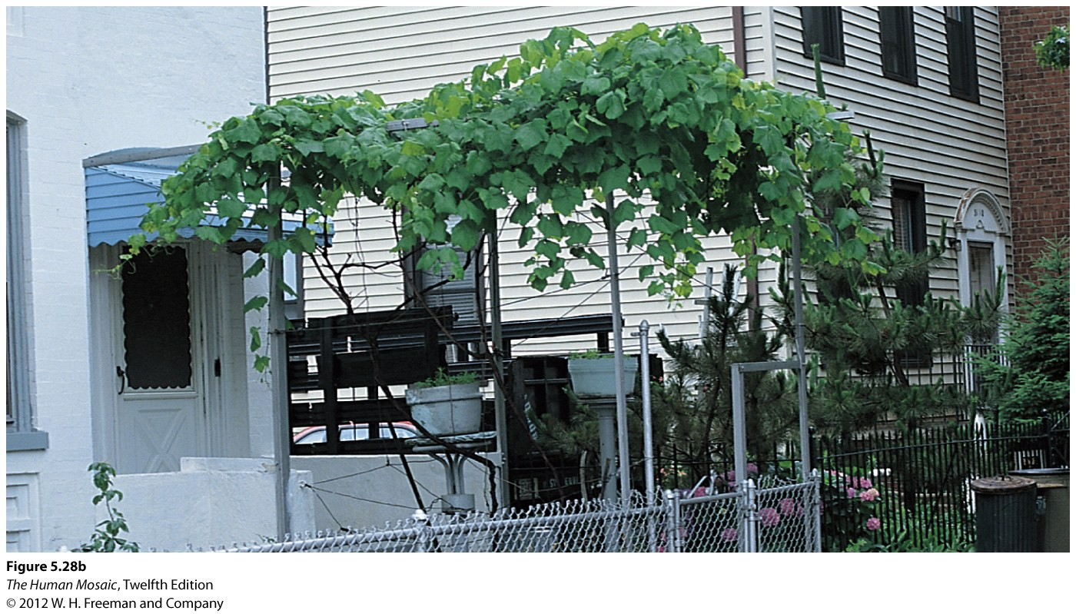
Urban Ethnic Landscapes: Astoria, Queens

Slide 45
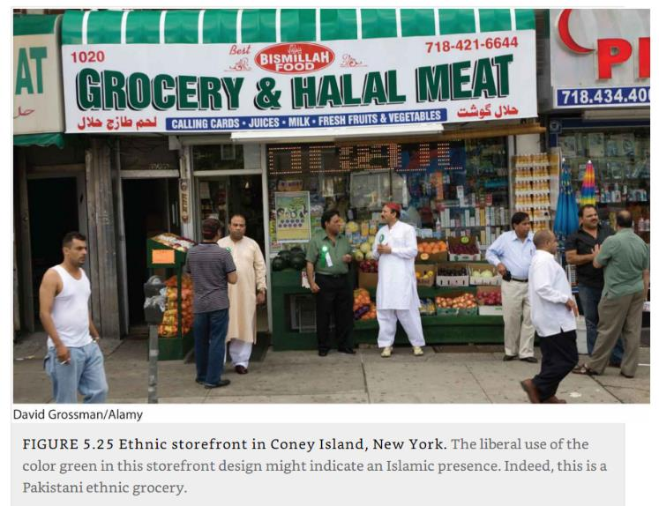
Urban Ethnic Landscapes: Coney Island

Slide 46
Ethnic Culinary Landscapes
Foodway
  Customary behaviors associated with food preparation and consumption.
  An important marker of ethnic identity.
Fusion cuisine
  Mix of ingredients and preparation techniques between two or more cultures.
  Lead to new cuisines.
  Singapore: Southern Chinese + Malay + Indian.
  TexMex : Shredded cheese, meat, beans, peppers, and flour tortillas.
  Poutine: Combination of roadside snack bars and dairy industry (curd cheese).
Provide some examples on how ethnic groups leave an imprint on the cultural landscape.

Slide 47
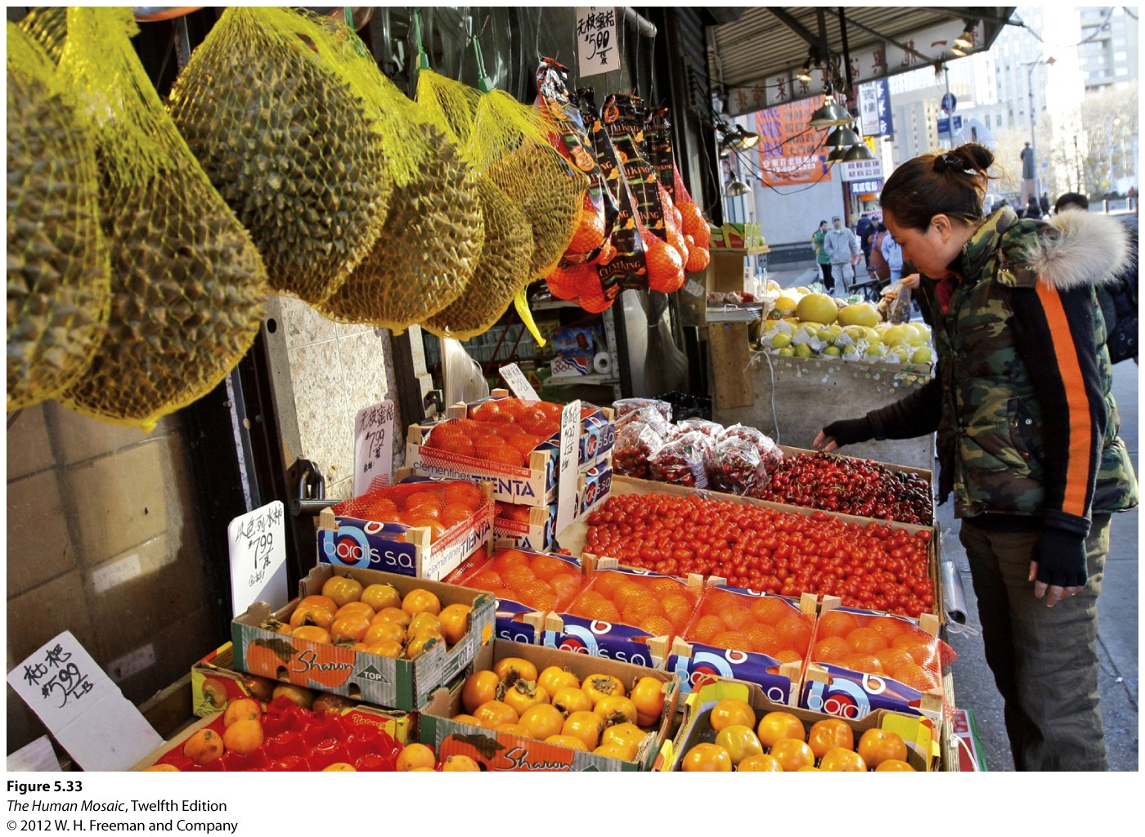
Ethnic Culinary Landscapes: Chinatown, New York

Slide 48
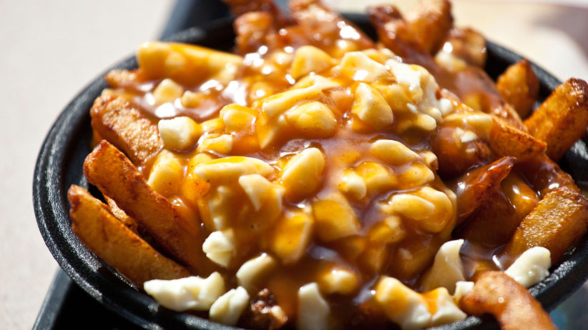
Ethnic Culinary Landscapes: French Canadian Poutine

