Slide 1
Topic 3 – Population Geography
A – Regional patterns of population characteristics
B – Patterns, causes, and consequences of population migrations
C – Theories of population growth and control
D – How the natural world shapes population characteristics
E – Imprints of demographic factors on the Cultural Landscape

Slide 2
Conditions of Usage
For personal and classroom use only
  Excludes any other forms of communication such as conference presentations, published reports and papers.
No modification and redistribution permitted
  Cannot be published, in whole or in part, in any form (printed or electronic) and on any media without consent.
Citation
  Dr. Jean-Paul Rodrigue, Dept. of Global Studies & Geography, Hofstra University.

Slide 3
What is Population Geography?
The study of the spatial and ecological aspects of population
  Distribution.
  Density per unit of land area.
  Fertility and mortality.
  Group characteristics (Gender, age).
  Health.
  Migration.

Slide 4
A – Regional Patterns of Population Characteristics
Population distribution and density
Patterns of natality
Patterns of mortality
Demographic transition
Age distribution

Slide 5
Population Distribution and Density
Uneven distribution of the population
Crude/arithmetic density
  Number of people per unit area of land.
  The world: 115 people/sq.mi (excluding oceans); (35 including oceans).
  US: 80.
  Bangladesh: 2,600; Urban areas 195,000.
  Nassau county: 4,690.
  NYC: 27,000.
  Manhattan: 67,000.
Physiologic density
  Number of people per unit area of arable land.

Slide 6
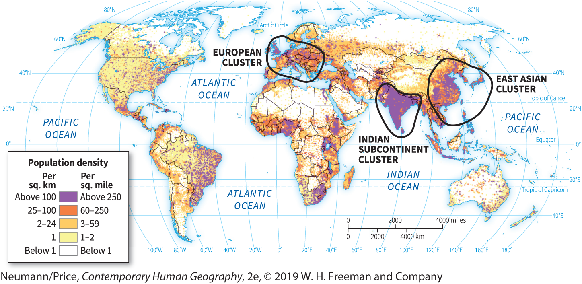
World Population Density

Slide 7
Population Distribution and Density
Singapore: 18,645 vs. 833,333
Notes:
Muller, Peter. 2000. Physiologic Population Density for Each of the World's States, Year 2000
Egypt: http://www.vidiani.com/large-detailed-egypt-satellite-photo/

Slide 8
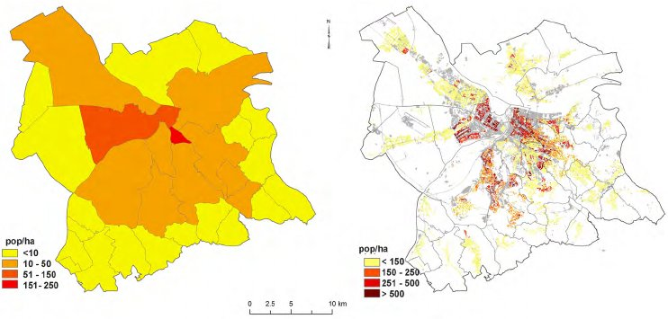
The Scale Issue in Population Density
Choropleth
Dasymetric
Marked and bounded area on a map denoting the distribution of some property.
Using the lowest possible spatial unit
Notes:
Note: Belgrade.
Source: Bajat, Branislav & Krunic, Nikola & Samardzic-Petrovic, Mileva & Kilibarda, Milan. (2013). Dasymetric modelling of population dynamics in urban areas. Geodetski Vestnik. 57. 777-792.

Slide 9
Population Distribution and Density
Carrying Capacity
  The maximum number of people that can be supported in a given area.
  Provides a more meaningful index of overpopulation than density alone.
  Can be difficult to determine until the region under study is near or over the limit.
  Sometimes the carrying capacity of one place can be expanded by drawing on the resources of another place:
    The 11% of American petroleum consumption is imported (dropping sharply).
  Some examples of countries importing a large share of their food:
    Singapore.
    United Arab Emirates.
    Saudi Arabia.
    Many small Caribbean islands.
Explain the concepts of population density and carrying capacity.

Slide 10
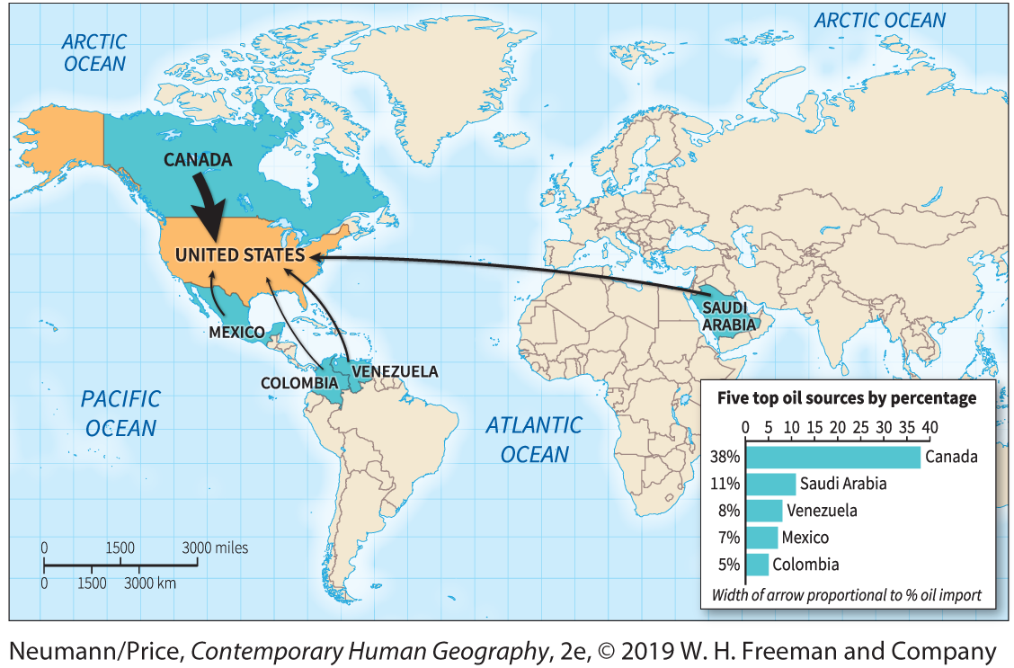
Where does imported oil come from?
Notes:
Data from U.S. Energy Information Administration, 2016

Slide 11
Source: The World Bank: SDG Atlas 2018

Slide 12
US: Overpopulated?
Common argument
  If US lifestyles were adopted by a significant number of Earth’s >7 billion inhabitants.
  Deplete or contaminate Earth’s life-support systems.
The electricity use of one person in the US is equivalent to the electricity use of approximately:
  10 people in China.
  34 people in India.
  64 people in Nigeria.
The US generates ~ 40% of the world’s waste
Notes:
Source: National Geographic’s “Beyond the Flood” documentary, 2016; greenscene.net

Slide 13
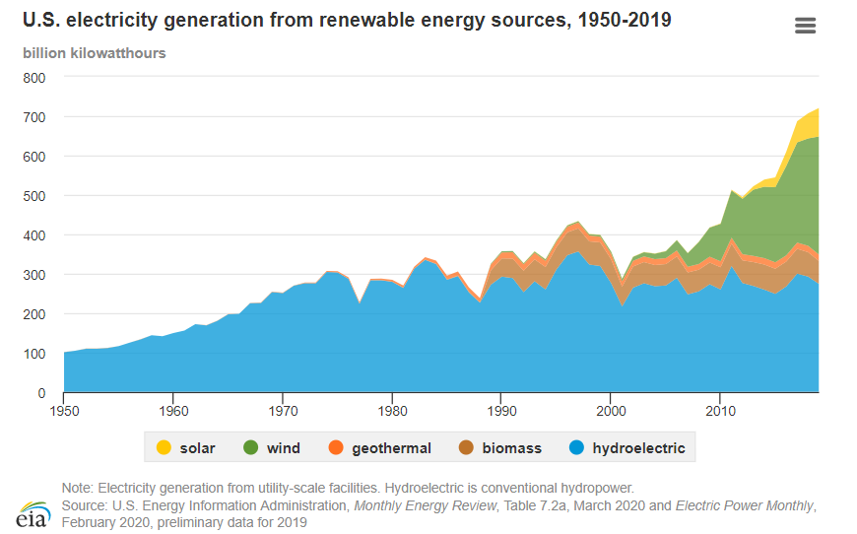
US Electricity Generation for Renewable Sources

Slide 14
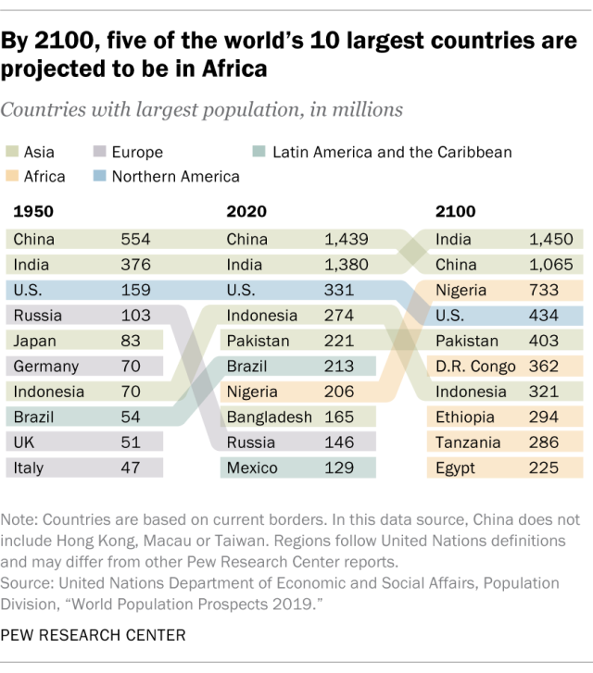
15 Largest Countries, 2018, 2050 (in millions)
Notes:
Source: FAO Statistical Database
https://www.pewresearch.org/fact-tank/2019/07/10/for-world-population-day-a-look-at-the-countries-with-the-biggest-projected-gains-and-losses-by-2100/

Slide 15
Patterns of Natality and Mortality
Crude Birthrate:
  Births per year per 1,000 people.
Total Fertility Rate (TFR)
  Number of children the average woman will bear during her reproductive lifetime.
Zero population growth
  Situation in which the population is neither growing nor shrinking.
  Achieved at TFR = 2.1.
Crude Death Rate
  Number of deaths per year per 1,000 people.

Slide 16
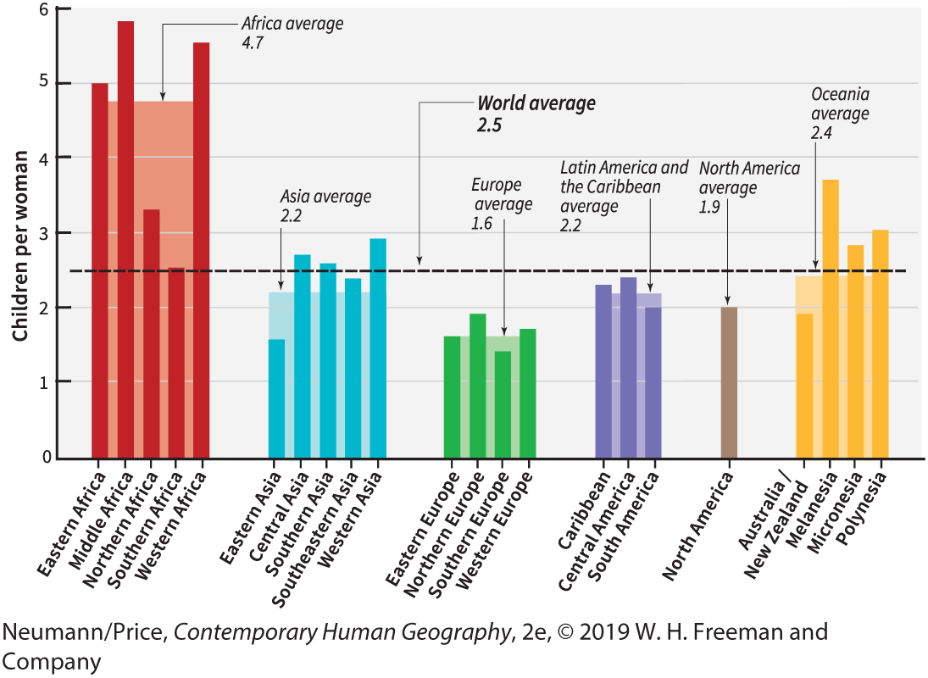
TFR by Region

Slide 17
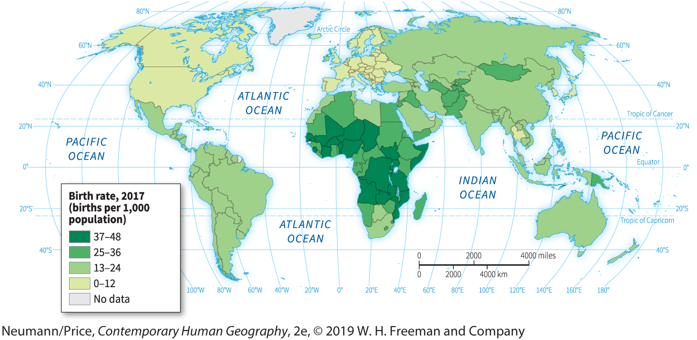
Birth Rates, 2017
Notes:
Crude birth rate. This map shows births per thousand population per year.
(Data source: Population Reference Bureau).

Slide 18
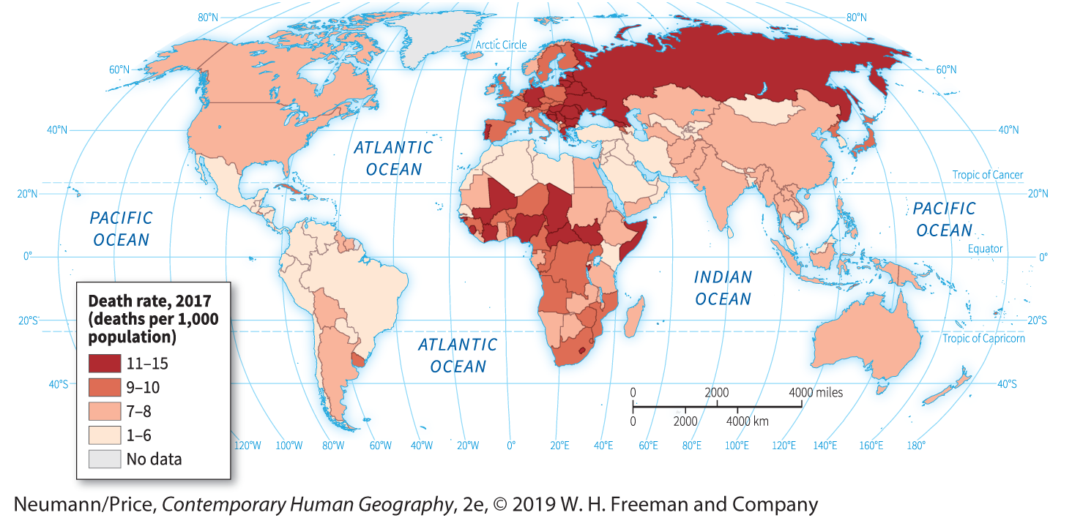
Death Rates, 2017
Notes:
Crude death rate. This map shows deaths per thousand population per year. (Data source: Population Reference Bureau, 2017.)

Slide 19
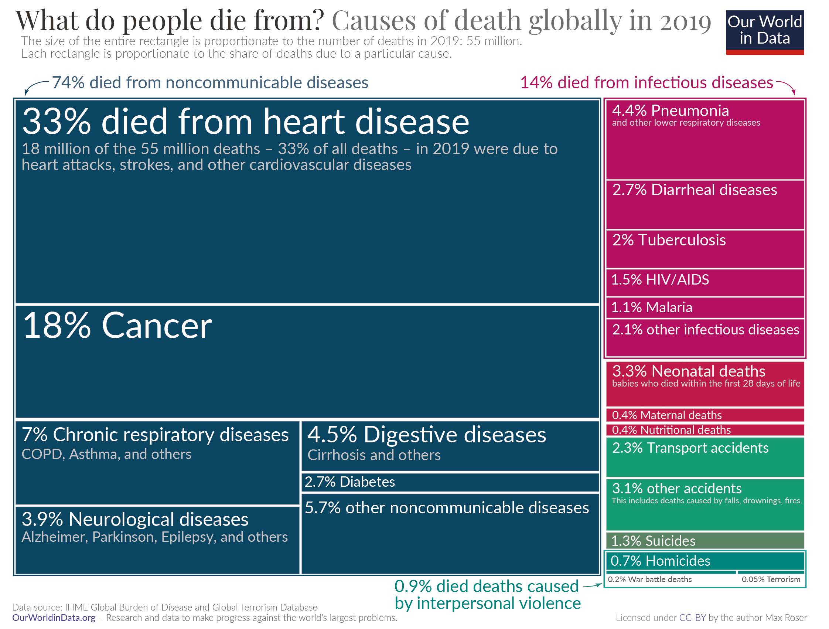
Notes:
140 million people are born each year.

Slide 20
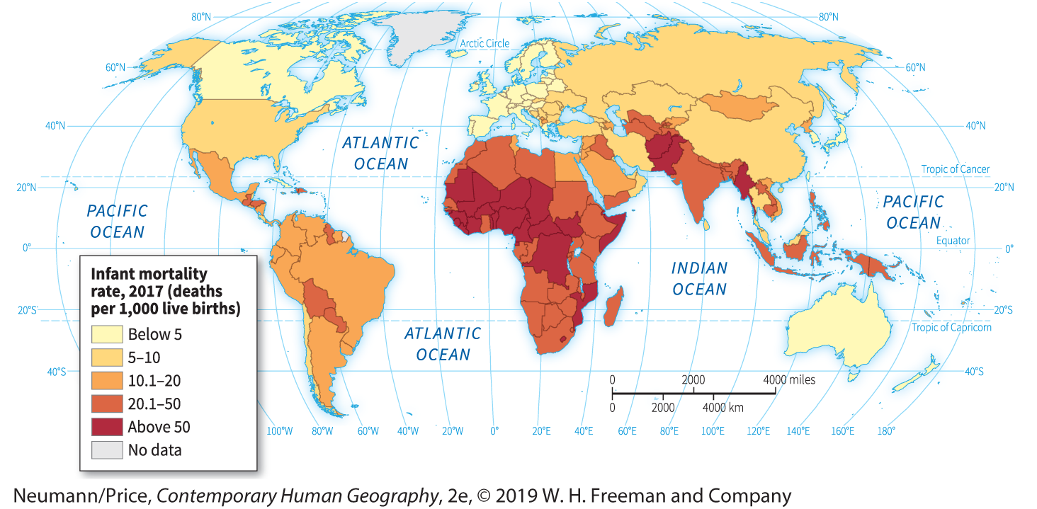
Infant Mortality Rates, 2017
Explain the global patterns of fertility and mortality.
Notes:
The present world pattern of infant mortality rate. The key indicates the number of children per 1000 born who die before reaching one year of age. The world’s infant mortality rate is 37. Many experts believe that this rate is the best single measure of living standards. (Source: Population Reference Bureau, 2017.)

Slide 21
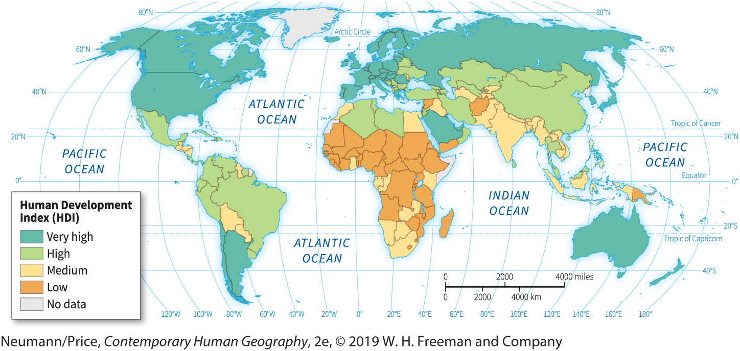
Human Development Index
Insert HDI world map
Life expectancy at birth
Expected years of schooling, and mean years of schooling
GNI per capita in USD, PPP

Slide 22
Discussion about transition in demography and fertility
How many siblings did your grandparents have?
How many siblings do your parents have?
How many siblings do you have?
How many children – if any - do you think you will have?
What could be the consequences of this?

Slide 23
Demographic Transition Model
Demographic transition model
  A transition of the reproductive behavior of a population.
  The movement from high birth and death rates to low birth and death rates.
  Summarizes historically observed population growth or decline related to stages of economic development.
  Traces the changing levels of human fertility and mortality associated with industrialization and urbanization.

Slide 24
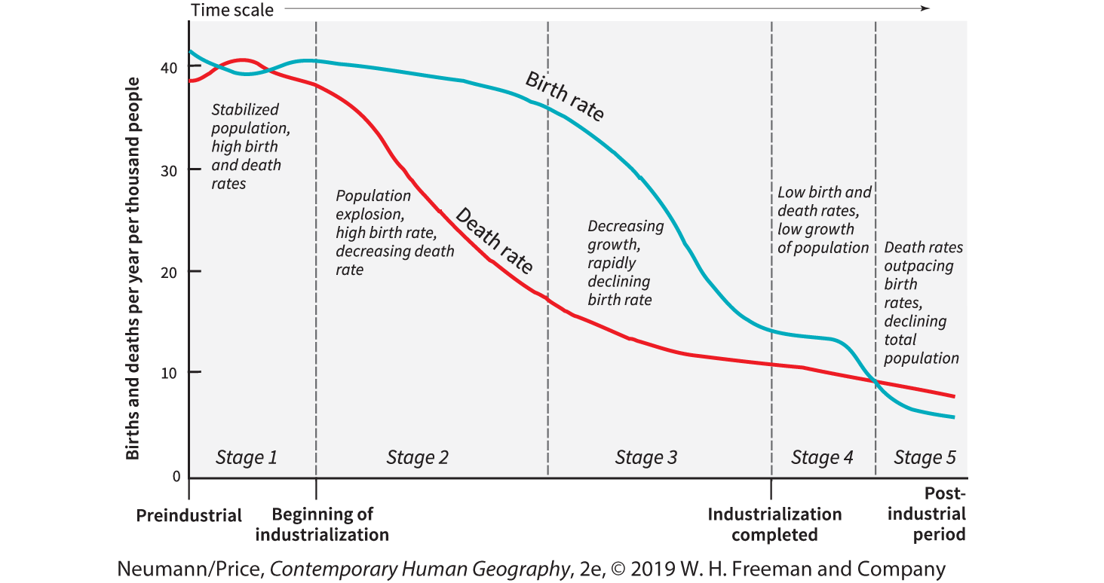
The Demographic Transition

Slide 25
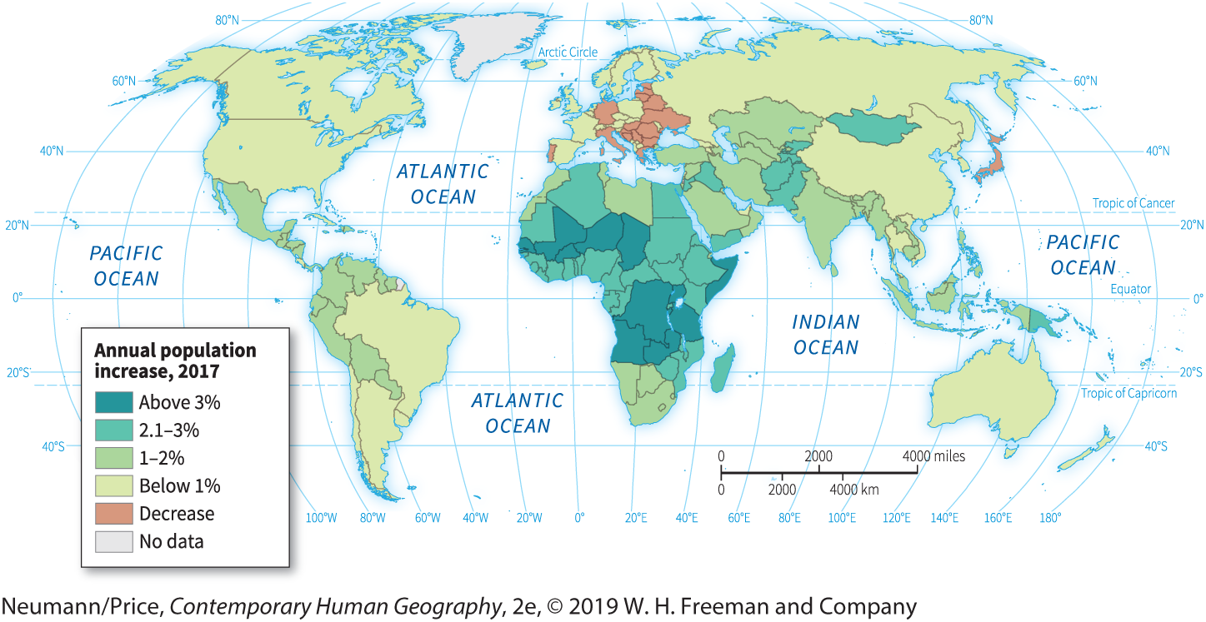
Annual Population Change (increase/decrease)
The difference between the number of births and deaths in a year, taken as a percentage of total population. Migration is not considered.

Slide 26
Shortcomings of the Demographic Transition Model
Eurocentric
  Reflects experience of Western Europe.
  Limited evidence that it is not applicable elsewhere.
Sequence
  Lock-step, stage-by-stage progression.
  Not all countries go through all stages in same way.
  Acceleration of the transition with modernization.
Influencing factors
  Government policies (e.g. One Child Policy in China).
  Wars, mass migrations, widespread disease.

Slide 27
Population Pyramids
Population Pyramids
  A graphic device that represents a population’s age and sex composition.
  A means of comparing populations.
  Most countries’ diagrams used to have a pyramid shape.
Watch this video

Slide 28
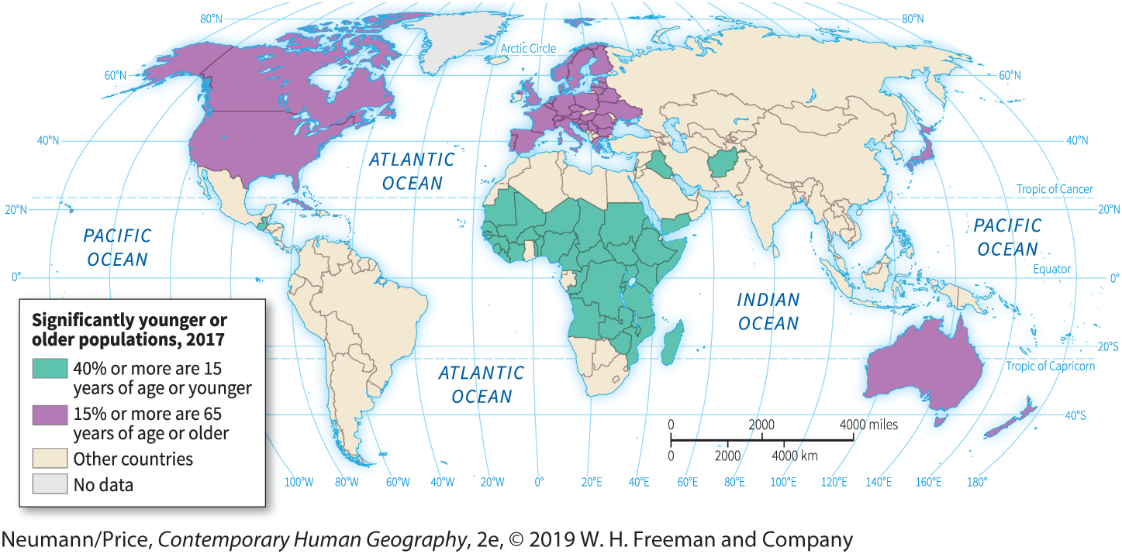
World Pattern of Young and Old Populations

Slide 29
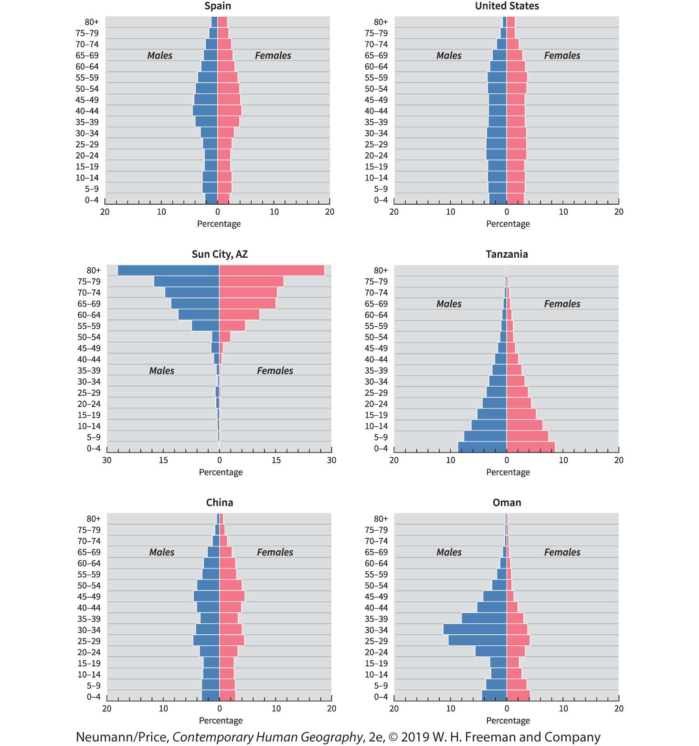
Notes:
In Oman, more than 33% of the population are expatriates.

Slide 30
The Geography of Gender
Geographical differences in sex ratio
  Slightly more boys than girls are born.
  Slight differences in infant mortality rates create an equilibrium by adulthood.
  Recently settled areas have more males than females.
  Prolonged wars reduce the male population.
  Females have a longer life expectancy.

Slide 31
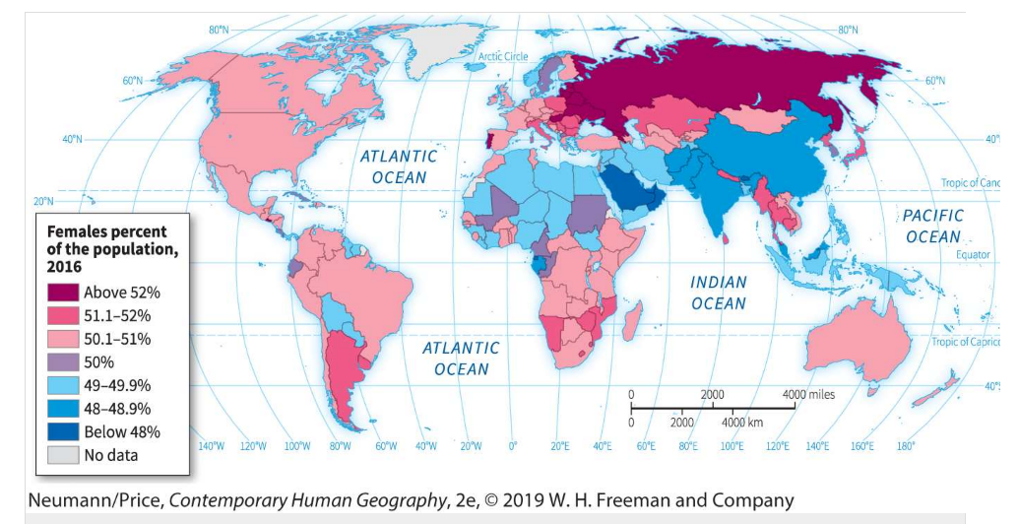
Females as a Percentage of Total Population, 2016
How is the demographic transition changing the composition of the global population by number and age?

Slide 32
B – Patterns, causes, and consequences of population migrations
After natural increases and decreases in populations, the second of the two basic ways in which population numbers are altered is by the migration of people from one place to another.

Slide 33
Migration
Usually the outcome of seeking better opportunities
Push factors
  Unfavorable, repelling conditions that spur migration.
  (Inability to live off the land, high taxes, repressive government, war)
Pull factors
  Favorable, attractive conditions that spur migration.
  (Opportunities for education and employment, proximity to family members).
Refugees

Slide 34
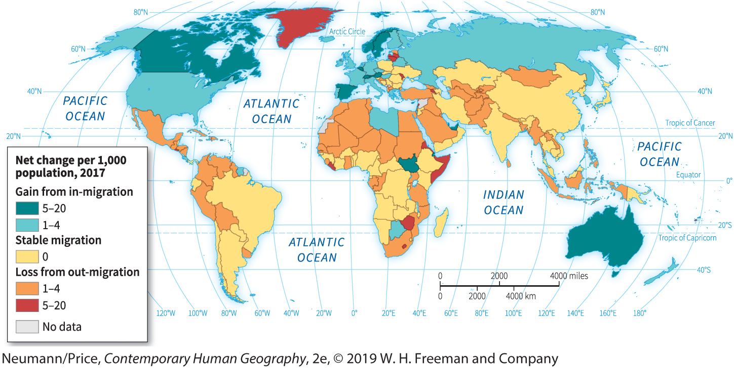
Immigration and emigration flows (current)
244 million people live outside their birth country.

Slide 35
C – Theories of population growth and control
Demographic processes and their global ramifications.

Slide 36
Population “explosion”
The rapid and accelerating increase in world population since 1900
  The crucial element triggering this “explosion” has been a steep decline in the death rate, particularly for infants and children, in most of the world, without an accompanying universal decline in fertility.
  Until very recently, the number of people in the world has been increasing geometrically, doubling in shorter and shorter periods of time.

Slide 37
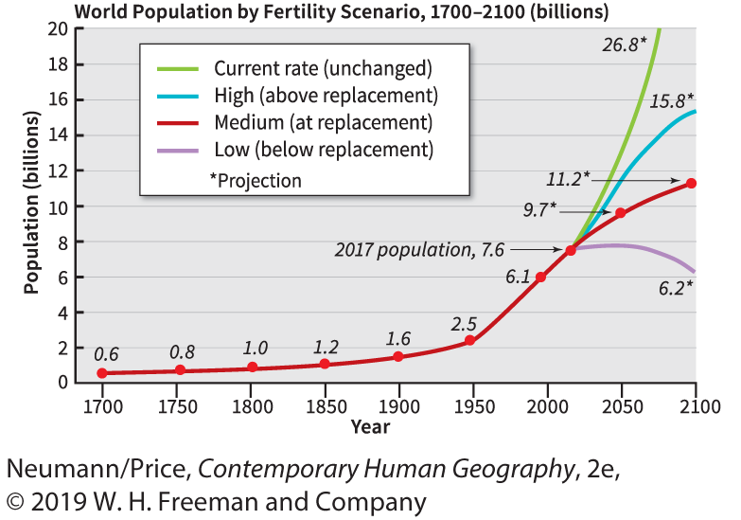
World Population to 2100: Possible Scenarios

Slide 38
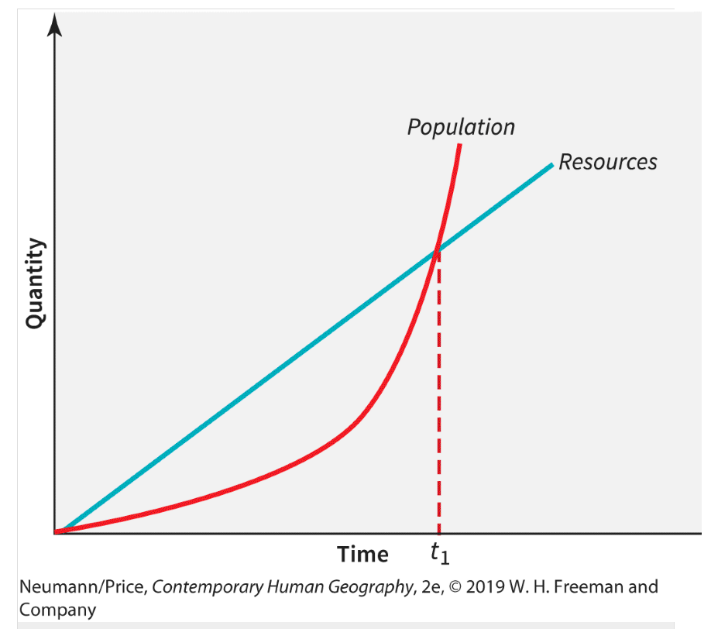
Thomas Malthus (1766-1834)
English economist and demographer
Published “An Essay on the Principle of Population” 1798
Population growth will exceed food production capacity
Checks are either “private” (moral restraint) or “destructive” (war, poverty, pestilence, famine)

Slide 39
Cornucopians and Neo-Malthusians
Cornucopians
  Those who believe that science and technology can solve resource shortages.
  In this view, human beings are a resource rather than a burden to be limited.
Neo-Malthusians
  Modern-day followers of Thomas Malthus argue that Earth’s support systems are being strained beyond their capacity by the widespread adoption of wasteful Western lifestyles.
  Remedy: Birth control and family planning.
Why perspectives about population growth and control are so controversial?

Slide 40
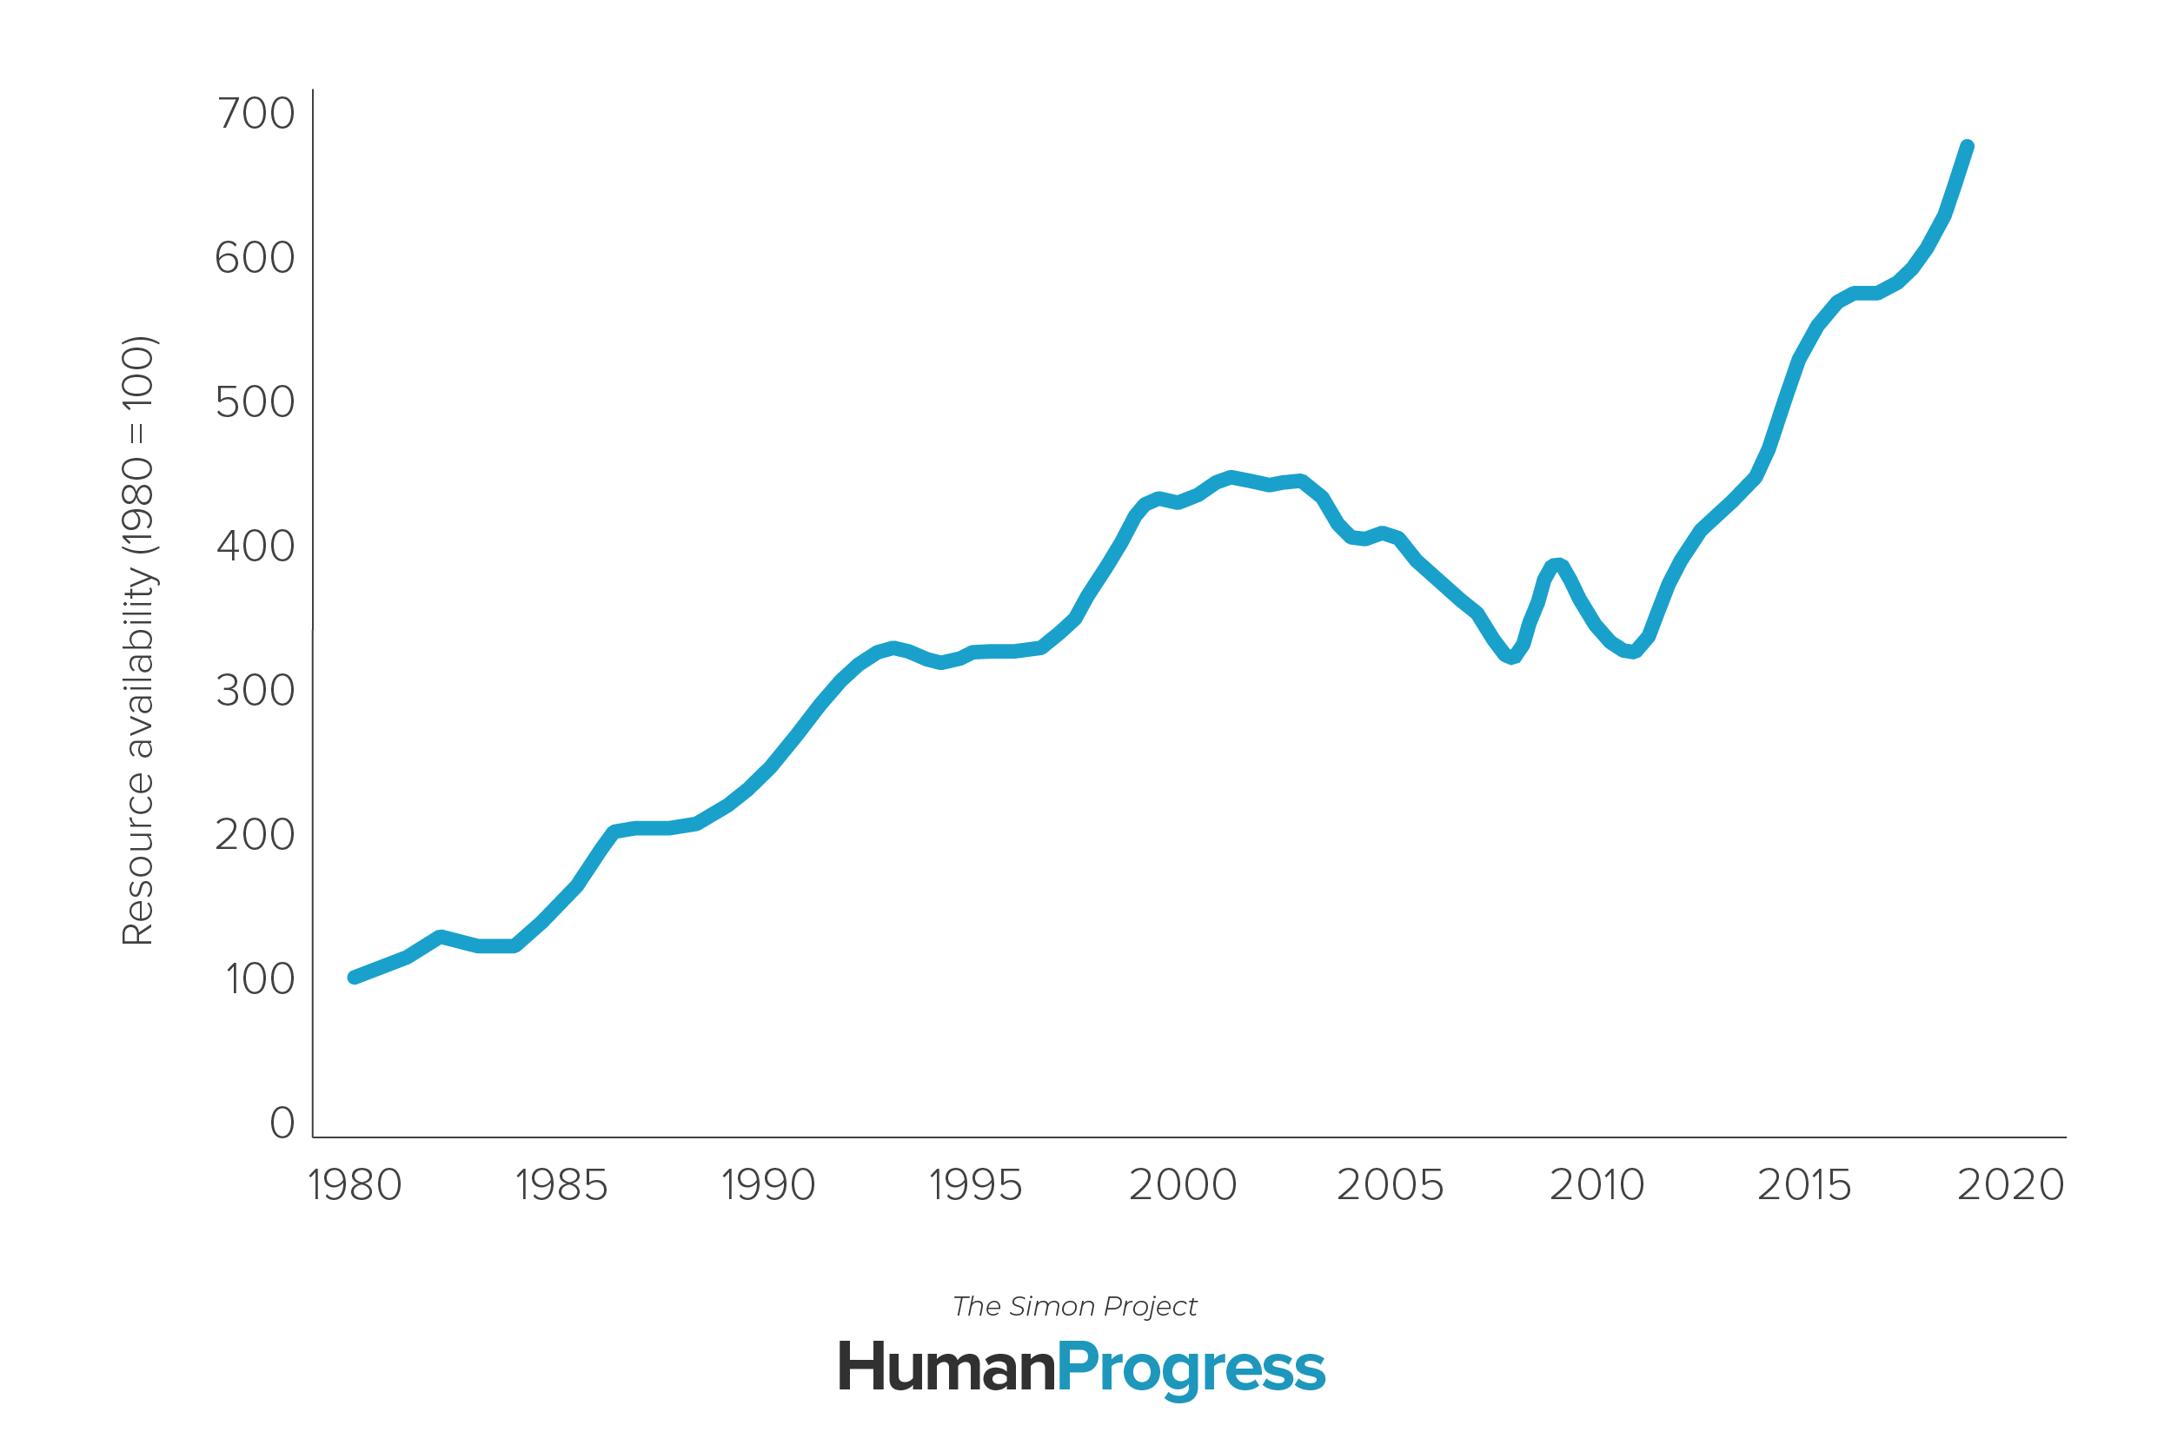
Simon Abundance Index, 1980-2019
The earth is 570% more abundant in 2019 than in 1980
For a pool of commodities. The ratio of the change in population over the change in the time price, times 100.
Notes:
Source: Human Progress, The Simon Project.

Slide 41
Slowdown in Population Growth
The end of the population explosion
  Global TFR around 2.3 in 2020 (2.4 in 2018).
Longer “doubling times”
  The Rule of 72.
  The law of compounding interest.
  Annual rate of population increase / 72.
  USA (2016) 0.43% / 72 = 167 years.
  Guatemala (2016) 2% / 72 = 36 years.

Slide 42
Population Control Programs
Pronatalist programs
  Supporting an increase in population, particularly when fertility rates and numbers are low.
  The case of the Nordic countries.
  Likely to become prevalent in advanced economies.
Antinatalists programs
  China’s One Child Policy (1981).
  Between 1970 and 1980, the TFR in China fell from 5.9 to 2.7, then to 2.2 by 1990, 2.0 by 1994, 1.7 by 2007, and 1.5 by 2013.
  400 million fewer births.
  Social consequences:
    “The little emperor syndrome”
    Abortion of female fetuses.
    Daughters given up for adoption
  The program ended in 2015.

Slide 43
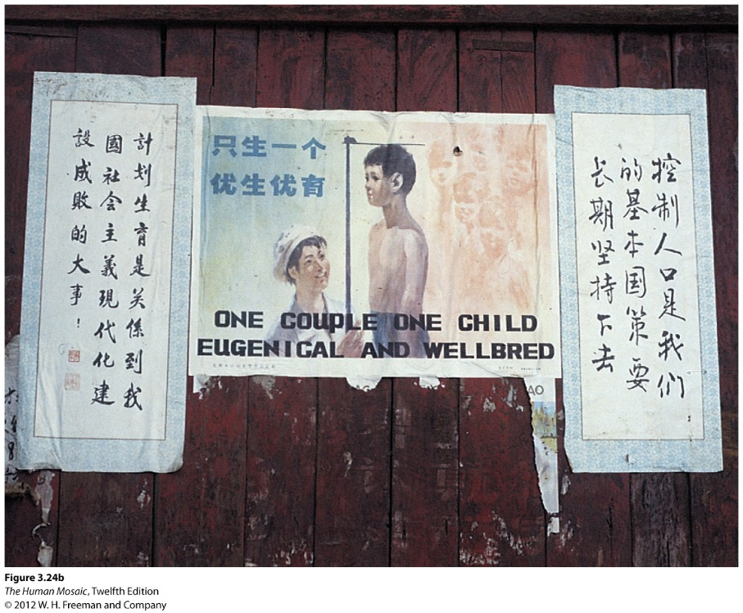
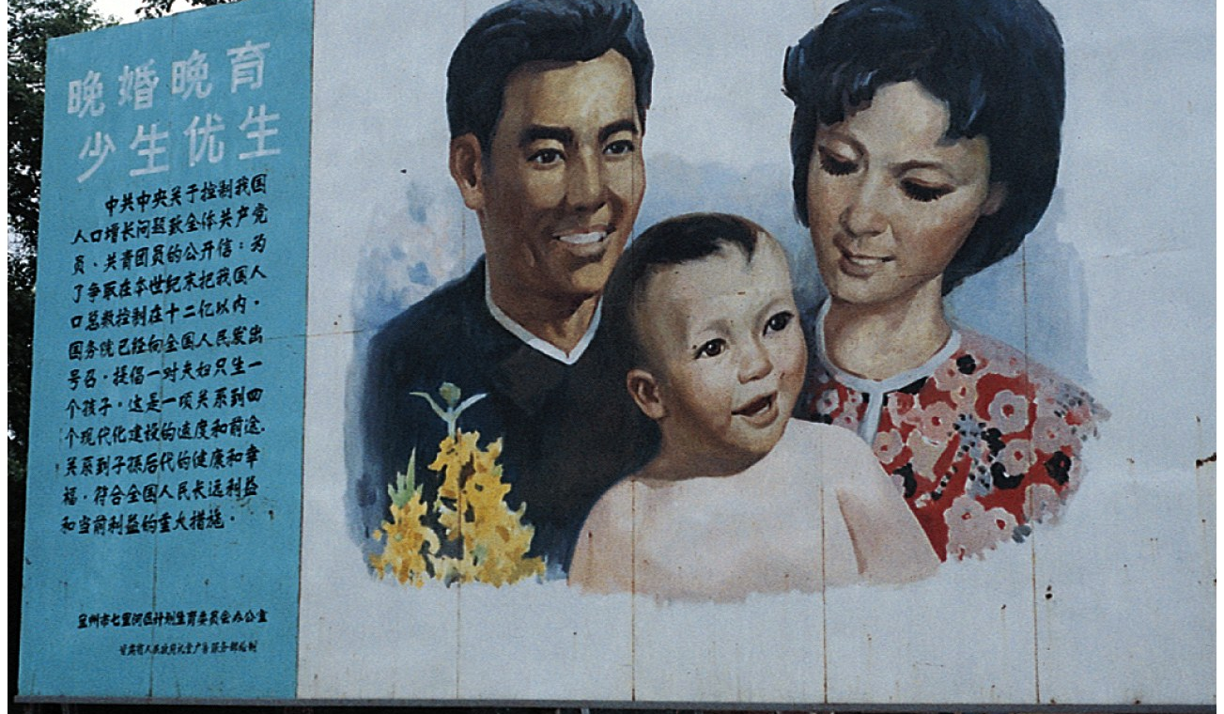
China’s Population Control Program

Slide 44
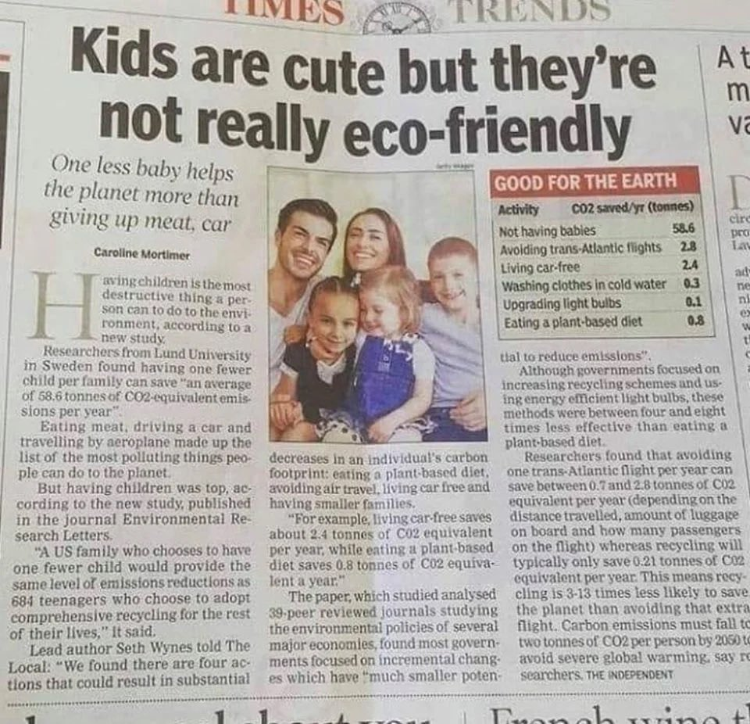
Antinatalism

Slide 45
D – How the natural world shapes population characteristics
Environmental influences on settlement patterns

Slide 46
Environmental Influence on Population
Important factors
  Climate (comfort and agriculture).
  Soil (potential for agriculture).
  Resources, such as minerals.
  Proximity to water (human and industrial demand, agriculture, navigation).
  Elevation (impact on climate and accessibility).
Preference for subtropical and temperate climates
  Avoidance of mountainous areas in temperate climates (Rockies).
  Preference for mountainous areas in tropical and subtropical areas (Andes).

Slide 47
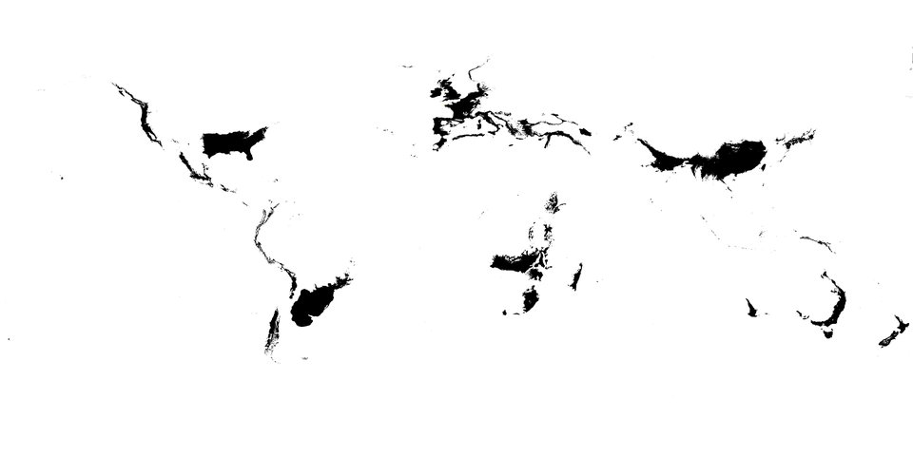
Temperate Climate Zones (C type Koppen-Geiger)

Slide 48
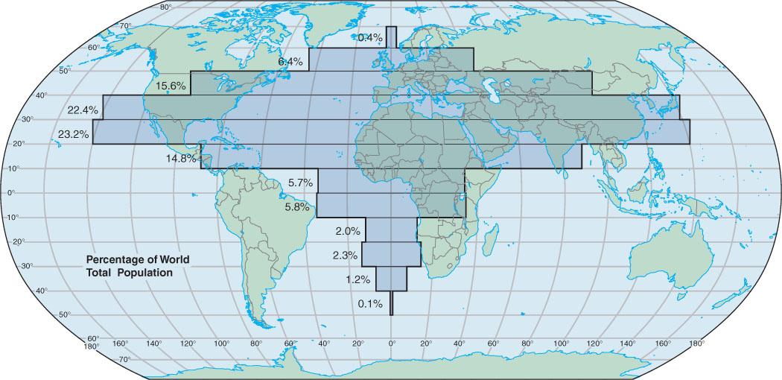
Population Distribution by Latitude

Slide 49
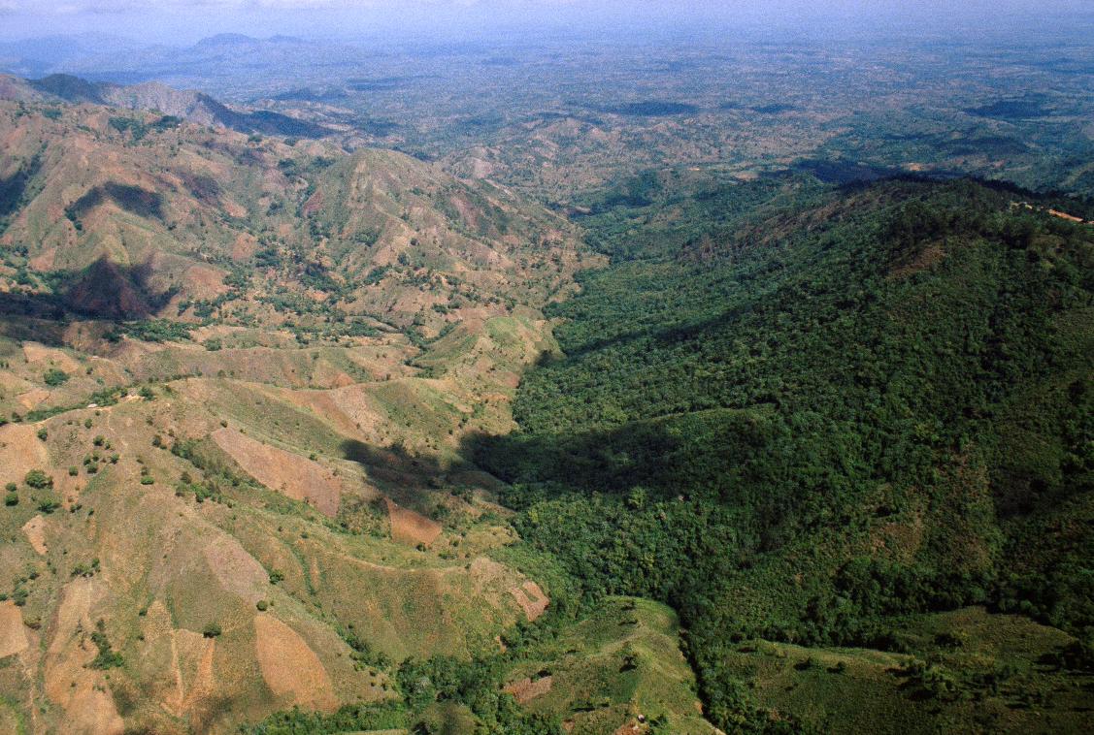
Political Border as Environmental Border
Environmental perception
  Different cultural groups perceive the same physical environment in different ways.
Humans as modifiers of the environment
  People modify their habitat via their adaptive strategies.
Are these strategies sustainable?
Border between Haiti and the Dominican Republic

Slide 50
E – Imprints of demographic factors on the Cultural Landscape
Population geographies are visible in the landscape

Slide 51
Diverse settlement types
Farm village
  Clustered rural settlement of moderate size.
  Inhabited by people who are engaged in farming.
  The fields surround the village.
Farmstead
  The center of farm operations, containing the house, barn, sheds, and livestock pens.
  Usually a single family.
Shantytowns
  Informal settlements adjacent to urban areas.
  Also known as favelas, slums, squatter settlements.

Slide 52
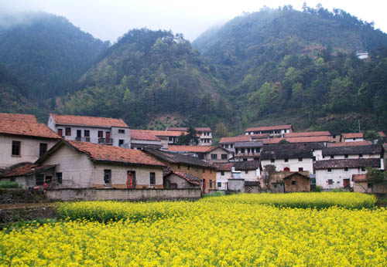
Farm Village, India

Slide 53
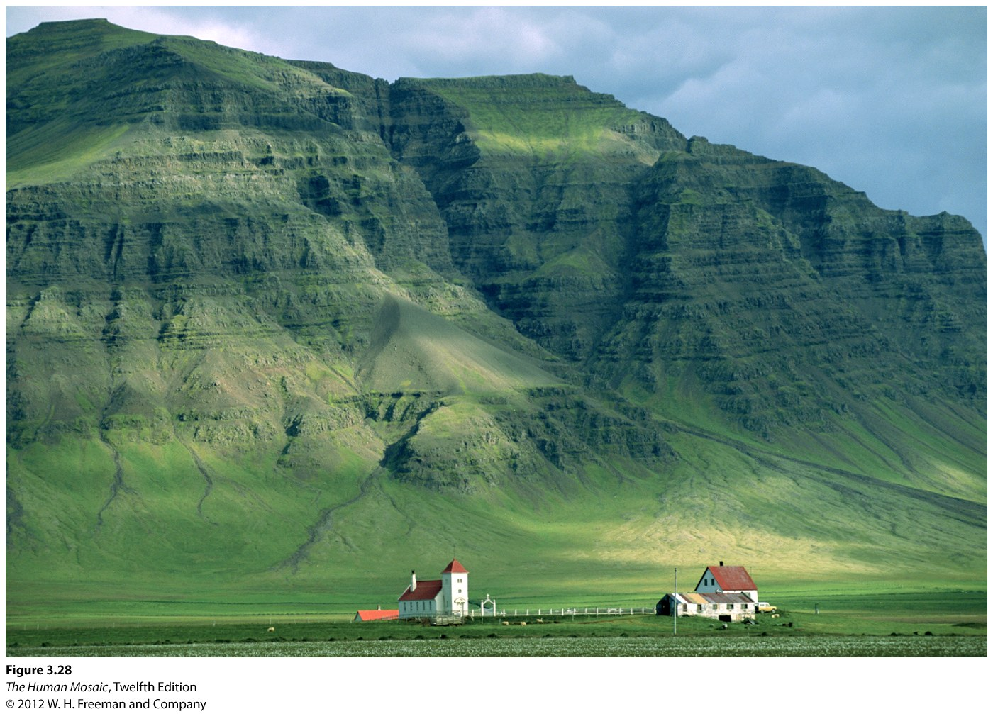
Isolated Farmstead, Iceland

Slide 54
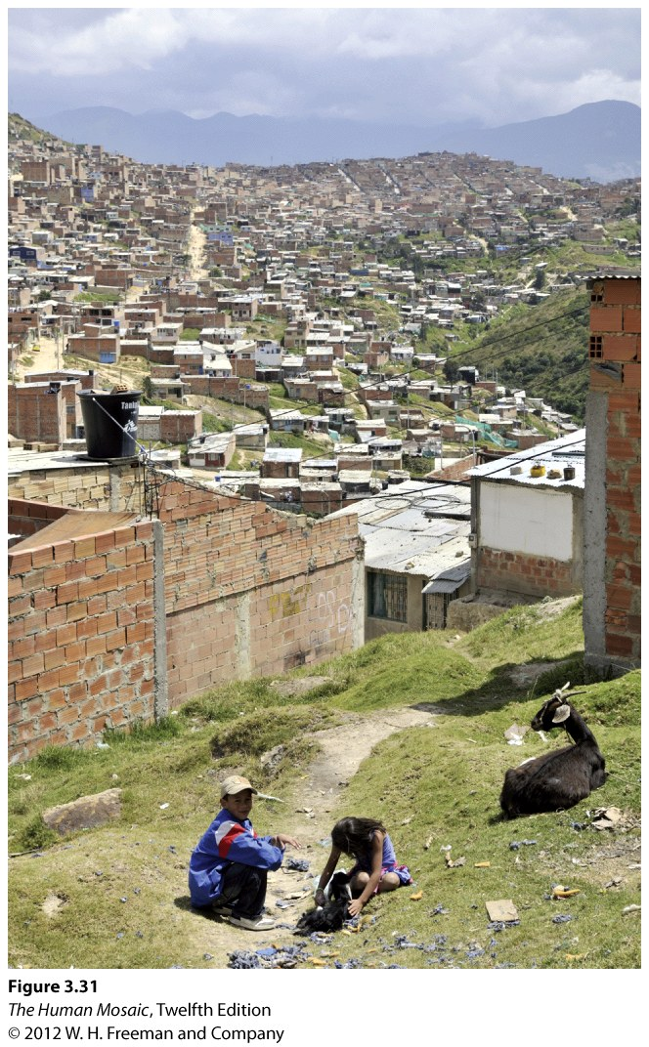
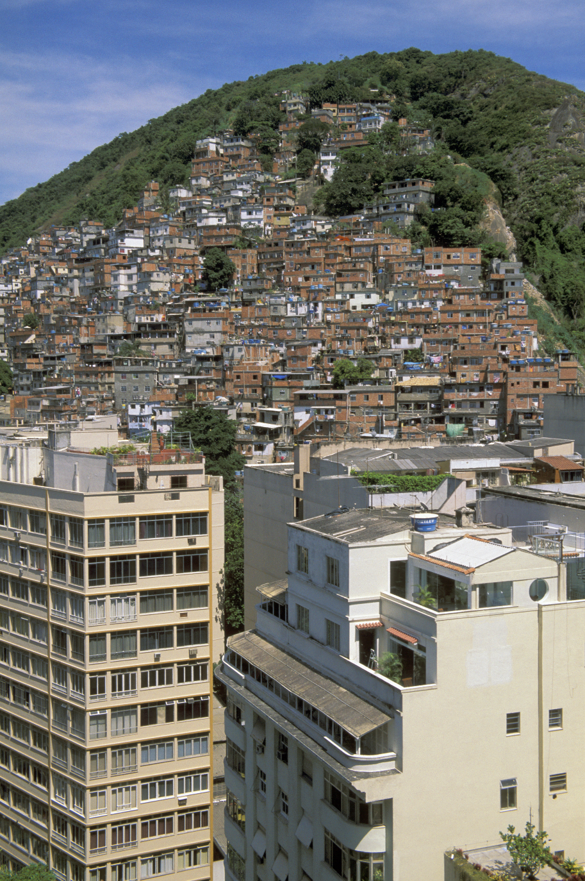
Shantytown Settlements
Outskirt of Bogota, Colombia
Rio de Janeiro, Brazil

Slide 55
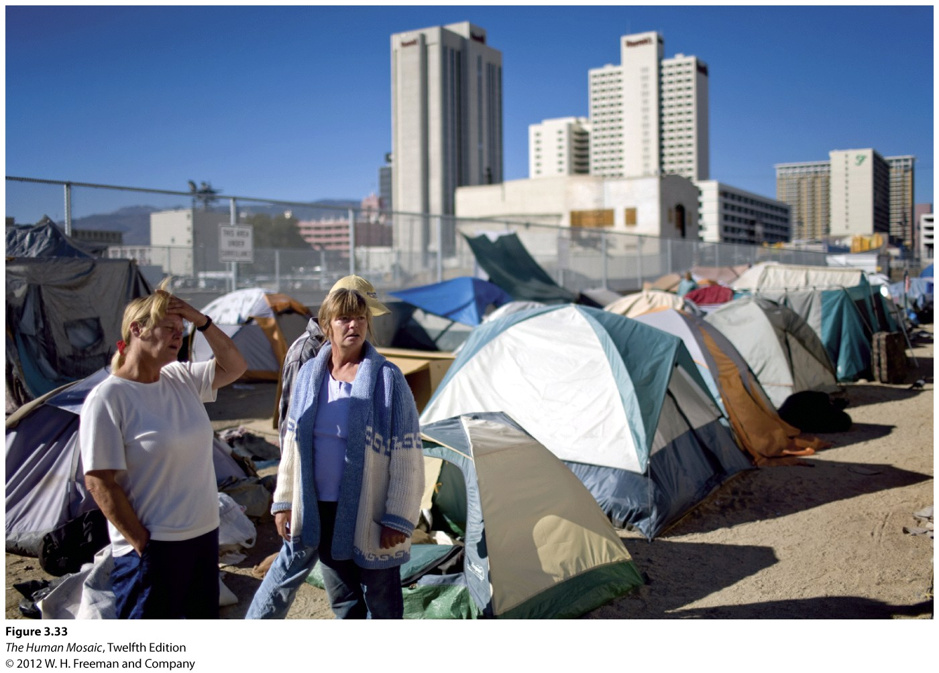
Tent City, Reno, NV, 2008

Slide 56
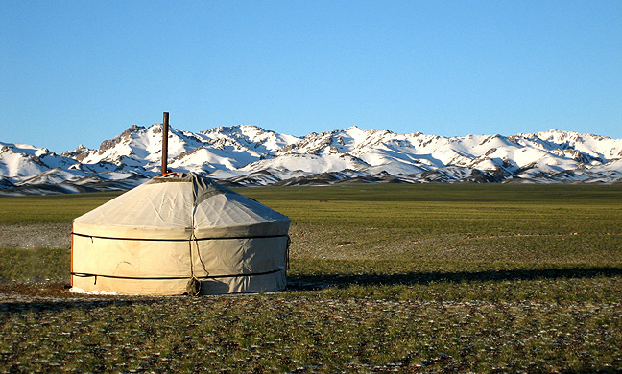
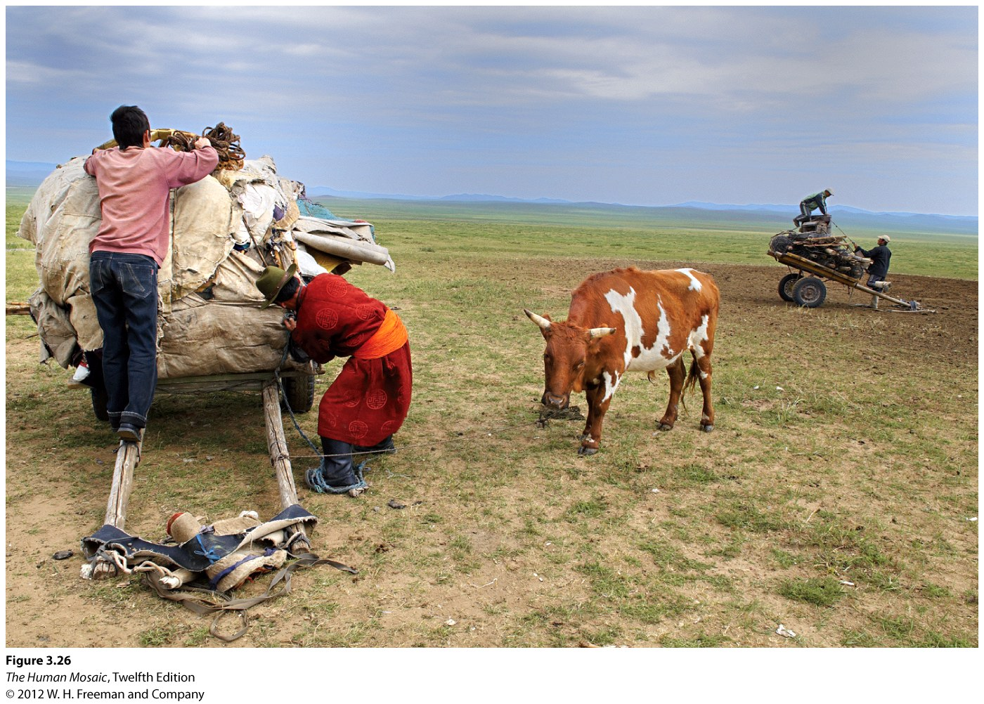
Nomadic Mongols
Today, it is common for Mongolian nomads to have cars (four-wheel drives).
Notes:
Photos: http://upload.wikimedia.org/wikipedia/commons/9/9b/Gurvger.jpg
Relevant documentary: https://www.bbc.co.uk/programmes/b05zqqbt
https://www.youtube.com/watch?v=bmUHLX-p_e4

Slide 57
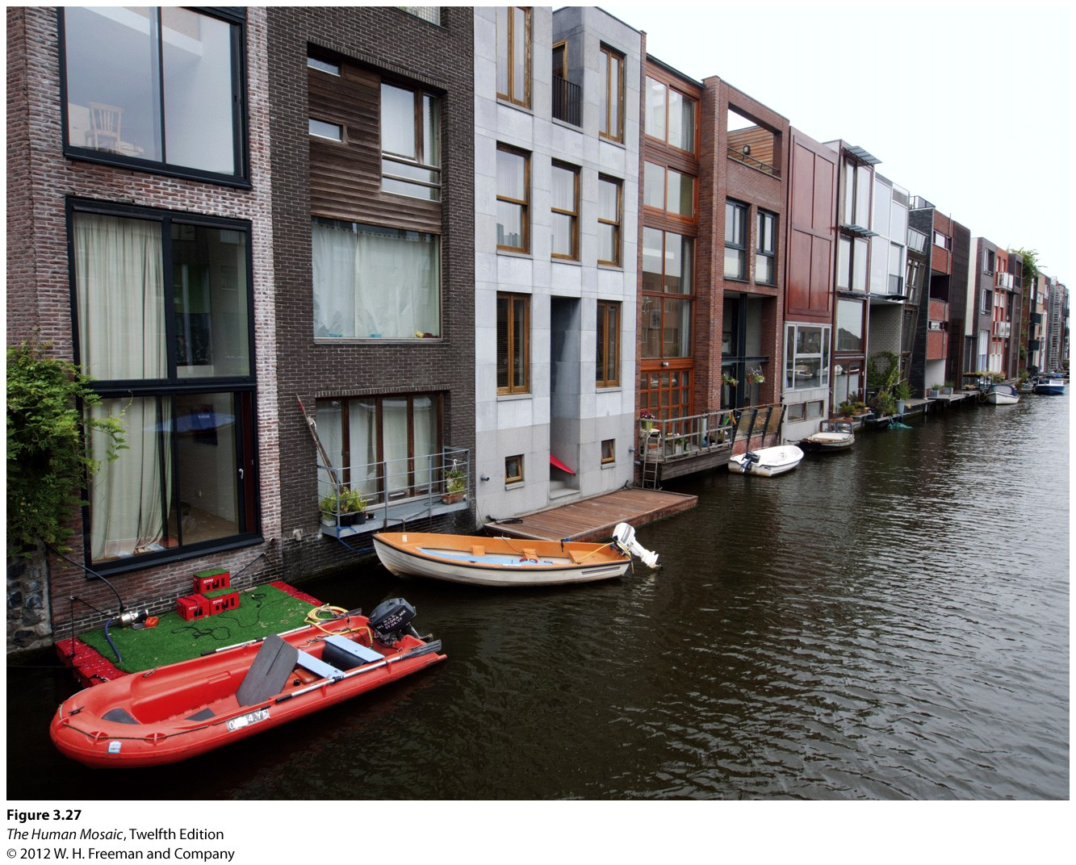
High-Density Dwelling in Amsterdam

Slide 58
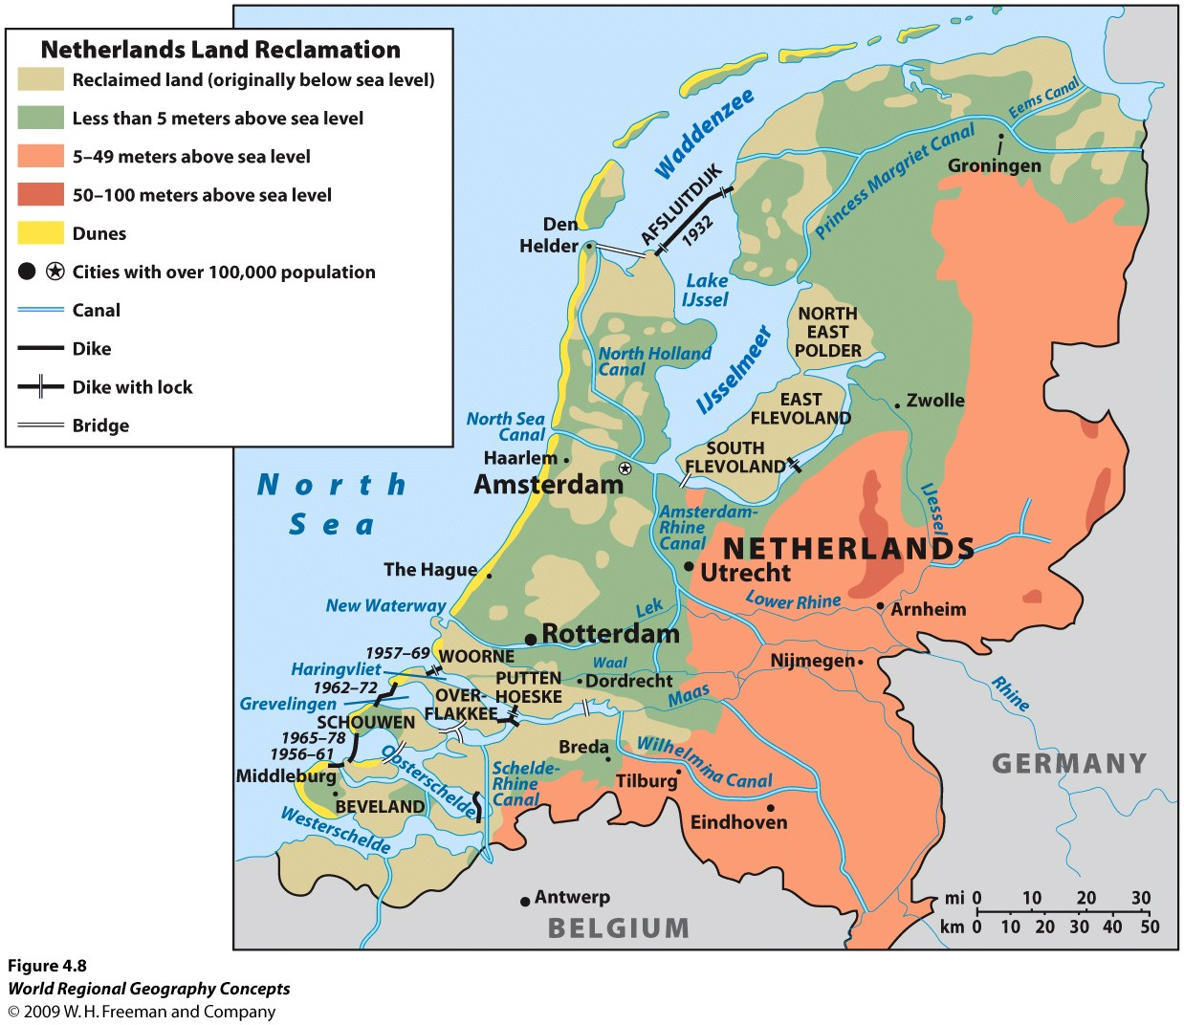
A human-made place: coastal wetland filled in since the middle ages. 60% of population live below sea-level.

Slide 59
Depopulation
Often the outcome of a catastrophic event
  Natural disaster, epidemic, warfare, genocide.
  Smallpox in North America (16th century; 10 to 20 million deaths).
  Syrian Civil War (2.5 million Syrians fled to Turkey between 2011 and 2015; out of 21 million).
  Venezuelan socialist utopia (5 million left between 2015 and 2019; out of 30 million).
  Can be a gradual process due to technological and economic changes:
    Rural to urban migrations.
    The economic decline of the “rust belt”.
    Changes in fertility patterns (countries with negative population growth).
    Post-Covid cities.
What is depopulation and provide some examples.

Slide 60
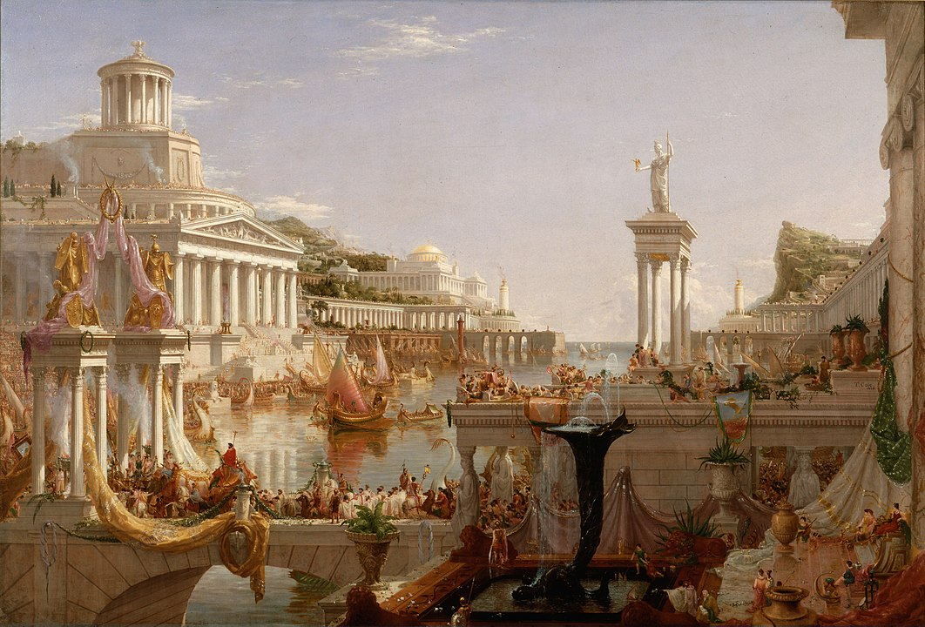
The Consummation of Empire (T. Cole, 1836)

Slide 61
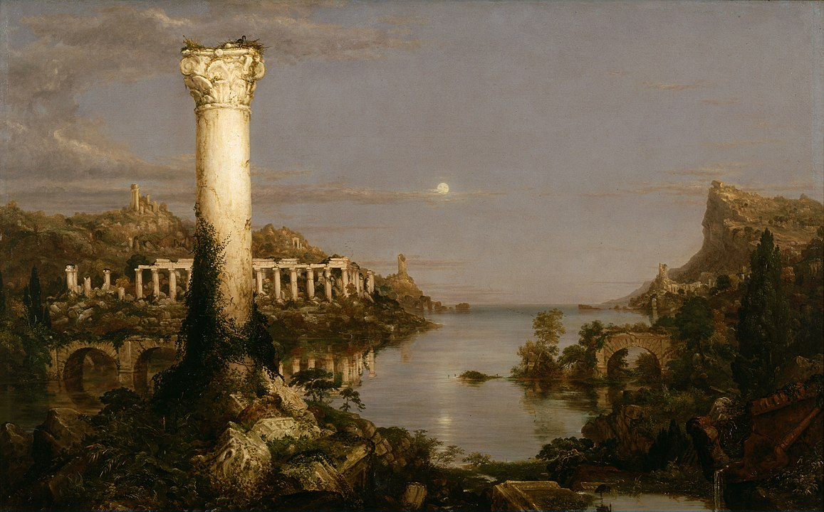
Desolation (T. Cole, 1836)

Slide 62


