Slide 1
Topic 10 – Urban Geography
A – Regional Patterns of Urbanization
B – Urban Migration and Mobility
C – Global Cities
D – Cities and the Natural World
E – The Urban Landscape

Slide 2
Conditions of Usage
For personal and classroom use only
  Excludes any other forms of communication such as conference presentations, published reports and papers.
No modification and redistribution permitted
  Cannot be published, in whole or in part, in any form (printed or electronic) and on any media without consent.
Citation
  Neumann, Roderick P. and Price, Patricia L. (2019) Contemporary Human Geography: Culture, Globalization, Landscape, Second Edition.
  Dr. Jean-Paul Rodrigue, Dept. of Global Studies & Geography, Hofstra University.

Slide 3
A – Regional Patterns of Urbanization
Historical and contemporary regional patterns of urbanization.

Slide 4
An urban world
Urbanization
  Change in the cultural geography of the world.
  54% of the global population living in cities.
  Cities grow by a combined total of 3 million people each week.
  Some regions contain many cities while others contain relatively few.
  The size, population density, and look and feel of those cities can vary greatly.
  Europe, North America, Latin America, and the Caribbean: approximately 75 percent.
  Africa and Asia, on the other hand, are less urbanized, with many countries in these regions having 40 percent.
  How do geographers explain these varying regional patterns of urbanization?

Slide 5
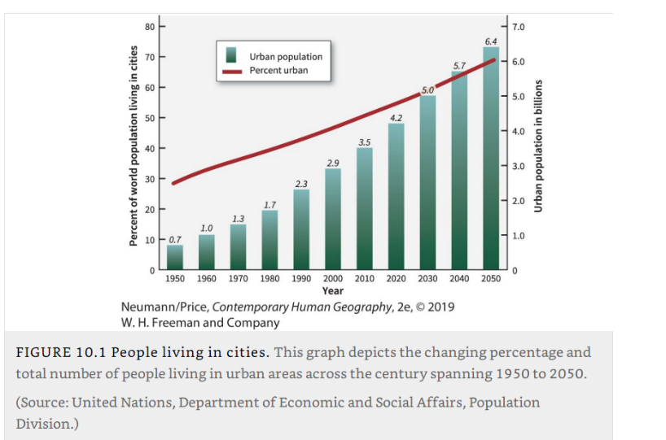
Urban Population

Slide 6
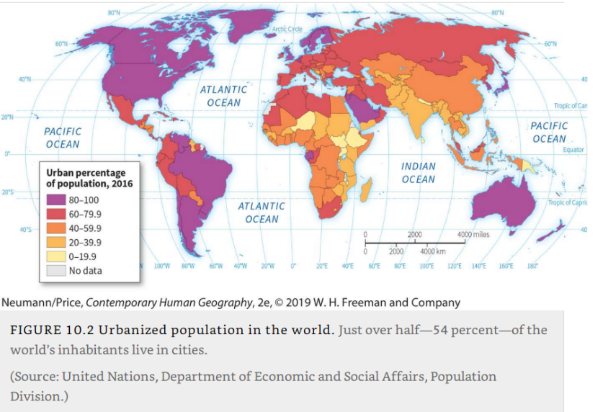
Urbanized Population

Slide 7
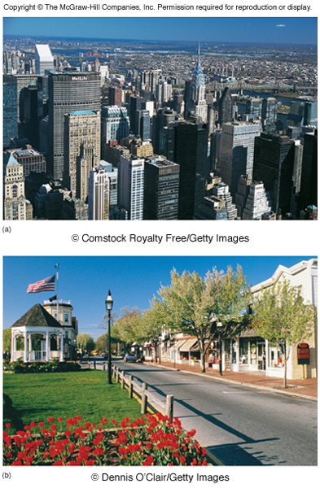
Patterns and Processes of Urbanization
Definition of “urban” varies between countries
  Lack of a standard definition of what constitutes a city.
  Japan: >50,000 people
  Greece: >10,000
  India:>5,000.
  US: >2,500
  Nicaragua: Administrative centers >1,000 & streets and electric lights
  Norway: >200 (!) & max. 50 meters between the houses.

Slide 8
Patterns and Processes of Urbanization
Growth prospects
  Almost all the worldwide population growth in the next several decades will be concentrated in urban areas.
  Cities of the less developed regions accounting for most of that increase.
  Urban population growth and its uneven distribution around the world.
  Urban growth comes from two sources:
    Migration of people from rural areas to cities.
    Higher natural birth rates of these recent migrants.
  Cities are often the centers of economic growth.
Explain what the terms urban and urbanization mean.

Slide 9
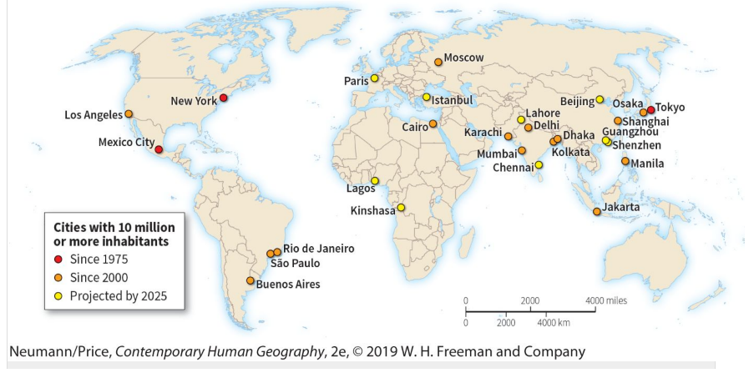
World’s Largest Cities

Slide 10
The Rise of Cities
Emergence
  In the Middle East, where the first cities appeared, a network of permanent agricultural villages developed about 10,000 years ago.
  All the inhabitants of agricultural villages involved in some way in food procurement.
  Urban settlements dating to around 4000 B.C.E. in Mesopotamia.
  Mesopotamian cities covered 0.5 to 2 square miles (1.3 to 5 square kilometers), with populations that rarely exceeded 30,000.
  Densities within these cities could easily reach 10,000 people per square mile (4,000 per square kilometer), which is comparable to the densities in many contemporary cities.
  Cities more removed, both physically and psychologically, from everyday agricultural activities.
  Food was supplied to the city, but not all city dwellers were involved in obtaining it.

Slide 11
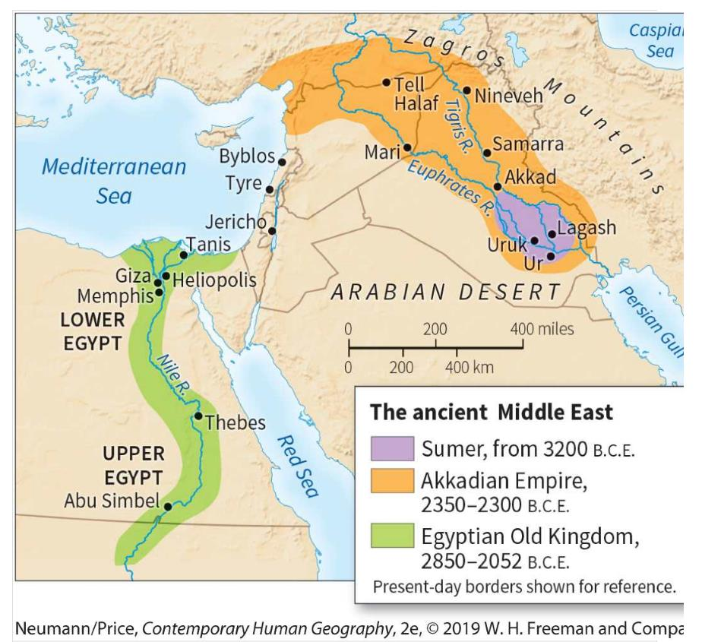
Early Mesopotamian and Egyptian cities

Slide 12
The Rise of Cities
The generation of surpluses
  Surplus food is a prerequisite for supporting nonfarmers.
  Cities associated with the productivity of their agricultural hinterlands.
Socioeconomic stratification
  Hierarchical arrangement of society through the emergence of distinct socioeconomic classes.
  Facilitates the collection, storage, and distribution of resources through well-defined channels of authority.
  A society with these two elements— surplus food and an organized means of storing and distributing it— was prepared for urbanization.

Slide 13
The Rise of Cities
Hydraulic civilization model
  The development of large-scale irrigation systems was the primary driver of urbanization.
  A class of technical specialists were the first urban dwellers.
  Irrigation of agricultural crops yielded more food, and this surplus supported the development of a large non-farming population.
  A strong, centralized government backed by an urban-based military could expand its power into the surrounding areas.
  Fits several areas where cities first arose; China, Egypt, and Mesopotamia.
  In parts of Mesoamerica an urban civilization blossomed without widespread irrigated agriculture.
What could explain the rise of early cities?

Slide 14
Urban Hearth Areas
First cities
  The first cities appeared in distinct regions.
  Mesopotamia, the Nile River valley, Pakistan’s Indus River valley, the Yellow River valley of China, Mesoamerica, and the Andean highlands and coastal areas of Peru.
Cosmomagical cities
  Cities that are arranged spatially according to religious principles.
  Great importance was given to the city’s symbolic center (axis mundi), which was also believed to be the center of the known world.
  The most sacred spot frequently identified by a vertical structure of monumental scale that represented the point on Earth closest to the heavens.
  Ziggurat (a massive structure having the form of a terraced step pyramid with receding levels) in Mesopotamia, the palace or temple in China, and the pyramid in Mesoamerica.

Slide 15
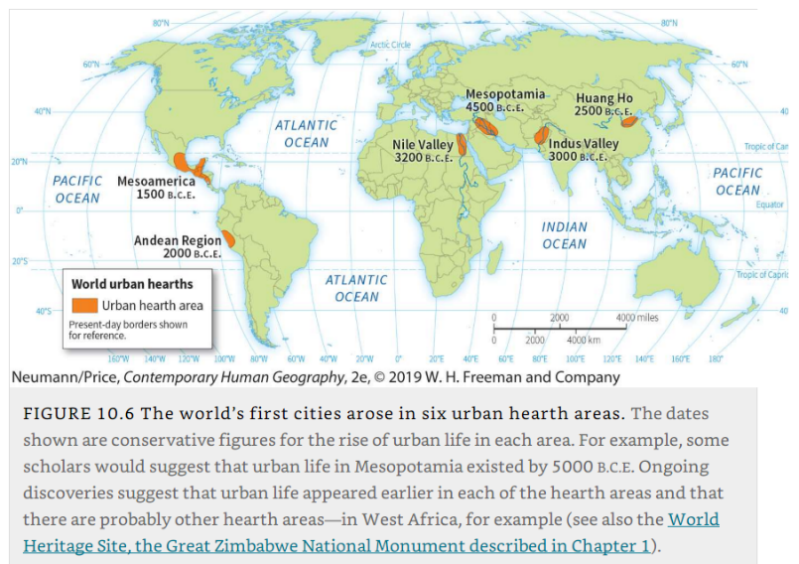
The world’s first cities arose in six urban hearth areas

Slide 16
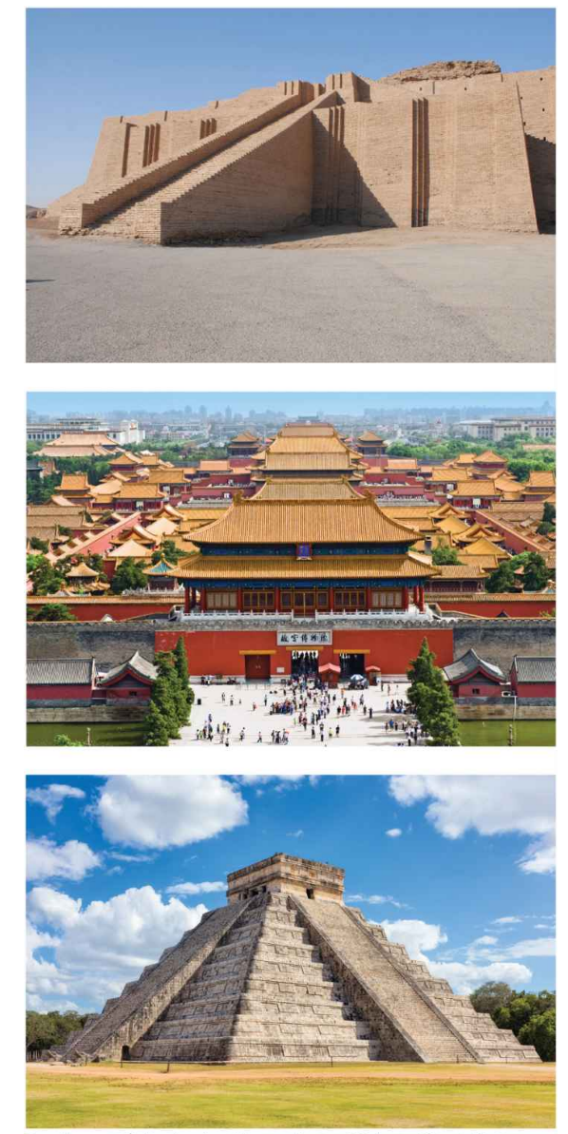
Urban Hearth Areas
Celestial alignment
  Four cardinal directions.
  The geometric form of the city reflected the order of the universe.
  Ensure harmony and order over the known world.
Shape and form
  According to that of the universe.
  Essential to maintaining harmony between the human and spiritual worlds.
  The world of humans would symbolically replicate the world of the gods.
Great Ziggurat of Ur
Forbidden City in Beijing
Chichen Itza, Yucatan

Slide 17
Imperialism and Urbanization
Cities and conquest
  Diffusion has been responsible for the dispersal of the city in historical times.
  The city has commonly been used as a means for imperial expansion.
  Won lands and sets up collection points for local resources, which are then shipped back to the heart of the empire.
  Surrounding countryside is increasingly pacified.
  Collection points lose some of their military atmosphere and begin to show the social diversity.
  Artisans, merchants, and bureaucrats increase in number; families appear; the native people are slowly assimilated into the settlement as workers.
  The process repeats itself as the empire pushes farther outward.

Slide 18
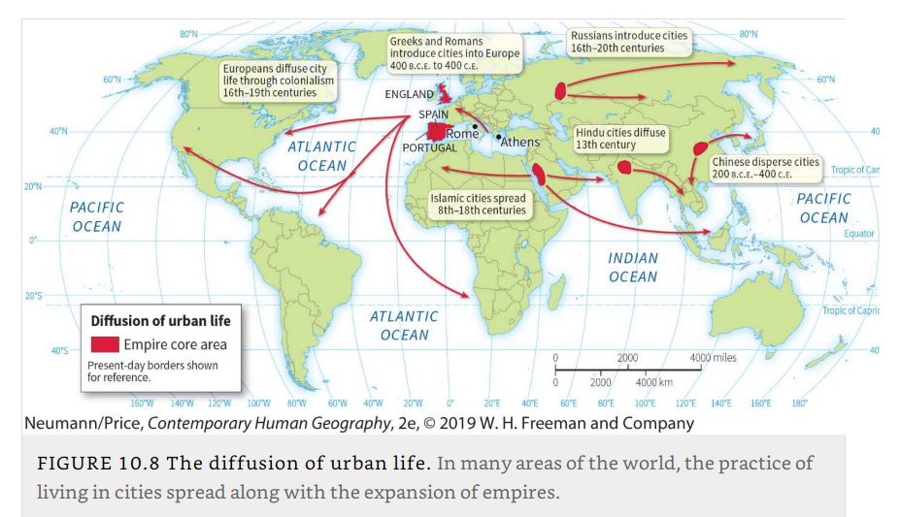
The diffusion of urban life

Slide 19
Imperialism and Urbanization
Ancient Empires and Imperial Expansion
  Greek civilization, to which both Western civilization and the Western city trace their roots, expanded in part through spreading cities throughout the Mediterranean.
  The Roman civilization supplanted ancient Greece and centered on a city: Rome.
  Roman Empire expanded, city life diffused into France, Germany, England, interior Spain, the Alpine countries, and parts of eastern Europe.
  Fundamental to Roman cities was the grid street pattern, composed of straight streets intersecting at right angles.
  The Roman Empire was held together by a system of roads and highways linking towns and cities.
  Many Chinese cities developed around a complex canal system.
What were imperial cities and provide some examples.

Slide 20
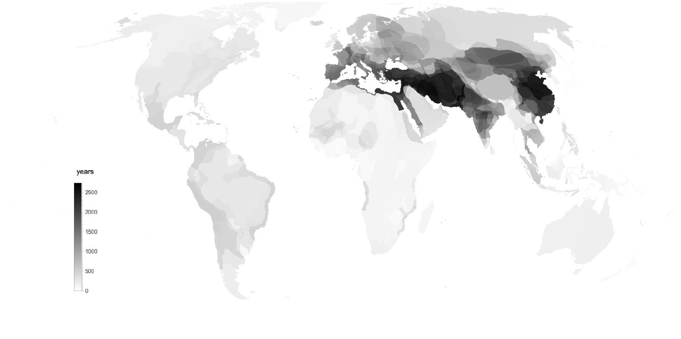
Imperial Density: Number of Years Area part of an Empire
Notes:
Number of years an area has spent inside a state bigger than 500 000 km2 from 1000 BC to now. Persia and China emerge as the imperial heartlands.

Slide 21
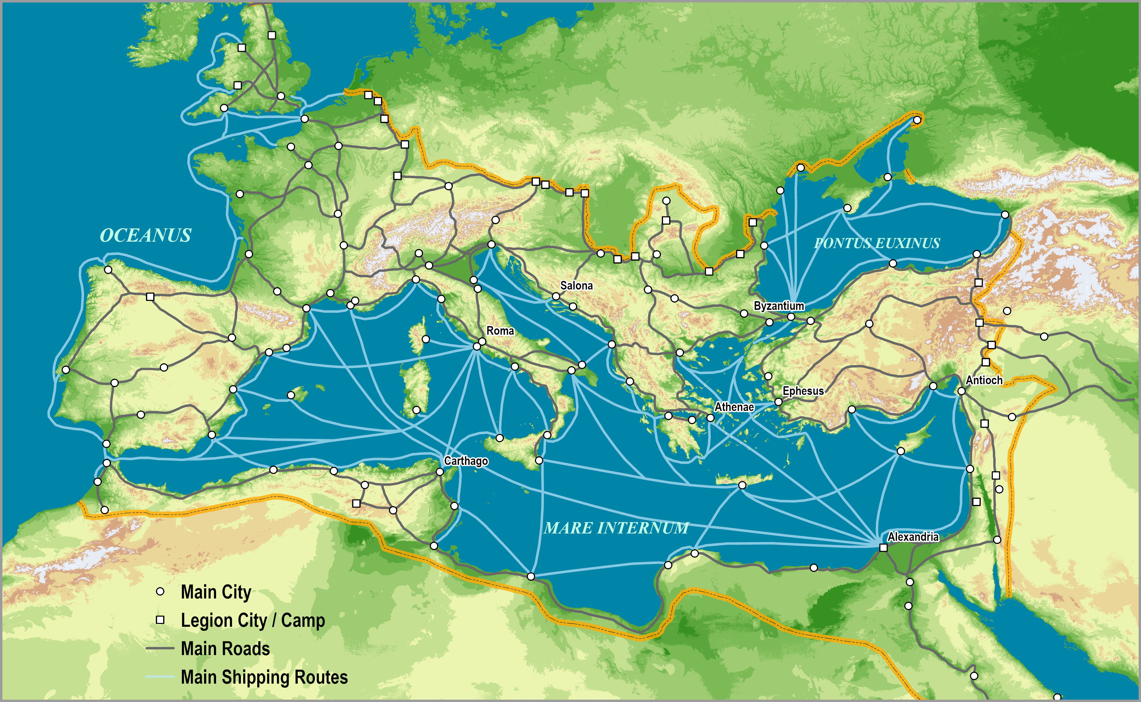
Roman Empire, c125AD
Notes:
Map location: roman_transportation

Slide 22
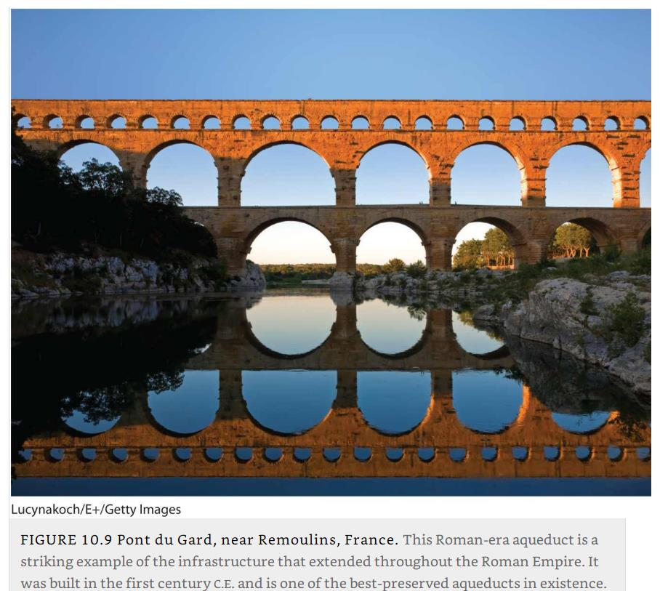
Pont du Gard, near Remoulins, France

Slide 23
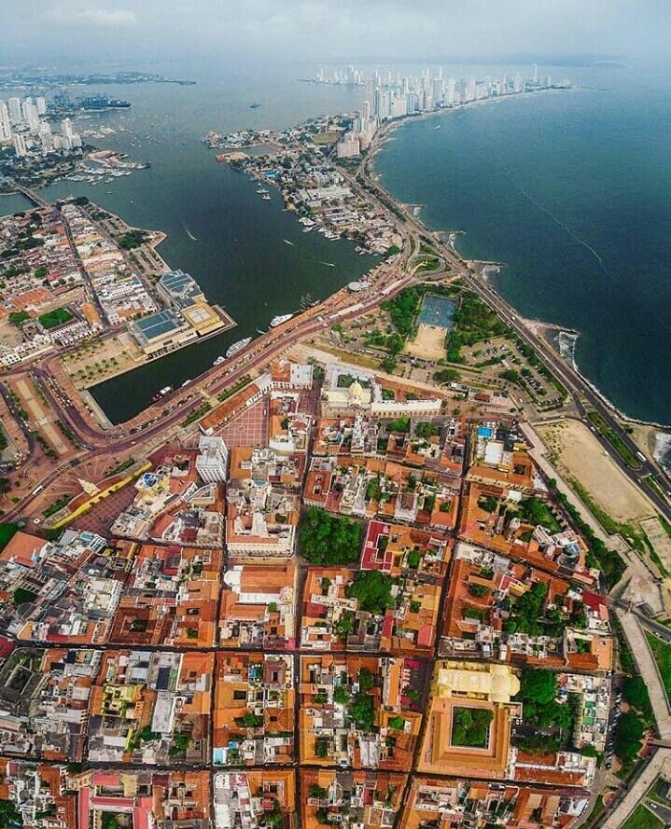
Cartagena, Colombia

Slide 24
Cities of the Industrial Revolution
Industrial revolution
  Located in western Europe and later North America, became industrialized.
  Transformations occurred in society that fundamentally reshaped cities, both spatially and in terms of the social, cultural, political, and economic functions assumed by cities.
  Notion of urban land as a source of income.
  Proximity to the center of the city added economic value to the land.
  Specialized locations, such as areas close to the river or harbor, or along major thoroughfares into and out of the city, also increased land value.
  Earlier urban configurations; little separation between home and workplace.
  The center of the city became the central business district.

Slide 25
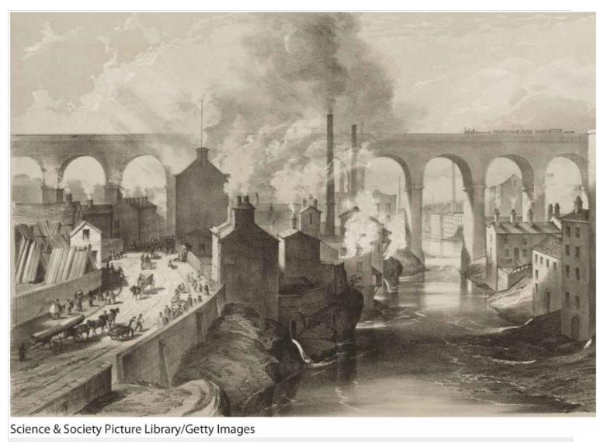
Early industrial-era London (mid 19th century)

Slide 26
Modern Urban Locations
Changing locational patterns
  Early cities tended to be located in places that were easily defended or along trade routes.
  Industrial-era cities sought locations near sources of raw materials.
  Growing importance of long-distance trade routes; ports and airports.
  The setting of a hierarchy within a system of cities; central places.
  Shift in trade-based urban functions with logistics and containerization.
  The growing importance of information technologies.
How the industrial revolution changed urbanization?

Slide 27
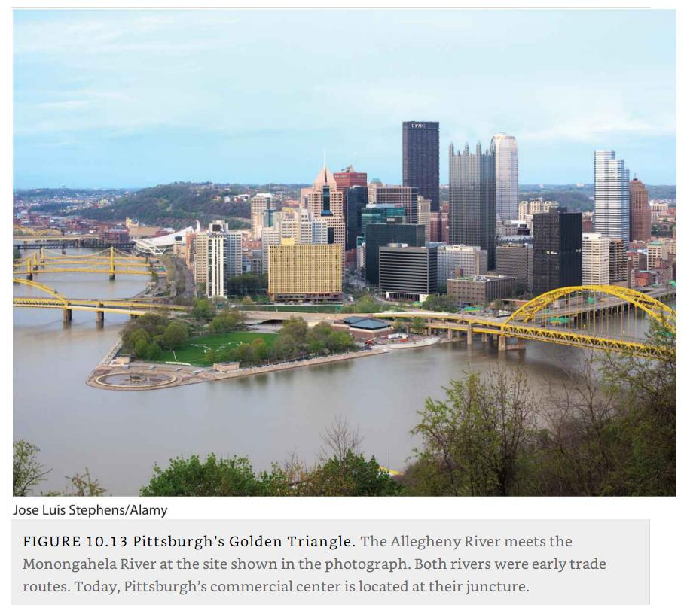
Pittsburgh’s Golden Triangle: The Allegheny River meets the Monongahela River

Slide 28
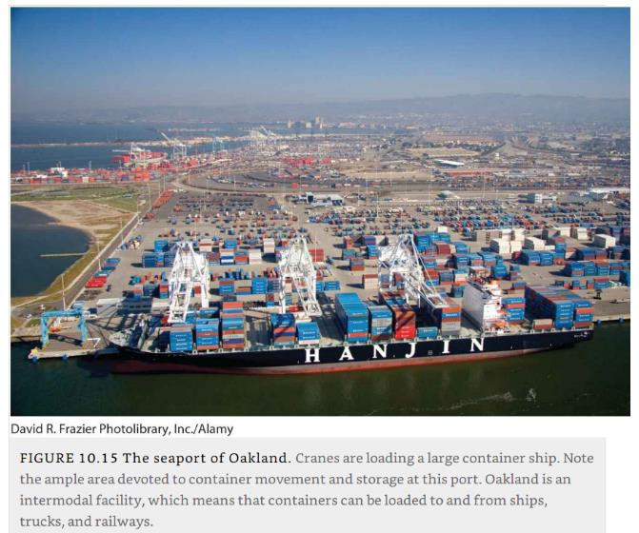
Oakland Container Port

Slide 29
B – Urban Migration and Mobility
The ways that migration has shaped the growth of cities, how cities have grown and changed, and how humans get around within cities.

Slide 30
Rural-to-Urban Migration
Urbanization causes
  Natural population increase.
  Rural-to-urban migration.
  Urban-to-urban migration.
  Industrialization incited urbanization.
  Most societies are now highly urbanized.
The case of China
  Until the late 1970s, China was predominantly rural, and its communist government was explicitly antiurban.
  State policy reform after 1978 lifted restrictions on internal migration.
  Enabled its rural population to become more mobile
  Many Chinese left the countryside to booming industrial cities, among them Guangzhou, Shenzhen, Shanghai, and Beijing.
  56% of the population is now urban.

Slide 31
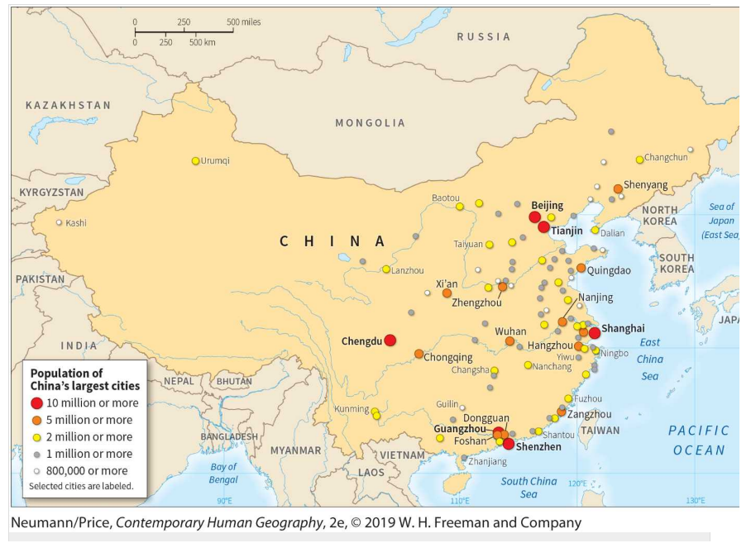
Cities in China

Slide 32
Megacities
Concentration
  Rural-to-urban migration affects nearly all cities in the developing world.
  The most visible cases are the extraordinarily large settlements called megacities.
  Those having populations of over 10 million.
  Most megacities are now in the developing world; account for 90% of urbanization.
  Unemployment rates often over 50 percent for newcomers to the city.
  Housing and infrastructure frequently cannot be built fast enough to keep pace with growth rates.
  Water and sewage systems can rarely handle the influx of new people.
  One of the world’s ongoing challenges will be how to cope with the radical restructuring of population and culture as people in developing countries move into cities.

Slide 33
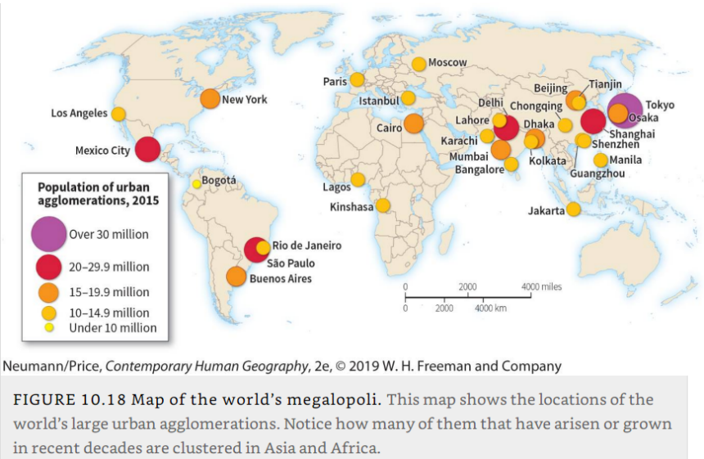
World’s Largest Cities

Slide 34
Urban Primacy
The primate city
  The destination of most of migrations.
  This is a city that, because it is so much larger than all the others, dominates the economic, political, and cultural life of a country.
  Usually 10 times or more larger than the next largest city.
  With 13 million residents, Buenos Aires is 10 times that of the next largest city, Rosario, which is the second largest city in Argentina, with a population of 1.3 million.
  London, Moscow, Athens, and Paris are examples.
  Most of the world’s population lives in mid-sized cities of 500,000 or less.
What are the differences between a mega-city and a primate city?

Slide 35
Urban Transportation
Urban mobility
  A major urban issue.
  Railroads, streetcars and trolleys, light rail systems, airplanes, buses, and subways have all presented innovations in urban transportation modes and infrastructure.
  Shaped and reshaped the layout and size of cities over time.
  Advent of streetcars, fixed rail systems within many U.S. cities that arose in the 1880s, led to the development of so-called streetcar suburbs.
  No innovation in transportation has had a more profound impact on cities, however, than the automobile.
  Automobiles brought a network of roadways and, by the 1950s, interstate highways.
  Housing architecture was reshaped around the automobile.
  Drive-through commerce and the architectural forms associated with it became a hallmark of America’s association with cars.

Slide 36
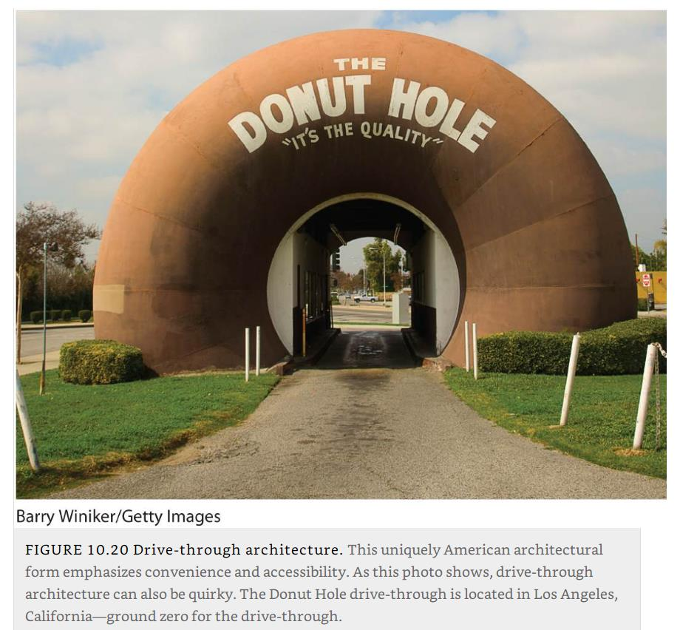
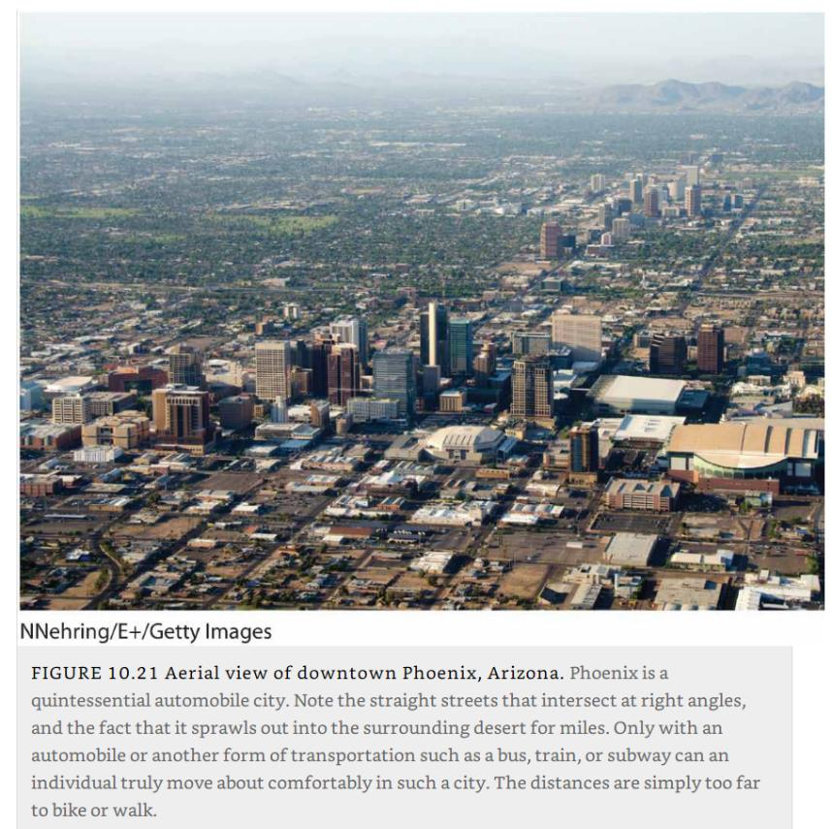
Drive-through architecture and car-dependent city (Phoenix)

Slide 37
C – Global Cities
The notion of global cities and some of the problems associated with them.

Slide 38
Global Cities
Global cities
  Cities that have become the control centers of the global economy.
  Sites of major decisions about the world’s commercial networks and financial markets.
  A concentration of multinational and transnational corporate headquarters, international financial services, media offices, and related economic and cultural services.
  The headquarters for a global economy, and they form the top level of a hierarchical global system of cities.
Ranking
  Having certain characteristics.
  Economic might, political power, information exchange, and research and development activity.
  Less tangible qualities such as influence, engagement, the ability to attract talented individuals, diversity, cultural experience, accessibility, and environmental quality.

Slide 39
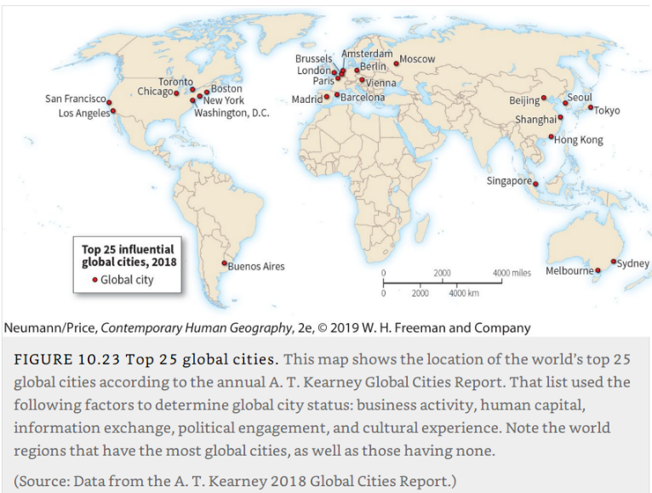
Top 25 global cities

Slide 40
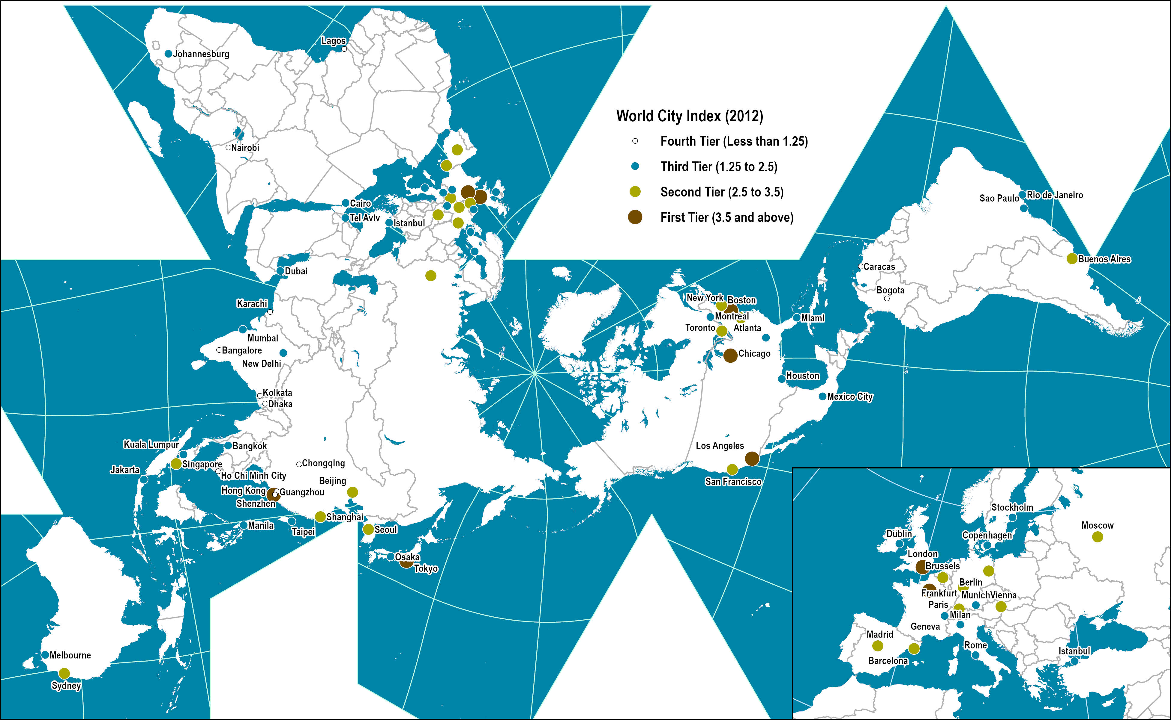
3. World Cities, 2012
Read this content
Notes:
Source: AT Kearney, 2012 Global Cities Index and Emerging Cities Outlook

Slide 41
The Globalization of Urban Wealth and Poverty
Gated communities
  Highly secure residential enclaves.
  More or less privately governed.
  Own services such as security and landscaping.
  Oversight board that sets and enforces policies, and their own amenities such as clubhouses, golf courses, and swimming pools.
  Some communities have walls or fences around them, use surveillance technology to track entry and exit, and restrict access through gates.
  Particularly prevalent in areas of high income inequalities.

Slide 42
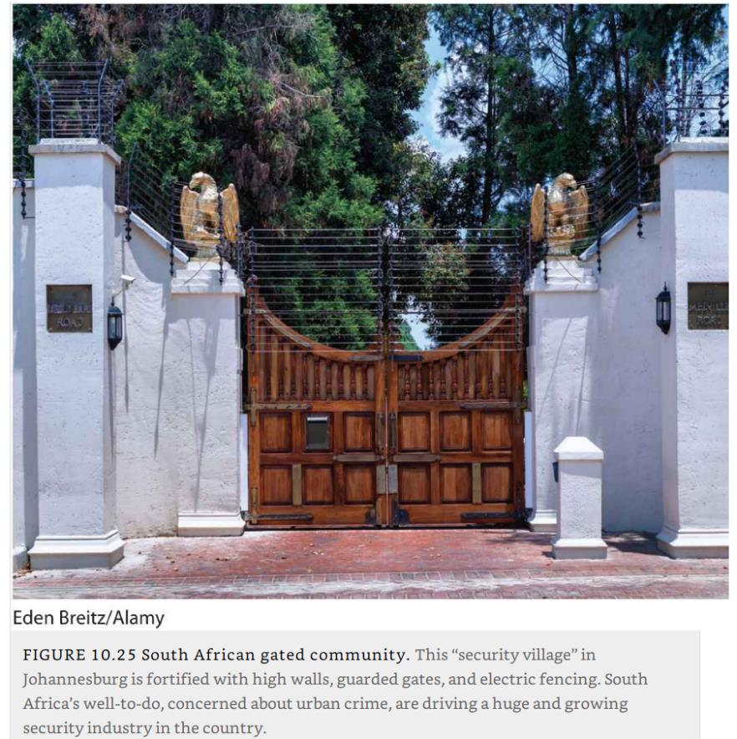
Gated community, Johannesburg, South Africa

Slide 43
The Globalization of Urban Wealth and Poverty
Urban poverty
  Unemployment, deterioration of housing and urban infrastructure, homelessness, and other manifestations of poverty in the urban landscape are quite visible.
  Urban poverty is not limited to the developing world but is rather a global phenomenon.
  Most global cities have pockets of both extreme wealth and extreme poverty.
Shantytowns
  Precarious and often illegal housing settlements, usually made up of temporary shelters and located on the outskirts of a large city.
  Also called favelas, barriadas, or squatter settlements.
  Areas of degraded, precarious, inadequate, and often illegal housing.
  Over 1 billion people in the world live in slums.
  Continuous improvement of the shantytown landscape.
How wealth and poverty take form in cities?

Slide 44
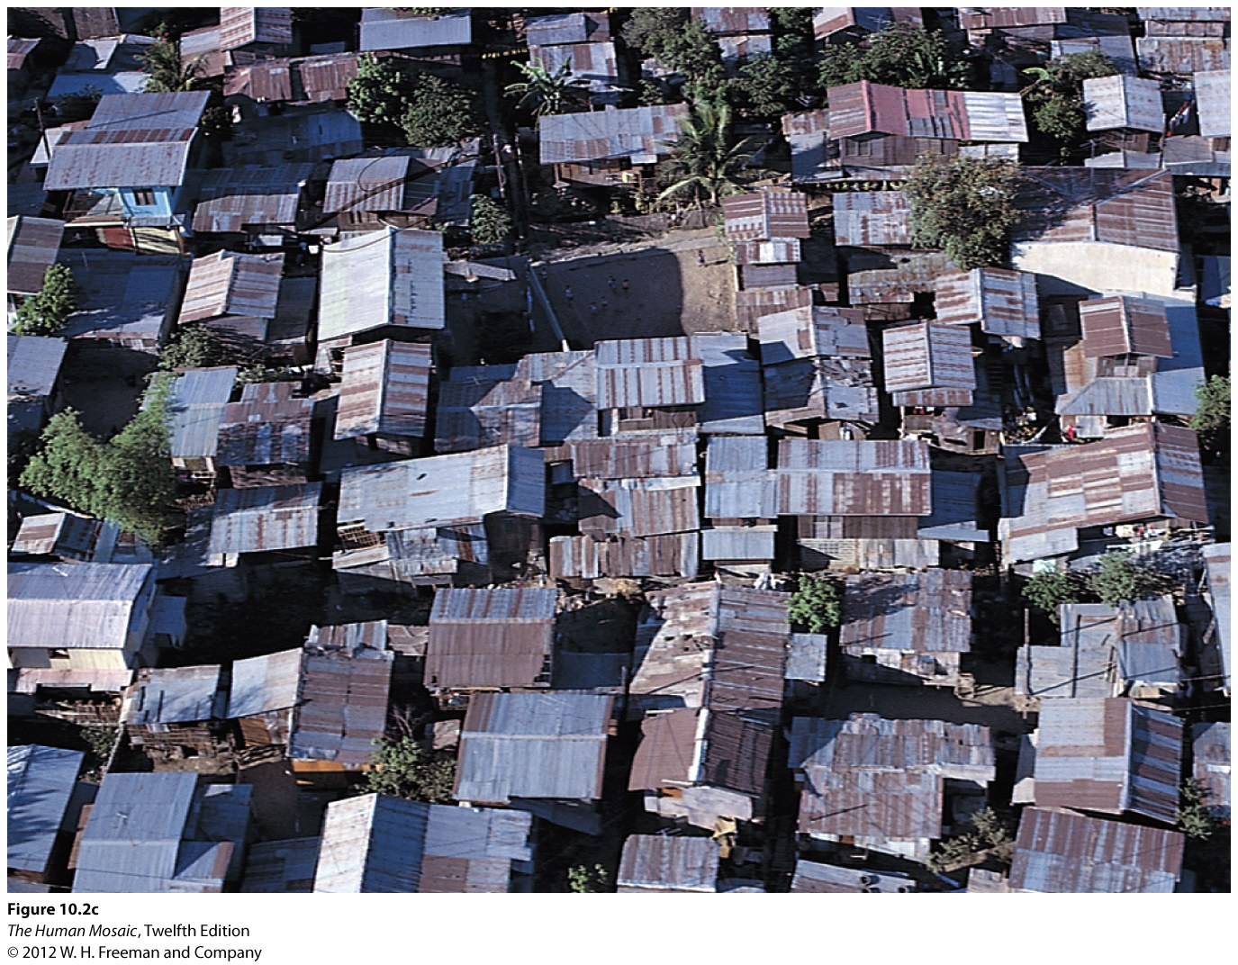
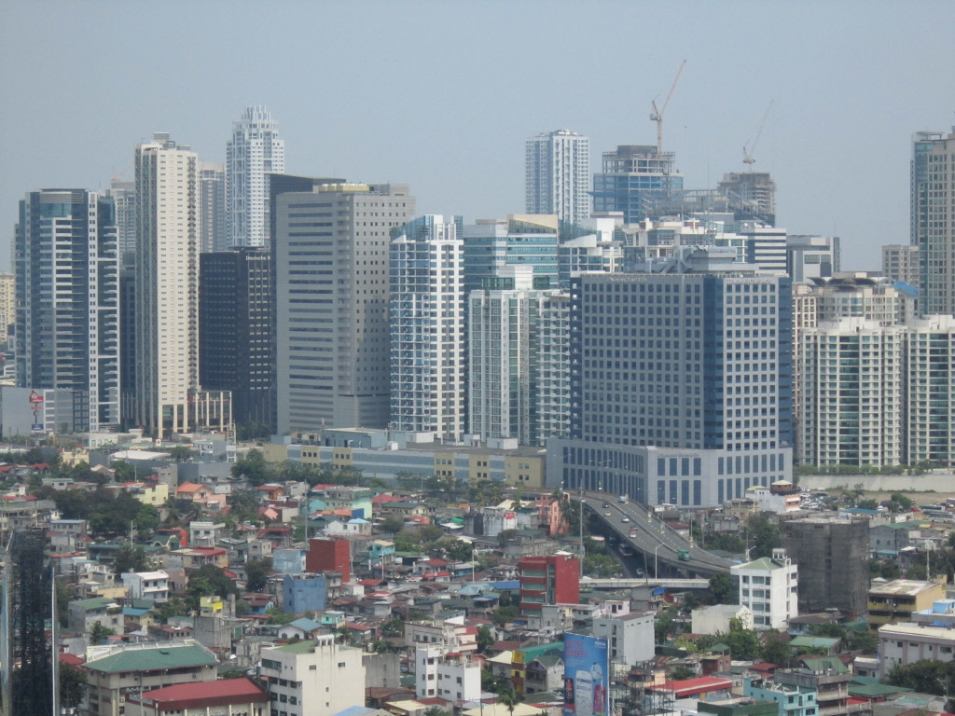
Urbanization: contrasts within cities
Manila

Slide 45
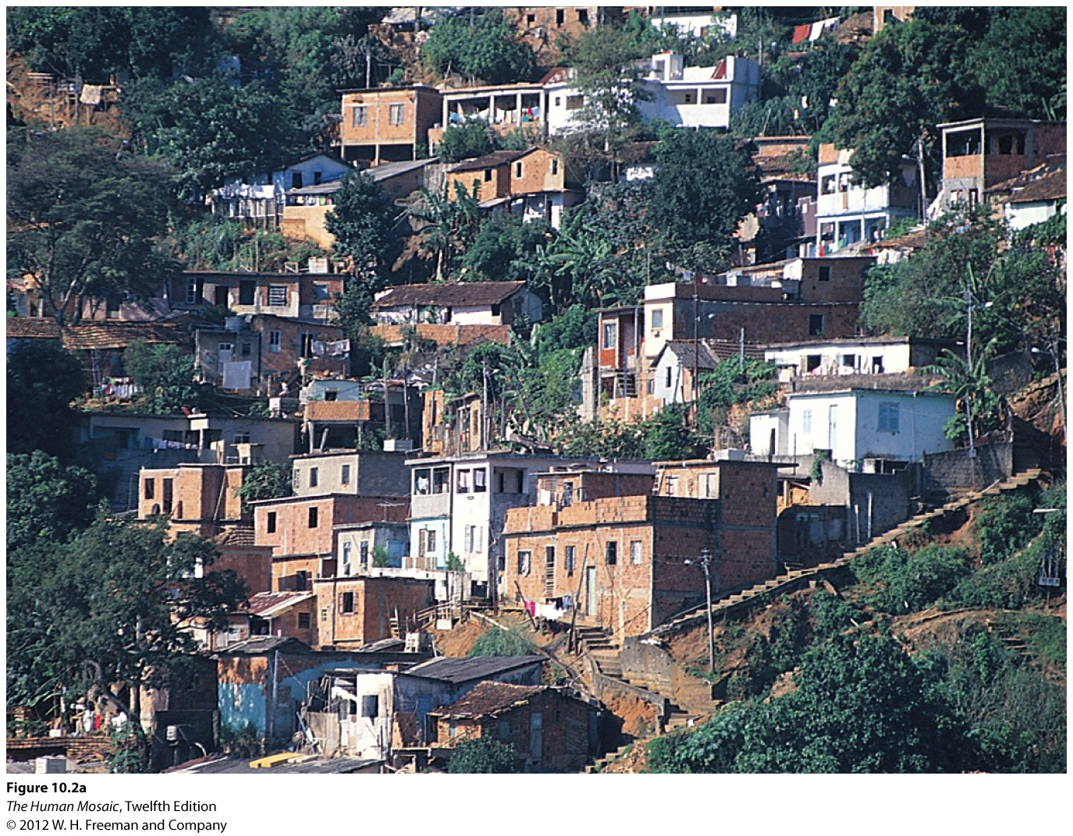
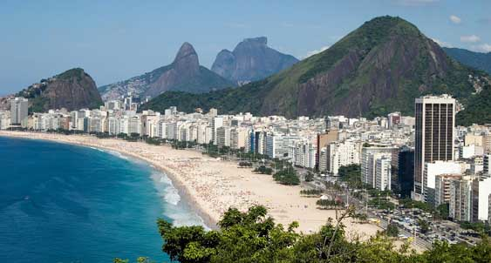
Urbanization: contrasts within cities
Rio de Janeiro

Slide 46
D – Cities and the Natural World
The ways that human and natural worlds interact in cities, and the effects on the health and well-being of those living in cities.

Slide 47
Urban Weather and Climate
Dislocation
  Cities are at start an artificial environment separated from the natural environment.
  Cities alter virtually all aspects of local weather and climate.
  Temperatures are higher in cities, rainfall increases (dust particles), the incidence of fog and cloudiness is greater, and levels of atmospheric pollution are much higher.
  About 50 percent of the urban area is a hard surface.
  Rainfall is quickly carried into gutters and sewers, so that little standing water is available for evaporation.
  Air temperatures are higher.
  Hard surface prevalent in urban areas retain heat very effectively.
  Urban heat islands.
  Yearly temperature averages in cities are 3.5 °F (2 °C) higher than in the countryside.

Slide 48
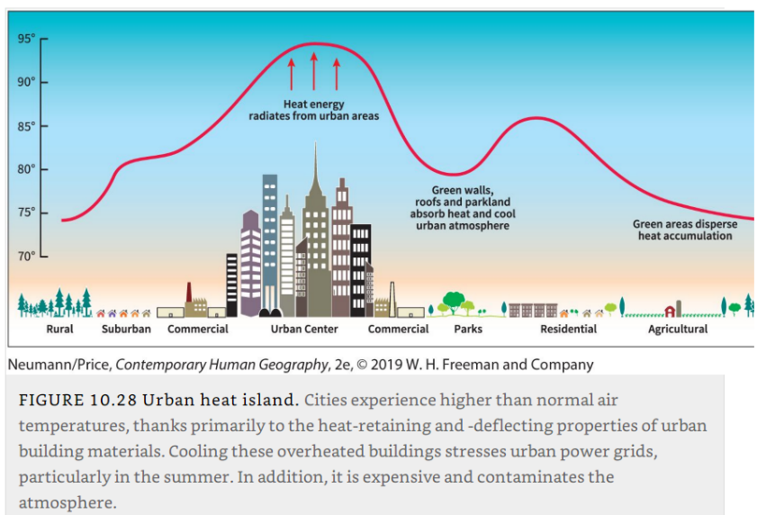
Urban heat island

Slide 49
Urban Weather and Climate
Urban hydrology
  The city a great consumer of water.
  Alters water runoff patterns in a way that increases urban flooding.
  Increase both the frequency and the magnitude of flooding because cities create large impervious areas where vegetation has been replaced with pavement.
  Water cannot soak into the earth; precipitation is converted into immediate runoff.
  Forced into gutters, sewers, and stream channels.
Urban vegetation
  Two-thirds of a typical North American city is composed of trees and herbaceous plants.
  Mix of natural and introduced species.
  Reduce wind velocity.
In which way cities are outside and part of the natural world at the same time?

Slide 50
Cities and Environmental Vulnerability
Urban footprint
  Composed of the physical footprint and the environmental footprint.
  The spatial extent of the impacts of urban areas on the natural environment.
  Urban living often encourages rising levels of consumption, as new urbanites gain access to better jobs and acquire more disposable income.
  Can impact areas far from urban centers.

Slide 51
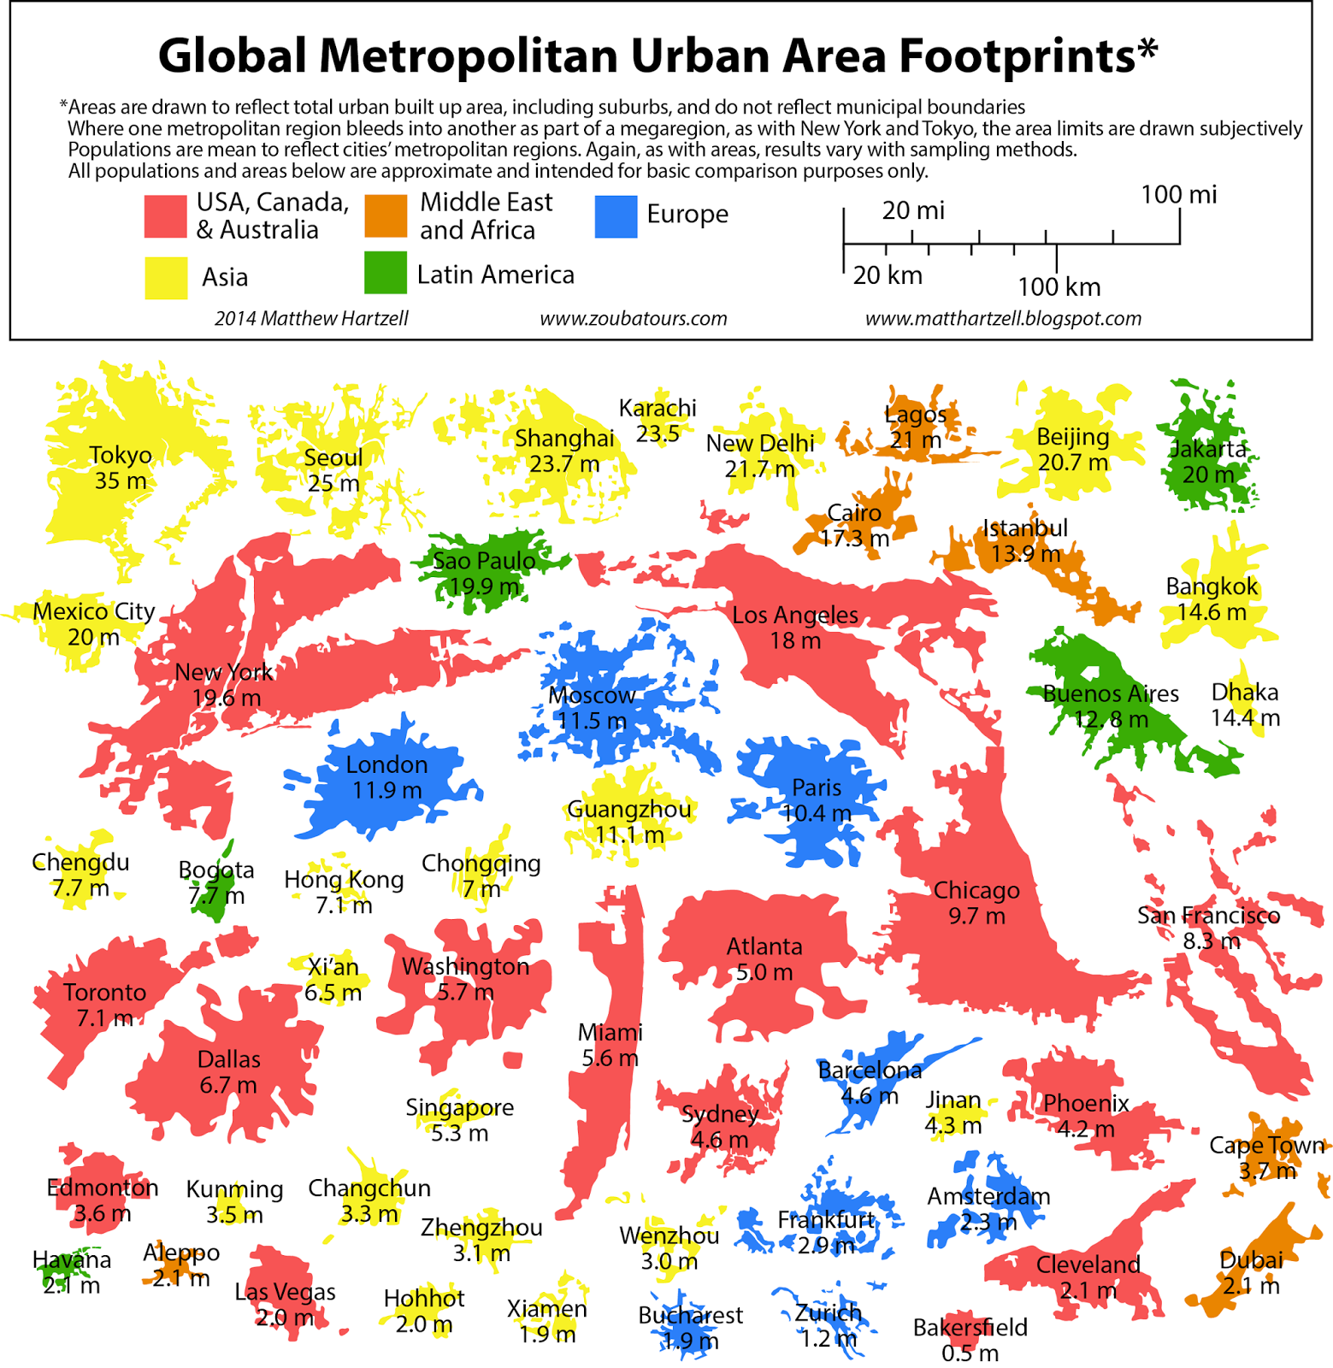

Slide 52
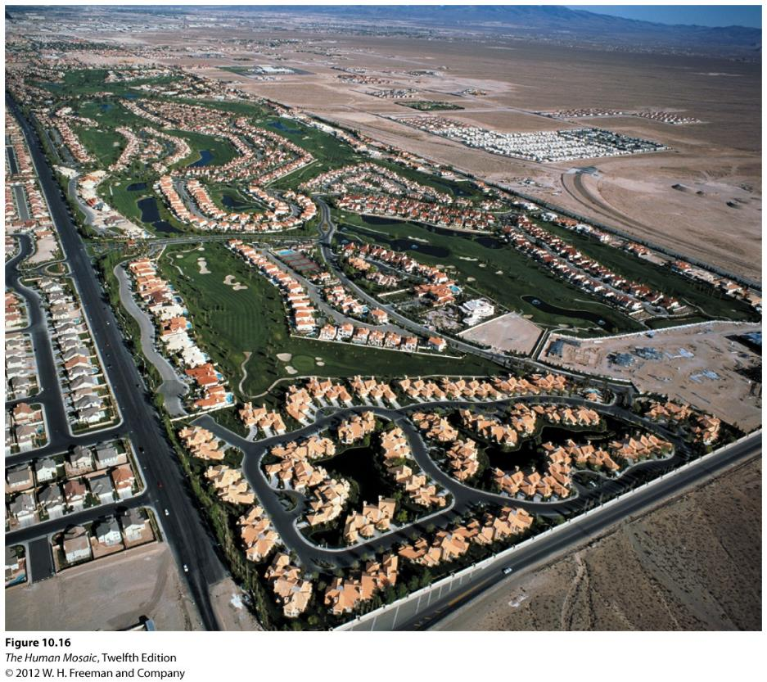
Urbanization and Sustainability: Las Vegas
Sustainability challenges:
Desert transformed into traditional suburbs with lawns and green parks.
Providing enough water is an environmental challenge.

Slide 53
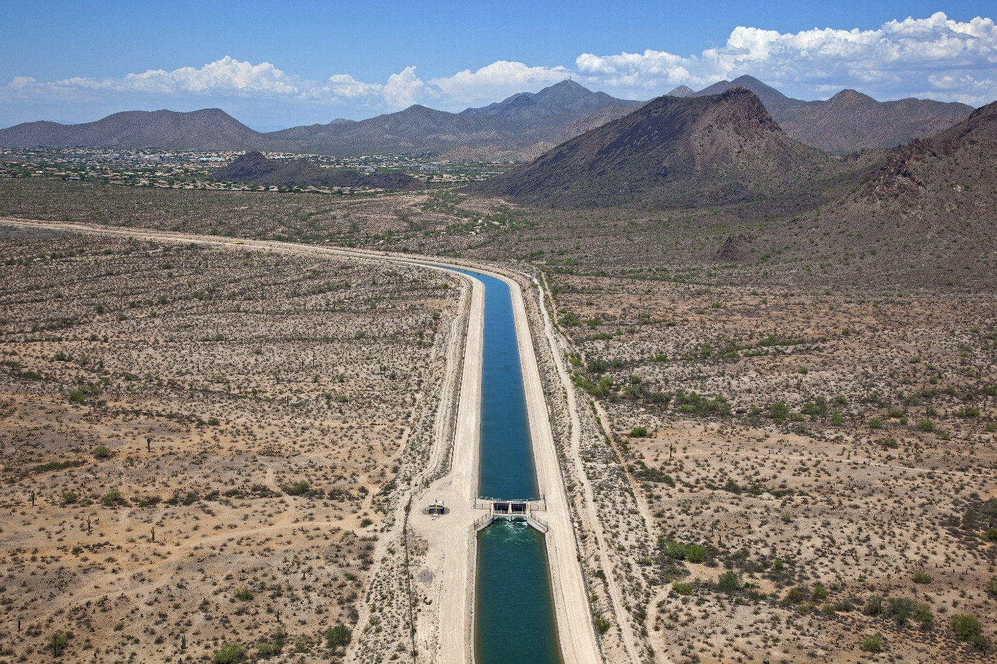
Urbanization and Sustainability: Phoenix
The Central Arizona Project (CAP) is a river-sized, open-air canal supported by an elaborate array of pumps, siphons, and tunnels that brings water from the Colorado River across the breadth of Arizona to Phoenix and Tucson.
Notes:
https://www.curbed.com/2016/3/30/11330838/phoenix-urban-development-planning-sustainable)

Slide 54
Cities and Environmental Vulnerability
Natural disasters
  Urban areas, with their dense concentrations of people, disasters are more destructive because so many lives and livelihoods are at risk.
  Many cities are located near rivers or coasts, they often lie in the direct paths of disasters such as hurricanes and tsunamis.
  Disaster risk becomes an urban phenomenon.
  Two major earthquakes in 2010:
    Chile: death toll from an 8.8-magnitude quake was in the hundreds.
    Haiti: quake of slightly less magnitude with over 200,000 dead and more than 1 million homeless.

Slide 55
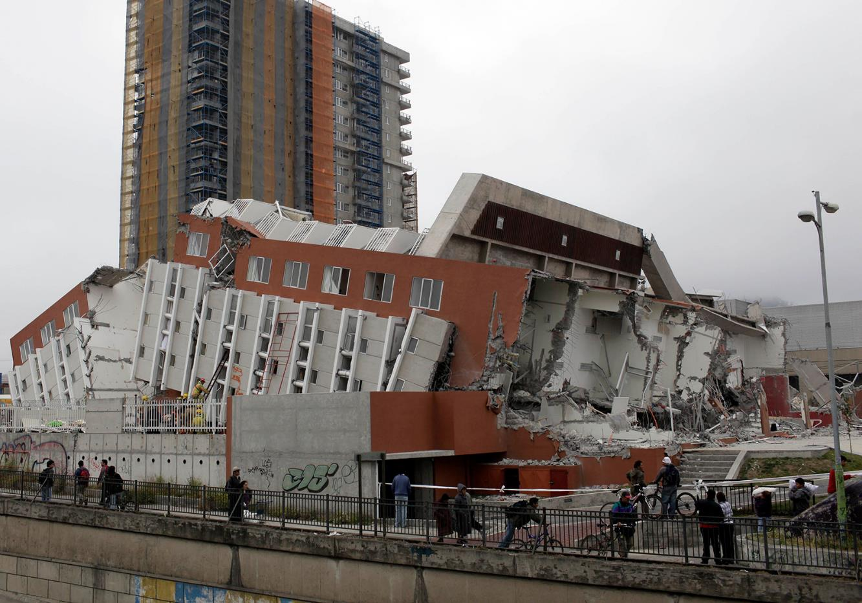
Chile Earthquake of 2010, City of Concepcion
About 550 people killed

Slide 56
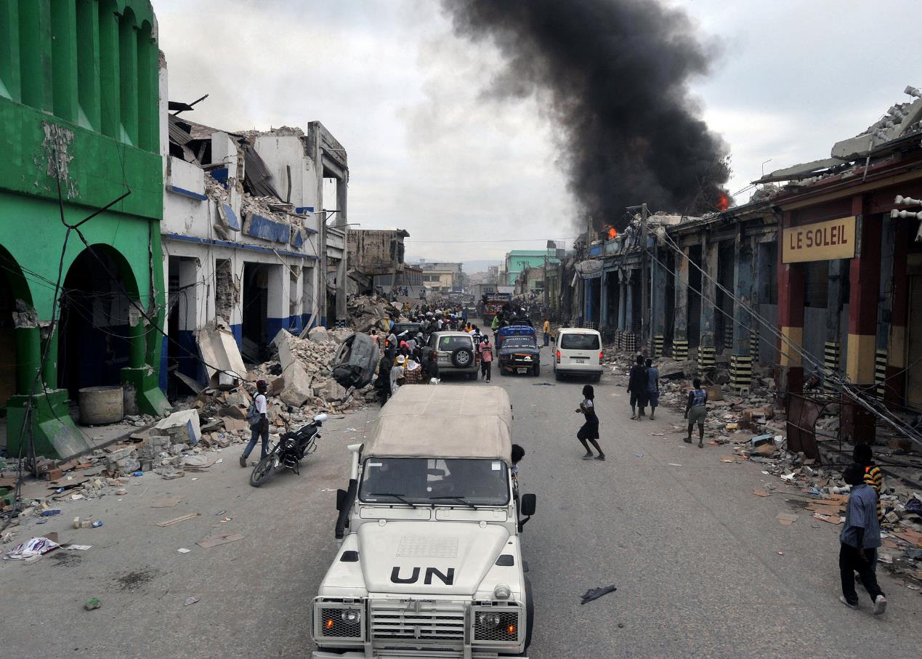
Haiti Earthquake of 2010, Port-au-Prince
200,000 to 300,000 people killed

Slide 57
E – The Urban Landscape
Interpret an urban landscape, and identify the trends shaping cities today and into the future.

Slide 58
Factors Causing Gentrification
Gentrification
  The city can be a contested place between different socioeconomic groups.
  The displacement of lower-income residents by higher-income residents as buildings in deteriorated areas of the city centers are restored.
  Some older suburbs are becoming gentrified, as well as some neighborhoods that began their lives as shantytowns.
Economic factors
  Lower prices for inner-city land and buildings.
  Deindustrialization (esp. on waterfront) makes factories available for gentrification.
  Opportunities for higher real estate values.

Slide 59
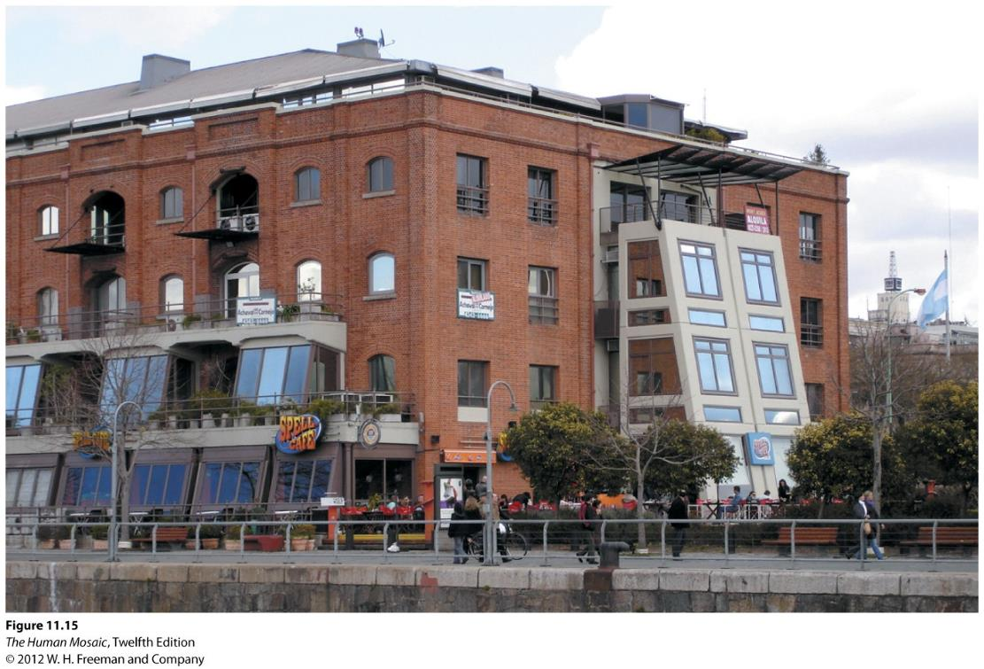
Puerto Madero, Buenos Aires
Dock facilities have been converted into clubs, restaurants, and shopping, and also apartments and hotels.

Slide 60
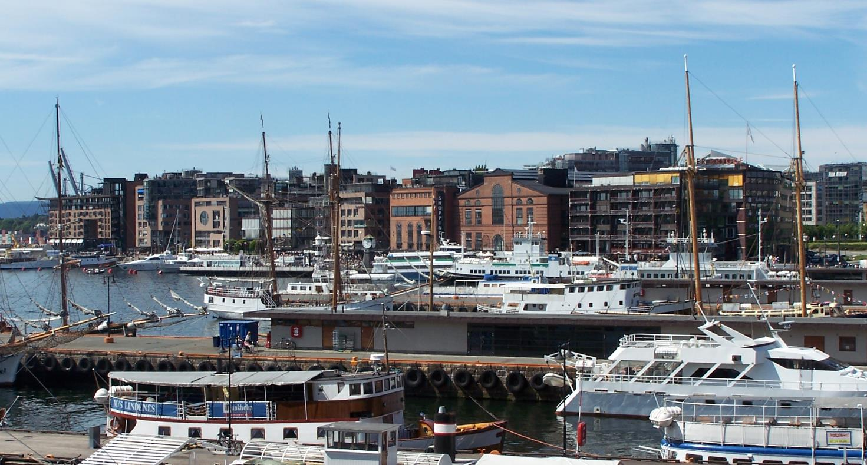
Aker Brygge, Oslo, Norway
An old shipyard has been converted into fancy restaurants, shops, apartments and hotels.
Notes:
http://upload.wikimedia.org/wikipedia/commons/b/b8/Oslo_Aker_Brygge_2005_June_19.jpg

Slide 61
Factors Causing Gentrification
Political Factors
  Tax breaks and other incentives.
  City planning efforts that target areas for revitalization.
  Attempt to promote development and higher land values (more taxes).
Social Factors
  Maturing of Baby Boomers.
  Demographic changes (women in workplace; couples choosing to delay having children).
  LGBTQ presence.
  Status/prestige.

Slide 62
Costs of Gentrification
Displacement of lower-income people
  Forced to leave their homes because of rising property values.
  Forced into neighborhoods more peripheral to the city.
  Initial gentrifiers can also be displaced by later waves of wealthier incomers.
Ethnic/racial tensions
Visible reminders of inequitable distribution of wealth
“Homogenization” of the city

Slide 63
The livable city
Livability
  Making the list of “the world’s most livable cities” is something many cities would like to achieve.
  Given that there is no real way to measure and thereby quantify many of the positive aspects of cities, a lot of subjectivity goes into compiling these lists.
  Refocusing cities on people seems to be at the heart of movements to make cities more livable.

Slide 64
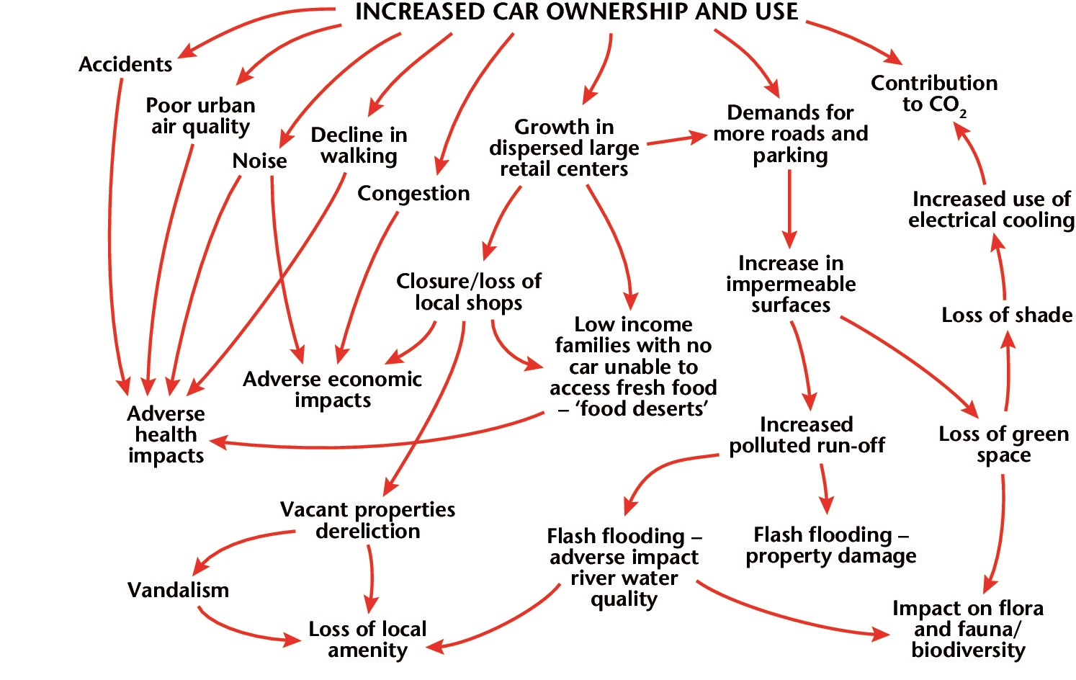
Automobile dependency and livability
Cars and urban consequences. This flowchart, adapted from one produced by the government of the United Kingdom, shows the various negative environmental and social outcomes of increased car ownership and use.

Slide 65
The right to the city
Many urban features, such as shopping malls, are not public spaces
  Certain groups (e.g., loitering teens) are denied access.
  Certain people are also denied access to public spaces within cities (e.g., homeless people chased out of parks; lack of ramps etc. for disabled people).
The right to the city
  The right of all urban residents to be in and move through public urban places is becoming increasingly curtailed.
  Many urban spaces are becoming private or being configured in ways that make them inaccessible to certain people or for certain purposes.
Using examples such as gentrification and the right to the city, explain how cities can be contested spaces.

Slide 66
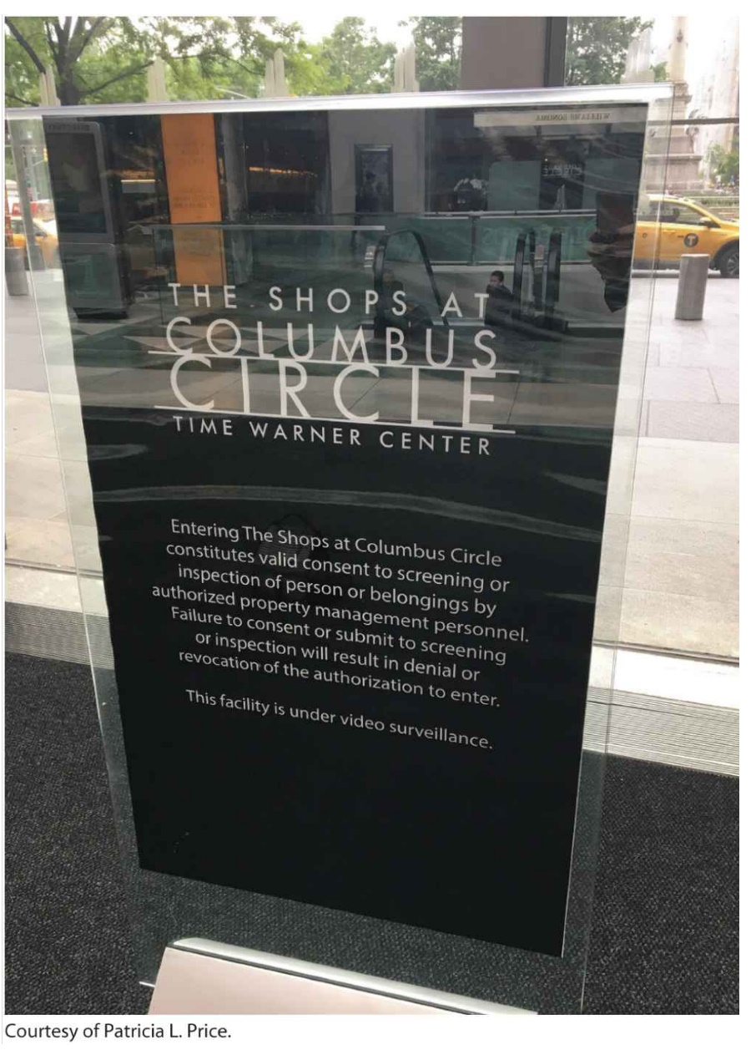
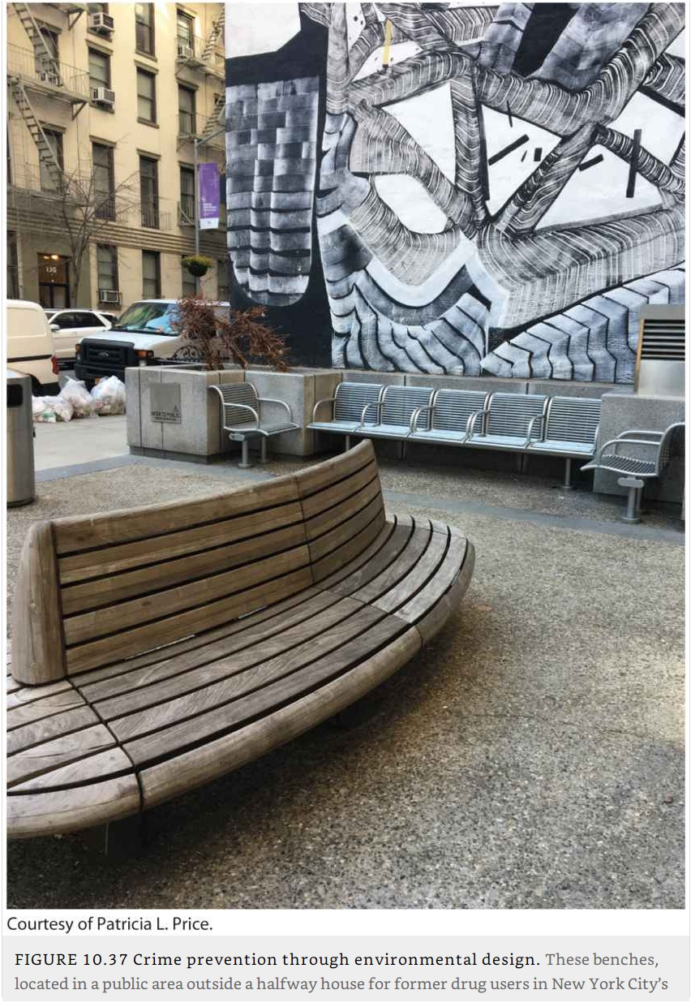
The right to the city: Codes of conduct and loitering prevention

